Slide 1
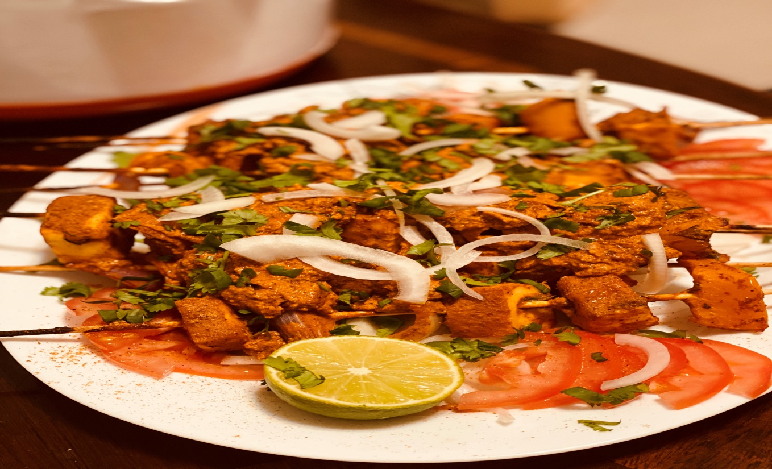
Predicting a neighborhood in Toronto for opening up a new Indian Restaurant

Slide 2
Extracting the data
- Scrapping of Toronto neighborhoods via Wikipedia
- Getting Latitude and Longitude data of these neighborhoods via Geocoder package
- Using Foursquare API to get venue data related to these neighborhoods

Slide 3
The results from k-means clustering show that we can categorize Toronto neighborhoods into 4 clusters based on how many Indian restaurants are in each neighborhood:
Cluster 0: Neighborhoods with little or no Indian restaurants
Cluster 1: Neighborhoods with no Indian restaurants
Cluster 2: Neighborhoods with high number of Indian restaurants
Cluster 3: Neighborhoods with fewer Indian restaurants

Slide 4
Recommendations
There are no Indian Restaurant in Cluster 1, which includes neighborhood like Richmond, Adelaide, King, Parkdale, Queen's park, Forest Hill, etc. Cluster 2 and 3 have good count of Indian Restaurants, whereas Cluster 0 has some restaurants in that neighborhood.
Studying the above cluster, I would recommend the food chain restaurant to open an Indian restaurant in Cluster 1 with little to no competition.

