Slide 1
Artificial Intelligence
Yukyung Choi

Slide 2
Agenda
History of MLP
Neural Net(NN)
Perceptron
Multi-Layer Perceptron (MLP)
Backpropagation

Slide 3




Problem: Perceptron
One logistic regression unit cannot separate XOR
$$w$$
$$z$$
$$\overline{Y}$$
$$X$$

Slide 4


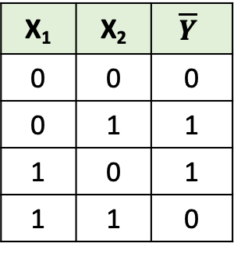
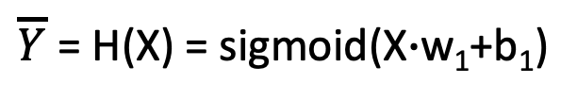

[실습] Perceptron for XOR
H(X)
$w1=\left[\begin{matrix}? & ? \\ ? & ?\end{matrix}\right]$
$b1$=$\left[\begin{matrix}? \\ ?\end{matrix}\right]$
$$X$$
$$\overline{Y}$$
Matrix input!
X₁ | X₂ | $$\overline{Y}$$
0 | 0 | 0
0 | 1 | 1
1 | 0 | 1
1 | 1 | 0
$\overline{Y}$ = H(X) = sigmoid(X$∙$w₁+b₁)

Slide 5
Problem: Perceptron
XOR using NN
XOR
X1 | X2 | XOR
0 | 0 | 0 | -
0 | 1 | 1 | +
1 | 0 | 1 | +
1 | 1 | 0 | -
+
-
1
0
-
+
0
1

Slide 6










Solution: MLP
Multiple logistic regression units can separate XOR
$$w$$
$$z$$
$$\overline{Y}$$
$$X$$
$$w$$
$$z$$
$$\overline{Y}$$
$$X$$
$$w$$
$$z$$
$$\overline{Y}$$
$$X$$

Slide 7
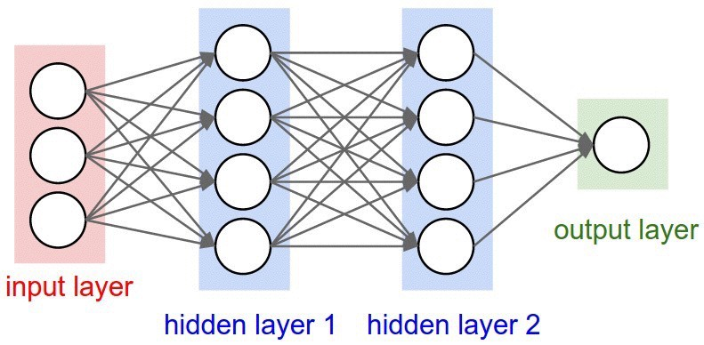
Solution: MLP
Multiple logistic regression units can separate XOR
But! “No one on earth had found a viable way to train”
W, b
*Marvin Minsky

Slide 8


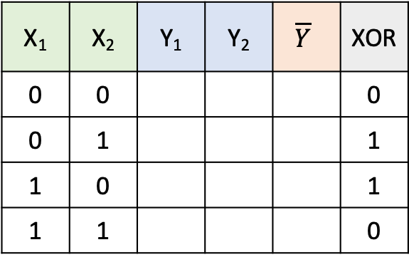


Solution: MLP
XOR using NNs
toy-examples
X₁
$W$=$\left[\begin{matrix}5 \\ 5\end{matrix}\right]$, $b$=-8
Y₁
X₂
$W$=$\left[\begin{matrix}−11 \\ −11\end{matrix}\right]$, $b$=6
$$\overline{Y}$$
X₁
$W$=$\left[\begin{matrix}−7 \\ −7\end{matrix}\right]$, $b$=3
Y₂
X₂
X₁ | X₂ | Y₁ | Y₂ | $$\overline{Y}$$ | XOR
0 | 0 |  |  |  | 0
0 | 1 |  |  |  | 1
1 | 0 |  |  |  | 1
1 | 1 |  |  |  | 0

Slide 9
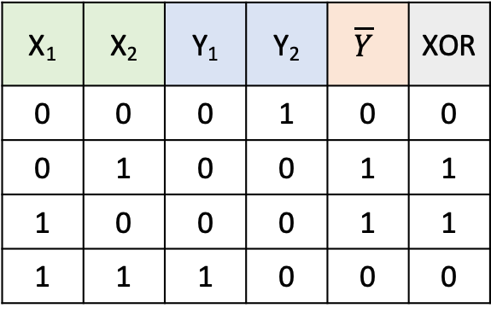
Solution: MLP
XOR using NNs
X₁
$W$=$\left[\begin{matrix}5 \\ 5\end{matrix}\right]$, $b$=-8
Y₁
X₂
$W$=$\left[\begin{matrix}−11 \\ −11\end{matrix}\right]$, $b$=6
$$\overline{Y}$$
X₁
$W$=$\left[\begin{matrix}−7 \\ −7\end{matrix}\right]$, $b$=3
Y₂
X₂
X₁ | X₂ | Y₁ | Y₂ | $$\overline{Y}$$ | XOR
0 | 0 | 0 | 1 | 0 | 0
0 | 1 | 0 | 0 | 1 | 1
1 | 0 | 0 | 0 | 1 | 1
1 | 1 | 1 | 0 | 0 | 0

Slide 10




Solution: MLP
Forward Propagation을 통한 XOR 문제 풀이 가능 검증 완료
X₁
$W$=$\left[\begin{matrix}5 \\ 5\end{matrix}\right]$, $b$=-8
$W$=$\left[\begin{matrix}−11 \\ −11\end{matrix}\right]$, $b$=6
$$\overline{Y}$$
X₂
$W$=$\left[\begin{matrix}−7 \\ −7\end{matrix}\right]$, $b$=3

Slide 11







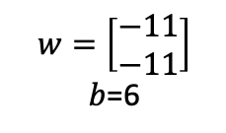
Solution: MLP
Forward Propagation을 통한 XOR 문제 풀이 가능 검증 완료
X₁
$W$=$\left[\begin{matrix}5 \\ 5\end{matrix}\right]$, $b$=-8
$W$=$\left[\begin{matrix}−11 \\ −11\end{matrix}\right]$, $b$=6
$$\overline{Y}$$
X₂
$W$=$\left[\begin{matrix}−7 \\ −7\end{matrix}\right]$, $b$=3
$w=\left[\begin{matrix}5 & −7 \\ 5 & −7\end{matrix}\right]$
$b$=$\left[\begin{matrix}−8 \\ 3\end{matrix}\right]$
$w=\left[\begin{matrix}−11 \\ −11\end{matrix}\right]$
$b$=6
$$X$$
$$\overline{Y}$$
Matrix input!

Slide 12
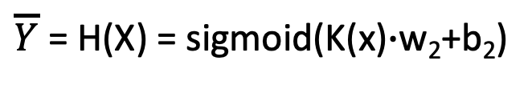

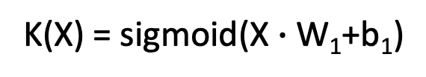

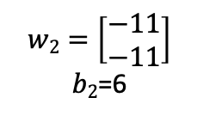

Solution: MLP for XOR
H(X)
$w1=\left[\begin{matrix}5 & −7 \\ 5 & −7\end{matrix}\right]$
$b1$=$\left[\begin{matrix}−8 \\ 3\end{matrix}\right]$
$$K(X)$$
$w2=\left[\begin{matrix}−11 \\ −11\end{matrix}\right]$
$b2$=6
$$X$$
$$\overline{Y}$$
Matrix input!
K(X) = sigmoid(X $∙$W₁+b₁)
$\overline{Y}$ = H(X) = sigmoid(K(x)$∙$w₂+b₂)

Slide 13
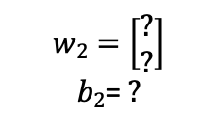
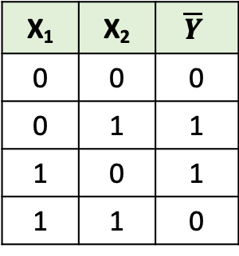
How can we learn W1, W2, B1, B2 from training data?
H(X)
$w1=\left[\begin{matrix}? & ? \\ ? & ?\end{matrix}\right]$
$b1$=$\left[\begin{matrix}? \\ ?\end{matrix}\right]$
$$K(X)$$
$w2=\left[\begin{matrix}? \\ ?\end{matrix}\right]$
$b2$= $?$
$$X$$
$$\overline{Y}$$
Matrix input!
K(X) = sigmoid(X $∙$W₁+b₁)
X₁ | X₂ | $$\overline{Y}$$
0 | 0 | 0
0 | 1 | 1
1 | 0 | 1
1 | 1 | 0
$\overline{Y}$ = H(X) = sigmoid(K(x)$∙$w₂+b₂)

Slide 14
Remind
We try to find a minimum value using a gradient descent method.
H(X)
$w1=\left[\begin{matrix}? & ? \\ ? & ?\end{matrix}\right]$
$b1$=$\left[\begin{matrix}? \\ ?\end{matrix}\right]$
$$X$$
$$\overline{Y}$$
Matrix input!
기울기➔미분값계산이 필요
w

Slide 15
Remind
But, MLP is too complex to apply gradient descent method for finding optimal parameters.
입력과 출력에 영향을 미치는 각각의 W, b 값을 구하는게 어렵다.

Slide 16
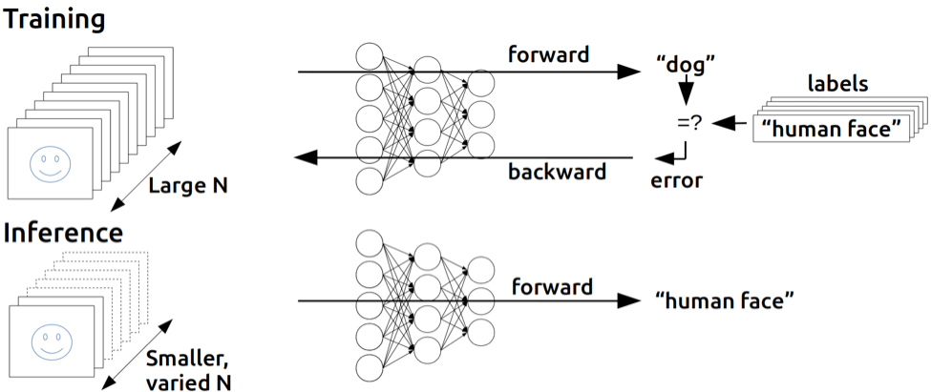
Remind
Backpropagation (1974, 1982 by Paul Werbos, 1986 by Hinton)
W, b 초기화
Forward 계산 & Error 측정
Error 값 을 Backward 하면서 w, b 업데이트

Slide 17
[실습] MLP for XOR
How can we learn W1, W2, B1, B2 from training data?
H(X)
$w1=\left[\begin{matrix}? & ? \\ ? & ?\end{matrix}\right]$
$b1$=$\left[\begin{matrix}? \\ ?\end{matrix}\right]$
$$K(X)$$
$w2=\left[\begin{matrix}? \\ ?\end{matrix}\right]$
$b2$= $?$
$$X$$
$$\overline{Y}$$
Matrix input!
K(X) = sigmoid(X $∙$W₁+b₁)
X₁ | X₂ | $$\overline{Y}$$
0 | 0 | 0
0 | 1 | 1
1 | 0 | 1
1 | 1 | 0
$\overline{Y}$ = H(X) = sigmoid(K(x)$∙$w₂+b₂)

