Slide 1
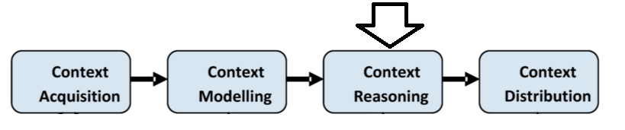
Where we are now?

Slide 2
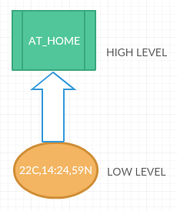
Context Reasoning
Method of deducing high level information from low level raw data of sensors.
Also required because
Data from sensor is incomplete
Due to missing attribute or information.
Data from sensor is uncertain
Due to Lack of precision and accuracy of
sensors interpreting the environment.
Due to involvement of multiple sensors.
The reasoning takes places in three different phases:
1. Sensor Data fusion. 2. Context pre-processing 3. Context inference.
Note: The sequence of phases has not been mentioned in research paper. Here, the mentioned sequence is as per how the data is processed from low level to high level.

Slide 3
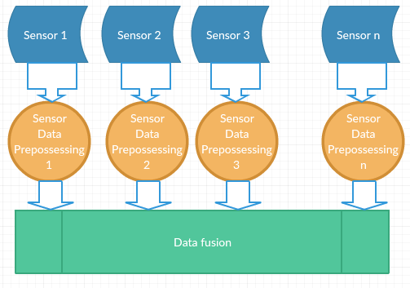
Sensor data fusion
Is process of combining data from multiple sensors to make data more complete, accurate.
Context reasoning continue…

Slide 4
Key Operations
Data fusion is based on three different key operations. Reference-CR01
Complementary: Sensing a data through a number of different sensors can help to understand the environment in a better way.
Ex: One sensor to measure temperature and another to measure pressure.
Redundant: If same environment factor is sensed through different sensors, it will help to increase the accuracy.
Ex: Taking average of temperature measure from different sensors.
Cooperative: Different sensors work together to give a new information.
Ex RFID tags recorded in super market and RFID sensor work together to identify shoplifting.
Notes:
For example, reading RFID tags recorded in a supermarket can be used to identify the events such as shoplifting. Let’s consider a scenario where RFID reader in a supermarket shelf detects that an item has been removed from a shelf. The RFID sensor in the counter does not see the object during payments. Later, the RFID sensor in the exit door detects the item that was removed from the shelf earlier. This sequence of actions can be simply inferred as a shoplifting event.

Slide 5
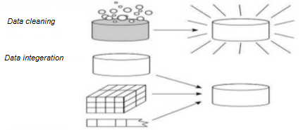
Data Preprocessing
Data collected from sensors can be inaccurate and missing. Because
IoT data comes from different sources with varying formats and structure
Inefficiency in sensor hardware and network communication.
Context reasoning continue…

Slide 6
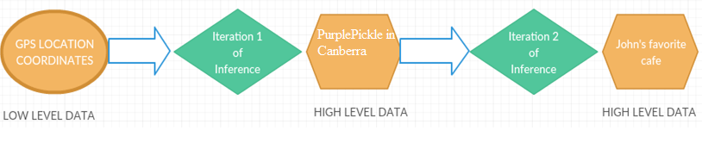
Context-Inference
Context-inference is deducing high-level context information using lower-level context.
A new knowledge can also be created from existing context.
Inferencing can be done in a simple iteration or multiple iteration through a different number of reasoning techniques.
Context reasoning continue…

Slide 7
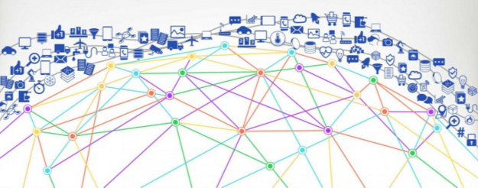
How to do reasoning?
Amount of context collected from billion of
sensors will be enormous and using all these
context will not be feasible.
93% accuracy has been achieved by using 10
raw context only.
Adding 30 more raw context further increase
the accuracy only 1.63%.
Need to select correct reasoning technique which will provide high accuracy for a given context..
1. Supervised Learning. 4. Fuzzy Logic
2. Unsupervised Learning 5. Ontological
3. Rules 6. Probabilistic reasoning
.
Context reasoning continue…

Slide 8
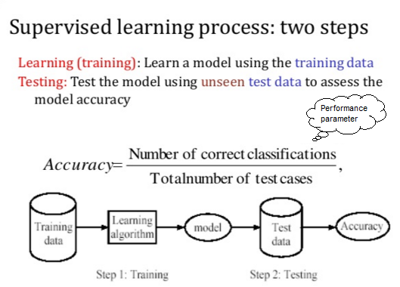
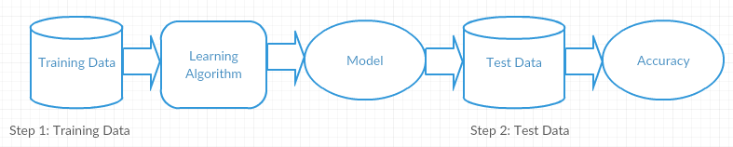

Supervised Learning
In supervised learning technique, we have training data. The training data has input and response. From the training data we make a model or function which predicts the outcome of a new set of data.
Context reasoning continue…

Slide 9
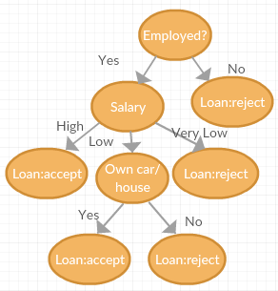
Supervised Learning Methods
Decision tree : In this method, a tree from a data
set is built that is used to classify data. The internal
node of decision tree represents a “test” on an
attribute, each branch represents the outcome of the
test and each leaf represents a class label.
It is easy to understand.
They can handle large amounts of data as it ignore
inappropriate information.
.

Slide 10

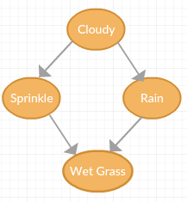


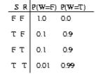
Supervised Learning Methods
Bayesian Networks : This technique is based on probabilistic reasoning technique concepts. It uses directed acyclic graphs to represent events
and relationships among them.

Slide 11
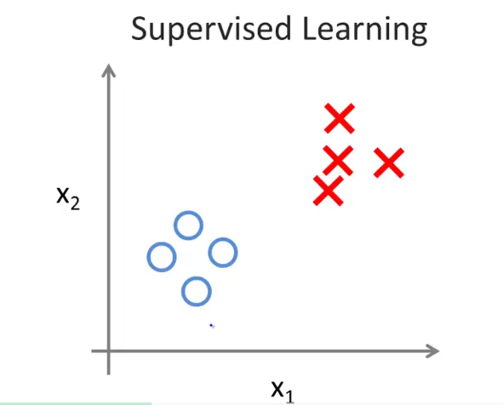
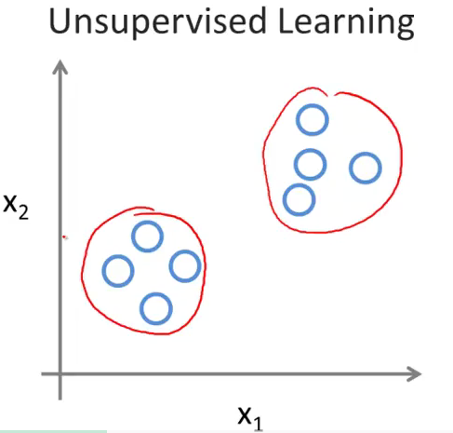
Unsupervised Learning
In this type of technique, there is no labelled data for training. We find hidden structure in unlabeled data.
Labelled Data
Unlabeled Data.

Slide 12
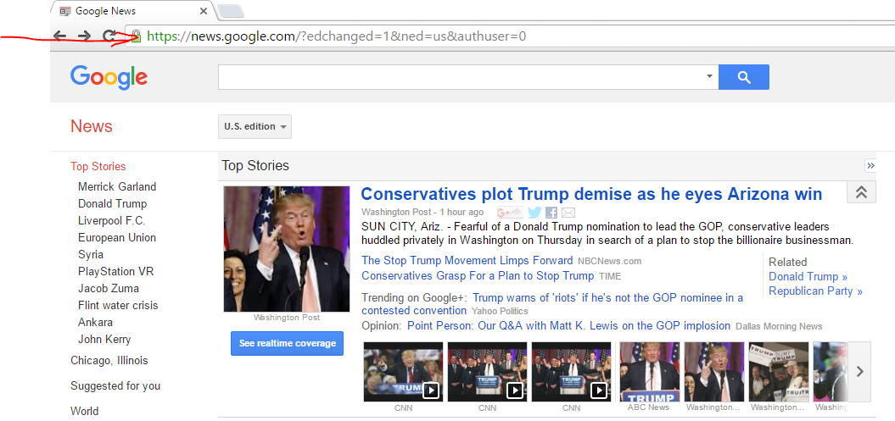
Unsupervised Learning
A clustering technique
One practical Example of Unsupervised learning

Slide 13
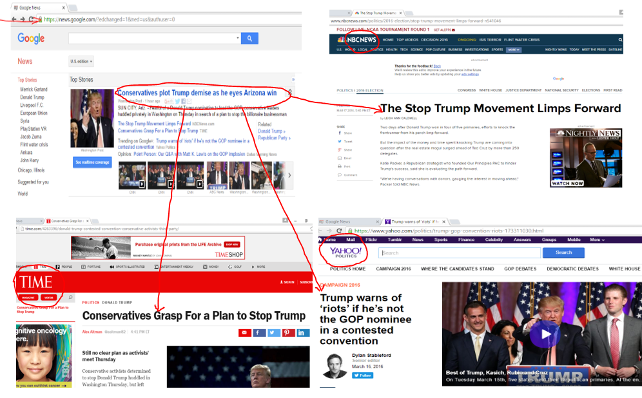
Unsupervised Learning
Clustering of topics

Slide 14
Unsupervised Learning Techniques & Uses
Below are the common Unsupervised learning techniques which are discussed in supplementary slides.
K-Nearest Neighbor
Used in sensor low-level sensor network task such as routing.
Used in high level tasks such as indoor and outdoor positioning.
Kohonen Self-Organizing Map
Used to classify incoming sensor data in real time fashion
Used in noise detection and outlier detection

Slide 15
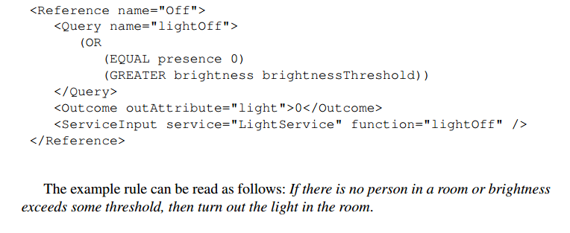
Rules
Rules are simplest and straightforward reasoning techniques. The usual structure of Rules is IF-THEN-ELSE.
Example: Below is the sample of rule written in a context Toolkit.

Slide 16
Probabilistic Logic
Decision is made on the basis of probability of facts related to the problem.
Used to resolve the confliction among context.
Used to combine context from two different sensors.
Hidden Markov Models : is a probability based technique that allows state to be represented using observable evidence rather than reading the state directly.
Example: We can predict a user destination, mode of transportation using cobservable evidence such as user calendar, weather etc rather than reading the GPS coordinates.

Slide 17
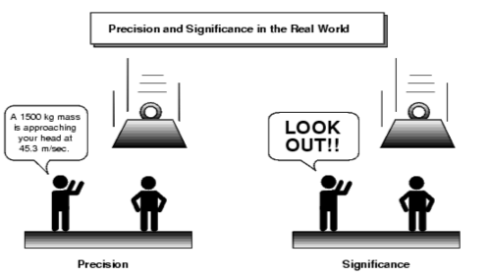
Fuzzy Logic
Like probabilistic logic.
But partial truth is also accepted.
It allows real world to be represented in more natural way.
It also allows use of natural language (e.g. slightly warm, fairly cold) instead of temperature : 10 degree Celsius.

Slide 18
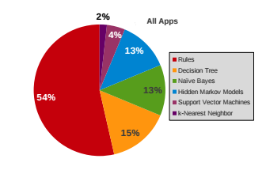

Slide 19
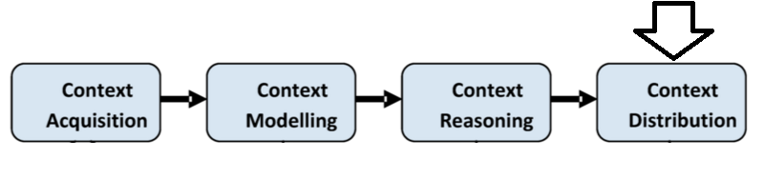
Where we are now?

Slide 20
Context Distribution
Methods to deliver context to consumer.
Fairly straightforward task.
From consumer perspective, this is context Acquisition.
Way of Distribution
Query
Consumer make a request in terms of query to context management system.
It’s processed on demand basis.
Subscription
Consumer is allowed to subscribe context management system by describing their requirement.
The system returns the result periodically or when an even occurs.

Slide 21
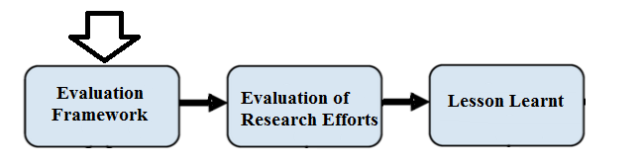
Existing Research Prototypes and Systems
In section, we first make our evaluation framework (set of factors)
We then evaluate most significant projects and highlight their significance.
Later, we points the lesson learnt from them towards context-aware development in the IoT paradigm in next section.
Where we are now?

Slide 22
Evaluation Framework
Project Name: This is the name given to the project by the authors of the related applications. If the project has no explicit name, here (-) has been used.
Year: Is the year of publication.
Project focus: Projects are classified as System (S), Toolkit (T) and Middleware (M).
Systems: System is an end to end solution where it involves hardware, software
and application layer. It performs one or a few tasks for user.
Middleware: It can be considered as a software layer between hardware and
application. It provides reusable functionalities that are required by the
application to meet complex requirements.
Toolkits: Toolkits are used by system, application and middleware developers.
They are not used by end users. They provide specific functionalities.
4. Modeling: Key value modeling(K), markup schemes(M), graphical modeling(G),
object oriented(Ob), logic-based modeling(L) and ontology based modeling (On).
5. Reasoning: Supervised Learning(S), un-supervised learning(u), rules( R ), fuzzy logic(F), Ontony-based(O) and probabilistic reasoning(P).

Slide 23
Evaluation Framework
6. Distribution: Publish/ Subscribe (P) and Query (Q).
7. Architecture: Architecture are of different types.
Component Based architecture where the entire solution is based on loosely coupled major components. Different component may perform different function. Denoted by (1)
Distributed Architecture. Denoted by (2)
Service Based Architecture where the entire solution consists of several services working together. Denoted by (3)
Node Based Architecture allows to deployment of pieces of software with similar or different capabilities, which communicate and collectively process data in sensor networks. Denoted by (4)
Centralized architecture which acts as a complete stack and provides application to be developed on top of that. Denoted by (5)
Client-Server architecture. Denoted by (6)

Slide 24
Evaluation Framework
8. History and Storage: Most of IoT solutions and application normally process real time data. However history data is able useful to know user behaviors, preferences, needs etc.
9. Knowledge Management: Middleware solutions require knowledge in different perspectives, such as knowledge on sensors, domains, users and many more. This facility is provided by knowledge management functionality. The symbol () is used to presence of knowledge management
11. Event Detection: IoT involves machine-to-machine (M2M) and machine-to-person (M2P) communication. Once an event has been triggered, a notification or action may be executed. For example, detecting current activity of a person or detecting meeting status in a room can be considered as event. The symbol () is used to presence of even detection.
12. Security and Privacy: Security is a major problem in context-aware computing in all paradigms. The symbol () is used to presence of security and privacy related functionality in the project.

Slide 25
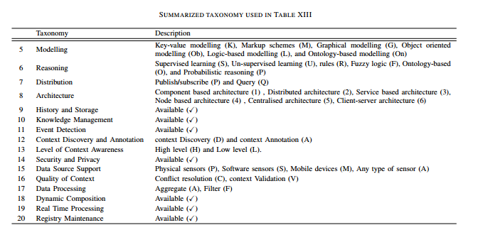
Taxonomy Used

Slide 26
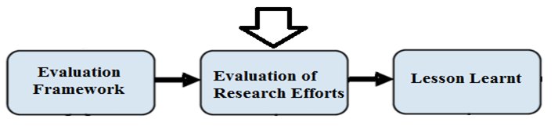
Evaluation of Research Efforts

Slide 27
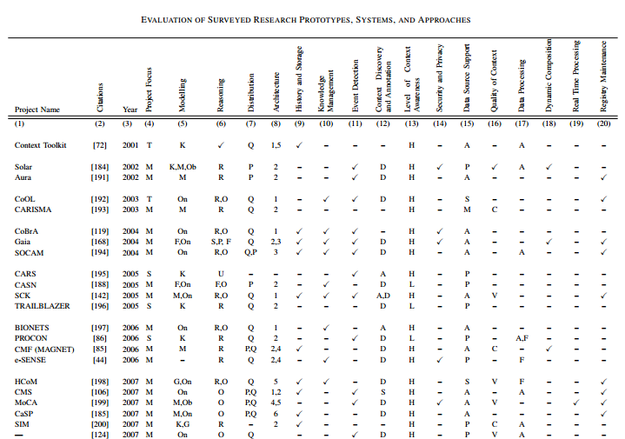
Evaluation Table

