Slide 1
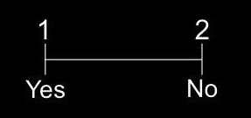
How and Why Test
For this test, you will answer questions about how and why people perform actions. Each question is presented in two parts:
Part 1 asks either a how or why question about an action.
Part 2 presents a potential answer. Use BUTTON 1 to accept the answer and BUTTON 2 to reject it.
How to
ride a bike?
grip handlebars
For how questions, judge whether the offered answer describes a commonly accepted part of performing the action. For why questions, judge whether the offered answer describes a commonly accepted reason for performing the action. If you are not sure about any answer, just make your best guess. You will have a limited amount of time to make each response.
Press BUTTON 1 to start the practice test

Slide 2
Important Reminder
Please keep your head
still while the scanner
is running.

Slide 3
1
2
Yes
No

