Slide 1
International Geobiology Course – 16S Amplicon Analysis

Slide 2
What is 16S and why do we care?

Slide 3
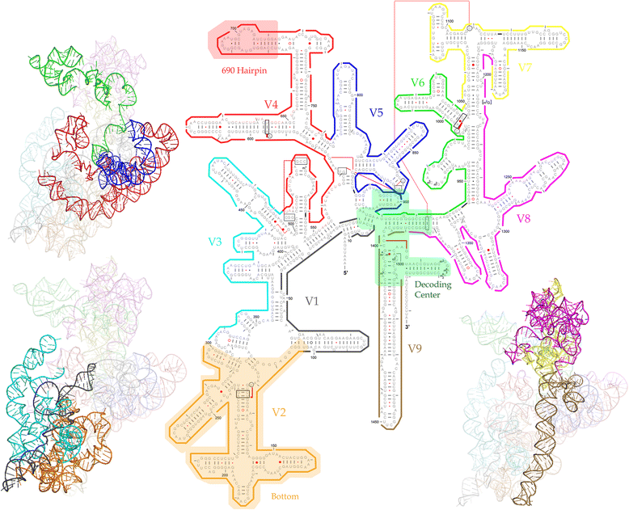
16S
The name 16S is short-hand for:
16S small-subunit (SSU) ribosomal RNA
It provides a structure and function to the ribosome. The ribosome is a protein-RNA complex that performs the task translating nucleic acids to proteins.
There are several features that make the 16S SSU rRNA molecule interesting:
It is essential for all life on Earth
There are equivalent molecules with similar structure in eukaryotes (18S SSU) and the mitochondria (12S SSU)
Because of its universality the information stored in the molecule can be used as molecular evidence for phylogeny
It has a conserved 2D and 3D structure that leads to important traits with different evolutionary constraints

Slide 4
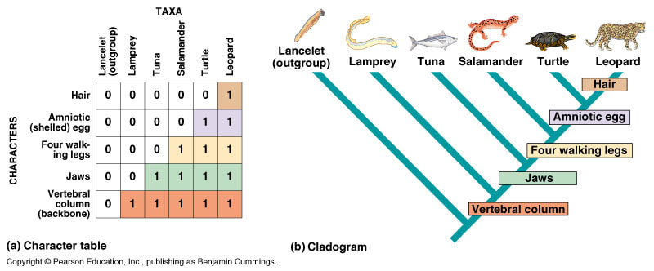
What is phylogeny?
History of the evolution of a species or group → based on the assumptions about how organisms descend from a common ancestor
Nodes on the cladogram represent a shared common ancestor

Slide 5
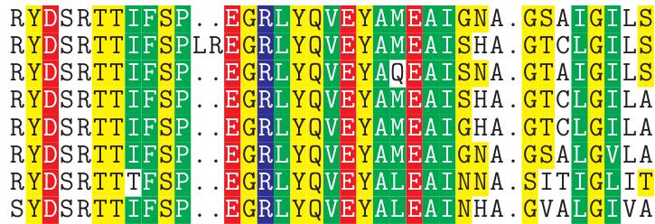
Molecular phylogeny
Similar to how a table of traits can be converted into a cladogram displaying history between organism, a biomolecule like DNA or protein can be used to reconstruct the history of organisms.
Example protein alignment. Columns with identical amino acids are highlights
Using empirical evidence and derived assumptions about the rate of certain substitutions we can build a phylogenetic interpretation of a gene/proteins history

Slide 6
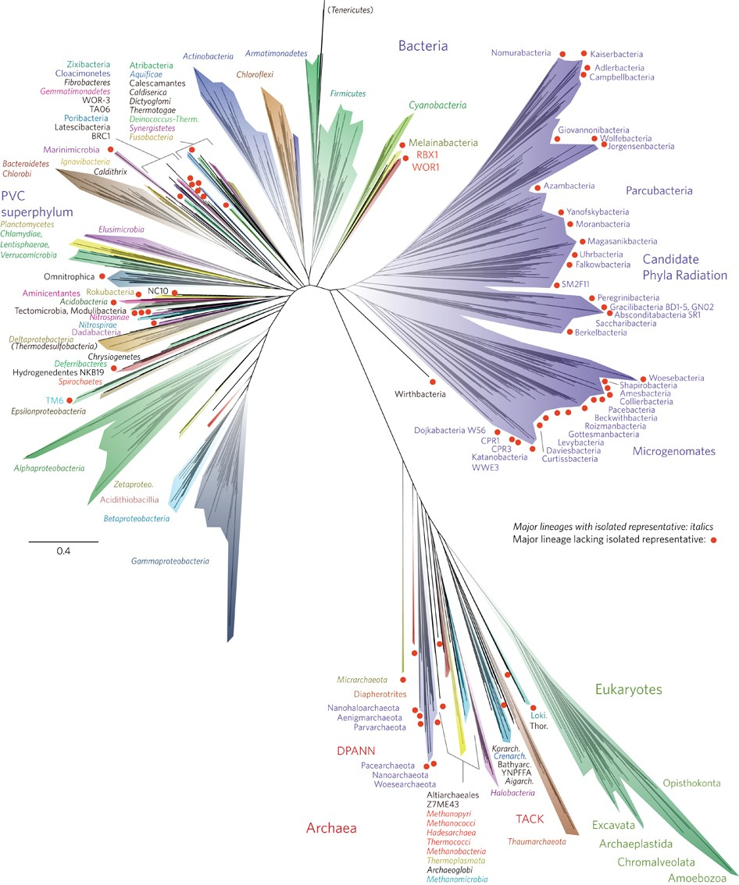

Slide 7
Two features that make the 16S SSU rRNA incredibly useful for this task:
It can be used to ID a microorganisms. Microbes of the same species share high sequence identity between members (>97% identity)
It has conserved and flexible features that provide meaning even if the full gene is not available
Conserved stems
required for providing structure
Hypervariable loops
which have less evolutionary constraint and more readily accumulate changes (a.k.a. mutations)

Slide 8
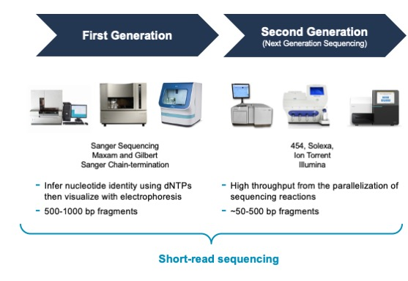
Why is it relevant that fragments of the 16S retain evolution and identity information?
The typically 16S rRNA gene is ~1,500 bp in length

Slide 9
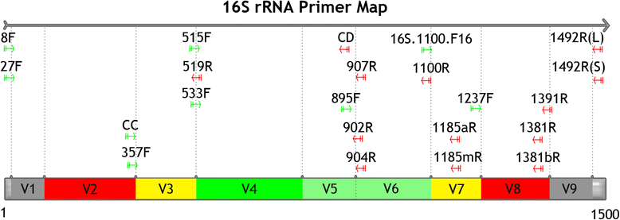
We can use a combination of short DNA fragments (known as primers) that match conserved regions to selectively amplify fragments of the 16S rRNA gene
The more conserved the target primer regions, the more diversity (bacteria & archaea) we can capture

Slide 10
sample collection
DNA extraction
consider: types of organisms, substrates
DNA amplification
select primers
DNA clean-up and quality control
create a sequence-ready library
sequence platform
another amplification step
Pre-sequencing steps
Decision points made prior to the start of course or even in previous years of the course

Slide 11
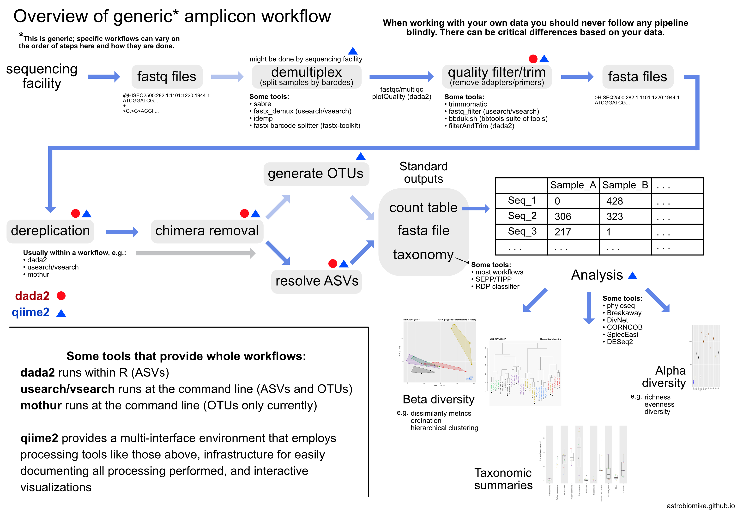

Slide 12
pre-processing
create biological decision points
determine level of resolution; biology table
analysis
consider who is there; how does sample compare
splitting samples; clean sequences; simplify sequences
Analysis steps

Slide 13
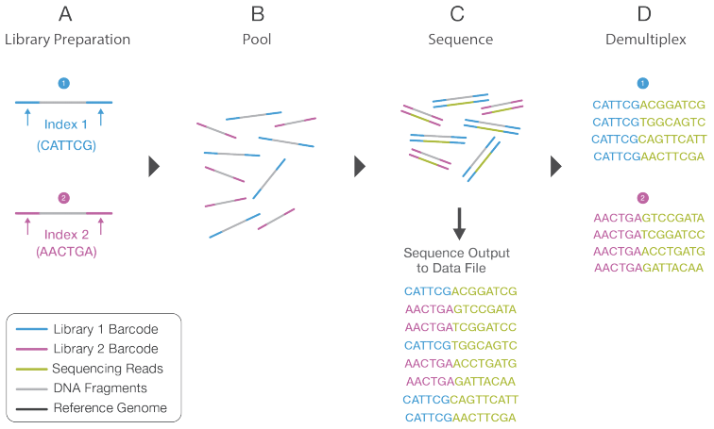
Pre-processing
pre-processing
splitting samples; clean sequences; simplify sequences
B
A. Demultiplex
B. Dereplicate
C. Remove chimeras
× 4
× 3
× 7
A
C
✓
✓
X

Slide 14
Biological goals
create biological decision points
determine level of resolution; biology table
Operational taxonomic units (OTUs)
Amplicon sequence variants (ASVs)

Slide 15
Biological goals
create biological decision points
determine level of resolution; biology table
OTU1
Operational taxonomic units (OTUs)
Amplicon sequence variants (ASVs)
Cyanobacteria
>97% identical
OTU2
OTU3
Desulfobulbus

Slide 16
Biological goals
create biological decision points
determine level of resolution; biology table
ASV1
Operational taxonomic units (OTUs)
Amplicon sequence variants (ASVs)
ASV2
Cyanobacteria
ASV3
ASV4
ASV5
ASV6
Desulfobulbus
ASV7

Slide 17
Difference between OTUs & ASVs
Resolution
OTU
ASV2
TAXA
ASV3
ASV1
Time

Slide 18
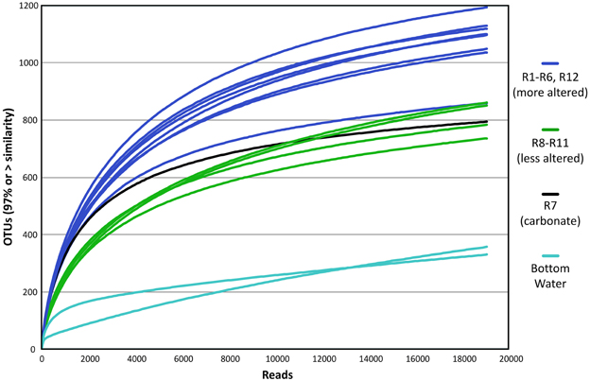
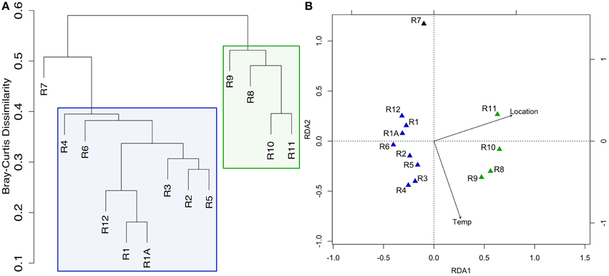
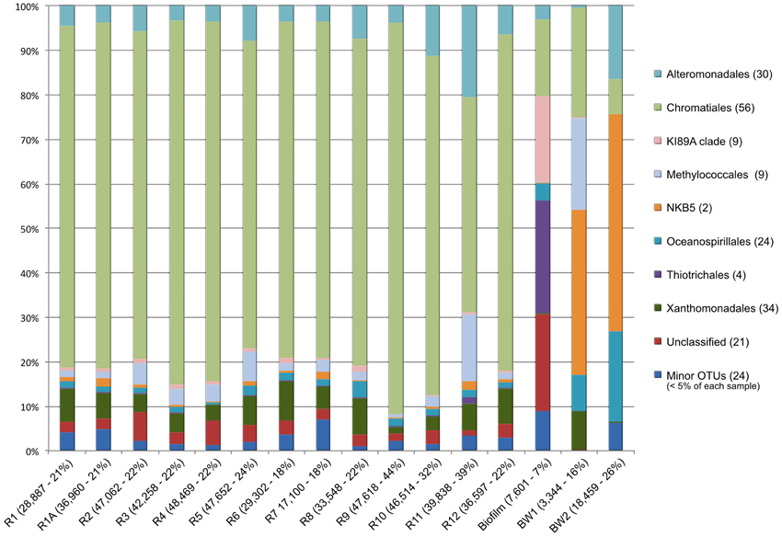
Analysis
analysis
consider who is there; how does sample compare
Alpha diversity
Beta diversity
Taxonomic profiles

Slide 20
