Slide 1
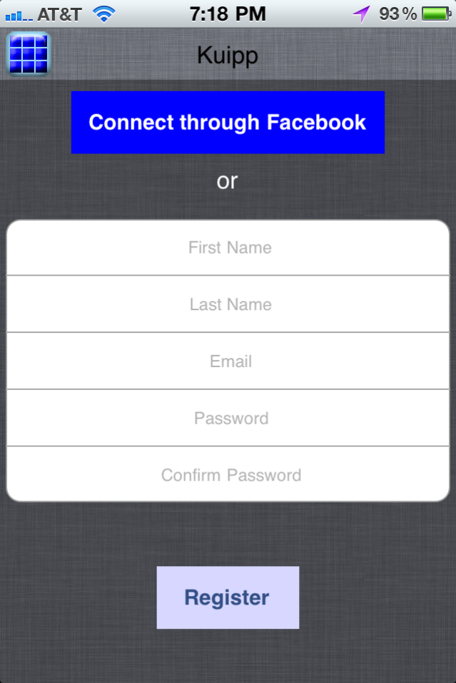
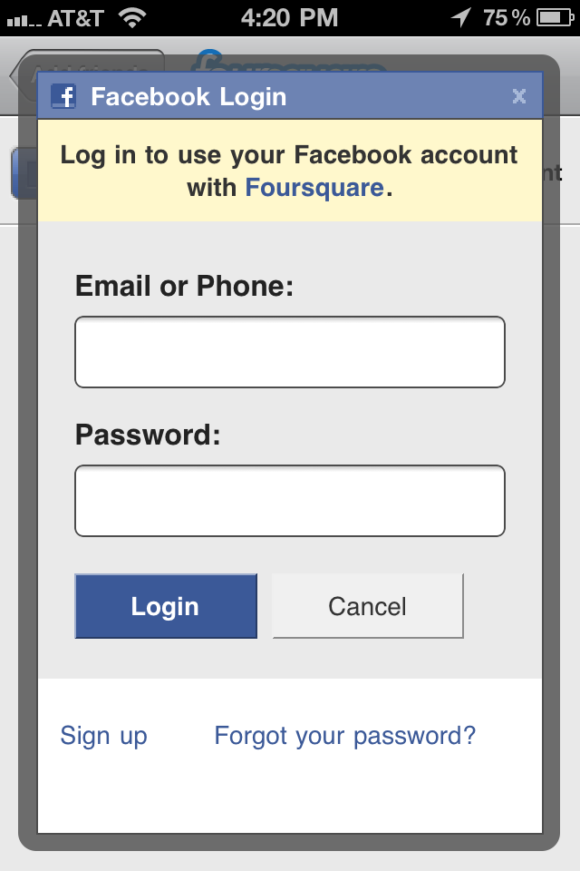
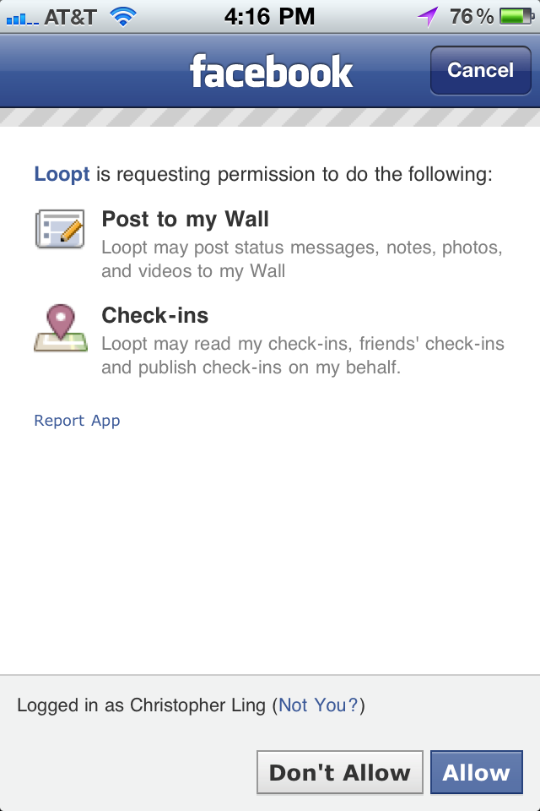
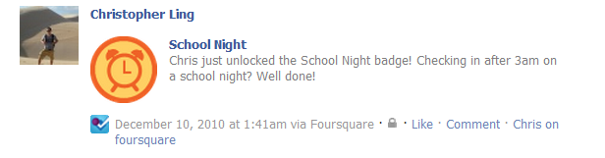
Standard register page
Will need some sort of approval authorization.
- Medal / level updates: it would be nice if we could publish whenever users obtain a medal or reach a new level status on facebook on their wall (see example to the right)

Slide 2
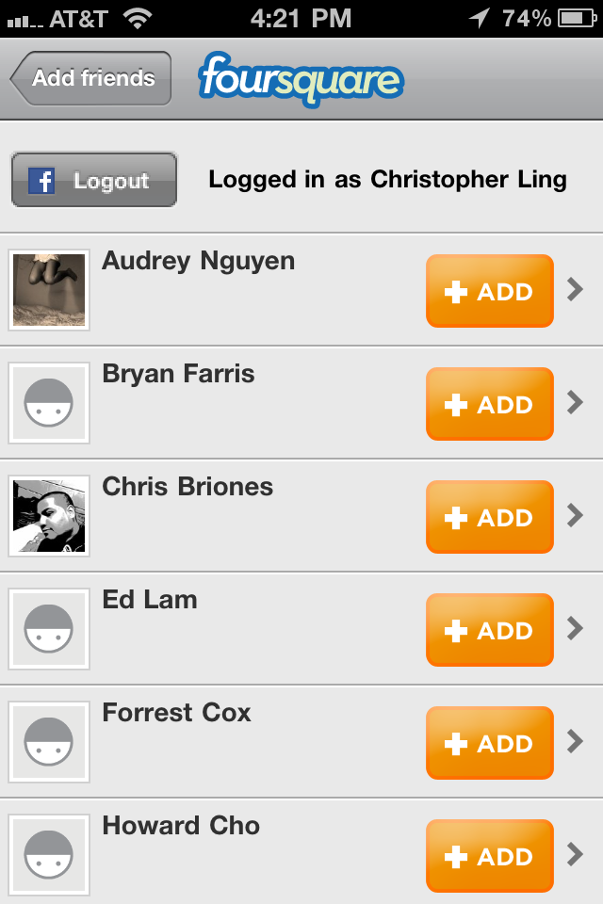
Question: Once the user approves, can we pull their first + last initial, profile picture (easy to allow them to change?), and email address (basically all the login information). Can they just be logged in through facebook or will we need them to create a separate password? It would be easier w/o having to create a password
- Image we may need additional authorizations since we want to pull their picture as well.
This is the same feature as the Settings→Connect page (next slide), however upon registering, if the user logs in through facebook, they should then be directed to a page where it shows their friends to add as followers. This should be a automatic process immediately after registering. This way they can start off with some friends.

Slide 3
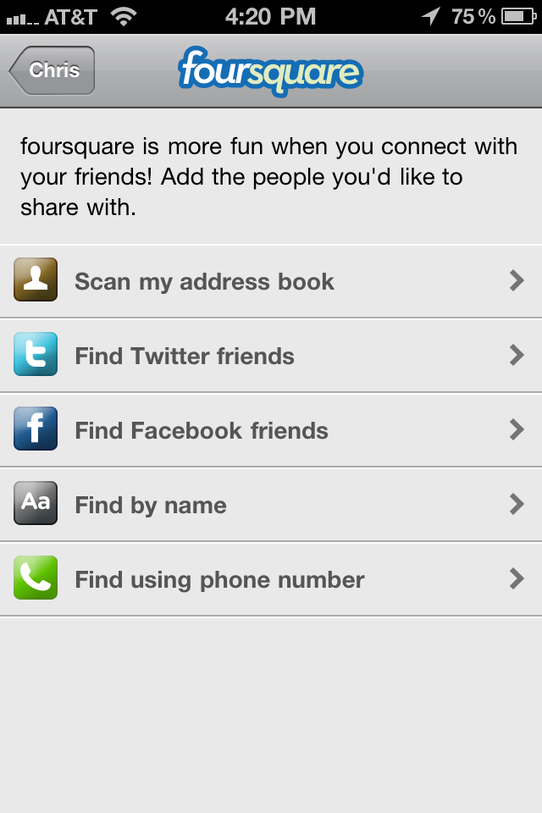
Settings → Connect
Users should also be able to access this through the Connect button, which will lead to the settings area
- For now, I imagine we should have the facebook and Twitter bars. Twitter is even more simple since all you do is enter your twitter name in a search bar and it returns all the users that are your followers
- Not sure how it works, but the “Scan my address book can also be useful, since it shows your friend in your contact list that are using the app as well. If they aren’t on, there is a button to invite them as well (see screen shot on next page)
Now they can add additional followers

Slide 4
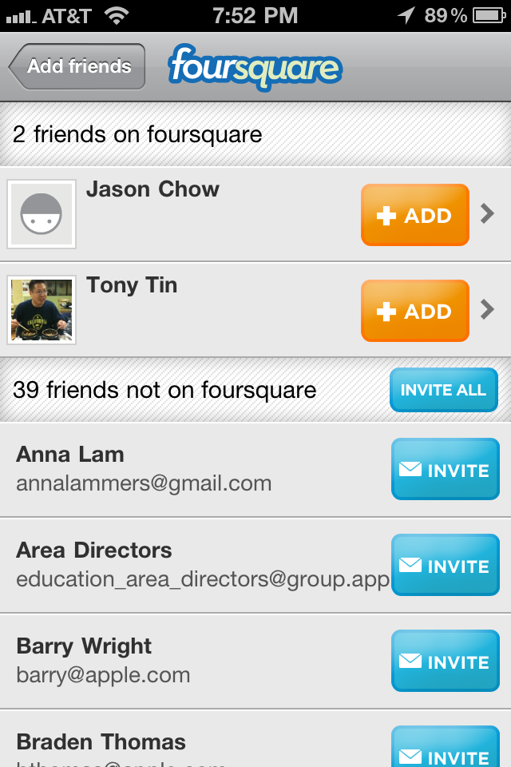
Connect → Snapshot of ‘Scan my address book’

