Slide 1

Hamrosamaj
हाम्रो समाज
Notes:
NOTE:
To change the image on this slide, select the picture and delete it. Then click the Pictures icon in the placeholder to insert your own image.

Slide 2
KUITmeet2017
iComDroid:
Milan Thapa
Binod Jung Bogati
Srishti Rimal
Sumit Bhattarai

Slide 3
Presentation Highlights:
Protein
Protein Deficiency Disease
Marasmus
Kwashiorkor

Slide 4
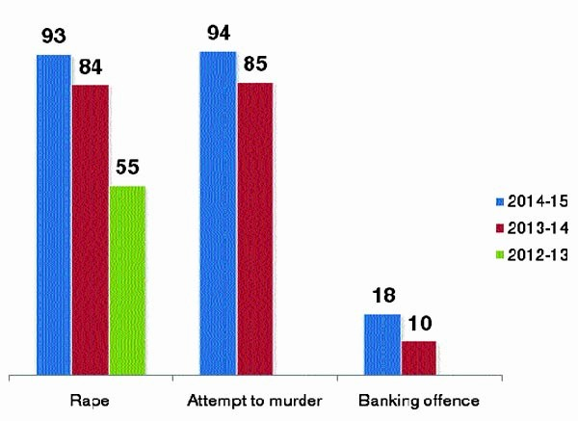
Crime and Safety Report(2012-2015):

Slide 5
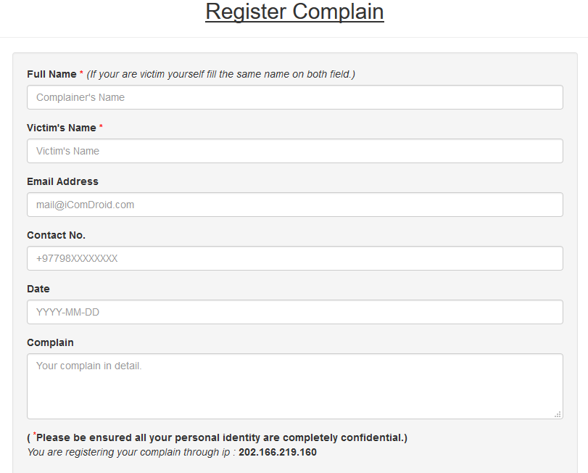
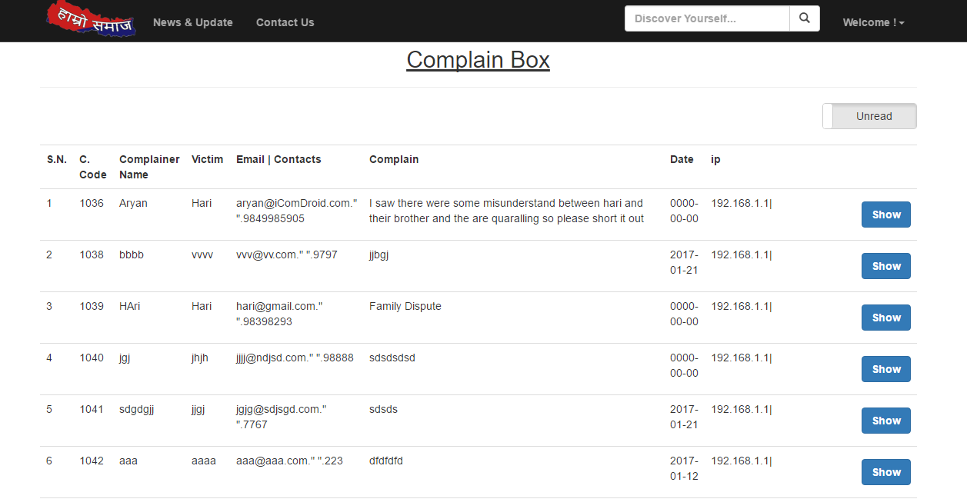
SnapShot

Slide 6
Add a Slide Title - 5

Slide 7


