Slide 1
Small TSP
D
8
6
5
C
2
E
7
A
4
3
5
B

Slide 2
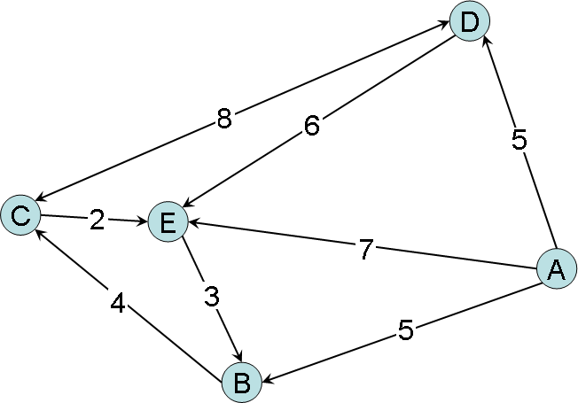
Small TSP
A Path has
  an origin
  a destination
A Leg has
  a path
  a distance
A Route is
  a sequence of linked legs

Slide 3
Small TSP Questions
Legs:
AB5, BC4, CD8, DC8, DE6, AD5, CE2, EB3, & AE7
Questions:
The distance of the route ABC
The distance of the route AD
The distance of the route ADC
The distance of the route AEBCD
The distance of the route AED
All routes starting at C and ending at C with a maximum of 3 legs
All routes starting at A and ending at C with exactly 4 legs
The shortest route (in terms of distance) from A to C
The shortest route (in terms of distance) from B to B
All routes from C to C with a distance of less than 30 units

Slide 4
Small TSP Answers
Legs:
AB5, BC4, CD8, DC8, DE6, AD5, CE2, EB3, & AE7
Answers:
9
5
13
22
No such route
CDC, CEBC
ABCDC, ADEBC, ADCDC
ABC
BCEB
CDEBC, CDC, CDCEBC, CEBC, CEBCDC, CEBCEBC, CEBCEBCEBC

