Slide 1
Demo

Slide 2
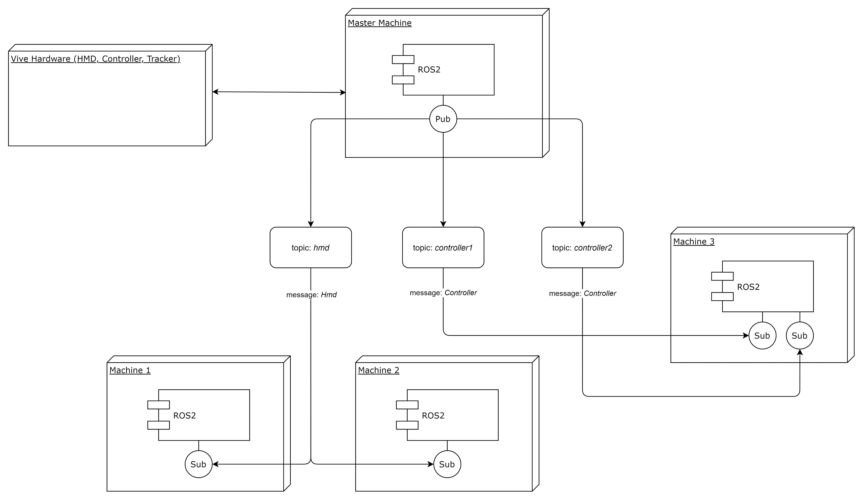
Design Architecture

Slide 3
Latency
Vive hardware to machine 1:
Min input lag (0.001 s) -> 1000 Hz
Max input lag (0.016 s) -> 62.5 Hz
Machine 1 to other subscriber nodes
Min input lag (0.0012 s) -> 833.33 Hz
Max input lag (0.018 s) -> 55.56 Hz

Slide 4
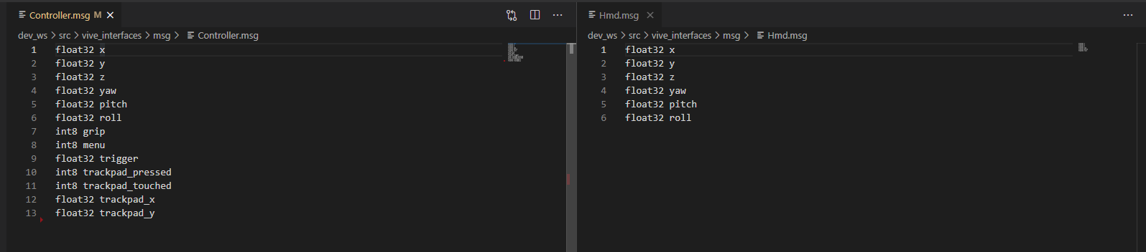
Messages
Hmd (x, y, z, yaw, pitch, roll)
Controller (x, y, z, yaw, pitch, roll + buttons)

Slide 5
Future improvements
Software graphical interfaces (clients can control cobot over GUI)

Slide 6
