Slide 1
Insert partner logos in this space
When Quality (doesn’t) Pay
Two Experiments in Ugandan Dairy
Technology, transparency, and the emergence of markets for quality
Bjorn Van Campenhout with R. Ariong, S. W. Kariuki & J. Chamberlin IFPRI | KU Leuven NOVAFRICA Conference | 19 June 2026
Notes:
Two linked field experiments in Uganda's dairy sector asking a single question: can making quality observable create a market for quality? Spoiler: observability is necessary but not sufficient.

Slide 2
The problem (1): quality you cannot see
Milk quality (butterfat, solids-not-fat, added water) is costly to verify at the point of sale.
MCCs rely on crude tools: lactometer + alcohol test — detect gross adulteration, not composition.
High- and low-quality milk therefore trade at the same per-litre price.
Classic asymmetric information (Akerlof 1970): no credible signal → no reward for quality → quality erodes.
Both adulteration margins pay: watering inflates volume; skimming fat extracts the most valuable component.
“Without verification, the market cannot tell good milk from bad.”
5–10% of milk samples in the region show water addition
Notes:
Start with the information problem. Quality is a credence/experience attribute at first sale. Crude tests catch only gross adulteration. Pay-per-litre with no composition adjustment means both watering and skimming are profitable. This is the lemons problem.

Slide 3
The problem (2): aggregation severs the link
Milk is pooled across many farmers early in the chain.
Buyers observe only a group-level quality signal; individual contributions vanish into the pool.
Shared reputation = a common-pool resource (Winfree & McCluskey 2005; Tirole 1996).
Moral hazard in teams: each farmer can free-ride on the pool — no one internalises the return to their own effort.
Layers of traders make traceability break down even faster.
⇒ Even if buyers want to pay for quality, the structure prevents it. No market for quality emerges.
Farmers → Trader → MCC (pool) → Processor
individual quality observed with noise
pooled & paid one flat price per litre
Notes:
Second, conceptually distinct impediment: aggregation. Pooling makes reputation a common-pool resource; moral-hazard-in-teams logic means individual effort is not rewarded. Intermediation layers worsen traceability. Two barriers: (i) observability at point of sale, (ii) traceability through aggregation.

Slide 4
This paper: two linked field experiments
Can making quality observable and traceable create a market for quality?
Experiment 1
Measurement & digital monitoring
Cluster-RCT, 95 catchments. Install milk analyzers + record-keeping app at MCCs.
Tests the information / enforcement margin.
Experiment 2
Activating the price channel
Within-MCC RCT, ~100 traders. Pay traders an explicit quality premium.
Tests the price / pass-through margin.
Notes:
Roadmap. The sequential design separates the informational dimension (Exp 1) from the pricing dimension (Exp 2) in the same supply chain. Exp 2 is run on infrastructure built by Exp 1.

Slide 5
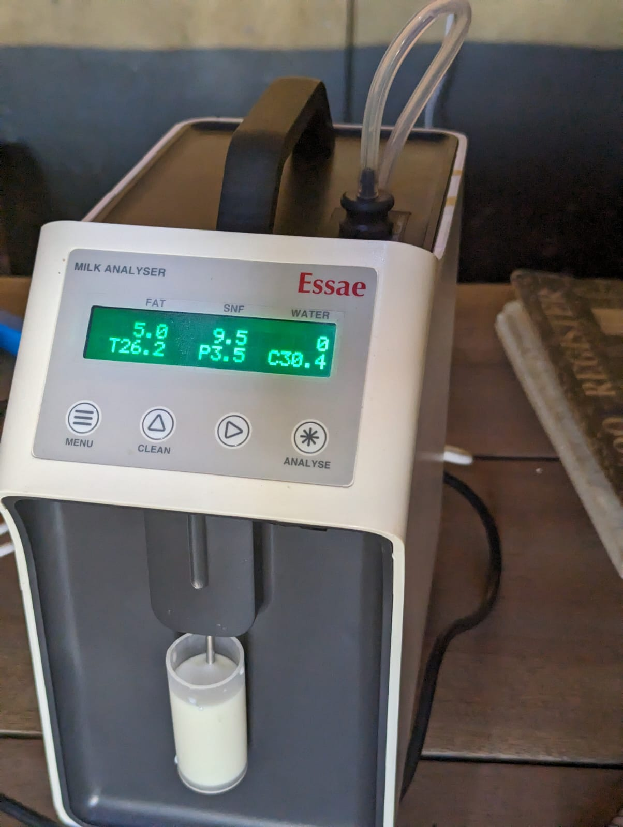
Context: Uganda’s dairy supply chain
Southwestern milk shed (Mbarara)
Most commercialised livestock sub-sector: 17% of agricultural GDP.
Output 5× since 2008; exports up to USD 265m (mostly to Kenya).
Dense network of milk collection centres (MCCs) linking farmers to processors.
Quality is central: it sets processing yields for cheese, casein, infant formula.
Yet prices are fixed per litre, set for 2-week windows, paid biweekly — the quality–payment link is severed.
Notes:
Set the scene: a transforming, commercially organised sector where quality genuinely matters for downstream products, but pricing institutions are flat per-litre. Photo: milk analyzer installed at an MCC during piloting.

Slide 6
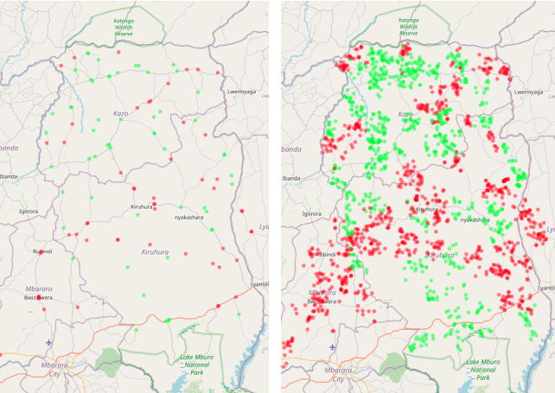
Experiment 1: design
Cluster-randomised controlled trial
Unit of randomisation: catchment area (1–few co-located MCCs + their farmers).
95 clusters / 125 MCCs; ~half treated, half control.
20 farmers sampled per MCC → ~2,500 farmers.
Effects estimated at three levels: MCC, farmer, and 2,518 supervised milk samples at endline.
Baseline 2022 → install/train 2023 → endline Dec 2024.
Treatment assignment: MCCs (left) and their farmers (right). Green = treated, red = control.
Notes:
Cluster RCT at the catchment level because the intervention is at the MCC and farmers within a catchment share MCCs. Three measurement levels including objective supervised milk testing — the cleanest outcome.

Slide 7
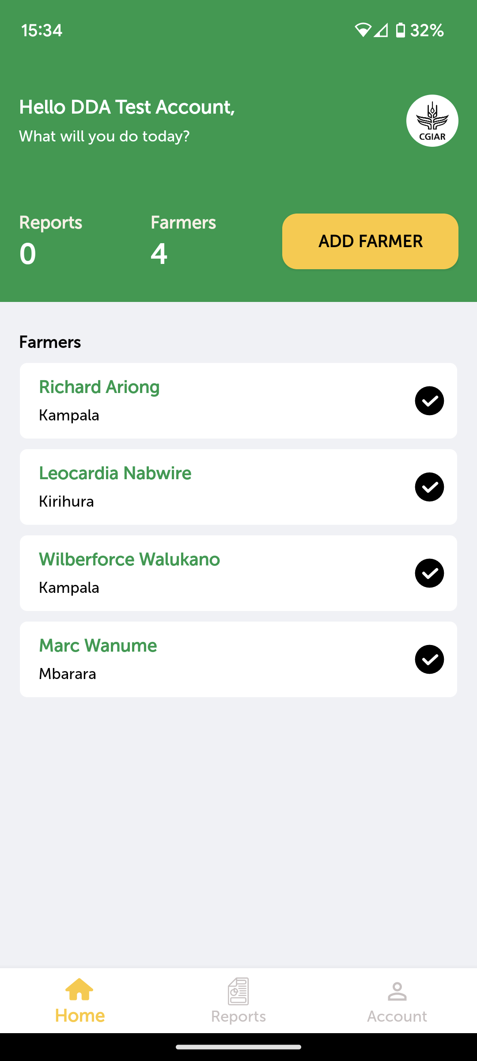
Experiment 1: the intervention bundle
1. Milk analyzer — measures fat, SNF, protein, added water & density in <1 min/sample.
2. Digital record-keeping app — Android tablet replaces paper notebook; stores quality + quantity per farmer, builds quality histories.
3. Farmer awareness campaign — posters publicise the new testing capacity and farmers’ right to request a free test.
Together: make quality observable, traceable, and actionable.
Compliance was imperfect — first stage = 0.37 (24% → 61% with a functioning analyzer). ITT is a lower bound.
Notes:
Three components: hardware (analyzer), software (app + portals for owners and DDA), and a farmer-facing information campaign to avoid power imbalance. Note imperfect compliance: analyzers moved, some unused. First stage 0.37, so ITT attenuated; we also report LATE.

Slide 8
Experiment 1 results: milk quality improves
On 2,518 supervised milk samples, treated MCCs receive cleaner, richer milk.
+0.11pp
Butterfat **
3.88% → ~4.0%
−0.49pp
Added water *
vs 1.63% control
+0.44
Density (CLR) *
less dilution
+0.21σ
Quality index **
Anderson composite
Effects load on handling/adulteration margins (fat, water, density), not on biologically-determined SNF and protein (both null).
Pattern is consistent with reduced skimming and dilution, not deeper changes in feeding or production.
Robust to dropping contaminated controls (index +0.22σ on clean sample) and to LATE.
Notes:
Headline of Exp 1: quality improves, but selectively — on the margins a farmer/trader can manipulate quickly (water, skimming) rather than on composition that needs feeding changes. Significance stars: **=1%, *=5%.

Slide 9
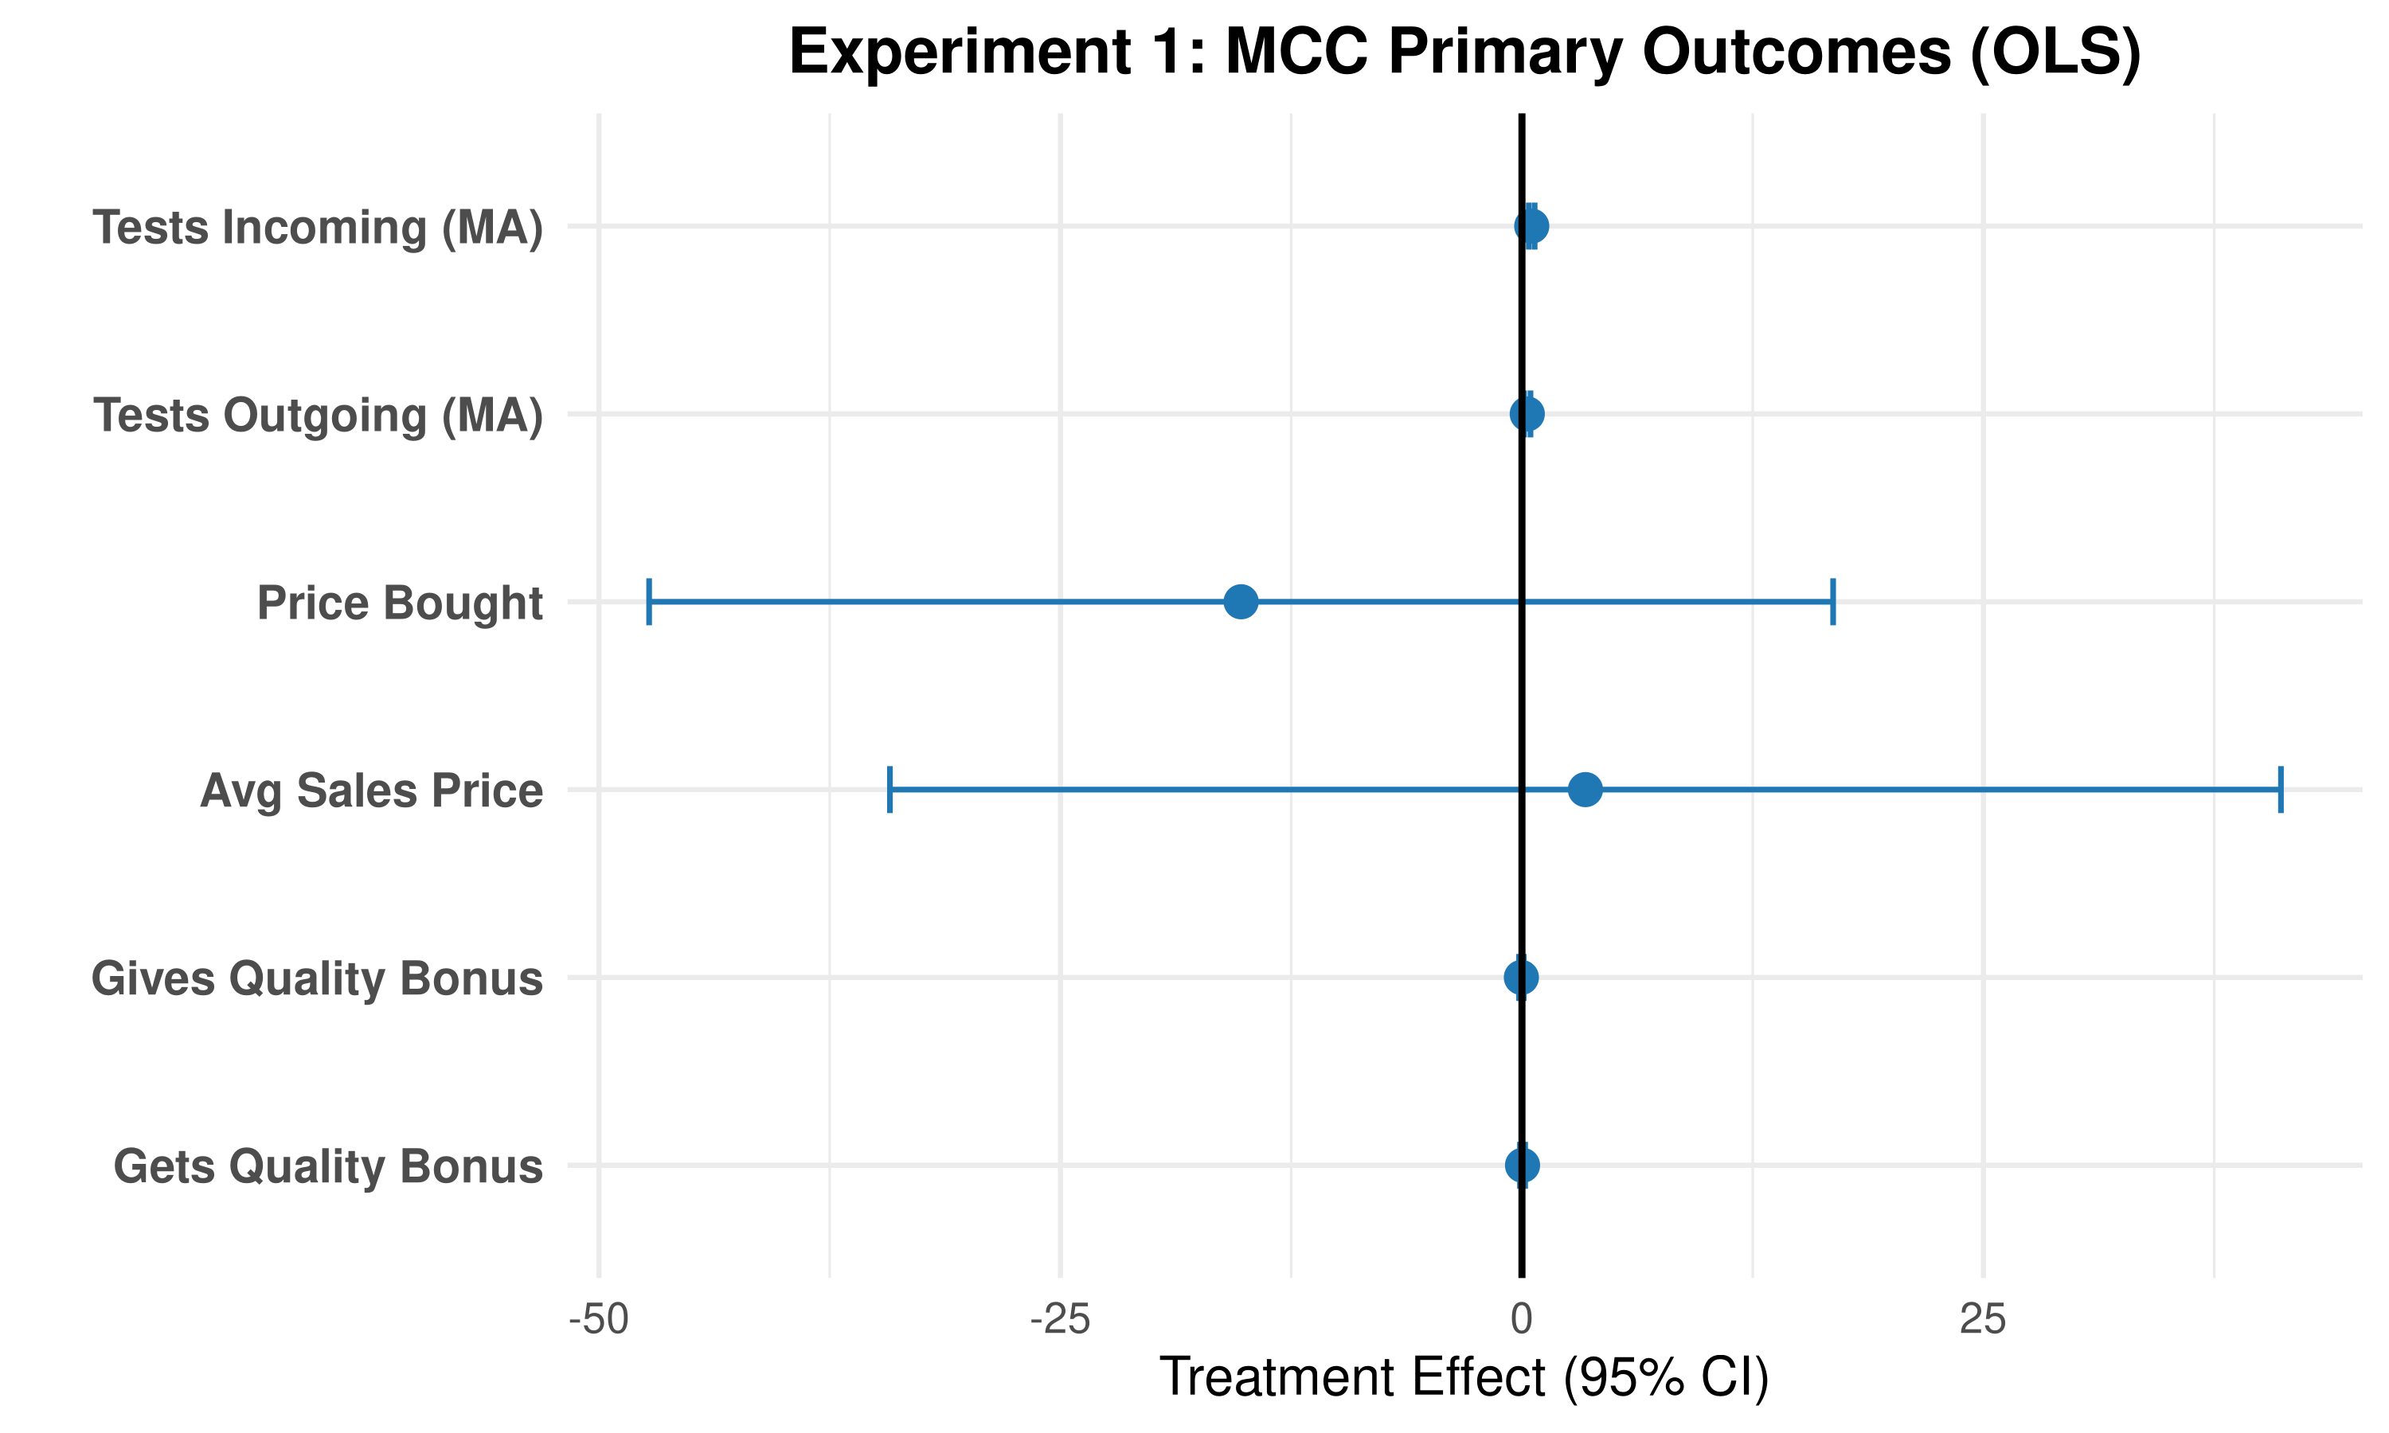
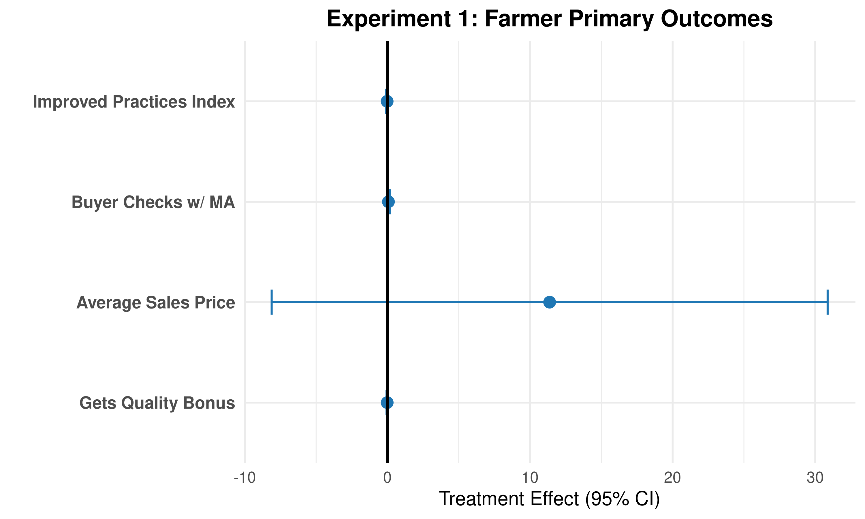
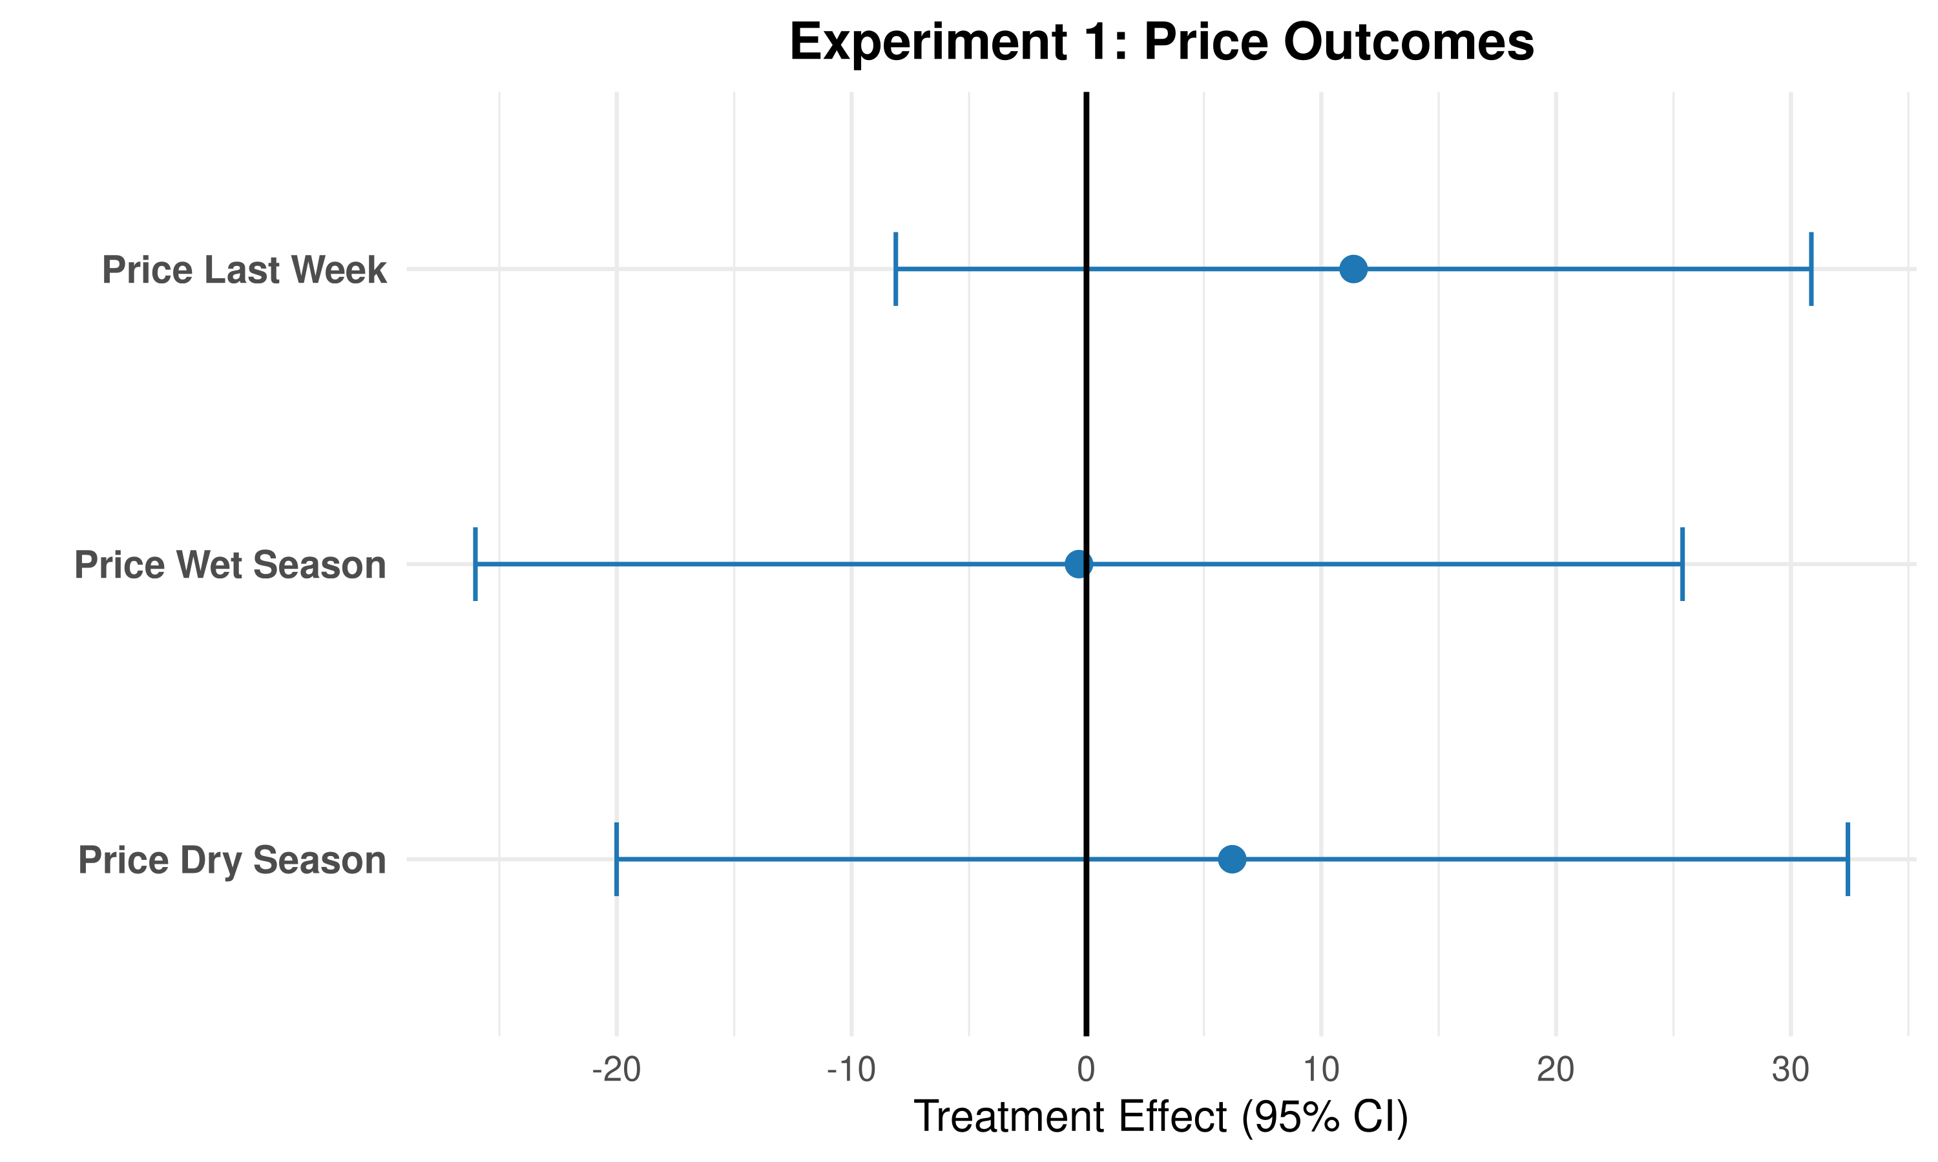
Experiment 1 results: … but no price premium emerges
Testing behaviour jumps: treated MCCs test incoming milk +53pp (29% → 82%).
Prices and premiums: all null — farm-gate price, MCC buy/sell price, quality bonuses (MCC & farmer).
Quality rises, but no one is paid for it. Enforcement without a price.
Notes:
Three forest plots: MCC primary outcomes, farmer primary outcomes, farmer prices by season. Testing rises sharply; every price/premium coefficient straddles zero. The quality gain is real but unrewarded — this is the puzzle the model resolves.

Slide 10
A model: two channels for quality infrastructure
MCC sees a noisy signal sᵢ = qᵢ + ηᵢ, ηᵢ ~ N(0, σ²); accepts if sᵢ ≥ q_min. The analyzer drives σ² → 0.
Enforcement channel
Lower σ² makes the rejection threshold credibly bind.
Farmers near q_min raise effort to avoid rejection — the extensive margin.
Works even if the price premium α = 0.
Signature: quality ↑ (esp. lower tail), prices flat.
Price channel
Requires a per-unit quality premium α > 0 paid up the chain.
And pass-through λᵢ > 0 so it reaches farmers.
Rewards quality along the continuous gradient.
Exp 1: measurement alone did not activate α.
Notes:
The model formalises why quality can rise with no price response. Two channels. Exp 1 is the enforcement channel operating in isolation: σ² falls, the floor bites, but α stays at zero because processors still buy flat per litre.

Slide 11
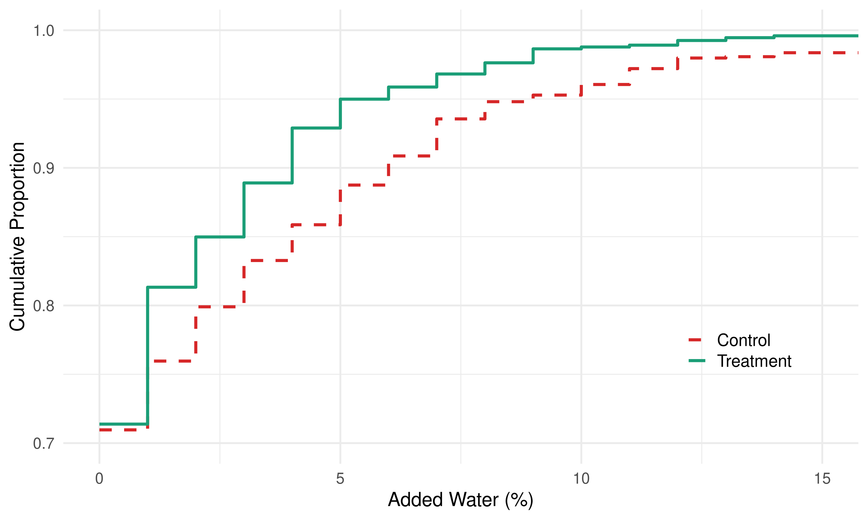
Making the floor bite: the enforcement signature
Prediction: a credible floor disciplines the lower tail, leaving clean suppliers unchanged.
Treatment CDF of added water lies above control — first-order stochastic dominance.
Serious adulteration (>5% water): 11% → 5%, roughly halved.
Median delivery: unchanged — already clean.
The threat of rejection, once toothless under noise, becomes real. The floor bites the worst adulterators.
Notes:
This CDF is the visual fingerprint of the enforcement channel. The whole treatment effect is in the right tail — the egregious adulterators — exactly what 'making the floor bite' predicts. Clean suppliers don't move.

Slide 12
What the model says is missing
Enforcement fixed the floor. To reward quality along the gradient, someone must pay a premium — and pass it up.
Can’t move α at the processor
would need to change how processors price — outside the project’s reach
So inject λα > 0 one node down
pay traders directly for verified quality at the trader–MCC interface
Test: is it passed to farmers?
observe whether traders share the bonus upstream — the pass-through margin
→
→
Notes:
Bridge to Exp 2. We can't literally raise α at the processor, so we inject the quality-linked transfer one node downstream, paying traders for verified quality. This creates a clean pass-through test: do traders share it with farmers?

Slide 13
Experiment 2: paying traders for quality
Within-MCC RCT on the Exp 1 infrastructure
19 MCCs (Kazo) where the analyzer system stayed live; 47 treated / 52 control traders, randomised within MCC.
Both arms tested + told their readings. Treated traders additionally get a cash bonus via mobile money: UGX 100/litre per 0.1pp of fat & SNF above standard.
Isolates the price incentive from the information channel.
Daily mobile-money payment + SMS → dense daily panel (5,596 submissions, 31 days).
Surprise mid-experiment threshold shift:
Stage 1 (fat ≥ 3.3%) — easy, rainy season → low q_min.
Stage 2 (fat ≥ 3.9%) — many deliveries now fail → high q_min.
Why traders?
largest unrealised quality gains sit at the trader link
creates a testable pass-through margin to farmers
~100 traders: power without 500 farmers
Notes:
Design isolates the price channel: both arms get information; only treated get money. Daily payments give a panel. The unannounced threshold increase moves the regime from intensive-margin (gradient) to extensive-margin (floor) — the model's key comparative static.

Slide 14
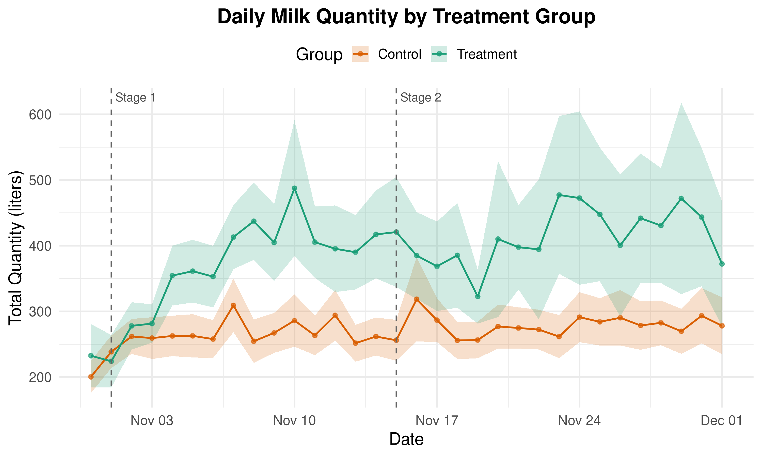
Experiment 2: traders respond on volume first
+124 L/day delivered by treated traders (~+45%).
Response is immediate and present in both stages.
When the threshold is easy to clear (Stage 1), the cheapest way to earn more bonus is to source more milk.
Volume is a low-cost margin: recruit more suppliers, collect bigger loads.
Notes:
First result of the daily panel: a large, immediate volume response sustained across both stages. Consistent with traders working the extensive margin of the bonus when quality is easy — grab volume.

Slide 15
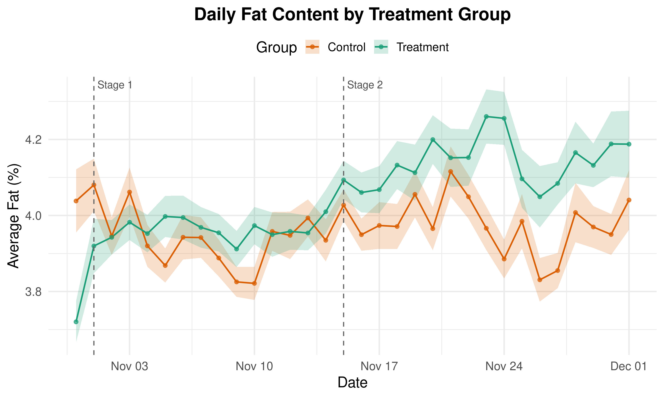
Quality responds only once the floor bites
Stage 1 (fat ≥ 3.3%): no quality response (+0.035pp, n.s.).
Stage 2 (fat ≥ 3.9%): fat jumps +0.17pp (p<0.001); SNF also rises.
The threshold, not the continuous gradient, triggers costly quality sourcing — exactly the model’s extensive-margin prediction.
Quality adjusts gradually (~1 week): re-sorting suppliers is costly and lumpy.
Notes:
Central finding. The continuous gradient — live the whole time — elicits nothing. Only when the discrete pass/fail floor rises do traders screen for quality. Discrete stakes beat smooth incentives. The ~1-week lag fits costly supplier re-sorting (and possibly loss aversion).

Slide 16
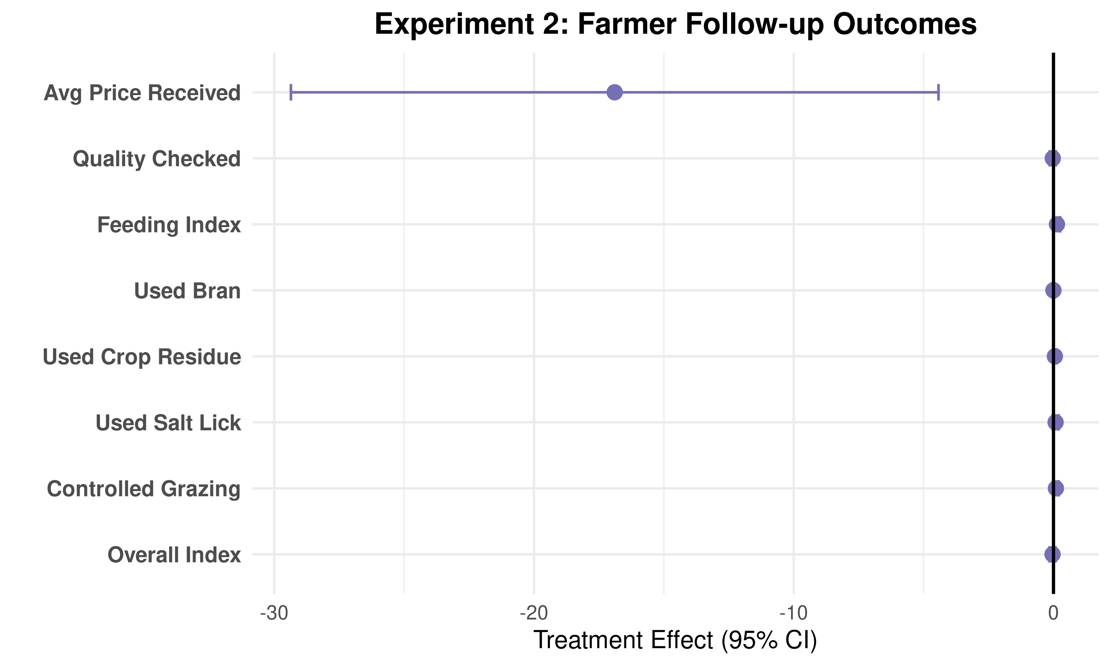
… but farmers are left out: the pass-through fails
Farm-gate price falls: −17 UGX/litre to farmers selling to treated traders (p=0.02).
Negative pass-through — the opposite of what a price channel should deliver.
Quality-checking and feeding practices: essentially null (one marginal feeding index, fails multiple-testing correction).
Trader endline survey: all null too — effects live in the daily panel, not the snapshot.
Informed intermediaries capture the surplus. The premium stops at the trader.
Notes:
The pass-through test fails — and worse, prices to farmers fall. Treated traders screen harder and capture the bonus; farmers see no gain and a price cut. Quality upgrading at the source still has no champion.

Slide 17
Conclusion: necessary, but not sufficient
Observability is necessary but not sufficient for a market for quality. Even when prices reward quality, the structure of intermediation decides who captures the returns.
Exp 1: measurement → enforcement. Quality rises (less adulteration), but no premium anywhere — processors buy flat per litre.
Exp 2: inject a premium → quality rises when the floor binds, but the surplus is retained by traders and farm-gate prices fall.
Thresholds beat gradients: discrete pass/fail signals move intermediaries facing lumpy adjustment costs; smooth gradients don’t.
Policy: measurement + pricing are complementary, not substitutes. Partial fixes leave a low-quality trap intact; pass-through to farmers needs its own instrument.
Notes:
Land the thesis: observability necessary, not sufficient. The two experiments together show a low-level equilibrium trap that single-margin interventions can't escape. Two design lessons: thresholds > gradients for intermediaries; and pass-through to farmers must be engineered, not assumed. Thank you.

