Slide 1
Are Free Testers Effective for Learning about a New Technology?
Experimental Evidence from Seed Trial Packs in Uganda and Ethiopia
Bjorn Van Campenhout, with Gashaw T Abate, Liesbeth Colen, Berber Kramer
AAEA session "Experimental evidence on accelerating agricultural technology adoption in Africa“ Tuesday July 29th from 10-11:30am

Slide 2
Motivation
Produce more with less and under increasingly challenging circumstances → A green revolution for Africa is needed
How to introduce new technologies (eg hybrid seed)? Here: provide for free/subsidized (eg starter/demo packs)
Reduce risk of trying out something new
Kick-start adoption – poverty traps argument
Positive externalities – peer learning in technology adoption

Slide 3
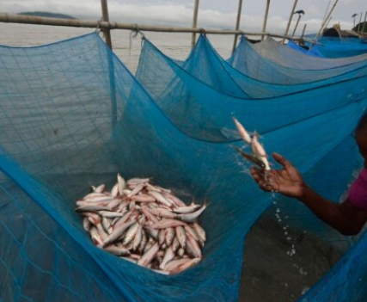
Problem with free/subsidized goods
Some argue that free goods may not be valued, result being that good remain unused, are repurposed or sold.
3 mechanisms
Screening effect: positive price only puts it in the hands of those who value it
Sunk cost effect: If I put money in it, I better use it or the money is wasted
Quality signaling effect: a higher price must mean it is better
Problem: confounded in observational data: all mechanisms imply higher price leads to higher intended use.

Slide 4
Method: three-stage pricing design
Ask farmers to buy something (farmer WTP price) and then give them a surprise discount (transaction prices):
Screening effect: look at effect of farmer WTP price on use controlling for transaction price
Sunk cost effect: look at effect of transaction price controlling for farmer WTP price
We add a third stage where we randomize the initial offer price to isolate quality signaling effect

Slide 5
Implementation
Trained enumerator offers a bag of seed for sale at initial (random) price (initial offer price).
farmer WTP price is determined through bilateral sequential bargaining:
farmer can accept (initial) offer price or not. If not, farmer is invited to name their counter bid
if difference between offer price and counter bid =< 500, sell at counter bid price
if difference between offer price and counter bid price > 500, new offer price = farmer's last counter bid price plus 80 percent of the difference between the last ask price and the farmer's last bid price – go to 1
Subgroup of farmers gets a surprise 100 % discount (unknown in advance to farmers and enumerators, leading to a transaction price)

Slide 6
Context
About 780 smallholder maize farmers in Uganda – high yielding maize seed variety
Smallholder farmers in Ethiopa
Teff seed – about 600
Wheat seed – about 400

Slide 7
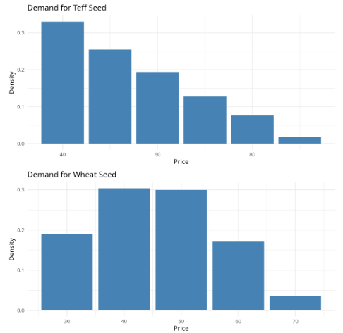
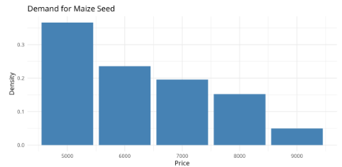
Results: price elasticity of demand

Slide 8
Results: Appropriate use
Outcome: Farmer planted seed from seed trial pack (1=yes)
 | mean | Screening | Sunk cost | Signaling | nobs
Pooled | 0 | 0.038** | -0.004 | -0.043* | 1673
 | (1) | (0.014) | (0.007) | (0.017)
Maize – UG | 0.972 | 0.006⁺ | -0.002 | -0.003 | 740
 | (0.165) | (0.003) | (0.002) | (0.005)
Teff – Eth | 0.8 | 0.038** | -0.018** | -0.039** | 554
 | (0.401) | (0.013) | (0.007) | (0.012)
Wheat - Eth | 0.684 | -0.04⁺ | 0.05** | -0.019 | 370
 | (0.465) | (0.021) | (0.01) | (0.02)

Slide 9
Results: adoption next year
Outcome: Farmer adopted seed that was in seed trial pack in the subsequent season (1=yes)
 | mean | Screening | Sunk cost | Signaling | nobs
Pooled | 0 | 0.044** | 0.007 | -0.026 | 1458
 | (1) | (0.015) | (0.011) | (0.019)
Maize – UG | 0.114 | 0.005 | 0.014 | 0.003 | 703
 | (0.318) | (0.006) | (0.024) | (0.01)
Teff – Eth | 0.339 | 0.072** | -0.013 | -0.03⁺ | 497
 | (0.474) | (0.019) | (0.009) | (0.017)
Wheat - Eth | 0.312 | 0.027 | 0.019 | -0.023 | 258
 | (0.464) | (0.028) | (0.013) | (0.027)

Slide 10
Result: Attention
Outcome: Does farmer remember the name of the seed type of the seed trial pack (1=yes)?
 | mean | Screening | Sunk cost | Signaling | nobs
Pooled | 0 | 0.055** | 0.008 | -0.03⁺ | 1673
 | (1) | (0.015) | (0.008) | (0.018)
Maize – UG | 0.772 | 0.008 | 0 | -0.022⁺ | 749
 | (0.42) | (0.008) | (0.004) | (0.013)
Teff – Eth | 0.298 | 0.049** | -0.003 | -0.021⁺ | 554
 | (0.458) | (0.014) | (0.007) | (0.012)
Wheat - Eth | 0.409 | 0.52* | 0.015 | -0.017 | 370
 | (0.492) | (0.025) | (0.012) | (0.024)

Slide 11
Results: Complementary Inputs
Outcome: Does farmer use fertilizer on randomly selected plot (1=yes)?
 | mean | Screening | Sunk cost | Signaling | nobs
Pooled | 0 | 0.04* | -0.019* | -0.006 | 1483
 | (1) | (0.016) | (0.008) | (0.019)
Maize – UG | 0.546 | 0.029** | -0.015** | 0.001 | 728
 | (0.498) | (0.009) | (0.005) | (0.015)
Teff – Eth | 0.982 | -0.003 | 0.002 | 0.002 | 497
 | (0.134) | (0.005) | (0.002) | (0.004)
Wheat - Eth | 0.997 | 0 | -0.001 | -0.001 | 258
 | (0.058) | (0.004) | (0.002) | (0.004)

Slide 12
Conclusion & Policy Recommendations
Overall, we find positive screening effects, no/negative sunk cost effects and no/negative signaling effects – so: free, subsidized or full price?
Positive screening effects suggests some level of targeting (a small symbolic price) may be useful.
No sunk cost effect or negative (crowding out complementary inputs in liquidity constrained situations) – free is best
No evidence of a price signaling or negative (farmers side selling if the believe seed is of exceptional quality) – fee is best

