Slide 1



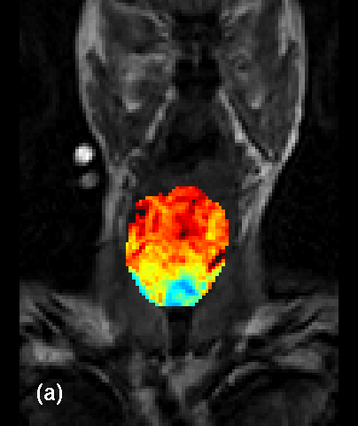
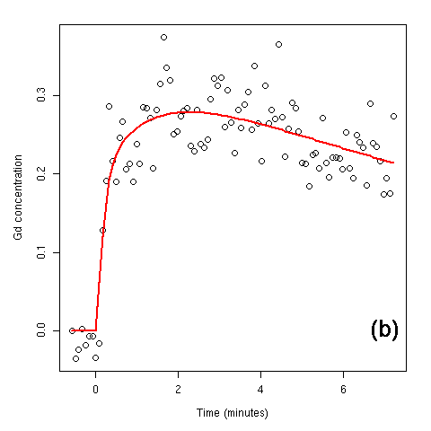
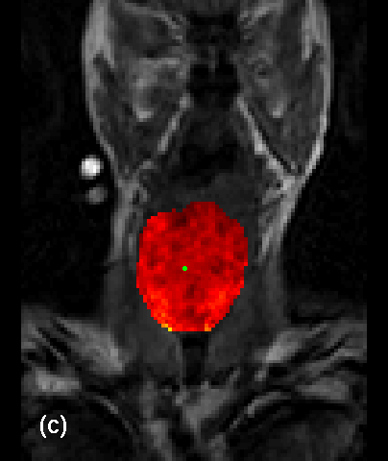
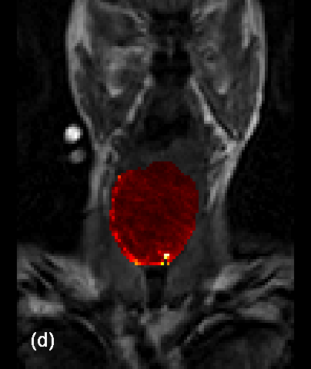
dcemri: R package for medical image analysis
Brandon Whitcher
Clinical Imaging Centre
GlaxoSmithKline, London, UK
Andrew Thornton
Department of Medicine
Cardiff University, UK
Volker J Schmid
Department of Statistics
Ludwig-Maximilians-University Munich, Germany
INTRODUCTION
dcemri is a package, written in the R programming environment, for the quantitative analysis of dynamic contrast-enhanced MRI (DCE-MRI) and diffusion-weighted imaging (DWI) for oncology applications. It has been released under the BSD license.
Quantitative analysis of perfusion imaging using dynamic contrast-enhanced MRI (DCE-MRI) is achieved through a series of processing steps, starting with the raw data acquired from the MRI scanner, and involves a combination of physics, mathematics, engineering and statistics. The dcemri package provides a collection of functions that move the experimental data through all steps of the data analysis pipeline using standard data formats that may be visualized and manipulated across a wide variety of software packages.
DESIGN
A major improvement in the dcemri package is the fact that standard medical imaging formats are stored in unique classes under an object-oriented programming (OOP) system. Essentially, NIfTI and Analyze data are stored as multi-dimensional arrays with extra slots created that capture all format-specific header information. The NIfTI class also has the ability to read and write extensions that conform to the data format standard. Customized printing and validity-checking functions are available to the user and every attempt has been made to ensure that the information from the multi-dimensional array is in agreement with the endogenous header values. An “audit trail” is turned on by default, such that all operations performed on the data are recorded in XML format. When estimating parameters based on input data, the audit trail is inherited from data set to results so that transparency in the data analysis pipeline is achieved. The audit trail is converted to a text string and stored as a NIfTI extension when any NIfTI class object is written to disk .
FUNCTIONALITY
Motion Correction and Co-registration
Basic motion correction within an acquisition, and co-registration between acquired series, is available using template matching. A reference volume must be pre-specified where a mask has been applied to remove all voxel that should not be included in the algorithm. So far, only three-dimensional translations are allowed and no interpolation is used (i.e., only whole-voxel translations) at this time.
T1 Relaxation and
Gadolinium Concentration
Estimation of the tissue T1 relaxation rate is the first step in converting signal intensity, obtained in the dynamic acquisition of the DCE-MRI protocol, to contrast agent concentration (Collins and Padhani, 2004).
Currently curve-fitting methods for two popular acquisition schemes „Inversion recovery“ and „Multiple flip angles“ are available in dcemri.
Once the tissue T1 relaxation rate has been estimated, the dynamic acquisition is then converted to contrast agent concentration. The B1 field is assumed to be constant (and accurate) when using multiple flip angles to estimate T1. At higher fields strengths (e.g., 3T) the B1 field should be estimated in order to correct the prescribed flip angles (see Cunningham et al. 2005).
Arterial Input Function
Whereas quantitative PET studies routinely perform arterial cannulation on the subject in order to characterize the arterial input function (AIF), it has been common to use literature-based AIFs in the DCE-MRI literature. Examples include Tofts and Kermode (1991) and Fritz-Hansen et al. (1996)
There has been progress in measuring the AIF using the dynamic acquisition and fitting a parametric model to the observations. Recent models include Parker et al. (2006) and Orton et al. (2008).
dcemri has incorporated all parametric models given above for the AIF - except Parker et al. - into the kinetic parameter estimation step. While default values for each model are provided, there is also the ability to include user-specified parameters.
Kinetic Parameter Estimation
The standard Kety model, a single-compartment model, or the extended Kety model, the standard Kety model with an extra “vascular” term, form the collection of basic parametric models one can apply using dcemri (see Schmid 2010).
Regardless of which parametric model is chosen for the biological system, the contrast agent concentration curve at each voxel in the region of interest (ROI) is approximated using the convolution of an arterial input function (AIF) and the standard/extended Kety model.
Parameter estimation is achieved using one of four options in the current version of dcemri:
  Non-linear regression using Levenberg-Marquardt‘s non-linear least squares algorithm (dcemri.lm), see Ahearn et al. (2005),
  Bayesian regression using Markov chain Monte Carlo (MCMC) simulation (dcemri.bayes), see Schmid, Whitcher et al. (2006),
  Bayesian regression using maximum a posteriori (dcemri.map)
  Non-linear regression after combined de-noising and de-convolution using Bayesian P-Splines (dcemri.spline), see Schmid, Whitcher, Yang (2009)
When using MCMC simulation all samples from the joint posterior distribution are also provided, allowing one to interrogate the empirical posterior probability density function of the parameter estimates.
Statistical Inference
No specific support is provided for hypothesis testing in dcemri. We recommend one uses builtin facilities in R to perform ANOVA or mixed-effects models based on statistical summaries of the kinetic parameters over the ROI per subject per visit. An alternative to this traditional approach is to analyze an entire study using a Bayesian hierarchical model (BHM) in PILFER (see Schmid, Whitcher et al. 2009).
EXAMPLES
Examples from various stages of the data analysis pipeline for a DCE-MRI acquisition are provided in Figure 1. From left-to-right, the T1 estimation is performed on a voxel-by-voxel basis and displayed for the pre-defined ROI; observed dynamic contrast agent concentration at a specific voxel with fitted values from compartmental model; K^{trans} estimates using voxel-by-voxel Bayesian estimation; widths of the Bayesian credible intervals for K^{trans}.
REFERENCES
T.Ahearn et al. The use of the Levenberg-Marquardt curve-fitting algorithm in pharmacokinetic modelling of DCE-MRI. Phys Med Biol, 50 N85-N92, 2005.
D.J.Collins, A.R.Padhani. Dynamic magnetic resonance imaging of tumor perfusion. IEEE Eng Med Biol, 23(5) 65-83, 2004
C.Cunningham, J.Pauly, and K.Nayak. Saturated double-angle method for rapid B1+ mapping. Magn Reson Med, 55(6) 1326-33, 2006.
T.Fritz-Hansen et al. Measurement of the arterial concentration of Gd-DTPA using MRI: A step toward quantitative perfusion imaging. Magn Reson Med 36(2) 225-231, 2005
M.R.Orton et al. Computationally efficient vascular input function models for quantitative kinetic modelling using DCE-MRI. PhysMedBiol, 53(5) 1225-39, 2008.
G.Parker, et al. Experimentally-derived functional form for a population-averaged high-temporal-resolution arterial input function for DCE-MRI. Magn Res Med, 56(5) 993-1000
V.J.Schmid, B.Whitcher, et al. Bayesian methods for pharmacokinetic models in dynamic contrast-enhanced MRI. IEEE Trans Med Imag, 25(12) 1627-1636, 2006.
V.J.Schmid, B.Whitcher, G.Z.Yang. Quantitative analysis of DCE-MR images based on Bayesian P-Splines. IEEE Trans Med Imag, 28(6):789-798, 2009a.
V.J.Schmid, B.Whitcher, et al., A Bayesian Hierarchical Model for the Analysis of a Longitudinal DCE- MRI Oncology Study, Magn Reson Med, 61 (1) 163-174, 2009.
V.J.Schmid. Kinetic Models for Cancer Imaging. In: H.R. Arabnia: Advances in Computational Biology. Heidelberg: Springer, 2010.
P.Tofts, A.G.Kermode. Measurement of the blood-brain barrier permeability and leakage space using dynamic MR imaging. MagnResMed, 17(2) 357-367, 1991

