Slide 1


Water Supply Forecasting Basics

Slide 2
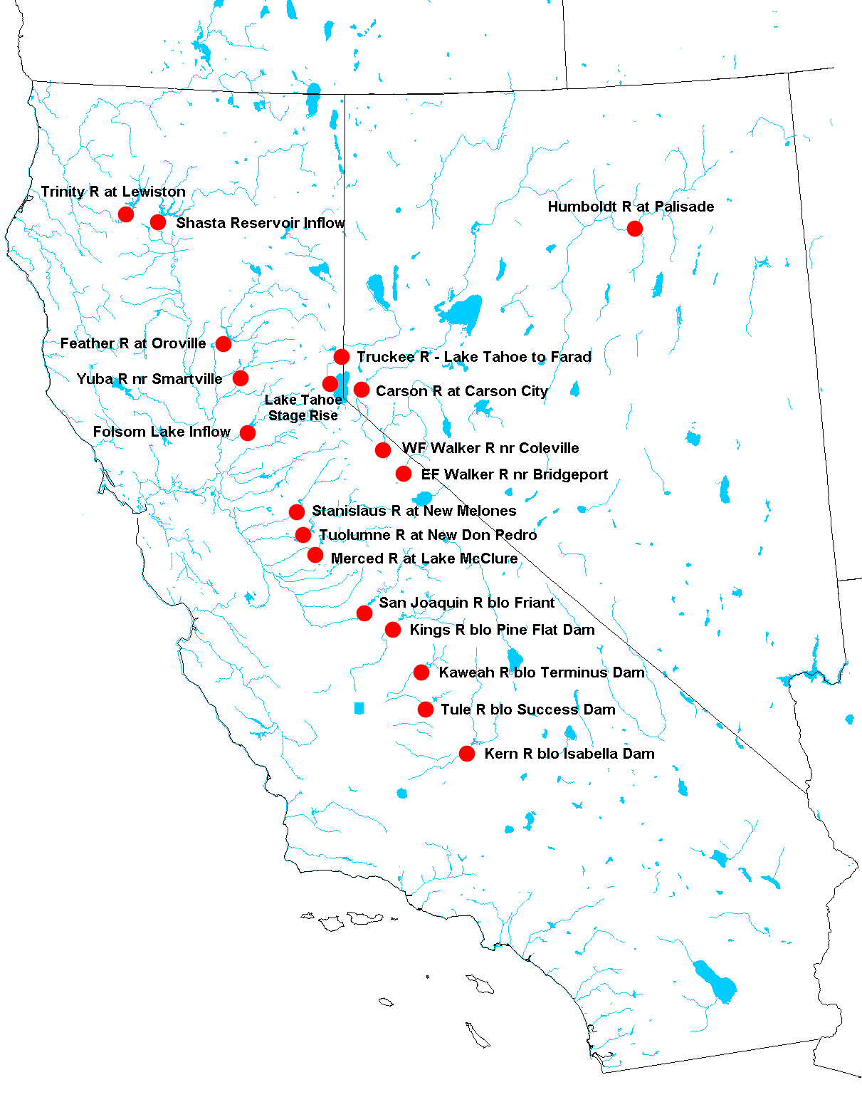
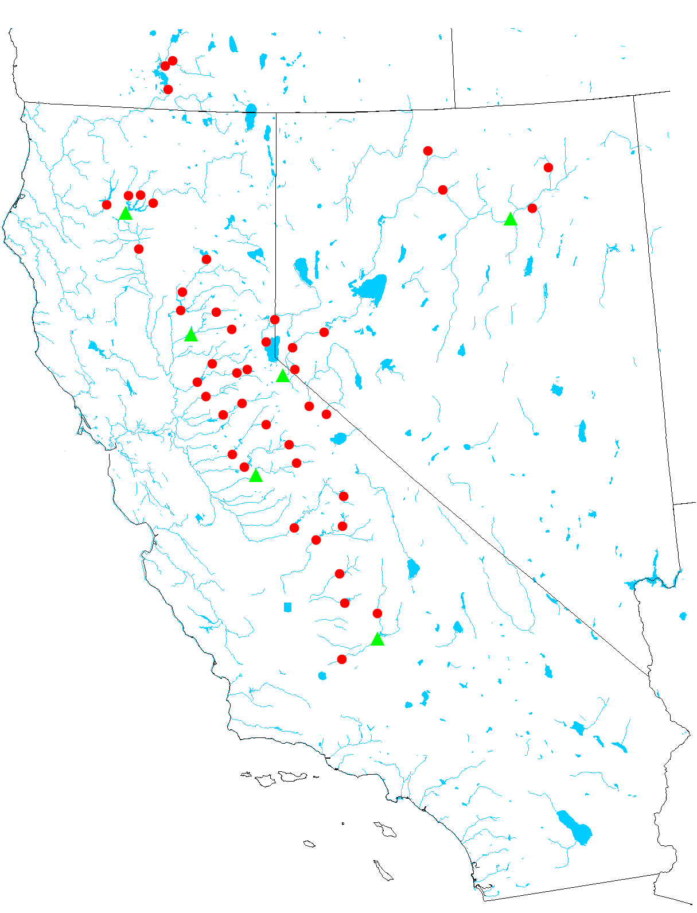
Water Supply Forecast Locations
Snowmelt Runoff Points
Water Supply Forecast Points

Slide 3
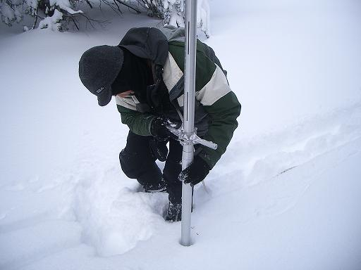
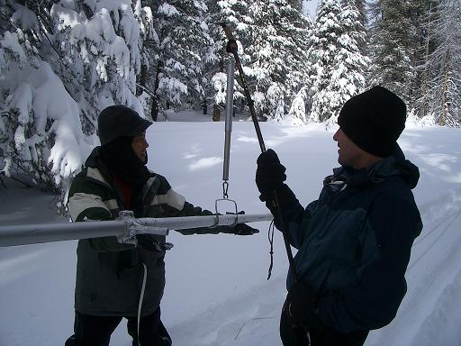
How is data collected?
Manual Snow Surveys
  Conducted within 10 day window surrounding the first of month
  Conducted January thru May – varies per snow course
  Inclement weather Can Effect the collection
  DWR Staff: Frank Gehrke, John King, Rick Louie & Kenny Karcher
  Many others from many other agencies statewide

Slide 4
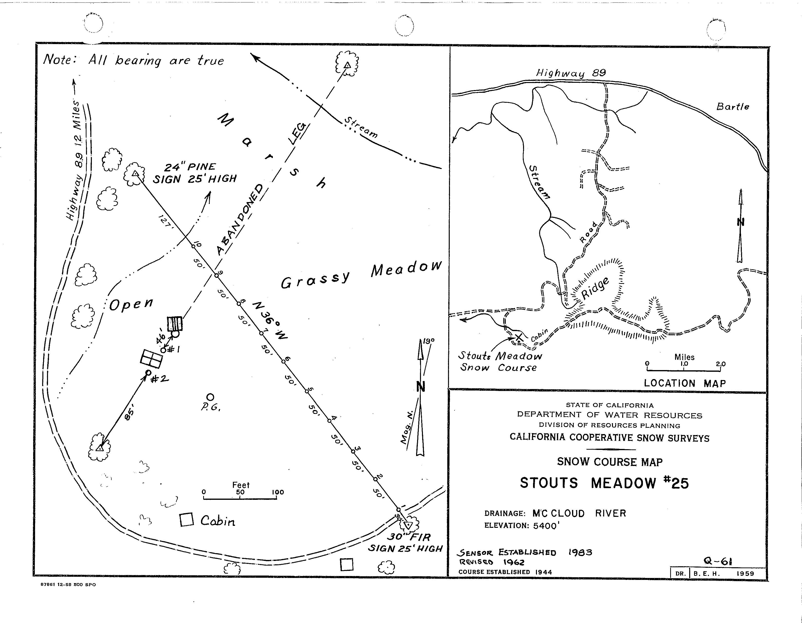
Manual Snow Survey
Example Snow Course
Stouts Meadow
McCloud River Basin
Measured across a transect
Precise measuring points on transect
Same points measured each month
Allows for comparisons from month to month
Long Term Averages

Slide 5
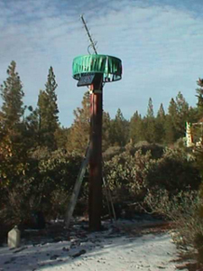
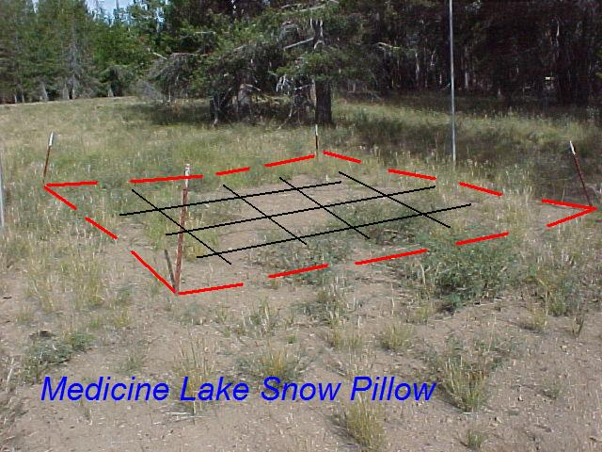
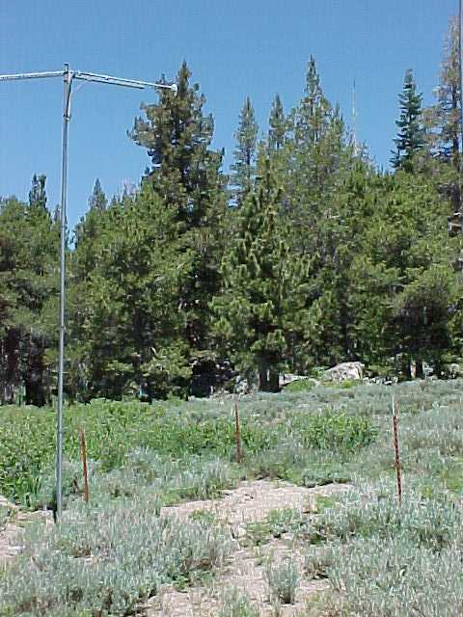
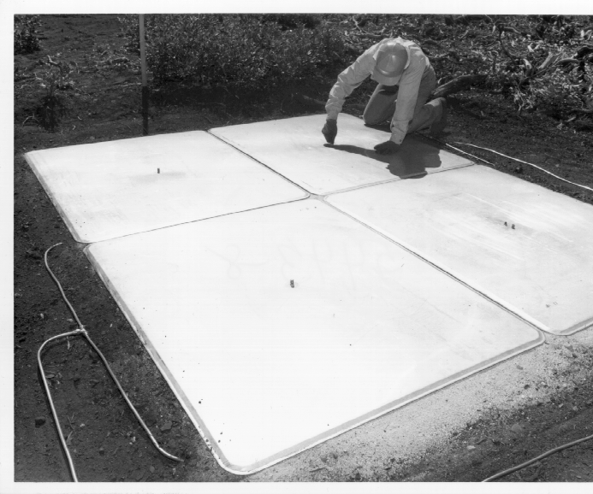
How is data collected?
Other Methods
Rain Gage
SNOW PILLOWS
Snow Depth Gage

Slide 6
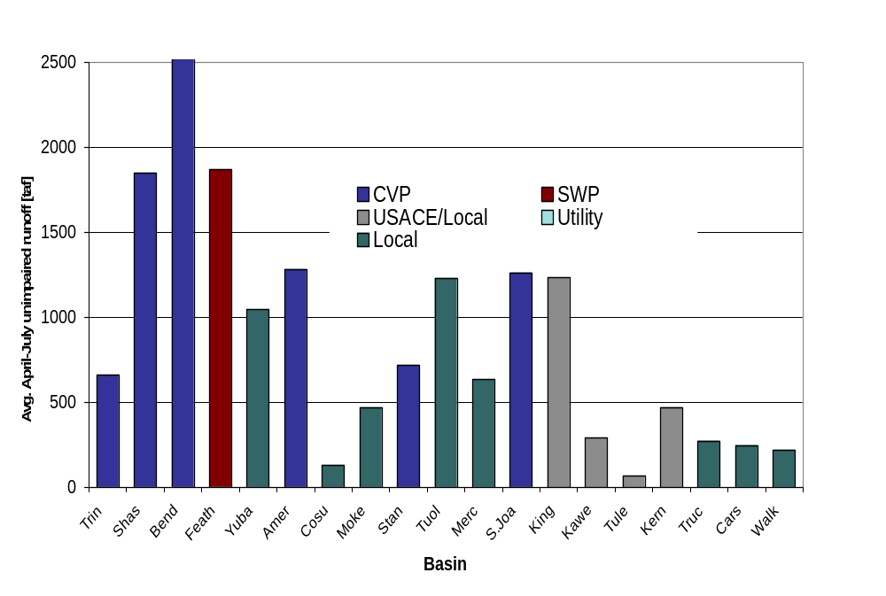
Water Supply Forecast Basins
Primary Interest

Slide 7

Where Does the Data Come From?
National Weather Service Offices
US Bureau of Reclamation
US Army Corps of Engineers
California State Water Project
US Geological Survey
National Park Service
US Forest Service
Natural Resources Conservation Service
City and County Water/Flood Control Departments and Districts
General Public – NWS weather observers
Public/Private Utilities
Irrigation Districts

Slide 8
Water Supply Forecasting Products

Slide 9
Two Basic Water Supply Products
Bulletin 120 – Seasonal runoff forecast which highlights the April – July runoff.
Water Supply Index – Water Year Classification product used to determine the Water Year Type.

Slide 10
Snow Surveys Water Supply Forecast Products
Seasonal … … …
Monthly Bulletin 120 A-J Runoff Forecasts (Feb – May)
Weekly Bulletin 120 Updates (Feb – June)
Spring Snow Melt Forecasts (April – June)
Sacramento River Accretions (Oct – May)
… … … … Water Year
Sacramento River Water Supply Index
(SRR and SVI) (Oct-May)
San Joaquin River Water Supply Index
(SJI) (Oct-May)

Slide 11
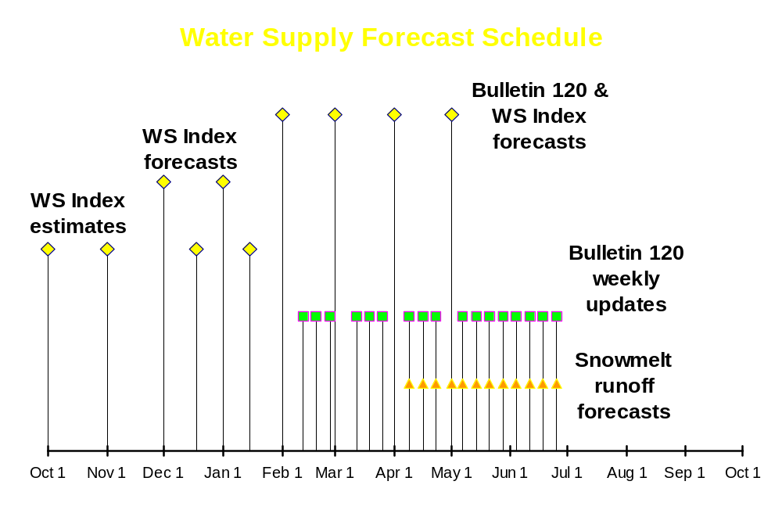

Slide 12
Water Supply Index (WSI)

Slide 13

Water Supply Index (WSI)
Monthly Updates published October thru May
Bi-Weekly Updates available by request after Nov. 1 (used for “in house” distribution)
  WSI procedures are not currently set up for mid-month updates
Regional forecasts are made for:
  Sacramento River Basin Runoff (SRR): Sum of unimpaired flows for Sacramento River at Bend Bridge, Feather, Yuba, and American Rivers
  Sacramento Valley Index (SVI): Water year type index determined with 40% current A-J runoff, 30% Oct-Mar runoff, 30% previous year’s index (where runoff is SRR sum as above)
  San Joaquin Valley Index (SJI): Water Year type index for Stanislaus, Tuolumne, Merced, and San Joaquin Rivers but with 60-20-20 breakdown

Slide 14
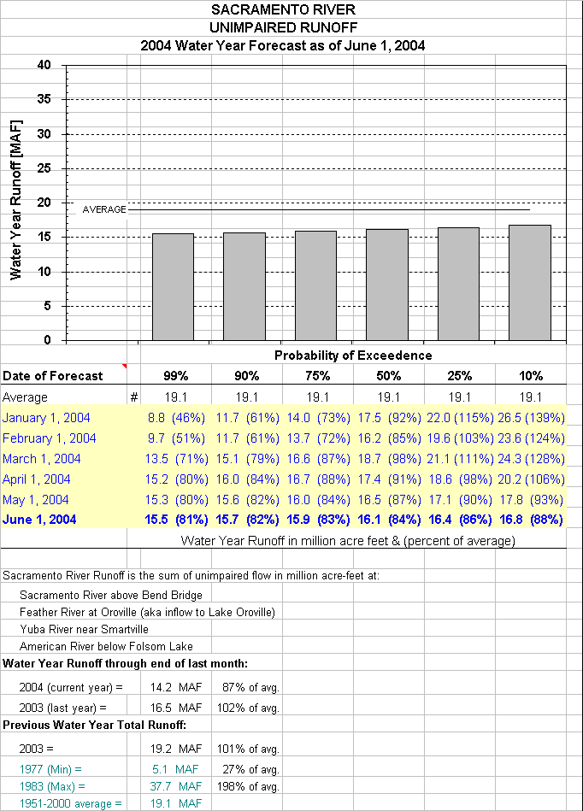
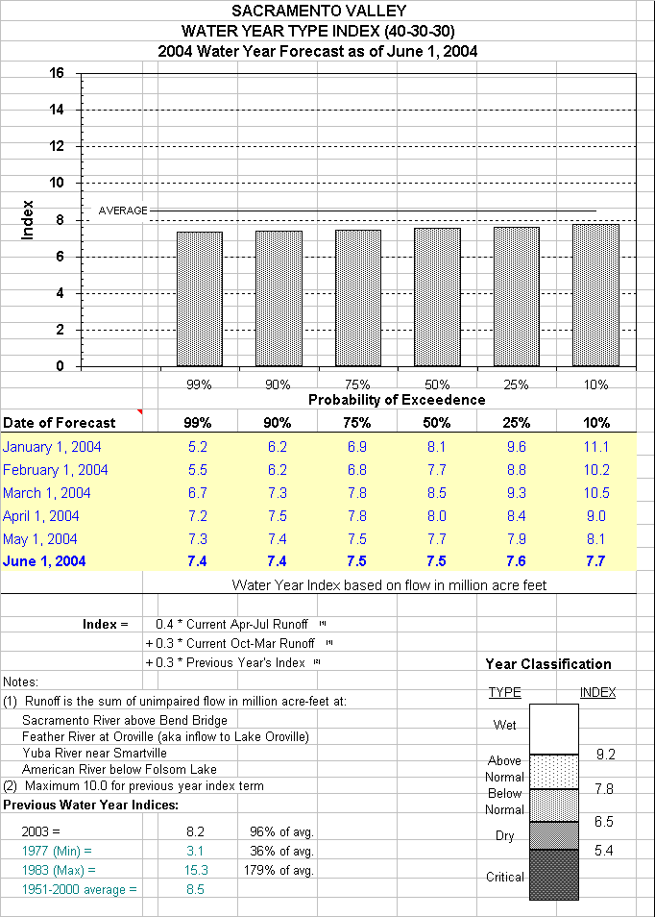
Water Supply Index (WSI)

Slide 15
Bulletin 120

Slide 16
BULLETIN 120 – Water Conditions in California
Monthly Bulletins published February thru May
Weekly Updates published February thru June
B120 uses regression equations to determine April thru July runoff forecasts for statewide river basins
Regression Formula variables include:
  October – March Precipitation Index
  April – July Precipitation Index
  High and Low Snow Indicies
  Previous fall and spring runoff
  50 year historic database (1951-2000)

Slide 17
BULLETIN 120 – Continued
Statewide forecasts are made for:
  North Coast Region: Trinity, Scott, and Klamath Rivers
  Sacramento River Basin: Lake Shasta Tributaries, Sacramento River at Bend Bridge, Feather, Yuba, and American Rivers
  San Joaquin River Basin: Cosumnes, Mokelumne, Stanislaus, Tuolumne, Merced, and San Joaquin Rivers
  Tulare Lake Region: Kings, Kaweah, Tule, and Kern Rivers
  East Sierra Drainage: Truckee, Carson, Walker, and Owens Rivers
Monthly forecasts are compared with NWS-CNRFC forecasts for both confidence and agreement
B120 Procedures are considered our best procedures

Slide 18
BULLETIN 120 – Continued
Other information published in Bulletin 120
  Historical max., min., and averages for each forecast point
  80% probability spread
  Water year unimpaired runoff forecasts for main valley streams
  Regional hydrologic summaries
  Statewide precipitation and snowpack conditions
  Major water project reservoir storage conditions
  Contact information for Snow Surveys staff

Slide 19
BULLETIN 120 – Regression Formula variables
Regression Formula variables include:
  October – March Precipitation Index
  April – July Precipitation Index
  High and Low Snow Indicies
  Previous fall and spring runoff
  50 year historic database (1951-2000)

Slide 20
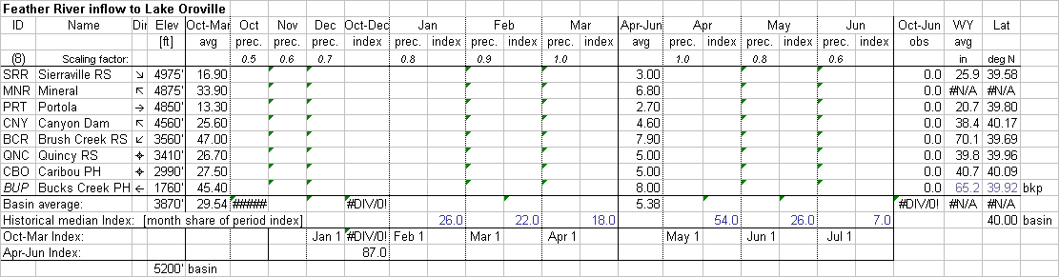
Precipitation Index Calculations
The precipitation variables of the regression equation are determined by calculating a precipitation index based on yearly and monthly averages over a mix of stations representing the basin.

Slide 21
Precipitation Index Issues
Issues:
  Precipitation station mix may be limited
    May have elevation or east-west bias
    May have out of basin station bias
  Data Collection may not be thorough
    Missing stations cause unintentional biases
Resolution:
  Use computation techniques to estimate precipitation at unaccounted for elevations or latitudes
  Use alternate stations to help estimate missing data

Slide 22
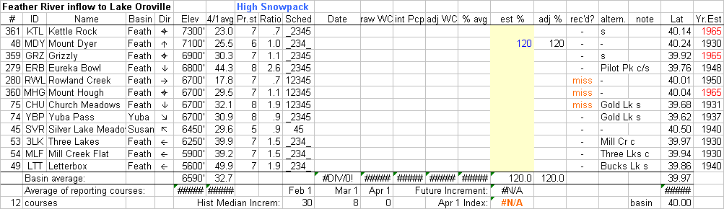
Snow Index Calculations
Similarly, the snow pack variables of the regression equation are determined by calculating a snow index based on yearly and monthly averages over a mix of stations representing the basin. In some cases, the basin is split into a high elevation and low elevation snow pack index to give ultimate consideration of basin snow.

Slide 23
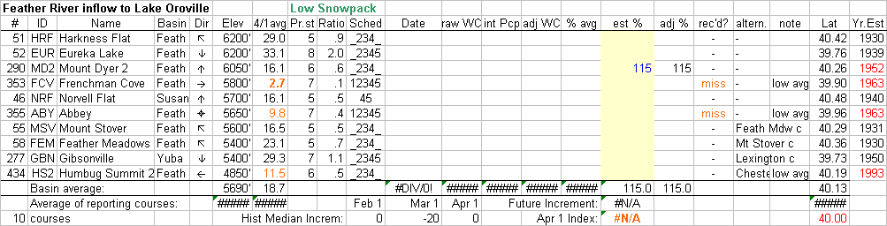
Snow Index Calculations – Low Elevation Index
Feather River inflow to Lake Oroville Low Elevation Snow Index

Slide 24
Snow Index Issues
Issues:
  Snow course mix may be limited
    May have elevation or east-west bias
    May have out of basin station bias
    Budget cuts have worsened these concerns
  Data Collection may not be thorough or have quality assurance
    Missing stations cause unintentional biases
    Lack of quality snow course measurements requires alternate source data or re-measurement
    IRONICALLY, harsh weather will often delay or prohibit data collection
    Relying on snow pillows is not as good as manual snow course measurements

Slide 25
Runoff Data Issues
Full Natural Flow (FNF)
  146 terms needed to complete FNF calculations
  25 sources of FNF data
  Some flow values are estimated based on historical records
  FNF calculations need to be done by third business day in order to have Water Supply Forecast products available as promised.
  Timeliness of data is crucial
  Data must be reviewed often because it is practice to receive estimates which are later revised
  Revised data has impacts on forecast assumptions

Slide 26
Example Regression Equation – Feather River at Oroville
Regression Equation:
  Developed 1989
  One of three available for comparison
  Additional May 1 equation compiled for use if necessary (for extreme cases)
  Variables Used:
    R = Oct-Mar runoff
    S_{h} = High Snow Pack
    S_{L} = Low Snow Pack
    P_{o} = Oct – March Precipitation
    P_{s} = April – July Precipitation
    Constant

Slide 27
Example Regression Equation – Feather River at Oroville
Regression Equation:
TOP
SECRET

Slide 28
Example Regression Equation – Feather River at Oroville
Regression Equation:
-0.0798R + 0.02236S_{h}² + 5.216S_{l} + 14.295P_{o} + 0.0231P_{s}² – 395.3 =
Feather River at Oroville April – July runoff.
Really!
Fact: The regression equations used by Snow Surveys were adopted from the UCLA Medical Center Multi-Linear Regression program by Stein Buer.
Fiction: Dave knows all of them like the back of his hand!
Future: A goal of Snow Surveys staff is to ultimately develop new regression equations based on updated historical data periods.

Slide 29
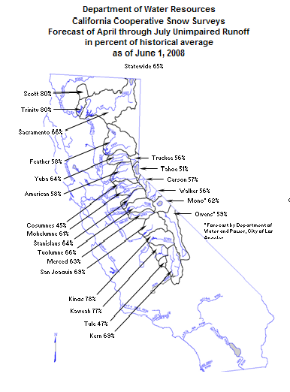
Bulletin 120

