Slide 1
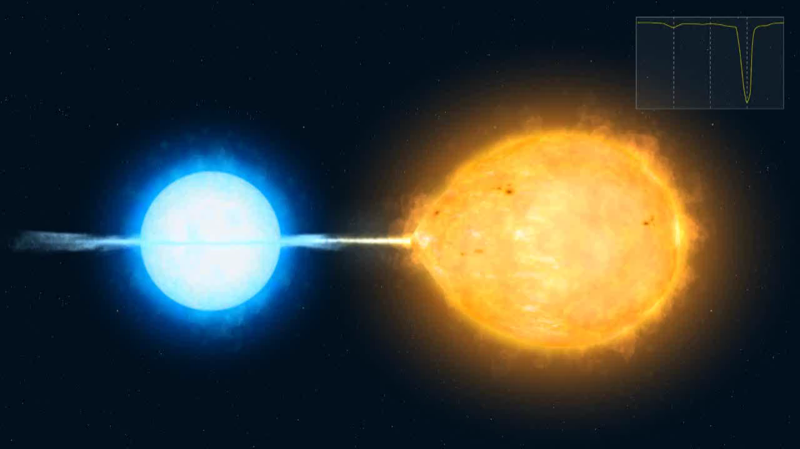
Eclipsing Binaries (EBs)
Max Moe (Einstein Postdoctoral Fellow - Steward Observatory)
Arizona Robotic Telescope Network Workshop - January 18, 2018

Slide 2
EB Surveys
Recent:
Kepler: 2,900 EBs (Kirk+2016)
OGLE: Magellanic Clouds - 49,000 EBs (Pawlak+ 2016);
Galactic Bulge - 451,000 EBs (Soszynski+ 2017)
Current/Upcoming:
Gaia: ~5 million EBs (Eyer+ 2015)
LSST: ~24 million EBs (Prsa+ 2011)
VARiability Survey of the TriAngulum GAlaxy (VARSTAGA):
• 200 1-hour epochs with Bok 90Prime (30% complete)
• 2 epochs per quarter-night (45% in i & g each, 5% in u and r each)
• 15 dithered 4-min exposures (fill in chip gaps; correct for i-band fringing)
• precision of σ ≲ 0.02 mag at ~22 mag per epoch
• ~10,000 massive EBs
1.3m Warsaw Telescope

Slide 3
Science with EBs
• Fundamental stellar main-sequence (MS) mass-luminosity-radius relations
• Pre-MS evolutionary tracks (Torres+ 2010)
• Most accurate distances to local group galaxies (Pietrzynski+2013),
anchoring cosmological distance scale, H_{o}, and w (Riess+ 2016)
• Tidal evolution (Moe & Di Stefano 2015b)
• Close Binary Statistics (F_{close} ∝ M₁^{0.7}; Moe & Di Stefano 2013, 2017)
• Stable mass transfer (Algols; Van Rensbergen+ 2010)
• Triples w/ eclipse timing variations (Borkovits+ 2016)
• Unique phases of formation & evolution:
- White dwarf + M-dwarf (HW Vir; Lee+ 2009)
- Cool disk (ε Aur; Kloppenborg+ 2010)
- MS + pre-MS (Moe & Di Stefano 2015a)

Slide 4
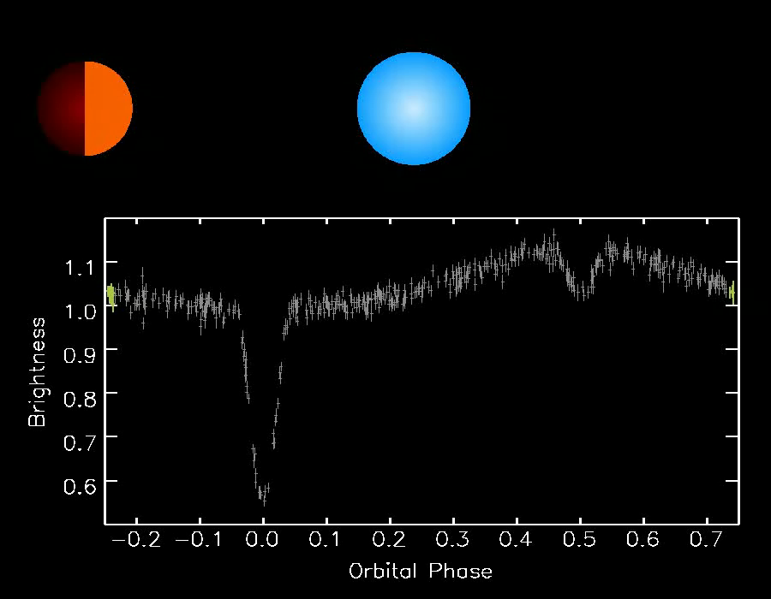
A New Class of Nascent EBs with Extreme Mass Ratios (Moe & Di Stefano 2015a)
Discovered 18 MS + pre-MS EBs with reflection effects:
M₁ = 6 - 20 M☉, M₂ = 0.8 - 2.4 M☉ (q = 0.06 - 0.3), & 𝜏 = 0.6 - 8 Myr.
P = 3 - 8 days
R₁ = 4 - 5 R
R₂ = 2 - 4 R
T₁ = 20,000 - 30,000 K
T₂ = 4,000 - 7,000 K
Extreme mass-ratio binaries (q < 0.2) are the progenitors of
low-mass X-ray binaries and certain types of Type Ia supernovae

Slide 5
Observational Requirements
Discovery Surveys:
• 50 - 500 epochs (single or multi-band)
• Logarithmic cadence (daily - annual)
• For crowded fields, need good seeing / focus across full FOV
(VARSTAGA: rejecting ~20% of nights with >2.0” seeing at Bok 90Prime)
• Dithered exposures (fill in chip gaps & bad pixels; correct for fringing)
Follow-up (e.g., of Gaia and LSST EBs):
• Different bands
• Better sensitivity
• Higher cadence, esp. at particular orbital phase (given known P and t₀)

