Slide 1
Bugzilla – New Status Workflow by Klaus Smolin
6/1/2016
May 2016

Slide 2
Current Bugzilla Status Definition
The following Bug Status definition is currently used in the zFrobisher Bugzilla Vendor:
  OPEN - new bug; needs screening
  ASSIGNED - screening done; assigned an owner, owner acknowledges the bug and is working/investigating
  FIXEDAWAITINGTEST - the fix was included in a the released minor/major driver
  TESTED - proposed fix confirmed to work
  SUBMITTED - Used only for bugs in „Service-Mode“
  ACCEPTED - Not used
  CLOSED - We're done. Problem is solved.
  REJECTED - Defect is rejected
  NEEDINFO - Additional information is required

Slide 3
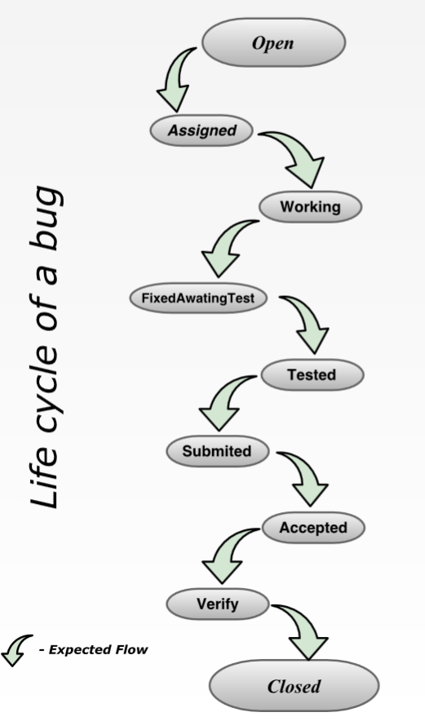
New Bugzilla Workflow
A new Status Worklflow is available since end of April in the Bugzilla Tool
New Status states:
  Working
  Verify
This is available in all IBM Bugzilla projects !

Slide 4
Changes to the current process – proposal
The following Bug Status definition could be used for zFrobisher Development Bugzillas,
if agreed.
  We use the status „Verify“ instead of „FIXAWAITINGTEST“,
  when a fix is included in a the released minor/major driver.
  The test teams from Holger and Scott start to verify a defect, only if it is in „VERIFY“.
  This is a „easy“ process change,
  but would give us the possibility to use all other Status values like „ASSIGNED“, „WORKING“, FIXAWAITINGTEST“, TESTED“ and „SUBMITTED“ to define the status of a given Bug in more details.
No change for „Service Mode“ (But, it need to be verified with the Service Team)
  We will still use the status „SUBMITTED“ and clone the defect to the Service Bugzilla Vendor, if a fix is availabe for a given Fix-Pack.

Slide 5
Changes to the current process – proposal
The following Bug Status definition could be used for zFrobisher Bugzillas, if agreed:
  OPEN - new bug; needs screening
  ASSIGNED - screening done; assigned an owner, owner agreed
  WORKING - owner acknowledges bug and is working / investigating
  FIXEDAWAITINGTEST - proposed fix needs testing by development
  TESTED - proposed fix confirmed to work by development
  SUBMITTED - fix added to source code repository;
  or fix is attached to the Bugzilla;
  ACCEPTED - will not be used..
  But, we could use is in the future to review
  all submitted patches.
  VERIFY - Fix is included to the build (driver);
  needs to be verified by test team
  CLOSED - We're done. Problem is solved.

Slide 6
Key Changes to the current process – proposal
A developer set the defect status from „ASSIGNED“ to „WORKING“,
when he startes to work on the defect.
A developer set the defect status to „SUBMITTED“ when the fix is available.
The driver build team set the defect to „VERIFY“ when the fix is included in a driver.
The test teams start to verify the defect and set the status to „CLOSED“,
if it works as expected.

