Slide 1
Linux内核最新进展
海航云资深架构师张健

Slide 2

Outline
Who I am
Who writes the Linux kernel
Live with upstream kernel
Architecture relative features
Memory features
Staging features: ILP32

Slide 3

Who I am?
Linux kernel developer
Distributed storage developer
Open source lover
Notes:
TODO 添加共享的社区

Slide 4
Live with upstream kernel
Why
Minimize migration effort
Collaborate with community
How
Mailing list
IRC(e.g. irccloud)
Conference
What
Feature
Pull request
Commit message
Code
Notes:
Mailing list
Conference

Slide 5
Live with upstream kernel
kernel newbie: https://kernelnewbies.org/Linux_4.16
LWN: merge window
4.16 Part1: https://lwn.net/Articles/746129/
4.16 Part2: https://lwn.net/Articles/746791/
4.17 Part1: https://lwn.net/Articles/750928/
4.17 Part2: https://lwn.net/Articles/751482/
Kernel mailing list
Git merge log

Slide 6
Who writes the Linux kernel?

Slide 7
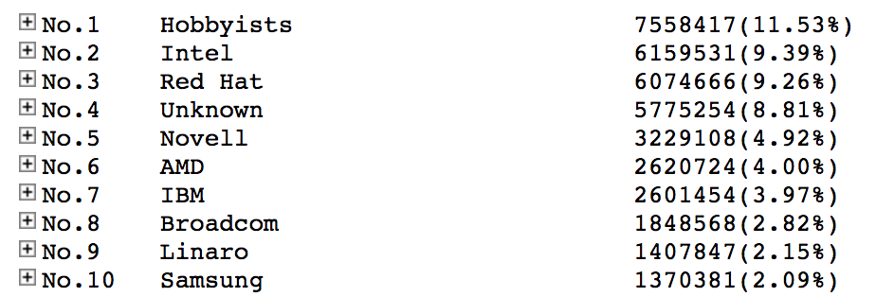
Who writes the Linux kernel
ref: http://www.remword.com/kps_result/all_whole_line.htm

Slide 8
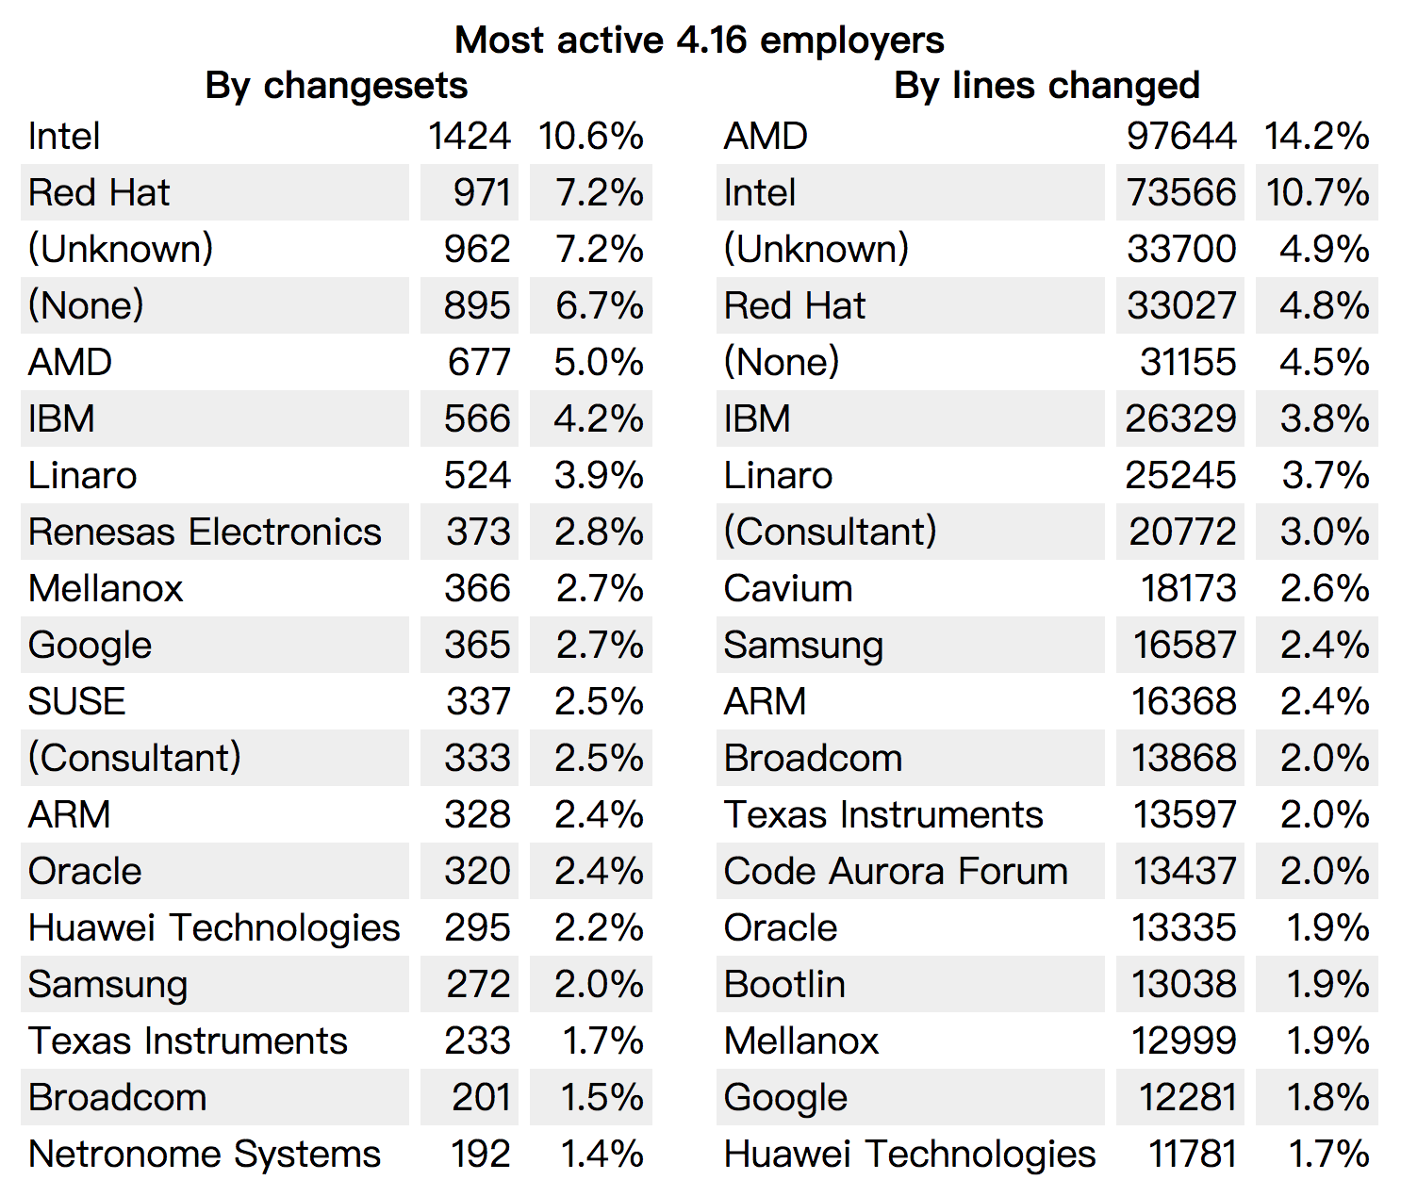
Who writes the Linux kernel
ref: https://lwn.net/Articles/750054/

Slide 9
Meltdown and Spectre
ISA and side-channel attack
Upstream status
Ref: google I/O 1’31’’: https://mp.weixin.qq.com/s/bUVQVk3W6BM4WNNbFnJ4HQ

Slide 10
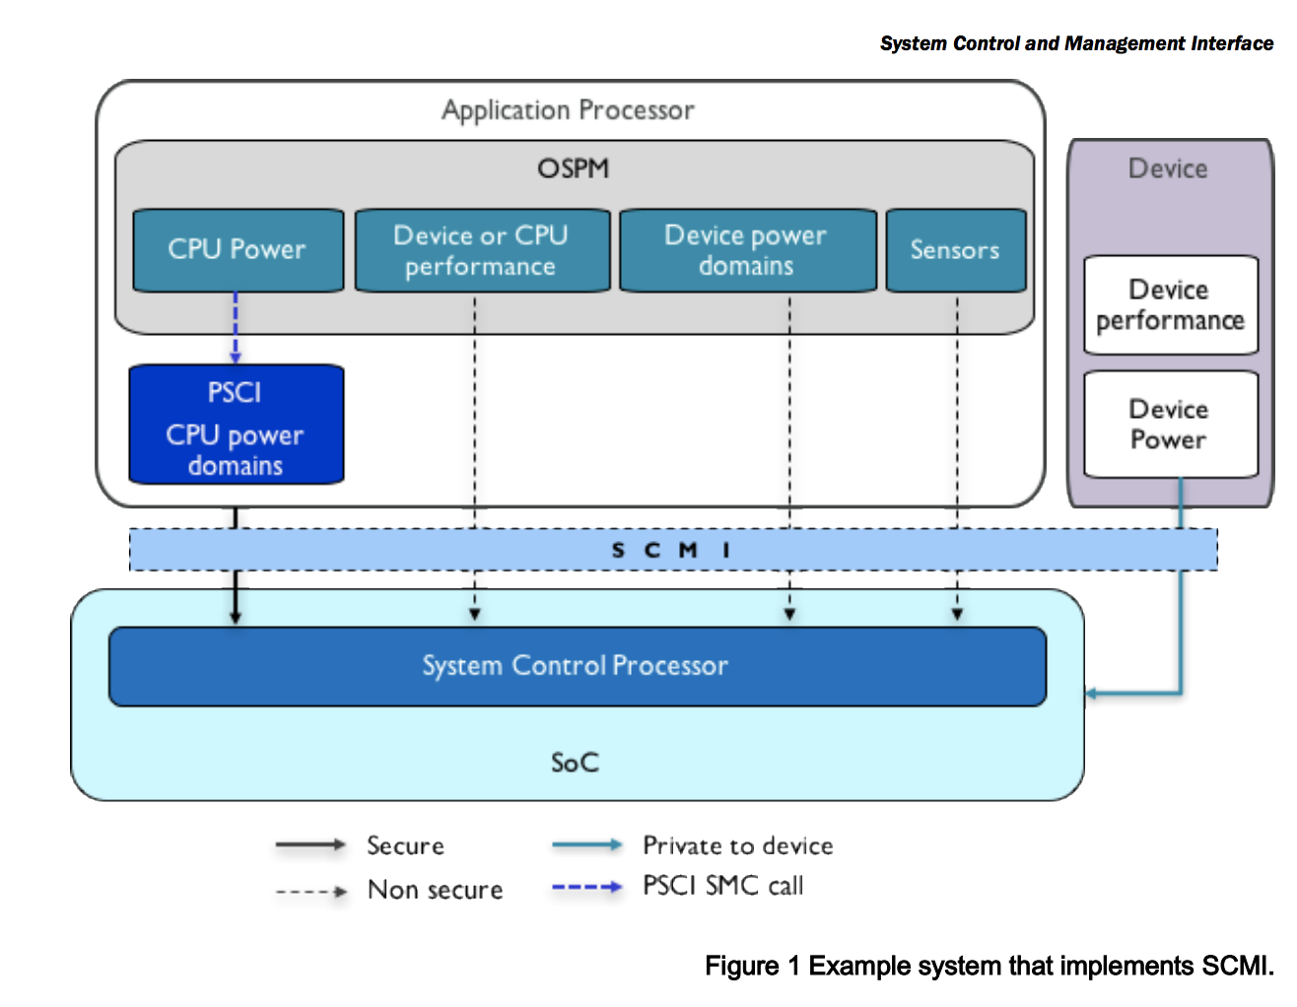
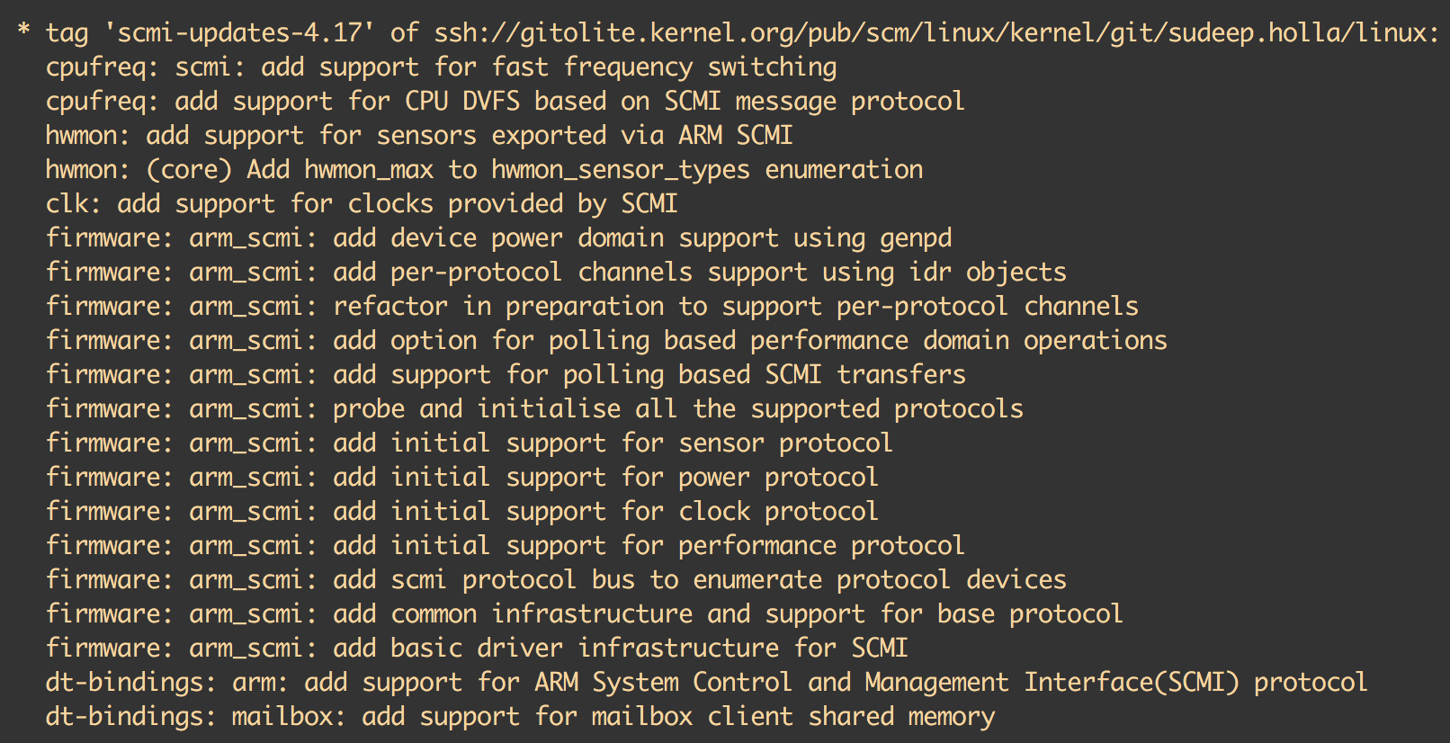
SCMI
Ref:
git log f46f11dc1e86270935041fbc3920ba71a050a5fd^!
http://infocenter.arm.com/help/index.jsp?topic=/com.arm.doc.den0056a/index.html

Slide 11
Memory encryption: Intel SGX
Ref: https://medium.com/@danny_harnik/impressions-of-intel-sgx-performance-22442093595a

Slide 12
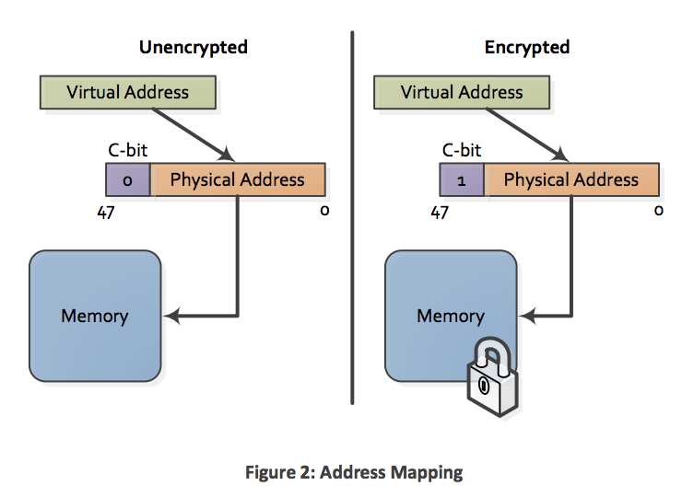
Memory encryption: AMD SEV
Ref: http://amd-dev.wpengine.netdna-cdn.com/wordpress/media/2013/12/AMD_Memory_Encryption_Whitepaper_v7-Public.pdf

Slide 13
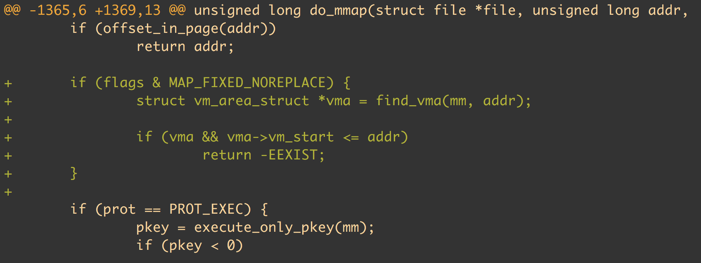
Memory: Introduce MAP_FIXED_NOREPLACE
git log --oneline --grep MAP_FIXED_NOREPLACE
Commit: a4ff8e8620d3 mm: introduce MAP_FIXED_NOREPLACE

Slide 14
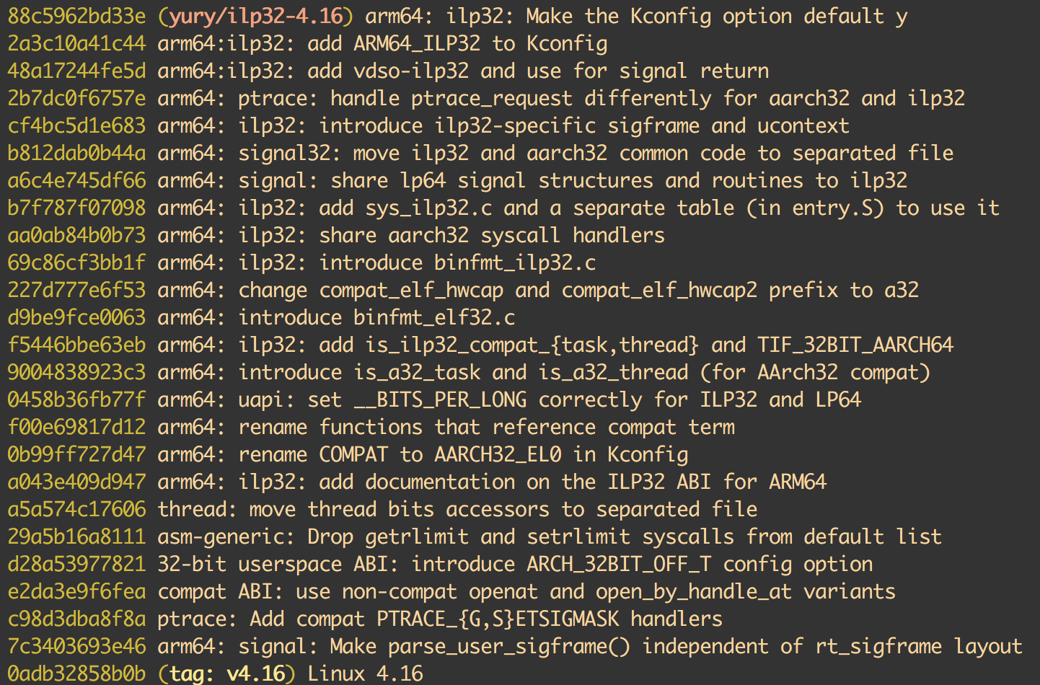
Staging features: ILP32
Ref: https://github.com/norov/linux/tree/ilp32-4.16

Slide 15
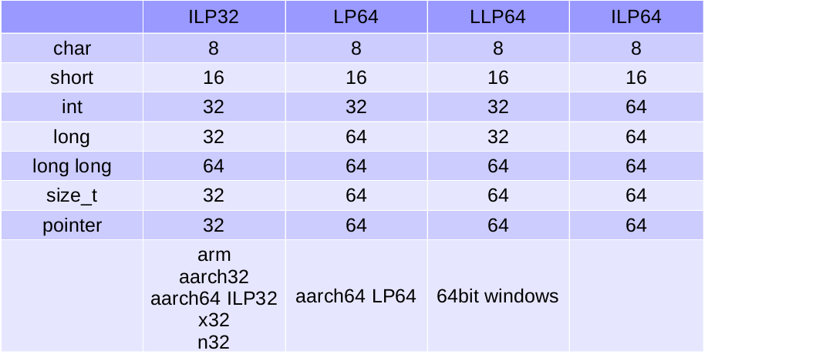
Staging features: ILP32

Slide 16
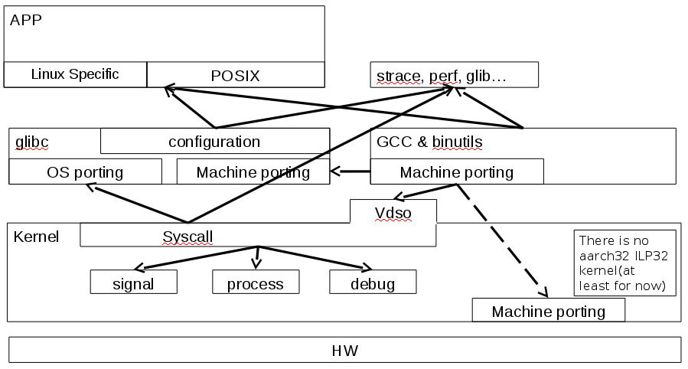
Staging features: ILP32

Slide 17
Thanks
半瓦平时有随手记笔记的习惯，公众号《敏达生活》。只分享自己有体会的信息，希望能促进价值信息流动。任何建议欢迎给我留言或添加我的微信：
春风吹又生—-梳理中国CPU
Linux自动化部署工具综述（Linux自动化部署工具系列之一）
比较操作系统镜像制作方式（Linux自动化部署工具系列之二）
ARM生态系统的盛会Linaro connect（之一）：arm64 server和端侧AI
ARM生态系统的盛会Linaro connect（之二）：arm64 workstation和低成本调试工具
内核测试小整理

