Slide 1
Opensuse arm on
Allwinner A10
Bamvor Jian Zhang <bjzhang@suse.de>

Slide 2
Introduction
DEMO: Opensuse arm on mele A1000
Open source on unbrickable/open/fexible device
Arm family and ecosystem
Notes:
- cluster types (local?, metro, geo)
First two types need to look like local network
Doesn't work west coast/east coast
- mechanism for knowing a site is up
- not for replicating data or configuration

Slide 3
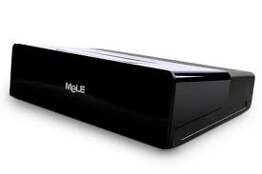
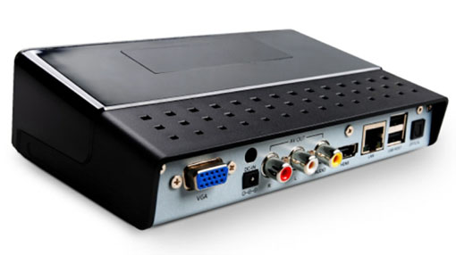
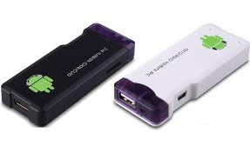
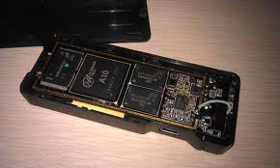
Allwinner A10/A13
Notes:
- Pacemaker ticket support in 1.1.6
- Resources depend on tickets
- In principle, allows manual failover between sites
- But how to automate?
- If site dies (to outside world), pcmk might still be running there
- Clusters talk to each other
- Booth, so named as a play on “ticket booth”

Slide 4
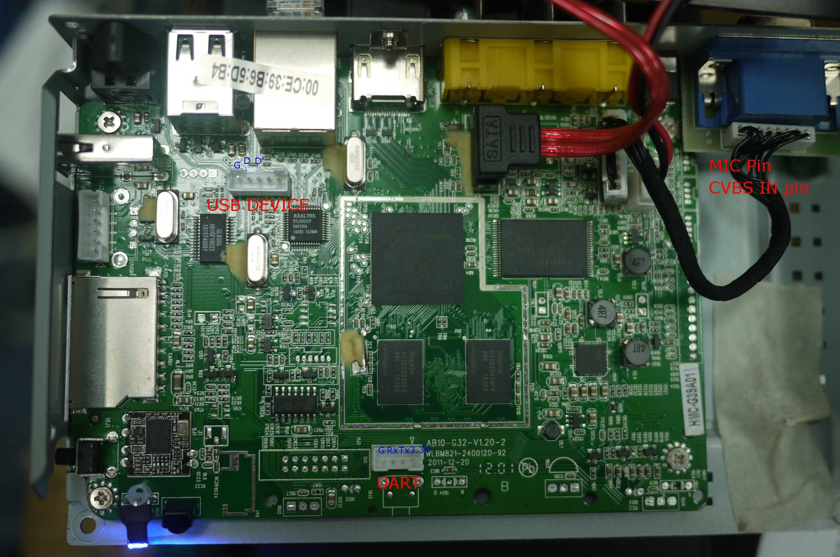
Allwinner A10/A13
Notes:
- Pacemaker ticket support in 1.1.6
- Resources depend on tickets
- In principle, allows manual failover between sites
- But how to automate?
- If site dies (to outside world), pcmk might still be running there
- Clusters talk to each other
- Booth, so named as a play on “ticket booth”

Slide 5
Open source on embedded device
Thanks to CyanogenMod, XMBC, XDA
Unbrickable
Open and Standard hardware
Fexible
  Varies display device support
  Multi-purpose GPIO. GPIO configuration file.

Slide 6
Open source on arm soc
ARM
Display output
3D
Memory
Controller
Memory
PMU
PMIC
SD/EMMC
Controler
Uart
Network
USB OTG
Notes:
- Configured in a group with IP address
- Arbitrator vs. Site

Slide 7
Open source on arm soc
Arm processor
Display adaptor
  3D: arm mali
  Output: hdmi, vga, AV, YPbPr
“hard disk”: sd, emmc
Uart: 8250 or 16650 compatability.
Notes:
- Configured in a group with IP address
- Arbitrator vs. Site

Slide 8
Compare with ARM and X86
 | ARM | INTEL | MIPS
name | Cortex | Pentium
pipeline | Supperscaler | Supperscaler | ?
SIMD multimedia | NEON | MMX, SSE, 3D NOW | ASE
Data width | 64bit | 64bit
Smaller code size | Thumb-2 |  | microMIPS
Notes:
Paxos is a family of protocols for solving consensus in a network of unreliable processors. (see wikipedia)

Slide 9
Arm processor Performance Comparison
Arm processor Performance Comparison
Arm processor Performance Comparison
Notes:
- Pacemaker ticket support in 1.1.6
- Resources depend on tickets
- In principle, allows manual failover between sites
- But how to automate?
- If site dies (to outside world), pcmk might still be running there
- Clusters talk to each other
- Booth, so named as a play on “ticket booth”

Slide 10
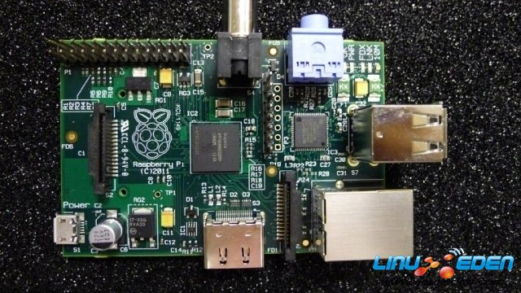
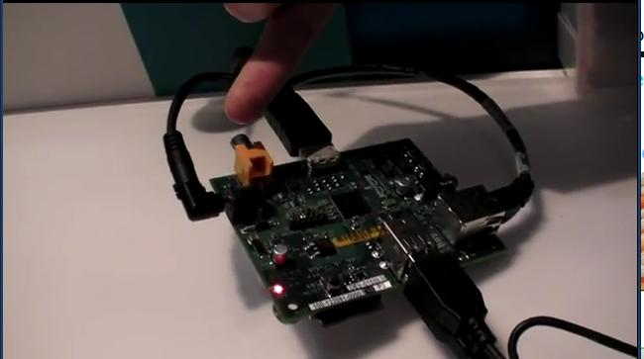
Arm processor Performance Comparison
Arm processor Performance Comparison
Arm processor Performance Comparison
Arm11
25$ raspberry pi
Notes:
- Pacemaker ticket support in 1.1.6
- Resources depend on tickets
- In principle, allows manual failover between sites
- But how to automate?
- If site dies (to outside world), pcmk might still be running there
- Clusters talk to each other
- Booth, so named as a play on “ticket booth”

Slide 11
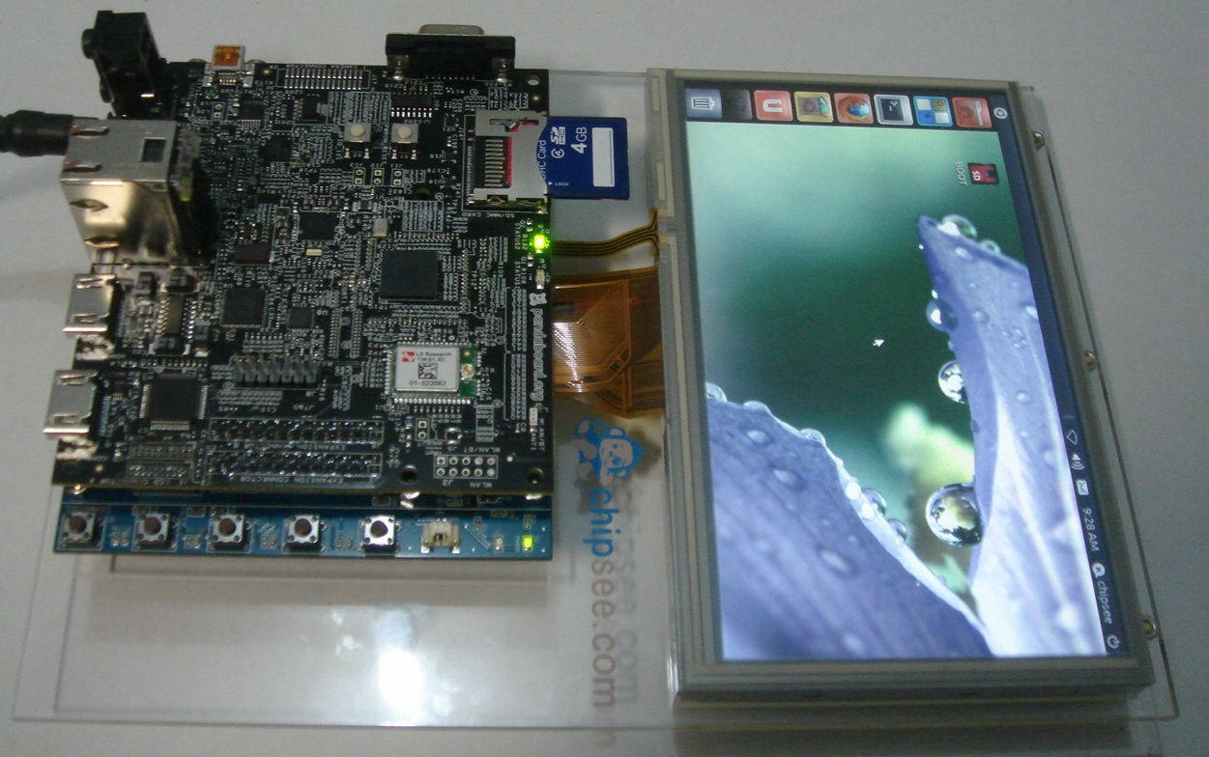
Arm processor Performance Comparison
Arm processor Performance Comparison
Cortex-A9
Panda board: TI OMAP4
AMlogic 8726-MX
Notes:
- Pacemaker ticket support in 1.1.6
- Resources depend on tickets
- In principle, allows manual failover between sites
- But how to automate?
- If site dies (to outside world), pcmk might still be running there
- Clusters talk to each other
- Booth, so named as a play on “ticket booth”

Slide 12
Arm processor Performance Comparison
Arm processor Performance Comparison
Cortex-A8 beagle board: TI OMAP3: low frequency, 140$
AMlogic 8726-MX
Notes:
- Pacemaker ticket support in 1.1.6
- Resources depend on tickets
- In principle, allows manual failover between sites
- But how to automate?
- If site dies (to outside world), pcmk might still be running there
- Clusters talk to each other
- Booth, so named as a play on “ticket booth”

Slide 13
“Harddisk” and boot up
bootloader(specific boot and u-boot)
Kernel and configuration(fexible)
 | kernel | rootfs
 | sdx1 | sdx2
Notes:
Paxos is a family of protocols for solving consensus in a network of unreliable processors. (see wikipedia)

Slide 14
Display adaptor(Display output + 3D acceleration)
Arm Mali:
  Samsung, Rockchip, Allwinner.
  Partial Open source
Imagination PowerVR: TI.
Vivenate GCxx: freescale.
Geforce: Nvidia
Adreno: Qualcomm

Slide 17
Unpublished Work of SUSE. All Rights Reserved.
This work is an unpublished work and contains confidential, proprietary, and trade secret information of SUSE.
Access to this work is restricted to SUSE employees who have a need to know to perform tasks within the scope of their assignments. No part of this work may be practiced, performed, copied, distributed, revised, modified, translated, abridged, condensed, expanded, collected, or adapted without the prior written consent of SUSE.
Any use or exploitation of this work without authorization could subject the perpetrator to criminal and civil liability.
General Disclaimer
This document is not to be construed as a promise by any participating company to develop, deliver, or market a product. It is not a commitment to deliver any material, code, or functionality, and should not be relied upon in making purchasing decisions. SUSE makes no representations or warranties with respect to the contents of this document, and specifically disclaims any express or implied warranties of merchantability or fitness for any particular purpose. The development, release, and timing of features or functionality described for SUSE products remains at the sole discretion of SUSE. Further, SUSE reserves the right to revise this document and to make changes to its content, at any time, without obligation to notify any person or entity of such revisions or changes. All SUSE marks referenced in this presentation are trademarks or registered trademarks of Novell, Inc. in the United States and other countries. All third-party trademarks are the property of their respective owners.

