Slide 1
Xen on Cubietruck
Bamvor Jian Zhang
Software Engineer
bjzhang@suse.com

Slide 2

Agenda
cubietruck
Arm virtualization extension
Xen on arm
demo

Slide 3
Arm SOC working by xen
The arm32 port:
The Cortex A15 Real-time System Model's provided by ARM.
A Cortex-A15 Processor running on the Versatile Express.
The Arndale board.
The Calxeda ECX-2000 (aka Midway) server.
ARM in the server room faces a set back as Calxeda shuts down
Allwinner A20/A30 boards.
Google Chromebook.(in process)
The arm64 port
Model
The AEMv8 Real-time System Models by ARM.
ARM v8 Foundation Model.(in process)
APM "Mustang". See TBD.

Slide 4
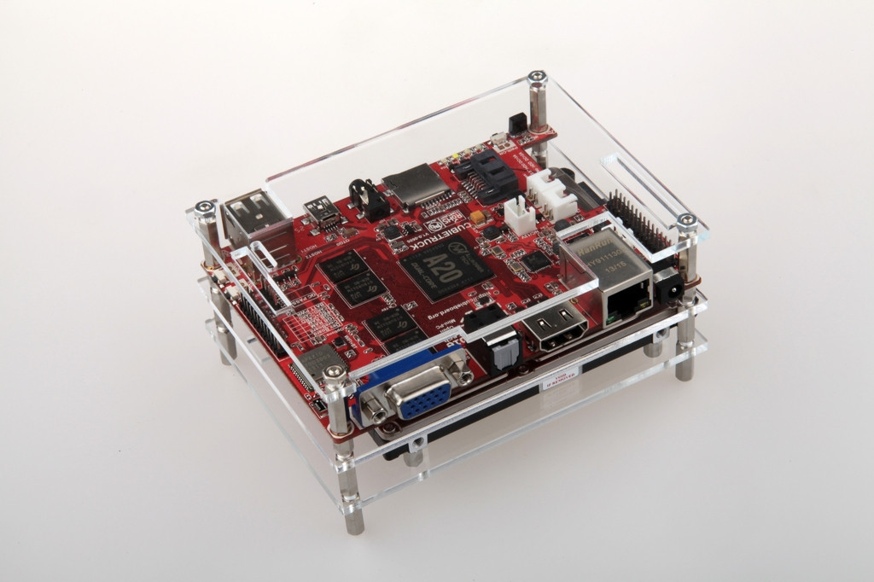

Slide 5
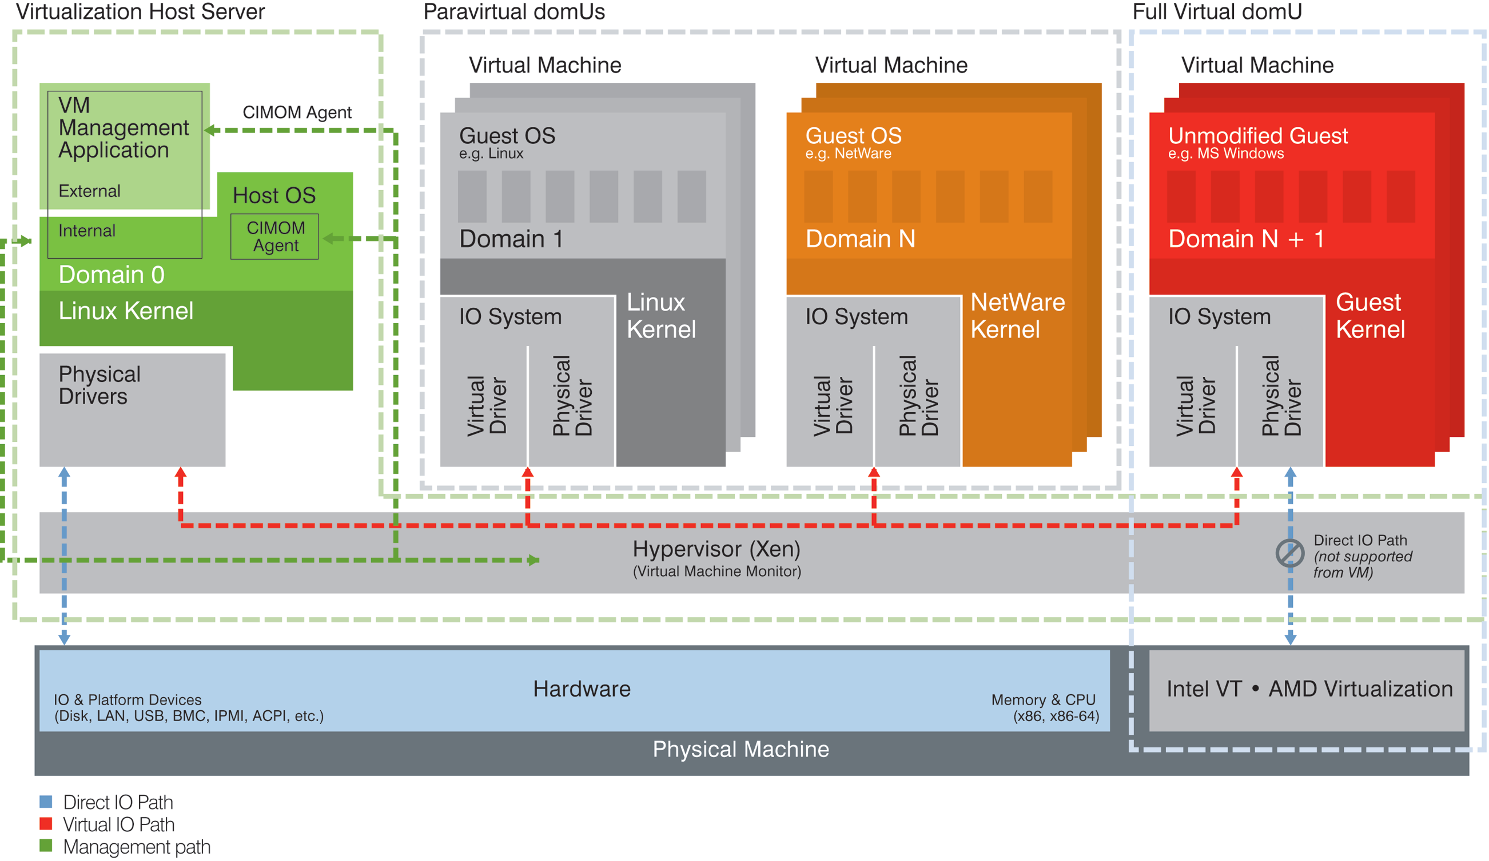
Xen Architecture

Slide 6
Arm virtualizaiton extension

Slide 7
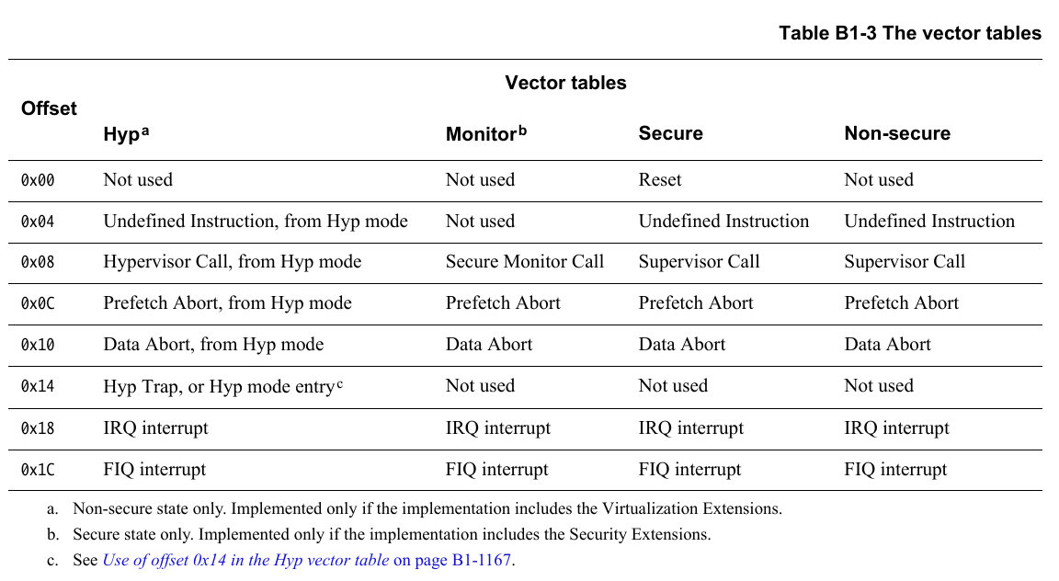

Slide 8
Exception offset | Exception (except monitor exception) | Operating modes | “正常”的异常
0x00 | Reset | Supervisor | Software reset
0x04 | Undefined Instruction | Undefined | Kgdb break inst
0x08 | Supervisor Call (SVC) | Supervisor | Enter kernel space
0x0C | Prefetch Abort | Abort | Break inst
0x10 | Data Abort | Abort | Page fault
0x14 | Not used | - | -
0x18 | IRQ (interrupt) | Interrupt | -
0x1C | FIQ (fast interrupt) | Fast interrupt | -

Slide 9
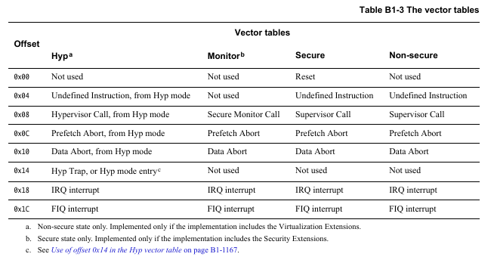

Slide 10
Problem and issue

Slide 11
How to use the memory large r than 4G in arm32?
[Xen-devel] [PATCH v2] xen: arm: improve handling of system with non-contiguous RAM region

Slide 12
1), 1:1 work around.
dom0 1:1 map and system MMU?
is dom0 1:1 map a work around?
DMA

Slide 13
Gic base address is fix in currrent xen

Slide 14
Background

Slide 15
Q & A

Slide 16
