Slide 1
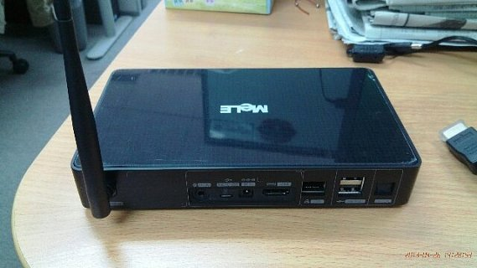
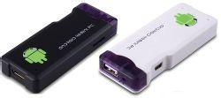
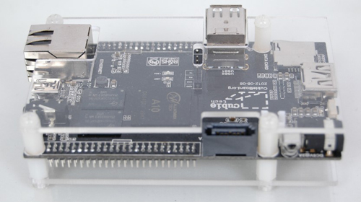
running xen on allwinner A31 device
use the same platform on hackweek VIII and hackweek IX.
fimiar with boot sequence on VIII.
try to packaging through kiwi on IX.

Slide 2
goal
run xen on Allwinner A31(Cortex-A7 qual-core) with opensuse distribution.
this is the cheapest hardware(including its brothor A20 dual core) for the arm virtualization. compare with exynos5250 and omap5 board.

Slide 3
road
base on the lastest community patch including my patches
if i could get usb host running. there is a chance to try the above things.
Previous effort on
http://xen_on_arm.farbox.com

Slide 4
a watch for taking care of my baby
I need a timer for waking up in night.
Only vibrate me. Not others.
Smaller than my phone

