Slide 1
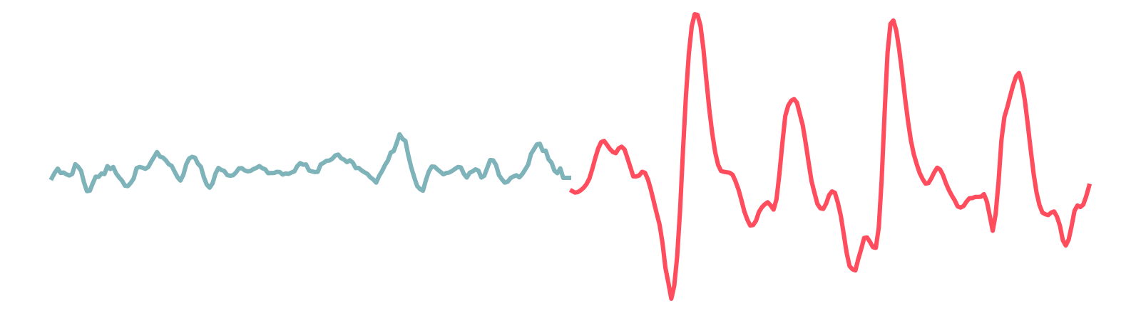
Spotting seizures in EEG with machine learning
Lab 9 · AI in Healthcare, Unit II · Ansh Upadhyay
healthy EEG
seizure EEG
Notes:
Today I will show how I built and tested machine-learning models that look at one second of brain-signal data and say whether it looks like a seizure. The left part of this line is normal EEG; the right part is a seizure segment from the dataset — notice how much bigger and sharper it is.

Slide 2




The problem: EEG review is slow
An EEG records the brain's electrical activity as a voltage over time.
Neurologists read long recordings by eye to find seizures. That takes hours.
Idea: a model flags short segments that look like seizure, so the doctor looks at those first.
Input
One EEG segment: 178 numbers, about 1 second
Task
Binary classification: seizure (1) or not (0)
User
A clinician, who always makes the final decision
Educational exercise only. This model is not a diagnostic tool and is not ready for clinical use.
Notes:
Reading EEG is slow, so the idea is triage: the model does not diagnose, it only reorders the queue so the clinician sees likely seizure segments first. Input is one segment of 178 values, output is seizure or not, and the doctor makes the final call.

Slide 3
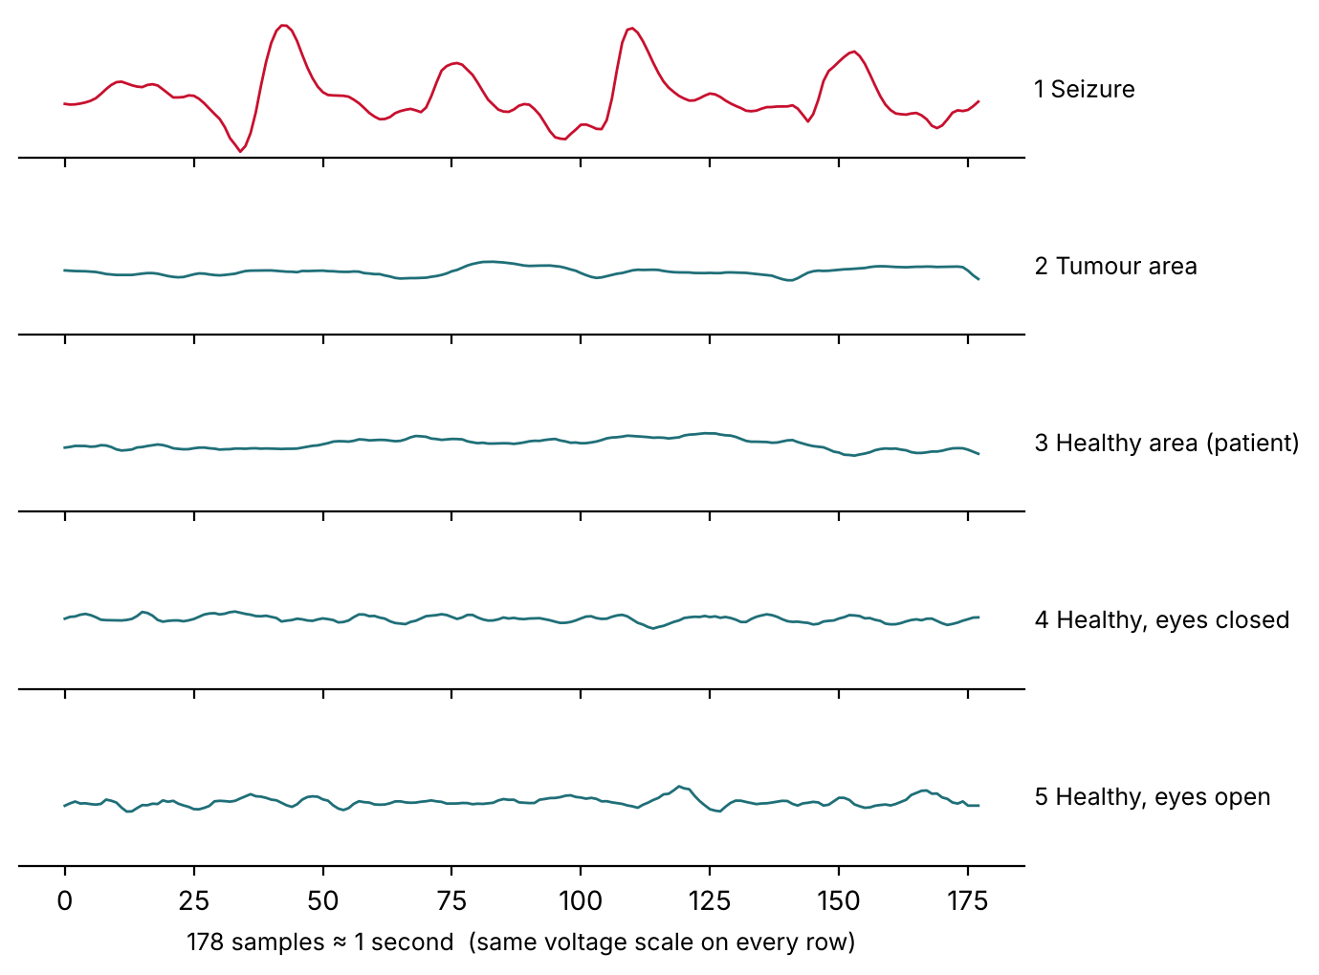
The data: 500 recordings, 11,500 segments
500
× 23
= 11,500
recordings
(100 per label)
chunks of
178 values each
rows in
the CSV
Five original labels → one binary target
y = 1 seizure activity → 1
y = 2 tumour area → 0
y = 3 healthy area, tumour patient → 0
y = 4 healthy volunteer, eyes closed → 0
y = 5 healthy volunteer, eyes open → 0
So 20% of rows are seizure. "Always say no" already scores 80% accuracy — useless, so accuracy is not our headline metric.
Seizure segments have much bigger, sharper waves
Notes:
The Kaggle file is a reshaped version of the Bonn EEG dataset. There are 500 recordings, 100 for each of 5 labels, and each recording is cut into 23 one-second chunks, giving 11,500 rows. I made label 1 the positive class and grouped the other four as non-seizure. Important: one row is a segment, 23 rows make a recording, and many recordings come from the same small group of people. Because 80 percent of rows are non-seizure, a model that always says no gets 80 percent accuracy, so I focus on sensitivity, specificity, PPV and NPV.

Slide 4


Split by recording, not by row
Random row split (leaks)
Recording-level split (what I did)
Chunks of the same recording end up in both train and test. They look almost identical, so the model can "recognise the recording" and the test score looks too good.
All 23 chunks of a recording stay together, using StratifiedGroupKFold. Checked: 0 recordings shared between sets.
Train
Validation
Test
300 recordings · 6,900 rows · 20% seizure
100 recordings · 2,300 rows · 20% seizure
100 recordings · 2,300 rows · 20% seizure
Fit models and scaler
Compare models, pick threshold
Used once, at the end
Limit: the CSV has no patient ID, so the same person can still appear in train and test.
Notes:
This is the most important design choice. If I split rows randomly, neighbouring chunks of one recording would be in both training and test, and the model could just memorise each recording. So I split by recording ID: 60/20/20, same 20% seizure rate in each, and I verified no recording appears in two sets. The scaler is inside a pipeline so it only learns from training data, and the test set was used only once. One limit remains: there is no patient ID, so the same person can still be in both sets.

Slide 5

Five models, two kinds of input
Raw signal
8 engineered features
All 178 values as they are
Simple numbers that describe each segment
Logistic regression (baseline)
Random forest
Gradient boosting
mean
std dev
min
max
range
energy
zero crossings
line length
Logistic regression
Random forest
Line length = total distance the trace travels; big fast waves give a long line.
Notes:
I trained a logistic regression baseline and two stronger models on the raw 178 values. Then I computed 8 simple features per segment — like range, standard deviation and line length — and trained logistic regression and random forest on those, so I can compare raw input with features using the same model types.

Slide 6
Features beat raw values
0.504 → 0.993
Logistic regression ROC-AUC on raw values vs on features
Why? Each segment starts at a random moment, so "value number 37" means nothing on its own. A seizure is about wave size and sharpness, which can appear anywhere. Features capture that; a linear model on raw values cannot.
Best by PR-AUC: random forest on features (0.979).
Notes:
On the validation set, every model except the raw logistic regression ranks segments almost perfectly. The baseline scores 0.504, a coin flip, but the same logistic regression on 8 features scores 0.993. The reason is that the position of a value inside the segment is arbitrary; what matters is amplitude and sharpness, which the features summarise. I chose the random forest on features as the best model by PR-AUC, 0.979; logistic regression on features was essentially tied.

Slide 7
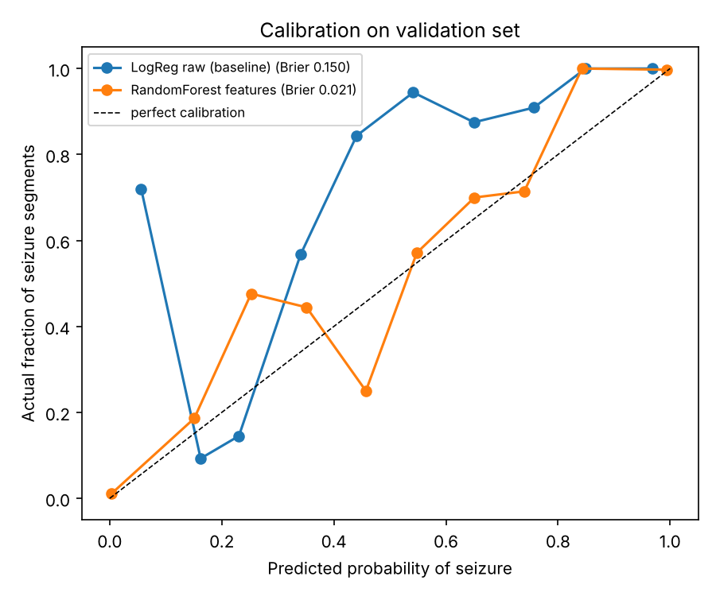
Can we trust the probabilities?
Baseline
Brier 0.150
Probabilities mean little: segments scored ~5% were mostly seizures
Random forest features
Brier 0.021
Close to the diagonal: a 70% score means roughly 70% are seizure
Brier score = average squared error of the probability. Lower is better.
Notes:
Calibration checks whether a predicted probability matches reality. The dashed line is perfect. The baseline is far off, with Brier 0.150. The random forest on features roughly follows the line with Brier 0.021; the middle bins are a bit noisy because few segments get mid-range scores.

Slide 8
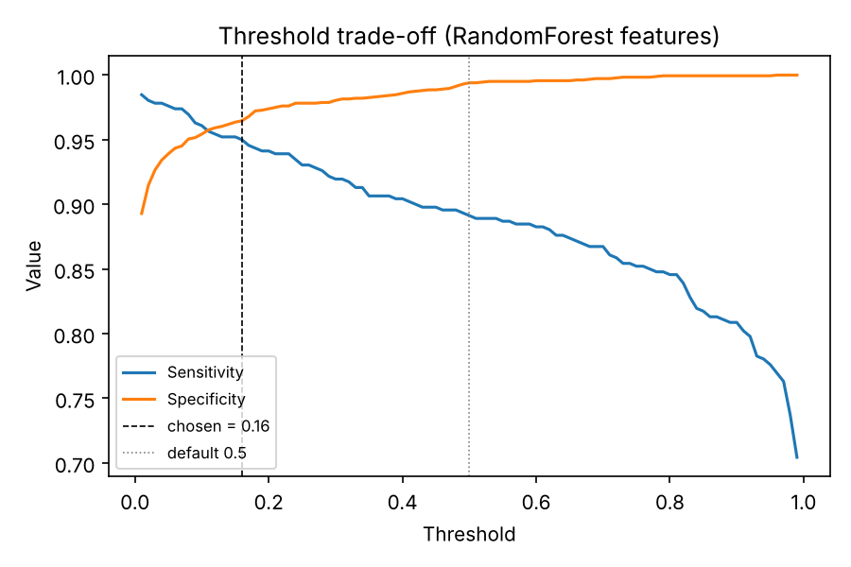
Threshold: catch at least 95% of seizures
Validation | t = 0.50 | t = 0.16
Missed seizures (FN) | 50 | 23
False alarms (FP) | 11 | 65
Sensitivity | 89.1% | 95.0%
Specificity | 99.4% | 96.5%
PPV | 97.4% | 87.1%
Why lower the threshold? A false alarm costs a few seconds of review. A missed seizure may never be looked at. So a miss costs more.
Rule: the highest threshold that still gives ≥ 95% sensitivity on validation
Notes:
The default 0.5 threshold misses 50 seizure segments. Because a miss is more costly than a false alarm in a triage tool, I used the rule: the highest threshold that keeps sensitivity at least 95 percent. That gives 0.16. Misses drop to 23, false alarms rise to 65 out of 1,840 non-seizure segments, and PPV is still 87 percent — about 87 of every 100 flags are real.

Slide 9
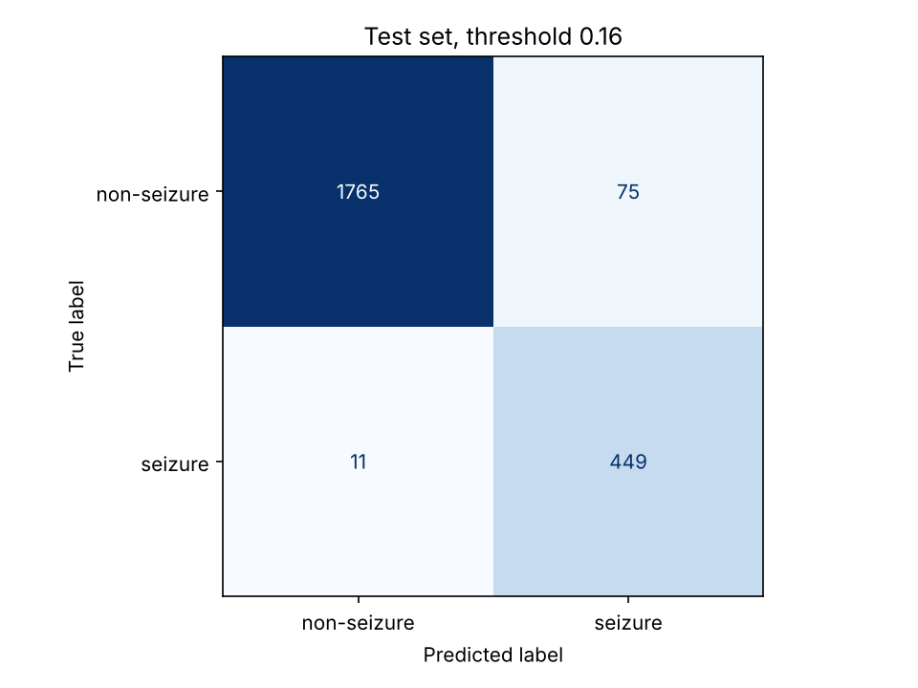
Final test, used only once
97.6%
95.9%
Sensitivity
Specificity
95% CI 94.1–100
95% CI 92.3–98.9
85.7%
99.4%
PPV
NPV
≈ 86 of 100 flags are real
unflagged are almost all clear
Random forest on features, threshold 0.16. CIs from 1,000 bootstrap samples of recordings, not rows.
Notes:
Only now did I touch the test set, once, with the model and threshold chosen on validation. Sensitivity was 97.6 percent and specificity 95.9 percent, similar to validation. The confidence intervals are wide because there are only 100 test recordings, and I bootstrapped recordings rather than rows because rows from the same recording are not independent.

Slide 10
Where the model goes wrong
86 mistakes
all inside just 15 of 100 test recordings
Two recordings alone had 23 and 20 of their 23 segments wrong, both from tumour patients.
So errors depend on the recording or person, not random noise. A new person could fail the same way.
Patients' EEG between seizures can still have sharp, large waves. Eyes-open EEG is calm and gave no false alarms.
Notes:
All false negatives were seizure segments, 11 of them. The false positives came from labels 2 and 3, the tumour patients, and some from eyes-closed volunteers; eyes-open gave none. More importantly, the mistakes cluster: all 86 are in 15 recordings, and two recordings are wrong almost completely. That means errors are tied to particular recordings or people.

Slide 11

From segments to whole recordings
Flag a recording if at least k of its 23 segments are predicted seizure (test set, 20 seizure and 80 non-seizure recordings).
k | Seizure recordings caught | Healthy recordings flagged | Sensitivity | Specificity
1 | 20 / 20 | 12 / 80 | 100% | 85.0%
2 | 20 / 20 | 8 / 80 | 100% | 90.0%
3 | 20 / 20 | 7 / 80 | 100% | 91.2%
5 | 20 / 20 | 5 / 80 | 100% | 93.8%
Every seizure recording is caught at every k.
With k = 1, one stray false alarm out of 23 flags a whole healthy recording. Asking for 5 segments cuts false alarms from 12 to 5.
Grouping like this is one way to reduce alert fatigue.
Notes:
A clinician thinks in recordings, not one-second segments. If I flag a recording when at least one segment is positive, sensitivity stays 100 percent but 12 healthy recordings are flagged. Requiring 5 positive segments keeps all 20 seizure recordings and only flags 5 healthy ones.

Slide 12


Good scores, but not ready for the clinic
Why not yet
What's needed
How it should fit
Only ~10 people in the data
Single channel, clean pre-selected segments
20% seizure by design; real EEG has far fewer
No clinical context (age, drugs, video)
New patients from other hospitals and machines
Continuous multichannel recordings
Person-level split, expert-agreed labels
Prospective study of review time and misses
Only reorders the review queue
Neurologist makes every decision
Flag time windows, not every second
Show the reason; monitor false-alarm rate
Notes:
To finish: these numbers are high, but they do not prove clinical usefulness. The data comes from about ten people, one channel, clean pre-selected segments, and an artificial 20 percent seizure rate. Before any hospital use we would need external validation on new patients and hospitals with continuous multichannel EEG, and a prospective study. In practice it should only reorder the queue for a neurologist, flag time windows rather than single seconds, and be monitored for false alarms.

