Slide 1

ECG Heartbeat Classification
A step-by-step deep learning study: from a simple 1D CNN to a 1D ResNet
Healthcare AI Lab Task | MIT-BIH Arrhythmia dataset (Kaggle)
Notes:
Introduce the task: we classify single ECG heartbeats into 5 types using deep learning. The key idea of this work is that we did not jump to one model; we improved step by step, and every change is backed by numbers.

Slide 2



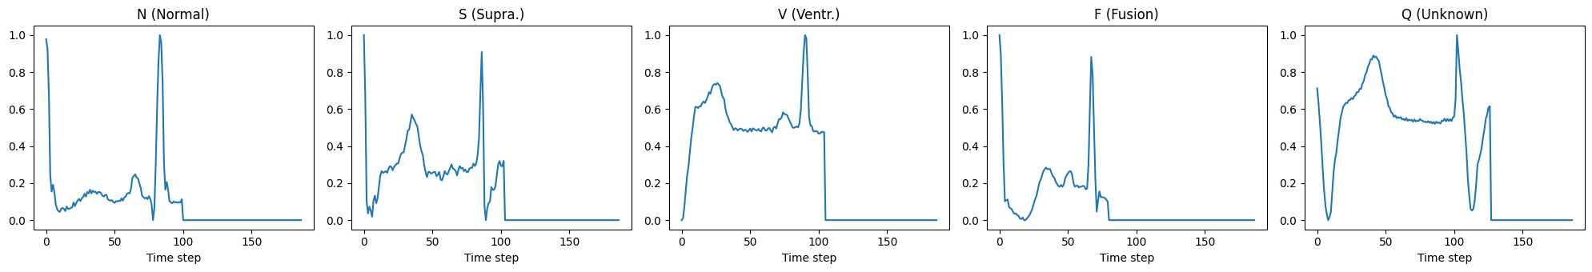
What is the problem?
Input
Output
Why it matters
One heartbeat from an ECG signal, stored as 187 numbers (signal height over time).
Which of 5 beat types it is: Normal, S, V, F or Q.
Abnormal beats (arrhythmias) can be a sign of heart disease. Automatic detection helps doctors.
One example beat from each class. The shapes and the timing of the spikes are different.
Notes:
An ECG records the heart's electrical activity. The dataset already cut it into single beats. Each beat is 187 numbers. Our job: look at one beat and say which of 5 types it is. The picture shows one example per class: you can see that shapes and spike positions differ.

Slide 3
The dataset
Label | Class | Meaning | Train beats | Share
0 | N | Normal beat | 72,471 | 82.8%
1 | S | Supraventricular premature beat | 2,223 | 2.5%
2 | V | Premature ventricular contraction | 5,788 | 6.6%
3 | F | Fusion of ventricular + normal | 641 | 0.7%
4 | Q | Unclassifiable / paced beat | 6,431 | 7.3%
87,554
21,892
training beats
test beats
187
5
time steps per beat
classes
Source: Kaggle "ECG Heartbeat Categorization" (MIT-BIH Arrhythmia). Signal sampled at 125 Hz, scaled to 0-1 and zero-padded to 187 steps.
We also split 10% of the training beats off as a validation set to choose the best epoch.
Notes:
The data is already clean: beats are cut, scaled 0 to 1, and padded to 187 points. 87 thousand training beats and 22 thousand test beats. The test set is used only at the very end. Look at the share column: S is only 2.5 percent and F only 0.7 percent.

Slide 4
The main challenge: class imbalance
83%
of all training beats are Normal
A model that always says "Normal" already gets 83% accuracy, and it is useless.
The rare classes S (2.5%) and F (0.7%) are the abnormal beats we most need to catch.
So we cannot judge a model by accuracy alone.
Notes:
This is the most important fact about the data. 83 percent of the beats are Normal. A model can look very accurate just by guessing Normal. That is why we need better metrics, shown on the next slide.

Slide 5



How we measure success
Recall
Precision
Macro F1 (main metric)
Of all real S beats, how many did we catch?
Of all beats we called S, how many were really S?
Average F1 score of the 5 classes. Rare classes count as much as Normal.
Low recall = missed disease
Low precision = false alarms
Cannot be gamed by guessing Normal
In healthcare, recall on abnormal beats matters most. A missed arrhythmia is dangerous; a false alarm can simply be re-checked by a doctor. We also use the confusion matrix to see which classes get mixed up.
Notes:
Recall answers: did we catch the sick beats? Precision answers: when we raise an alarm, is it real? F1 balances both. Macro F1 averages F1 over the 5 classes, so a rare class like F counts just as much as Normal. This is our main metric.

Slide 6




My approach: change one thing at a time
1
2
3
4
5
Build a model
Measure it
Find its weakness
Change ONE thing
Compare & repeat
Why? When a score changes, we know exactly which change caused it, so every decision is backed by evidence.
To keep the comparison fair, these stay the same in every step:
Same data split
Same training settings
Fixed random seed
Best epoch kept
Train 90% / validation 10% / separate test set.
Adam optimizer, learning rate 0.001, batch size 128.
Same result on every run, so differences are real.
We keep the epoch with the best validation macro F1.
Notes:
We followed a simple scientific loop: build, measure, find the weakness, change only one thing, compare. Because only one thing changes, we know what caused each improvement. Everything else stayed fixed. The fixed seed matters: without it, the same model gave 0.799 once and 0.777 the next time.

Slide 7
The three model families we used
1D CNN
CNN + BiLSTM + Attention
1D ResNet
Detects local shapes
Shapes + order and timing
Deep CNN with skip connections
Input: 187 x 1
Input: 187 x 1
Input: 187 x 1
Conv + ReLU + Pool x3
Conv + ReLU + Pool x2
Conv layer
Global average pool
BiLSTM (both directions)
Residual block + Pool x5
Dense layer
Attention (weighted average)
Global average pool
5 class scores
Dense layer → 5 scores
Dense layer → 5 scores
17k parameters
86k parameters
54k parameters
Notes:
These are the three architectures. The CNN looks at small windows of the signal. The CNN plus BiLSTM plus attention first finds shapes, then reads them in order, then focuses on the important part. The ResNet is a much deeper CNN; skip connections make the deep network trainable.

Slide 8
The 5 experiments at a glance
1
2
3
4
5
Simple 1D CNN
+ Class weights
CNN + BiLSTM + Attention
+ Softer (√) weights
1D ResNet
Baseline: how good is a simple model?
Does punishing rare-class mistakes help?
Does reading the beat in order help?
Can we catch more abnormal beats safely?
Can a deep CNN beat the sequence model?
Each step starts from the weakness found in the step before it, so the experiments tell one connected story.
Notes:
Here is the whole journey. Each step answers one question, and the question comes from the weakness of the previous step.

Slide 9
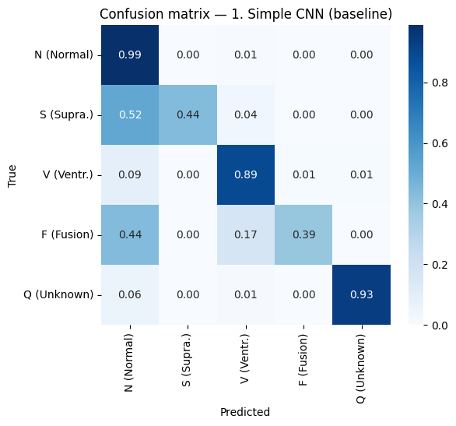


Step 1: Simple 1D CNN (baseline)
Why this step?
95.9%
0.776
Start simple. We need a baseline score that every later model has to beat.
Accuracy
Macro F1
What I did
0.44
0.39
3 convolution layers + a small classifier. No handling of class imbalance. 15 epochs.
Recall S
Recall F
Intuition
A small window (5 samples) slides along the beat and learns to spot local shapes such as a sharp spike or a wide wave.
Half of the S beats and 44% of the F beats are predicted as Normal.
What worked
What did not
Fast (~45 s) and small (17k parameters)
Normal, V and Q beats found well
Misses more than half of S and F beats
96% accuracy hides this problem
Notes:
The baseline is a small CNN. Accuracy looks great at 96 percent, but macro F1 is only 0.776. The confusion matrix shows why: half of the S beats and 60 percent of the F beats are called Normal. The model learned that when in doubt, say Normal, because most training beats are Normal.

Slide 10
Step 2: Add class weights
Why this step?
87.2%
0.661
Step 1 ignored rare beats because 83% of the training data is Normal.
Accuracy
▼ from 95.9%
Macro F1
▼ from 0.776
What we changed
0.73
0.84
Only the loss function. Mistakes on rare classes now cost more ("balanced" weights).
Recall S
▲ from 0.44
Recall F
▲ from 0.39
Intuition
If missing an F beat costs 27 points and missing a Normal beat costs 0.24, the model is pushed to pay attention to F.
What worked
What did not
Rare beats are now caught much more often
Too many false alarms: S and F precision fell to ~0.2
Weights were too strong (F = 27x)
Notes:
We changed only the loss: mistakes on rare classes cost more. Recall of S and F went up a lot, but the model over-corrected: it started calling Normal beats abnormal, so precision fell to about 0.2 and macro F1 dropped. This failed experiment taught us the trade-off between recall and precision.

Slide 11
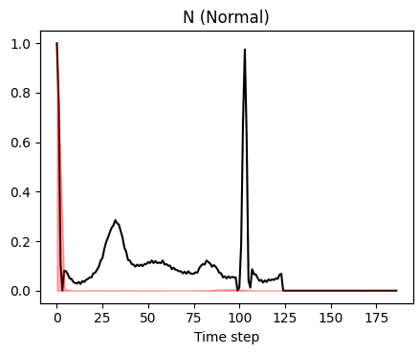
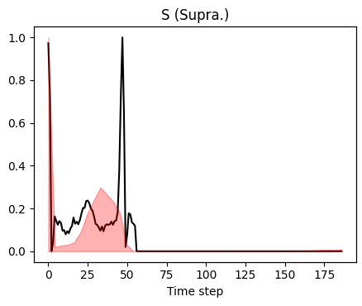
Step 3: CNN + BiLSTM + Attention
Why this step?
97.9%
0.887
Weights cannot help if the model cannot tell the classes apart. The small CNN sees shapes, but not timing.
Accuracy
▲ from 95.9%
Macro F1
▲ +0.11
What we changed
0.66
0.71
Only the architecture (no class weights): CNN for shapes, BiLSTM to read the beat in order, attention to focus.
Recall S
▲ from 0.44
Recall F
▲ from 0.39
Intuition
Each beat starts at an R-peak; the next spike is the next beat. A premature (S) beat arrives early. A BiLSTM can measure that gap.
What worked
What did not
Biggest jump in macro F1
High precision (S 0.90, F 0.83): real improvement
S and F recall still the lowest
5x more parameters than Step 1
Normal: next spike at ~step 100. S: next spike at ~step 47, it comes too early.
Notes:
Here we changed only the model. The CNN finds shapes, the BiLSTM reads them in order, and attention focuses on the useful part. The key insight is timing: in the Normal beat the next spike comes at about step 100, in the S beat at about step 47. A shallow CNN cannot measure that distance, a sequence model can. Macro F1 jumped from 0.776 to 0.887 with high precision.

Slide 12
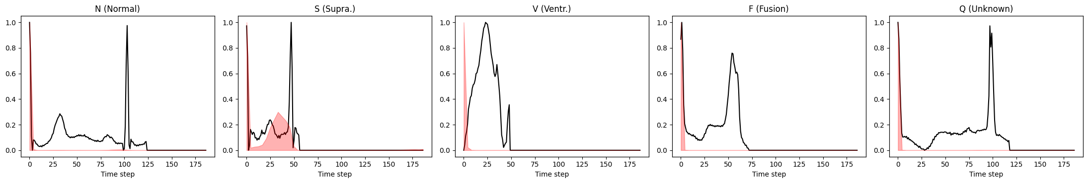


Where does the attention look?
Black = ECG beat, red = attention weight over time (one correctly classified test beat per class).
What we see
What it means
For most classes, attention sits on the first few time steps.
For the S beat, it spreads over the gap between the two spikes, exactly where the early beat shows.
In a BiLSTM, the backward pass has read the whole beat by step 0, so step 0 is already a summary.
Attention shows where the model reads its summary, not exactly which part of the signal matters.
Notes:
This is the attention plot. Be honest here: for most classes attention points at the very start. That is not a bug. In a bidirectional LSTM the backward direction has already read the whole beat when it reaches step 0, so that position is a summary. The S beat is the interesting case: attention covers the gap between the spikes, which is where an early beat is visible.

Slide 13
Step 4: Softer (√) class weights
Why this step?
97.7%
0.883
S and F recall were still the lowest. Step 2 showed weights help recall, but full strength was too much.
Accuracy
≈ same
Macro F1
≈ same
What we changed
0.78
0.80
Weights = square root of the balanced weights (F: 5x instead of 27x). Also 30 epochs instead of 15.
Recall S
▲ from 0.66
Recall F
▲ from 0.71
Intuition
Keep the direction (rare classes still count more) but remove the extreme values that caused false alarms.
What worked
What did not
Catches more abnormal beats
No collapse like Step 2
S and F precision fell to ~0.7
Macro F1 did not improve
Notes:
We took the square root of the weights, so F costs about 5 times instead of 27 times. Recall of S and F went up clearly while precision only dropped moderately. We changed two things here, so we checked: 30 epochs without weights gave the same F1 and did not raise recall. So the recall gain comes from the softer weights.

Slide 14
Step 5: 1D ResNet (deep residual CNN)
Why this step?
98.6%
0.920
Step 4 bought recall with precision. Can a better model raise both? The shallow CNN was the limit.
Accuracy
▲ best
Macro F1
▲ best
What we changed
0.84
0.86
Only the architecture: a deep CNN with skip connections. Same √ weights and 30 epochs as Step 4.
Recall S
▲ from 0.78
Recall F
▲ from 0.80
Intuition
A deep CNN sees the whole beat, timing included. Skip connections (out = out + x) let it train well even with 11 layers.
Input x
Conv → BatchNorm → ReLU
Skip connection: add the input back
What worked
What did not
Conv → BatchNorm
Recall AND precision both improve
Fewer parameters than Step 4 (54k)
Slowest to train (~3.7 min)
Validation F1 jumps between epochs
+
ReLU → output
Notes:
Finally we tried a deep residual CNN, the same idea as the original paper for this dataset. The diagram shows one residual block: two conv layers, and then the input x is added back to the output. This skip connection lets the learning signal flow through many layers. Result: best macro F1 of 0.920, and both recall and precision of S and F went up, with fewer parameters than Step 4.

Slide 15
Results: all 5 steps compared
Step 5 (1D ResNet) is the best on all three: macro F1, recall S and recall F.
Notes:
This chart shows the whole story. Step 1 is the baseline. Step 2 raised recall but hurt F1. Step 3 was the big jump. Step 4 raised recall at the same F1. Step 5 is best overall.

Slide 16

Results in numbers
Step | Model | Accuracy | Macro F1 | Recall S | Recall F | Precision S | Precision F | Params | Train time
1 | Simple CNN | 0.959 | 0.776 | 0.44 | 0.39 | 0.79 | 0.70 | 17k | 43 s
2 | + Class weights | 0.872 | 0.661 | 0.73 | 0.84 | 0.23 | 0.21 | 17k | 42 s
3 | CNN + BiLSTM + Attention | 0.979 | 0.887 | 0.66 | 0.71 | 0.90 | 0.83 | 86k | 58 s
4 | + √ weights, 30 epochs | 0.977 | 0.883 | 0.78 | 0.80 | 0.73 | 0.68 | 86k | 134 s
5 | 1D ResNet + √ weights | 0.986 | 0.920 | 0.84 | 0.86 | 0.83 | 0.78 | 54k | 220 s
Step 5 is best in accuracy, macro F1 and recall S/F, while keeping precision high.
Step 2 has high F recall but terrible precision, so it is not a good model.
Notes:
The same results as a table, with precision and training time added. Notice step 2: high F recall but precision of only 0.21, so we should not pick it. Step 5 has the best balance.

Slide 17
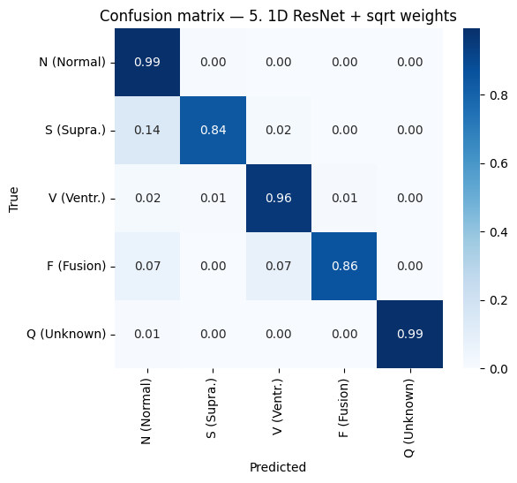

Final model: 1D ResNet + √ class weights
Best macro F1 (0.920)
and best accuracy (98.6%) of all models.
Catches abnormal beats
Recall at least 0.84 for every abnormal class.
Few false alarms
Precision of S and F stays high (0.83 / 0.78).
Smaller than Step 4
54k parameters vs 86k, simple to explain.
Notes:
This is our final model. The confusion matrix diagonal is 0.84 or higher for every class. Only 14 percent of S beats are still called Normal, compared with more than half in the baseline.

Slide 18
CNN vs LSTM: what did we learn?
Shallow CNN
CNN + BiLSTM
Deep ResNet CNN
0.776
0.887
0.920
macro F1
macro F1
macro F1
Sees only small windows, so it detects shapes but cannot measure timing.
Reads the beat in order, so it also understands timing (gap between spikes).
Deep enough to see the whole beat, so shapes AND timing, with fewer parameters.
Answer: the LSTM helped only because the first CNN was too shallow. For short, fixed-length signals like one heartbeat, a well-designed deep CNN is enough, and it beat the recurrent model.
Notes:
This answers the question from our instructor: CNN or LSTM? A shallow CNN loses to the LSTM, because it cannot see timing. But a deep residual CNN wins, because it sees the whole beat too. For a single heartbeat, a deep CNN is enough.

Slide 19
Key takeaways
1
Accuracy can lie
2
Timing matters
With 83% Normal beats, macro F1 and per-class recall tell the real story.
Abnormal beats differ in when the next beat comes, not only in shape.
3
Depth needs skip connections
4
Handle imbalance gently
Residual blocks + BatchNorm make an 11-layer CNN easy to train.
Full class weights over-correct; softer √ weights give a good balance.
Notes:
Four lessons. One: accuracy can lie on imbalanced data. Two: timing between beats is a key signal. Three: deep networks need skip connections. Four: handle imbalance gently, not with extreme weights.

Slide 20

Limitations and next steps
Limitations
Next steps
Each model was trained once (one seed), so small differences (e.g. 0.887 vs 0.883) may be noise.
Only one dataset (MIT-BIH), with beats already cut and cleaned.
Validation F1 of the ResNet jumps between epochs.
Data augmentation for S and F (noise, scaling, shifting).
Learning-rate scheduler to make training smoother.
Attention directly on CNN features for clearer explanations.
Notes:
Be open about limits: each model was trained once, so tiny differences may be noise. We only used one dataset. Next steps would be augmentation for the rare classes, a learning-rate scheduler, and testing on the PTB dataset.

Slide 21
Thank you
Notes:
Summarise: step by step we went from macro F1 0.776 to 0.920. Thank the audience and take questions.

