Slide 1
Fine-tuning GPT-2
Adapting a pretrained causal language model
Generative AI (ABAI3009L) · Module 3: Training and Fine-tuning LLMs
Companion notebook: module3/lectures/fine_tuning/gpt2_fine_tuning.ipynb
Notes:
Open the companion notebook in a second window before starting and run it once top to bottom (about a minute on a CPU), so the live demos have outputs ready. Turmeric 'LIVE DEMO' tags mark the points to switch to the notebook.

Slide 2
What you will learn
1
What fine-tuning is
2
Preparing data
3
What it costs
The pretraining objective, started from pretrained weights; how it differs from prompting and retrieval
Text → tokens → labels; which positions give a loss; why the end-of-text token matters
Every parameter is updated: about 16 bytes per parameter, plus activations
4
The training loop
5
What goes wrong
6
Evaluation
Learning rate, warmup and decay, gradient clipping, weight decay, train vs. eval mode
Catastrophic forgetting, and a model that never stops
Validation loss, fixed-setting generation, base vs. tuned, and why loss is not enough
Notes:
Preview the six parts of the lecture. Emphasise the scope: this is full fine-tuning, every weight trainable. PEFT and LoRA come in a separate lecture, so students first see what plain fine-tuning does and what it costs.

Slide 3
Three ways to get a recipe out of GPT-2
The goal: given recipe : dosa ;, write the ingredients, then the steps, then stop. GPT-2 can continue almost any text, but not reliably in this format.
Prompting
Retrieval
Full fine-tuning
Changes: The input only
Training: No
Changes: The context, not the weights
Training: No
Changes: All weights
Training: Yes
Weakness for GPT-2:
GPT-2 was trained to continue text, not to follow instructions; few-shot formatting is fragile
Weakness for GPT-2:
Supplies facts, but does not teach an output style or format
Weakness for GPT-2:
Needs data, compute, and care to avoid forgetting
These are not rivals: a fine-tuned model can still be prompted, and can still be given retrieved context.
Notes:
Concrete problem first. Ask GPT-2 for 'Recipe: masala dosa' and it continues the text, but not reliably in the format we need. The three approaches differ in what they change: the input, the context, or the weights. Stress that they are not rivals: a fine-tuned model can still be prompted and given retrieved context.

Slide 4
Same objective, different starting point
L(θ) = − (1/N) Σ_{t} log P_{θ}( x_{t} | x_{<t} )
Average negative log-likelihood of each real next token. Identical in pretraining and fine-tuning.
 | Pretraining | Fine-tuning
Initial weights θ₀ | Random | Pretrained checkpoint
Data | Huge and broad (GPT-2: WebText) | Small, narrow, chosen for the task
Learning rate | Large enough to learn from scratch | Small: adjust the weights, don't erase them
Length | Very long | Minutes to hours; a few epochs
Result | General language ability | The same ability, shifted toward the target data
Plasticity vs. stability
Too little change: nothing new is learned
Too much change: good at the new data, but the general ability we started from is lost
This trade-off runs through the whole lecture
Notes:
The loss is identical to pretraining: average negative log-likelihood of each real next token. Everything around it differs. The key row is the starting weights: fine-tuning starts from the pretrained checkpoint, so the new data only has to teach what is specific (format, style, domain vocabulary). End on plasticity vs. stability: this trade-off returns in the learning-rate experiment.

Slide 5
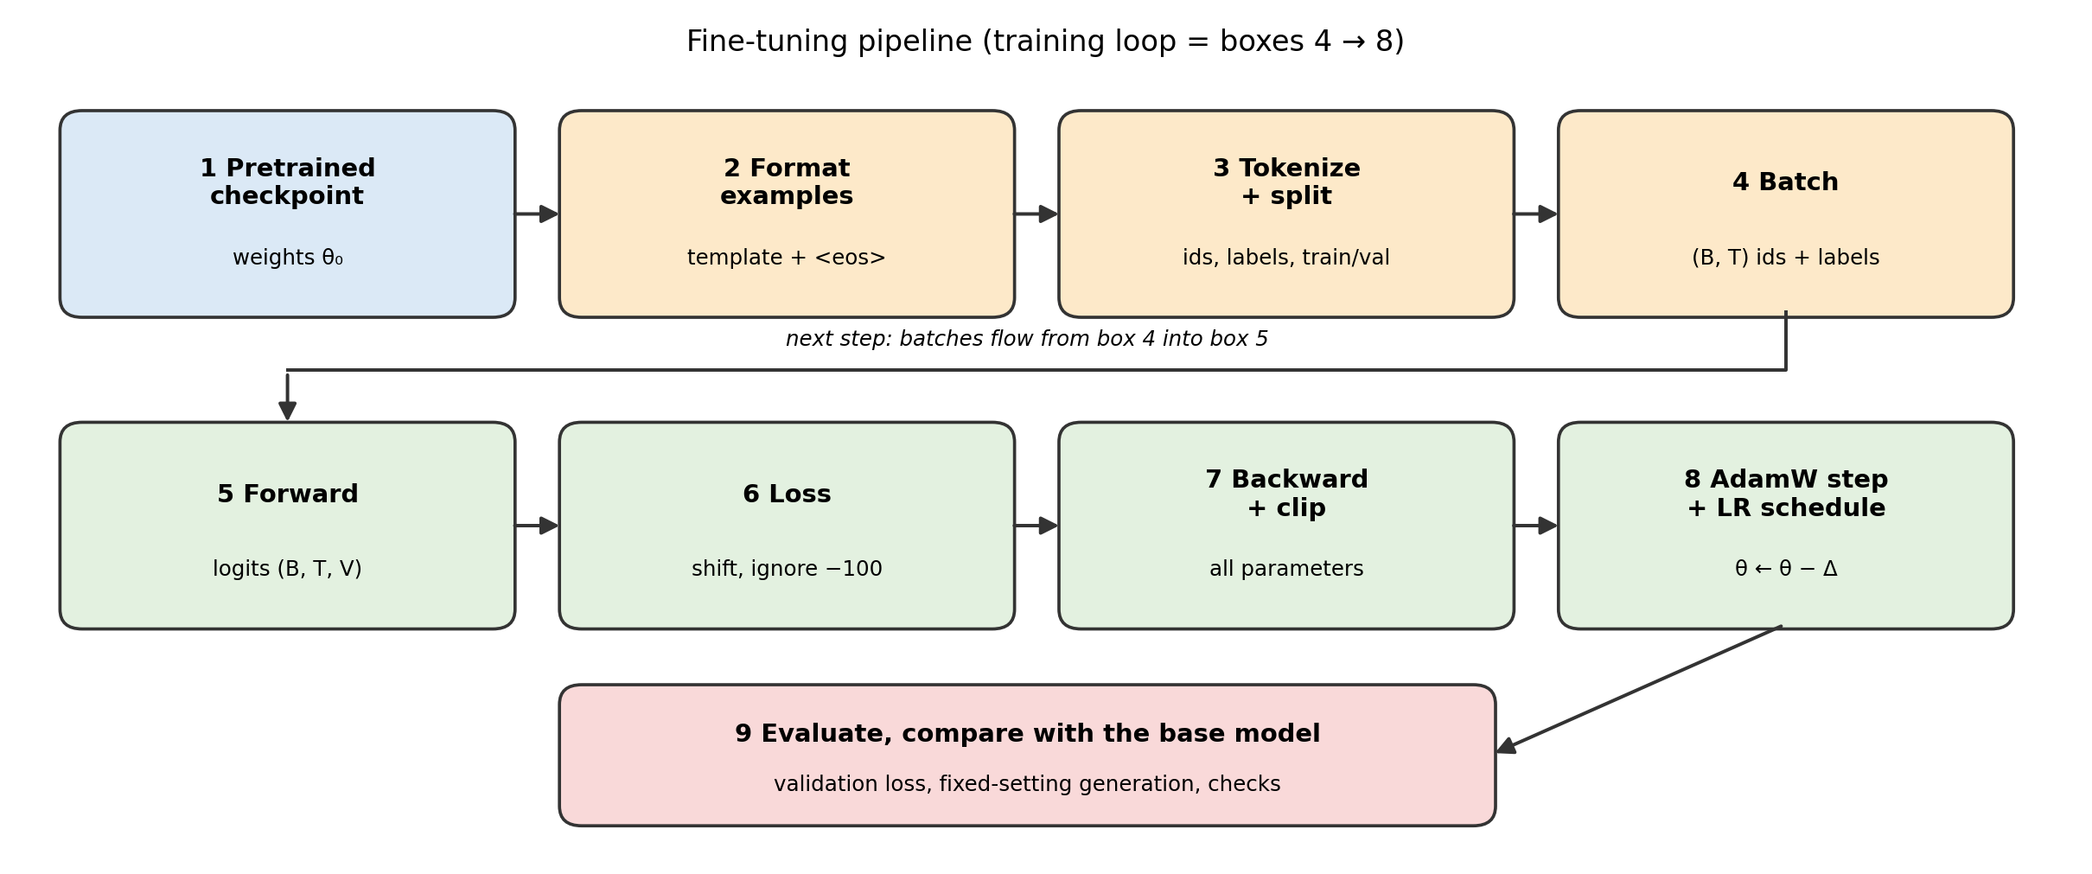
The fine-tuning pipeline
Top row: data preparation. Bottom row: one training step, repeated. Box 9: evaluation against the base model.
Notes:
Walk the figure left to right. The top row prepares data; the bottom row is one training step repeated many times; the last box is how we decide whether anything improved. Box 1 is the only thing that separates fine-tuning from training from scratch.

Slide 6
A toy world we can train in seconds
Real setting | Toy stand-in
GPT-2 pretrained on web text | Tiny GPT-style model pretrained on simple generic sentences
A task corpus (recipes) | Synthetic recipe records
Fine-tuning on recipes | Continued training on 120 recipe records
Forgetting general ability | Rising loss on held-out generic sentences
108,096
parameters in the toy model (GPT-2 small: 124 M)
240
possible recipes: 6 dishes × 10 ingredient sets × 4 step sets
Generic sentence
the cat sat on the mat .
Recipe record
recipe : dosa ; ingredients : rice , salt , oil ; steps : soak , grind , fry
120 / 40
training / validation records, split before training
Notes:
Real GPT-2 needs a GPU for comfortable experiments, so the notebook reproduces the same pattern at small scale. The pretraining text already contains the food words, so like GPT-2 the toy model knows the vocabulary but has never seen the recipe format. Be explicit that the data is synthetic and the model is not the Hugging Face GPT-2: results illustrate mechanisms only.

Slide 7
Inputs, labels and the ignored value −100
LIVE DEMO cell 12
input_ids token IDs, right-padded to the longest sequence in the batch
labels the targets we want a loss on, and −100 wherever there is no loss
input_ids
the
cat
sat
on
the
mat
.
<eos>
<pad>
<pad>
labels
the
cat
sat
on
the
mat
.
<eos>
−100
−100
A short sentence padded to the batch length. Padding is ignored; the real <eos> keeps its label.
Shift exactly once
The output at position t predicts token t + 1, so the loss pairs
logits[:, :-1] with labels[:, 1:]
The first token is never a target: nothing precedes it.
Two conventions — don't mix them
Our toy code: shifts explicitly
Hugging Face GPT2LMHeadModel: pass labels=input_ids unshifted; the model shifts internally
Shifting both ways predicts two tokens ahead and trains a quietly wrong model.
Notes:
Training needs two aligned (B, T) tensors. −100 is PyTorch cross-entropy's default ignore_index: those positions add nothing to the loss and are not counted in the average. Padding must be ignored. Then the shift: our code shifts explicitly; Hugging Face GPT2LMHeadModel shifts internally, so shifting yourself as well trains the model to predict two tokens ahead without any error message. Show notebook cell 12 output: pads appear as dots, the real <eos> keeps its label.

Slide 8
Every position makes a prediction
t | Model has seen | Target (t + 1) | Target is in
0 | recipe | : | prompt
1 | recipe : | dosa | prompt
2 | recipe : dosa | ; | prompt
3 | … dosa ; | ingredients | prompt
4 | … ingredients | : | prompt
5 | … ingredients : | rice | answer
6 | … rice | , | answer
7 | … rice , | salt | answer
8 | … salt | <eos> | answer
One forward pass over prompt + answer gives logits of shape (B, T, V): one next-token distribution per position
Causal mask: the guess at position t uses tokens 0 … t only
Teacher forcing: the true previous tokens are fed in, so every guess is scored at once
Each prompt token has two roles: context for every later position, and the target for the position just before it
At generation time prompt-position logits are computed too, then discarded; only the last one gives the first answer token
Notes:
Common confusion: students think only the answer is predicted. In training the whole record goes through in one forward pass and the model predicts at every position. Teacher forcing feeds the true previous tokens, so every guess can be scored at once. At generation time the model also computes logits at prompt positions; we just throw away all but the last.

Slide 9
Which predictions enter the loss?
LIVE DEMO cell 10
 | Loss on every token | Loss on the answer only
Labels | labels = input_ids (padding still −100) | Prompt positions also set to −100
Prompt tokens are | Context and targets | Context only: computed, never scored
Model learns | To imitate the prompts too, and produce the answer | Only to produce the answer, given the prompt
Typical use | Adapting to a domain's text; simplest | Instruction or chat data, where users write the prompts
Watch out for | Hard-to-guess prompt tokens (the dish name) can dominate | Fewer target tokens, so less training signal
1.254
1.011
Worked example (cell 10):
illustrative probabilities for the 10-token record on the previous slide. F.cross_entropy(…, ignore_index=−100) gives the same two numbers. This notebook uses every token.
mean −log P over all 9 predictions
mean over the 4 answer tokens only
Notes:
The choice is not what the model predicts but which predictions are scored. Run notebook cell 10: the same 9 made-up probabilities give a loss of 1.254 over every token and 1.011 over the four answer tokens, and F.cross_entropy with ignore_index reproduces both. Note the answer-only mean has a denominator of 4, not 9: ignored positions are not counted. This notebook uses every token.

Slide 10
Batching, padding and packing
A batch of two documents, right-padded to the same length
row 0
recipe
:
dosa
;
…
fry
<eos>
recipe
:
dosa
;
…
fry
<eos>
row 1
the
cat
…
.
<eos>
<pad>
<pad>
the
cat
…
.
<eos>
−100
−100
In each row, the top line is input_ids and the bottom line is labels.
The padding trap
GPT-2 has no pad token, so the usual practice reuses <|endoftext|> as padding.
Mask padding with the attention mask, not by token identity, or the genuine end-of-text label is erased too.
Packing: the alternative
Concatenate short documents, separated by <eos>, into fixed-length blocks.
+ no compute wasted on padding
− documents split across blocks; without special masking, a document can attend to an unrelated earlier one
Notes:
A batch is rectangular, so short documents are padded on the right. The trap: real GPT-2 has no pad token, so people reuse <|endoftext|> as padding, then mask labels by token identity, which erases the genuine end-of-text label. Preview of the never-stopping model later. Packing is the alternative used for large-scale training.

Slide 11
What “full” fine-tuning costs
Stored per parameter | Why | fp32 bytes
Weight θ | The model | 4
Gradient ∂L/∂θ | Output of the backward pass | 4
Adam first moment m | Running mean of gradients | 4
Adam second moment v | Running mean of squared gradients | 4
Total | ≈ 4× the weights | 16
1.9 GiB
23 GiB
GPT-2 small: fits a free GPU
GPT-2 XL: does not fit a typical free-tier GPU
Memory grows linearly with parameter count. Rough planning estimates from the GPT-2 parameter formula, not measurements. Activations come on top.
Notes:
Every parameter receives a gradient and is updated, including the embeddings (about 32% of GPT-2 small; the token table is shared with the output layer). Gradient = dL/dθ for each parameter: one fp32 number, 4 bytes. Adam keeps two more running averages. These are planning estimates for plain fp32 training, not measurements, and they exclude activations. Mixed precision keeps an fp32 master copy of the weights, so it saves activation memory more than parameter-state memory.

Slide 12
One training step, five parts
Forward
Loss
Backward
Clip
Update
logits = model(ids)
lm_loss(…)
loss.backward()
clip_grad_norm_(…, 1.0)
opt.step(); sched.step()
(B, T, V)
shift once, ignore −100
∂L/∂θ for every parameter
cap the gradient norm
AdamW + LR schedule
The toy model
GPT-2 design at small scale: learned positions, pre-norm blocks, causal attention, GELU feed-forward, tied output head
D = 64, 4 heads, 2 blocks: 108K parameters
Dropout 0.1, so train() and eval() behave differently
Sanity check before training
Untrained loss on recipes: 4.355
ln V = 4.344
Every token about equally likely, as expected. Starting far above ln V would suggest a bad initialization or a bug.
Notes:
The loop is the same as in the GPT-2 notebook; fine-tuning only adds decisions about how gently to update. Point at the code in notebook cell 22. The toy model uses dropout 0.1, so train() and eval() really differ: evaluate() switches to eval mode and back. Sanity check from cell 18: the untrained loss is 4.355, close to ln V = 4.344, i.e. every token about equally likely.

Slide 13
The knobs
Knob | What it controls | Typical practice
Peak learning rate | Size of each update | Much smaller than in pretraining. HF Trainer default 5e-5: a starting point only
Warmup | LR rises from 0 over the first few % of steps | Adam's moment estimates are noisy at first
Decay | LR falls (linear or cosine) to ~0 | Large steps early, small steps to settle
Gradient clipping | Rescales the gradient if its norm exceeds a limit | Commonly 1.0; guards against one odd batch
Weight decay (AdamW) | Shrinks weights slightly, decoupled from the gradient | Mild regularization; often skipped for biases and layer norms
Batch size / accumulation | Examples per update | Accumulate micro-batches when memory is short
Epochs / steps | Passes over the data | Few; stop by validation loss, not training loss
train() vs. eval() | Dropout on or off | train() for updates; eval() for measuring and generating
Notes:
The learning rate matters most. 5e-5 is the Hugging Face Trainer default: a starting point, not an answer; choose by validation loss. Warmup protects against noisy early Adam estimates. Weight decay in AdamW is decoupled from the gradient (Loshchilov and Hutter, 2019). Stop by validation loss, not training loss.

Slide 14
Warmup, then linear decay
η(s) = η_{max} · (s + 1) / S_{w} for s < S_{w}
η(s) = η_{max} · (S − s) / (S − S_{w}) for s ≥ S_{w}
S: total steps; S_{w}: warmup steps; η_{max}: peak LR
Warmup avoids destructive first updates while Adam's estimates are still noisy
Decay takes large steps early to adapt, small steps late to settle
Notes:
Read the equation with the plot. With S = 800 total steps and 10% warmup, the LR rises linearly to the peak over the first 80 steps, then falls linearly to zero at the end. This is the schedule used for every run in the notebook (cell 20).

Slide 15
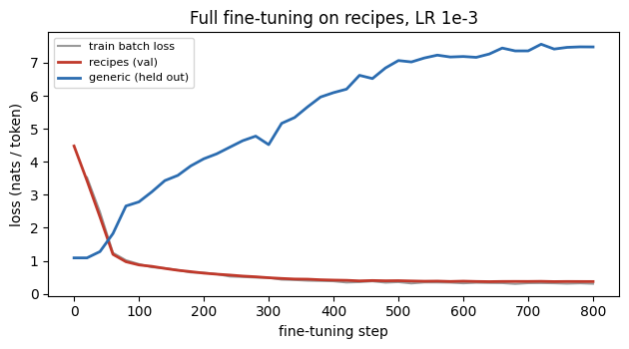
Pretrain, then fine-tune
LIVE DEMO cells 24–26
Recipes (validation)
4.48 → 0.37
Learned the format and much of the dish-specific content
Generic (held out)
1.09 → 7.48
Pretraining: generic sentences, 400 steps, LR 3e-3. Fine-tuning: 120 recipes, 800 steps, LR 1e-3. Toy model, one CPU run.
Catastrophic forgetting: the updates moved weights the old data relied on
Notes:
Step 1 (cell 24): 'pretrain' the toy model on generic sentences only, 400 steps at LR 3e-3. Step 2 (cell 26): copy the weights and fine-tune all parameters on 120 recipes, 800 steps at LR 1e-3. Red falls steeply: the model learned the format on records it never saw. Blue rises: catastrophic forgetting. In this tiny model forgetting is much stronger than it would be for GPT-2, but the direction is the same. The grey line is noisy because each point is one small batch.

Slide 16
Base vs. fine-tuned: same prompt
LIVE DEMO cell 28
Prompt | Base model continues | Fine-tuned model continues
recipe : dosa ; | ingredients , , , , , . <eos> | ingredients : rice , lentil , water ; steps : soak , grind , fry <eos>
recipe : kheer ; | ingredients , , , , , . <eos> | ingredients : milk , sugar , cardamom ; steps : boil , stir , sweeten <eos>
the cat sat | on the mat . <eos> | : rice , chili , water , ghee ; steps : roast , saute , serve <eos>
Format learned
Forgetting in the text
Two samples prove little
The fine-tuned model writes the full record for each dish and ends with <eos>.
On a generic prompt it drifts into recipe vocabulary.
Well-formatted output can still hold wrong content. Measure over many samples.
Notes:
Greedy decoding, so there is no randomness: these are the saved outputs of notebook cell 28. Loss is necessary but not sufficient, so always look at generations. Point out the third row: forgetting is visible in the text, not only in the loss. Two greedy examples cannot tell us how often the content is right; that is the job of the evaluation section.

Slide 17
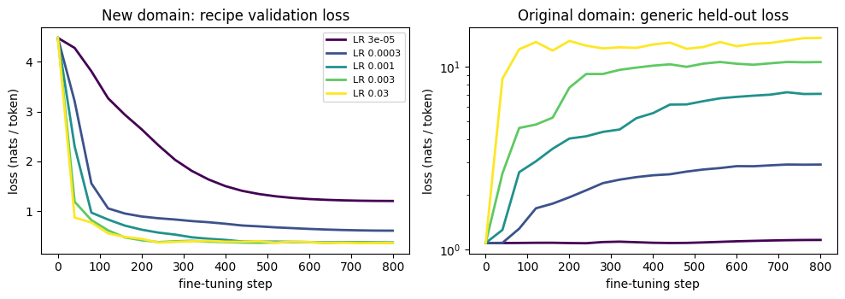
Learning rate: plasticity vs. stability
LIVE DEMO cell 31
Peak LR | Recipes val | Generic held-out
3e-5 | 1.206 | 1.131
3e-4 | 0.610 | 2.916
1e-3 | 0.372 | 7.095
3e-3 | 0.368 | 10.583
3e-2 | 0.362 | 14.343
Too small (3e-5): little learned, little forgotten
1e-3 and above: recipe loss flat at ≈ 0.37, generic loss keeps climbing: extra LR buys nothing and costs a lot
Toy model: one run per setting and very little capacity, so forgetting is far more extreme than in GPT-2
Notes:
Five peak learning rates, same base model, same batch order (cell 31). One run per setting on a toy model: read trends, not exact numbers. From 1e-3 upward the recipe loss has flattened while generic loss keeps climbing: the extra learning rate buys nothing and costs a lot. Which setting is right depends on whether the model must still work as a general model. Note we chose by validation loss, not training loss.

Slide 18
Limiting forgetting and overfitting
Lower LR / fewer steps
Replay (data mixing)
Small data overfits
Move the weights less
Mix some original-style data into each batch
Training loss keeps falling as the model memorizes a few hundred examples
Validation loss stops improving, then rises: the gap is the warning
Keep the best checkpoint by validation loss, or stop early
With little data: smaller LR, fewer epochs, more diverse examples
Cost: May under-fit the new task
Cost: Needs access to such data
Freeze layers
Regularize toward θ₀
Train only part of the network
Penalize drift from the pretrained weights (Kirkpatrick et al., 2017)
Cost: Partial fine-tuning; a precursor of PEFT
Cost: Extra hyperparameters
Notes:
Four ways to limit forgetting, each with a cost. Freezing layers is partial fine-tuning, a precursor of PEFT, covered next. Regularizing toward the pretrained weights: Kirkpatrick et al. (2017), elastic weight consolidation. For small datasets: training loss keeps falling while validation loss turns up; the gap is the sign of overfitting. Keep the best checkpoint or stop early.

Slide 19
A model that never stops
LIVE DEMO cell 34
Bug
tok.pad_token = tok.eos_token
labels[input_ids == tok.pad_token_id] = -100
Masks every end-of-text label, including the real ones.
Fix
labels[attention_mask == 0] = -100
Mask by which positions are padding, not by which token sits there.
Experiment: fine-tune twice, with and without the <eos> label; sample 40 recipes at temperature 1; count how many stop on their own
What to look for: with the label, nearly every sample stops after the record; without it, the model runs to the token limit and often starts a new, malformed record
Invisible in the loss curve: only generation reveals it
Rule of thumb
After building labels, print one decoded example with its labels and check the last real token. It takes ten seconds.
Notes:
Very common real bug. GPT-2 has no pad token, so people set pad_token = eos_token and then mask labels by token identity, which masks every end-of-text token, including the genuine ones. Run cell 34: the same fine-tuning with <eos> labels masked; sample 40 completions at temperature 1 and count how many stop within 30 new tokens. Expected pattern (see the notebook's reading notes): the correct model stops in nearly every sample; the buggy one runs to the token limit. Report the numbers your run prints. The loss curve does not reveal this bug.

Slide 20
What each measurement tells you
Measurement | Tells you | Does not tell you
Validation loss / perplexity | How well held-out text from the same distribution is predicted | Whether outputs are correct or useful; not comparable across tokenizers
Held-out original-domain loss | How much general ability was lost | Whether that loss matters for your application
Generations (fixed prompts and settings) | What a user sees: format, style, stopping | Statistical reliability from a handful of samples
Task-specific automatic checks | Whether outputs satisfy rules you can write down | Quality beyond those rules
BLEU / ROUGE | n-gram overlap with a reference | Factuality or usefulness; depends on tokenization and references
Human review with a rubric | Usefulness, correctness, tone | Cheapness or consistency: needs clear criteria and several raters
Always: compare with the base model under identical prompts and decoding settings, and record those settings with the result.
Notes:
Each measurement answers one question and leaves others open. Perplexity is not comparable across tokenizers or datasets. BLEU and ROUGE measure surface overlap and depend on tokenization and reference quality; they do not establish factuality or usefulness. The single most important control: compare with the base model under identical prompts and decoding settings, and record those settings.

Slide 21
A rule-based check for the toy task
LIVE DEMO cell 37
Category | Meaning
Format-valid | Matches recipe : D ; ingredients : a , b , c ; steps : x , y , z <eos>
Content-valid | Format-valid, and a possible recipe for dish D
Copied | Content-valid and identical to a training record
Novel valid | Content-valid and never shown in training
What the check shows
Content-valid < format-valid: some recipes look right but mix ingredients or steps from the wrong dish
Loss alone doesn't rank models: two LRs with almost equal recipe loss differ clearly in content-validity
Memorization: most valid outputs are copies of training records, almost none novel
Real data: needs human review against a rubric; BLEU / ROUGE cannot replace it
60 samples per model at temperature 1, one seed: compare only large differences.
Notes:
Because the toy recipes have a known structure, we can write down what a correct output is and measure it over 60 samples per model (cell 37, reusing the Section 7 sweep models). Report the percentages your run prints, and remind students that with 60 samples and one seed they move by several points: compare only large differences. The lessons on the right are the notebook's observed patterns. 'Copied' is the toy version of memorization of private or copyrighted training data.

Slide 22
Responsible use
Data rights and privacy
Inherited and amplified bias
Fine-tune only on data you may use. Models can memorize and reproduce training text, including personal data.
GPT-2 reflects its web text; a small fine-tuning set can sharpen it. Check outputs across realistic inputs.
Fluency is not truth
Prototype, not product
A well-formatted recipe can contain wrong or unsafe steps. Keep a human in the loop for anything consequential.
Deployment needs realistic evaluation, monitoring, and license review for the base model and the data.
Notes:
Four points, each tied to something students saw: memorization (the copied category), bias, fluency vs. truth (format-valid but content-invalid), and the gap between a teaching prototype and a product.

Slide 23
Check your understanding
1
For tokens [A, B, C, D] with labels −100 on A and B, which predictions enter the loss, and what is the denominator of the mean?
2
Why is labels[input_ids == pad_token_id] = −100 dangerous when pad_token = eos_token? What would you use instead?
3
GPT2LMHeadModel shifts labels internally. What goes wrong if you also shift them yourself?
4
Estimate the fp32 training-state memory for a 355M-parameter model.
5
The largest learning rate gave the lowest recipe loss. Argue for and against choosing it.
6
Give one case where fine-tuning beats retrieval, and one where retrieval is better.
Notes:
Selected from the notebook's Section 11 (questions 2, 3, 4, 5, 7, 9). Good for pair discussion. Expected answers belong in instructor material, not on the slide.

Slide 24
Next, and further reading
Radford et al. (2019). Language Models are Unsupervised Multitask Learners. The GPT-2 report.
Howard & Ruder (2018). Universal Language Model Fine-tuning for Text Classification. arXiv:1801.06146
Loshchilov & Hutter (2019). Decoupled Weight Decay Regularization (AdamW). arXiv:1711.05101
Kirkpatrick et al. (2017). Overcoming catastrophic forgetting in neural networks. arXiv:1612.00796
Carlini et al. (2021). Extracting Training Data from Large Language Models. arXiv:2012.07805
Korthikanti et al. (2022). Reducing Activation Recomputation in Large Transformer Models. arXiv:2205.05198
Hugging Face docs: causal language modeling guide · GPT-2 model card · Trainer
Next
Fine-tuning with the Hugging Face Trainer: the same loop, through the Trainer API, on a real pretrained model.
hf_trainer_fine_tuning.ipynb
Notes:
Next lecture runs the same kind of loop through the Hugging Face Trainer on a real pretrained model.

