Slide 1
Attention mechanisms
Multi-head, multi-query, and grouped-query attention, and what else modern LLMs change
Generative AI (ABAI3009L) · Module 2: Transformers & LLMs
Companion notebook: module2/transformers/attention_mechanisms.ipynb
Notes:
Open the companion notebook in a second window and run it once top to bottom before class (a few seconds on a CPU), so every live demo already has output. The attention-sink demo (cell 40) downloads distilgpt2 from Hugging Face (about 350 MB) on its first run; do that before class or set RUN_SINK_DEMO = False and use the figure on slide 20. Amber 'LIVE DEMO' tags mark where to switch to the notebook; the cell numbers are 0-based positions in the notebook. Prerequisites: the key-value cache notebook and its slides. Suggested split for 60 minutes: slides 2-15 are the core (about 47 min, with notebook demos), slides 21-24 wrap up (about 5 min), and if time allows, the optional block on sliding windows and attention sinks (slides 16-20, about 15 min); otherwise set it as reading. FlashAttention, formerly an optional block here, now has its own notebook (flash_attention.ipynb) and deck.

Slide 2
What you will learn
Llama-2-7B, fp16:
one 4,096-token conversation → ~2 GiB of KV cache. 32 at once → 64 GiB, more than 4× the weights.
Every new token reads that whole cache. How do modern LLMs shrink it without removing attention heads?
1
The decoding bottleneck
2
MHA → GQA → MQA
3
One class for all three
Why generation waits on memory reads, not arithmetic
Three variants that differ in one setting: the number of K/V heads
Two code changes, and checks that the implementation is correct
Next: FlashAttention
the same attention, computed without the T × T matrix. Its own notebook and slides.
4
The trade-off at scale
5
Sliding windows and sinks
Memory, parameters, quality, and what Llama, Mistral and Falcon use
Capping the cache length, and why the first tokens must stay (optional)
Notes:
Open with the numbers on the slide: one 4,096-token conversation with Llama-2-7B needs about 2 GiB of key-value cache (fp16), and serving 32 conversations at once needs 64 GiB of cache, several times the 13.4 GB of weights. Every generated token reads all of it. The lecture answers the question on the right. Preview the five parts; part 5 is an optional extension. The dark card points to the FlashAttention lecture, which has its own notebook and deck.

Slide 3
Reminder: attention is a soft lookup table
Vector | Question it answers | Role
Query Q | What am I looking for? | the current position's request
Key K | What do I offer as a match? | used only for matching
Value V | What do I actually pass on? | used only for information transfer
In MHA every head has its own Q, K and V
searches
Q1
K1, V1
searches
Q2
K2, V2
searches
Q3
K3, V3
Attention(Q, K, V) = softmax( QK^{T} / √d_{k} ) V
searches
Q4
K4, V4
Multi-head attention (MHA) runs H lookups in parallel, each on its own head_dim = d_model / H slice, with its own Q, K and V projections.
… up to head H
Different heads can learn different lookups, e.g. nearby tokens vs. long-range links. That flexibility has a cost at generation time.
Notes:
A quick refresher, two minutes at most. Keys are used only for matching, values only for information transfer: that split is what makes sharing them across heads possible later. Each head has its own query, key and value projections, so each can learn a different lookup. Section 2 of the notebook shows what that flexibility costs at generation time.

Slide 4
Generation: one new query reads the whole cache
Prefill: the whole prompt in one pass, store its K and V
At every decoding step
The
robot
opened
the
query length Tq = 1
keys read: all T_past earlier tokens
in every layer and every head
nothing is recomputed, but everything is read from memory
Decode: one token per step, attending to everything cached
The
robot
opened
the
door
step 1: 5 keys
The
robot
opened
the
door
and
step 2: 6 keys
Grey: K and V read from the cache. Teal: the new token, the only one whose Q, K, V are computed.
Two ways to read less:
fewer heads in the cache (this lecture), or fewer positions (sliding windows, optional).
MHA cache, per layer:
cached_K, cached_V: (B, H, T_past, head_dim)
Notes:
Recall the key-value cache lecture. During generation each step processes one new token, so the query length is 1, but that query must attend to every earlier token's key and value, in every layer. Past keys and values never change, so they are stored rather than recomputed. Point at the cache shape: the H in it is what this lecture shrinks. Its length T_past is what sliding windows cap later.

Slide 5
Counting one head's arithmetic
LIVE DEMO cell 4
Step 1: scores = q · K^{T}
Step 2: output = weights · V
V (T × d), from the cache
Kᵀ (d × T), from the cache
score 3
q · column 3
d = 4 multiply-adds
output 2
weights · column 2
T = 6 multiply-adds
q (1 × d)
scores (1 × T)
weights (1 × T)
output (1 × d)
6 scores × 4 = T·d multiply-adds = 2·T·d FLOPs
4 outputs × 6 = T·d multiply-adds = 2·T·d FLOPs
Every number in K and V is used in exactly one multiply-add per query head: 2·T·d + 2·T·d = 4·T·d FLOPs per head, 4·H·T·d for H heads.
Notes:
Show the figure in cell 4, or draw it on the board. Toy sizes: T = 6 cached tokens, head width d = 4, one query head, one decoding step. Left: each score is the dot product of q with one column of K transposed, so it costs d = 4 multiply-adds; T scores cost T times d. Right: each output value is the weights dotted with one column of V, so it costs T = 6 multiply-adds; d outputs cost T times d again. A multiply-add counts as 2 FLOPs, so each product is 2 T d FLOPs and one head does 4 T d. The key observation for the next slide: every number in K and V takes part in exactly one multiply-add per query head. The count leaves out the softmax and the 1/sqrt(d) scaling (about T operations per head) and the Q, K, V, O projections, which are a separate cost.

Slide 6
Why reading the cache, not computing, is the limit
One decoding step, one layer, G key/value heads (fp16)
The arithmetic is fixed by the number of query heads.
The only way to speed decoding up is to read fewer bytes, which means storing fewer K/V heads.
 | Amount
Arithmetic: q·K and weights·V for H query heads | ≈ 4 · H · T · head_dim FLOPs
Cache read: K and V for G heads, 2 bytes each | = 4 · G · T · head_dim bytes
Arithmetic per byte read | H / G FLOP/byte
≈ 1
~100
Do all heads really need separate keys and values? Or can each head ask its own question (its own query) and search a shared table?
FLOP per byte read with MHA (G = H)
FLOPs a modern GPU can do in the time it reads one byte
So the GPU spends most of each decoding step waiting for data.
Notes:
The previous slide counted one head; now put it in a table with the class. Arithmetic: q dot K is H times T times head_dim multiply-adds, and weights times V the same, so about 4 H T head_dim FLOPs (a multiply-add counts as 2). Bytes: K and V, for G heads, T positions, head_dim values, 2 bytes each in fp16, so 4 G T head_dim. The ratio is H over G. With MHA, G = H, about 1 FLOP per byte. A modern data-centre GPU can do on the order of 100 FLOPs in the time it reads one byte, so it mostly waits for data. The arithmetic is set by the number of query heads, which we want to keep. So the only lever is to read fewer bytes. End on the question in the callout; the next slide previews the answer.

Slide 7
Each byte read serves H/G heads
LIVE DEMO cell 6
MHA
Q1
Q2
Q3
Q4
Q5
Q6
Q7
Q8
1 FLOP/byte
8 / 8 = H / G
G = 8 K/V heads
K,V1
K,V2
K,V3
K,V4
K,V5
K,V6
K,V7
K,V8
GQA
Q1
Q2
Q3
Q4
Q5
Q6
Q7
Q8
4 FLOP/byte
8 / 2 = H / G
G = 2 K/V heads
K,V1
K,V2
MQA
Q1
Q2
Q3
Q4
Q5
Q6
Q7
Q8
8 FLOP/byte
8 / 1 = H / G
G = 1 K/V head
K,V1
Grey: one query head's arithmetic, 4·T·d FLOPs, the same in every row. Blue: one K/V head read from the cache, 4·T·d bytes, read once and used by every head connected to it.
Notes:
Show the figure in cell 6. Each grey chip is one query head's arithmetic, 4 T d FLOPs; each blue chip is one K/V head read from the cache, 4 T d bytes in fp16. The top row is the same in all three variants: 8 query heads, each doing its own work. Only the bottom row shrinks. A K/V head is read from memory once and then used by every query head connected to it, so FLOPs per byte is just the number of query heads per K/V head, H/G: 1 for MHA, 4 for this GQA, 8 for MQA. This answers the question on the previous slide: yes, heads can share keys and values, and every head still asks its own question. The next section shows how the sharing is implemented and what it costs in quality.

Slide 8
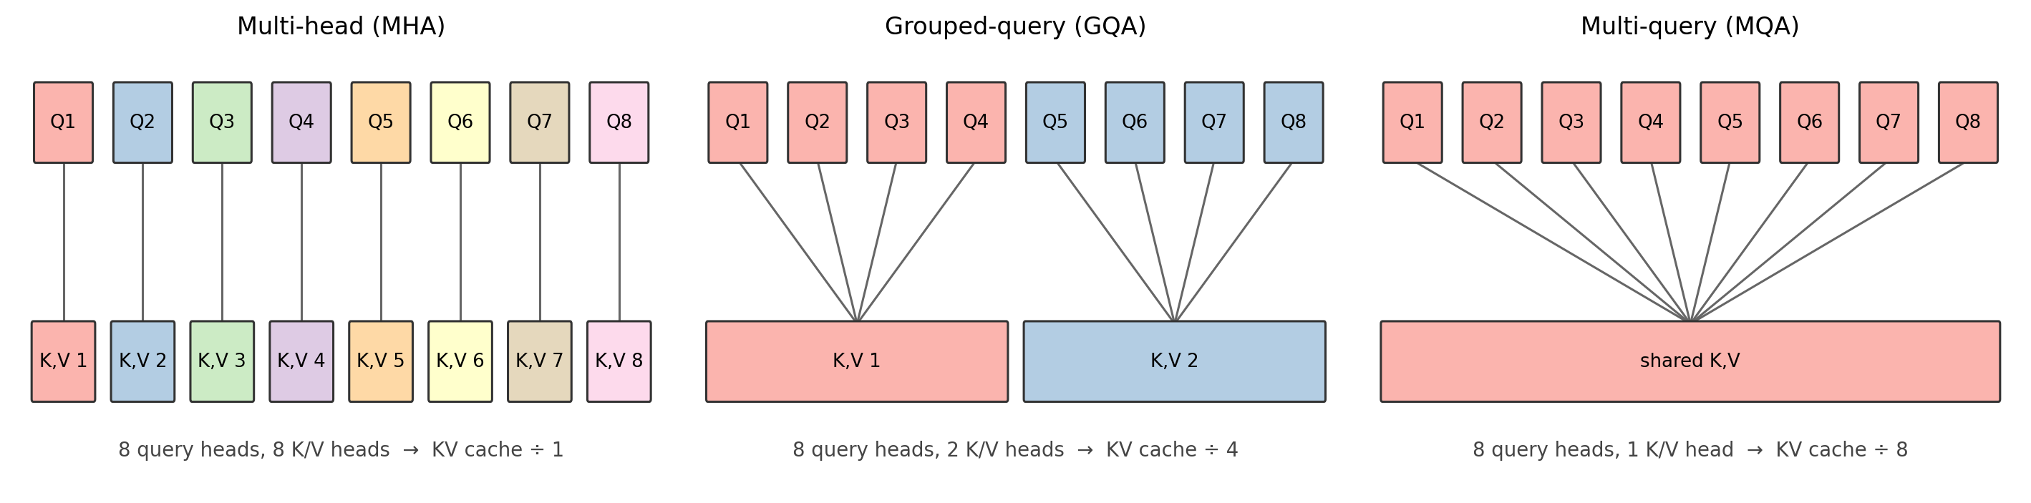
MHA, GQA and MQA: one setting differs
LIVE DEMO cell 11
Variant | Query heads | K/V heads G | Who shares | KV cache vs. MHA
Multi-head (MHA) | H | H | nothing is shared | 1×
Grouped-query (GQA) | H | 1 < G < H | each group of H/G query heads | G / H
Multi-query (MQA) | H | 1 | all query heads | 1 / H
Per head, the formula is unchanged:
head_{h} = softmax( Q_{h} K_{g(h)}^{T} / √d_{k} ) V_{g(h)}
g(h) = ⌊ h / (H/G) ⌋
Only which K and V each head reads changes.
Notes:
Show the figure in cell 11. Colours show which query heads share a K/V head. Stress the first point: every variant still has 8 query heads, so it still produces 8 different attention patterns. MQA does not remove heads. Only the bottom row, the part that is cached and read at every step, gets smaller. The formula per head is unchanged; only which K and V it reads changes: head h reads K/V head g(h) = floor(h / (H/G)), so consecutive query heads share.

Slide 9
One class, two changes
LIVE DEMO cell 14
W_q = nn.Linear(d_model, n_heads * head_dim)
W_k = nn.Linear(d_model, n_kv_heads * head_dim) # change 1
W_v = nn.Linear(d_model, n_kv_heads * head_dim)
Q = split_heads(W_q(x), n_heads) # (B, H, T, Dh)
K = split_heads(W_k(x), n_kv_heads) # (B, G, T, Dh)
if cache: K = torch.cat([cache[0], K], dim=2) # + V
new_cache = (K, V) # stored with G heads
K_shared = K.repeat_interleave(group_size, dim=1)
V_shared = V.repeat_interleave(group_size, dim=1)
scores = Q @ K_shared.transpose(-2, -1) / sqrt(Dh)
Shapes printed by cell 14 (B = 2, T = 6, d_model = 32, H = 4)
 | G | cached K | scores
MHA | 4 | (2, 4, 6, 8) | (2, 4, 6, 6)
GQA | 2 | (2, 2, 6, 8) | (2, 4, 6, 6)
MQA | 1 | (2, 1, 6, 8) | (2, 4, 6, 6)
Output: (2, 6, 32) in all three
Cached K shrinks 4 → 2 → 1 heads: the saving
Scores stay (B, H, T, T): every query head keeps its own pattern
Same output shape: the variants swap into a block
Amber: the two changes from standard MHA. Teal: the cache is stored before the repeat. group_size = H / G.
Notes:
Walk through GroupedQueryAttention in cell 14. Change 1: W_k and W_v produce G times head_dim features instead of H times head_dim. Change 2: before attention, each K/V head is repeated for the H/G query heads in its group with repeat_interleave. The crucial line is new_cache = (K, V) before the repeat: the cache stores only the G original heads, which is where the memory saving comes from. Then run the cell and read the shapes: cached K shrinks 4, 2, 1 heads; scores stay (B, H, T, T) because every query head still has its own attention pattern; the output is unchanged, so the variants are drop-in replacements for each other.

Slide 10
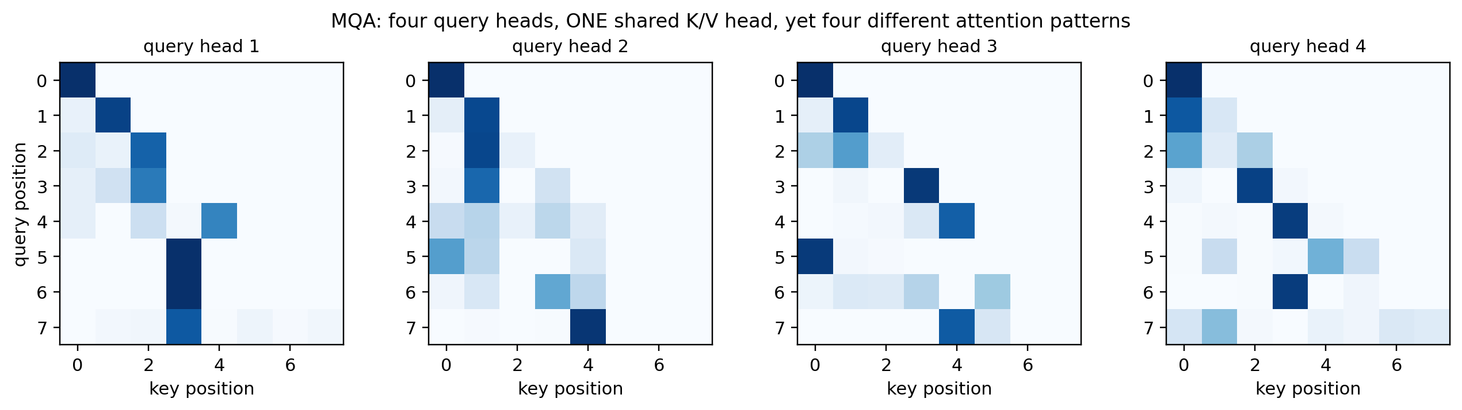
Shared keys, different patterns
LIVE DEMO cells 17–19
Correctness checks (cell 17)
Same keys, different queries:
each head has its own query projection, so its dot products with the shared keys, and therefore its softmax weights, differ. Largest difference between two heads: 1.00.
G = H matches nn.MultiheadAttention: True
G = 1: repeat_interleave == broadcasting: True
Notes:
Cell 17 runs two checks. With G = H the class matches PyTorch's nn.MultiheadAttention after copying the weights across. With G = 1, repeat_interleave gives the same result as broadcasting the size-1 head axis, which is what efficient kernels do without copying. Then cell 19: a random MQA layer with a single K/V head, yet four clearly different patterns (the largest difference between two heads' weights is 1.00, so some query reads a key with weight near 1 in one head and near 0 in another). The inputs are scaled by 3 to make the random-weight patterns sharp. Ask the class why, before revealing the right-hand card.

Slide 11
Decoding: the head axis is the saving
LIVE DEMO cell 22
Cached K shape (B, heads, positions, head_dim) after each phase
prefill
step 1
step 2
step 3
= full recompute?
MHA
(1, 4, 5, 8)
(1, 4, 6, 8)
(1, 4, 7, 8)
(1, 4, 8, 8)
True
GQA
(1, 2, 5, 8)
(1, 2, 6, 8)
(1, 2, 7, 8)
(1, 2, 8, 8)
True
MQA
(1, 1, 5, 8)
(1, 1, 6, 8)
(1, 1, 7, 8)
(1, 1, 8, 8)
True
Sequence axis grows by one per generated token, in every variant.
Head axis is 4, 2 or 1: the factor GQA and MQA save on every step.
Same result: cached decoding equals a full recomputation; the cache only removes repeated work.
Notes:
Cell 22 runs a single attention layer: prefill 5 prompt positions, then decode 3 new positions one at a time, with random vectors standing in for token embeddings. Read the trace: the third axis, the sequence, grows by one per generated token. The second axis, the heads, stays at 4, 2 or 1: that is the factor GQA and MQA save on every step. Each variant's cached result matches a full recomputation without a cache, so the cache changes the amount of work, not the result.

Slide 12
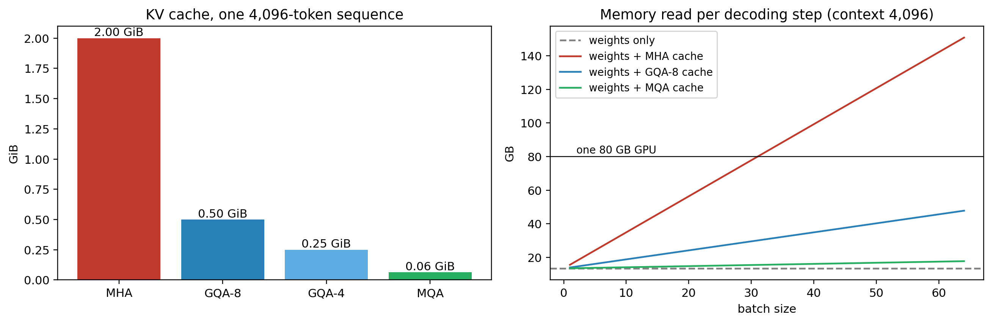
The saving at Llama-2-7B scale
LIVE DEMO cell 25
¼ and 1/32
~7 / ~32
33.6M → 8.4M
1 → 4 → 32
of the MHA cache for GQA-8 and MQA
sequences at which the MHA cache passes the weights / one 80 GB GPU
K+V projection parameters per layer, MHA → GQA-8 (Q and O unchanged)
FLOP per byte read: MHA → GQA-8 → MQA
Notes:
Cell 25 uses Llama-2-7B's sizes: 32 layers, 32 heads, head width 128, fp16, about 6.7B parameters, so about 13.4 GB of weights. Left: one 4,096-token sequence needs 2 GiB of cache with MHA, 0.5 with GQA-8, 1/16 GiB with MQA. Right: the memory read at every decoding step as the batch grows. Weights are read once per step whatever the batch; the cache grows with batch times context. With MHA the cache outgrows the weights at about 7 sequences and weights plus cache pass one 80 GB GPU at about 32. With GQA-8, batch 64 still stays under 50 GB. Note: these are arithmetic from published sizes, not measurements. Llama-2-7B itself uses MHA; GQA-8 here is a what-if.

Slide 13
GQA buys throughput, not fewer FLOPs
Batch | MHA | GQA-8 | MQA
1 | 15.5 GB · 7.8 ms 129 tokens/s | 13.9 GB · 7.0 ms 144 tokens/s | 13.5 GB · 6.7 ms 149 tokens/s
16 | 47.8 GB · 23.9 ms 670 tokens/s | 22.0 GB · 11.0 ms 1,455 tokens/s | 14.5 GB · 7.2 ms 2,211 tokens/s
32 | 82.1 GB: does not fit | 30.6 GB · 15.3 ms 2,093 tokens/s | 15.5 GB · 7.8 ms 4,116 tokens/s
Helps: decoding
Capacity: more or longer sequences fit next to the weights
Bandwidth: fewer bytes read per step, so faster steps
Does not help
Memory read per step · idealized step time at 2.0 TB/s (A100) · throughput = batch ÷ step time. Llama-2-7B sizes, context 4,096. Reads only: estimates, not measurements.
Attention FLOPs: every query head still scores every key
Training, prefill: limited by compute, not cache reads
Growth with context: still linear; see sliding windows
1.1× → 2.2×
31 → 124
140 → 1,450
GQA-8 speed-up over MHA, batch 1 → batch 16
4,096-token sequences that fit on 80 GB, MHA → GQA-8
tokens/s with GQA-8, batch 1 → batch 16
Notes:
This slide is the 'Where GQA and MQA help' table in notebook cell 26 (markdown, nothing to run). Each step must read the weights (13.4 GB) plus every sequence's cache; the table divides that by the A100's 2.0 TB/s from Section 2. These are idealized estimates from reads only, not measurements: compute, activations and overheads are ignored. Read it in two directions. Down a column: with MHA the step time grows fast because the cache dominates; with MQA it hardly grows. Across a row: at batch 1 GQA-8 is only about 10 percent faster, because the weights dominate; at batch 16 it more than halves the step; at batch 32 MHA no longer fits on one 80 GB GPU (about 31 sequences of 4,096 tokens at most, against about 124 with GQA-8). The main payoff is throughput: a bigger batch makes each step a little slower but gives one token per sequence per step, so GQA-8 at batch 16 makes about 1,450 tokens per second against about 140 at batch 1. The teal second line in each cell is that throughput, batch divided by step time. Compare columns at batch 16: MHA reaches only about 670 tokens per second because its cache reads grow four times faster than GQA-8's; MQA reaches about 2,200. Then the right-hand card: the attention FLOPs are unchanged, training and prefill are compute-bound so barely change, and the cache still grows with context, which is what sliding windows address. Ask: a chatbot serving one user with short prompts switches from MHA to GQA. Should it expect a big speed-up? (No: at batch 1 the weights dominate what is read.)

Slide 14
The trade-off, and what real models choose
 | Gained | Given up
MQA | the smallest cache and the fastest decoding | all heads match against the same key features and read the same values: less expressive, quality can drop
GQA | most of the saving (GQA-8 caches 4× less than 32-head MHA) | a little expressiveness; the GQA paper reports quality close to MHA
What real models use
Model | Query heads | K/V heads | Variant
GPT-2 small | 12 | 12 | MHA
Llama-2-7B | 32 | 32 | MHA
Falcon-7B | 71 | 1 | MQA
Llama-2-70B | 64 | 8 | GQA
Llama-3-8B, Mistral-7B | 32 | 8 | GQA
In the lookup-table picture
MHA: every head has its own index and its own notes.
GQA: each group of heads shares an index and notes.
MQA: every head asks its own question of one shared index and one set of notes.
Sources: Touvron et al. (2023), Llama 2; Jiang et al. (2023), Mistral 7B; Almazrouei et al. (2023), Falcon; Ainslie et al. (2023), GQA.
Notes:
Use the lookup-table picture: with MHA every head has its own index and its own notes. With MQA every head asks a different question but consults one shared index and one shared set of notes. GQA gives each group of heads its own index and notes. The GQA paper (Ainslie et al., 2023) reports quality close to MHA with speed close to MQA. Point out that GPT-2 and Llama-2-7B use plain MHA, while Llama-2-70B, Llama-3-8B and Mistral-7B use GQA with 8 K/V heads, and Falcon-7B uses MQA. Ask: why might a model family use MHA at 7B but GQA at 70B? (The larger model is the one most expensive to serve.)

Slide 15
Uptraining an MHA checkpoint to GQA
LIVE DEMO cell 27
Step 1: mean-pool each group's K (and V) projection
52%
K head 1
K head 2
K head 3
K head 4
relative change in this toy layer's output right after pooling, before any uptraining
mean → K/V 1
mean → K/V 2
A starting point, not a finished model.
Pooling discards the differences between heads within a group; continued training lets the model recover. The grouping matches repeat_interleave: heads 1–2 share K/V 1, heads 3–4 share K/V 2.
Q and output projections are copied unchanged. W_k: (32, 32) → (16, 32) in cell 27.
2
Step 2: continue pretraining briefly
The GQA paper uses about 5% of the original pretraining compute, so the model adapts to the shared heads.
Notes:
The GQA paper does not train GQA models from scratch. It converts an existing MHA checkpoint: mean-pool the K and V projection weights of the heads in each group into one K/V head, then continue pretraining briefly, about 5 percent of the original compute, so the model adapts. Cell 27 does step 1 in a few lines. The grouping matches repeat_interleave: consecutive heads 0 and 1 share K/V head 0, heads 2 and 3 share K/V head 1. Right after pooling the output of this random layer changes by 52 percent: pooling throws away the differences between heads in a group, which is why step 2 is needed. The pooled weights are a starting point, not a finished model.

Slide 16
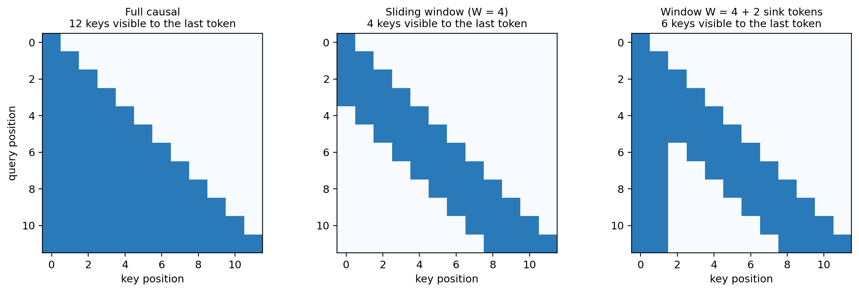
Optional: sliding-window attention
LIVE DEMO cell 30
Full causal:
the last token reads all 12 keys; the cache grows with every token.
Sliding window, W = 4:
at most W keys per row, so at most W cached per layer: a rolling buffer.
Window + 2 sinks:
the first two columns stay visible to every row; the cache holds 2 + W keys.
Notes:
Optional extension. GQA and MQA store fewer heads; a sliding window stores fewer positions. Each token attends only to the last W tokens including itself. The cache stops growing at W entries per layer and becomes a rolling buffer. Mechanically it is just a different mask: a diagonal band instead of the full lower triangle. The third panel adds two attention sinks, explained on slide 19.

Slide 17
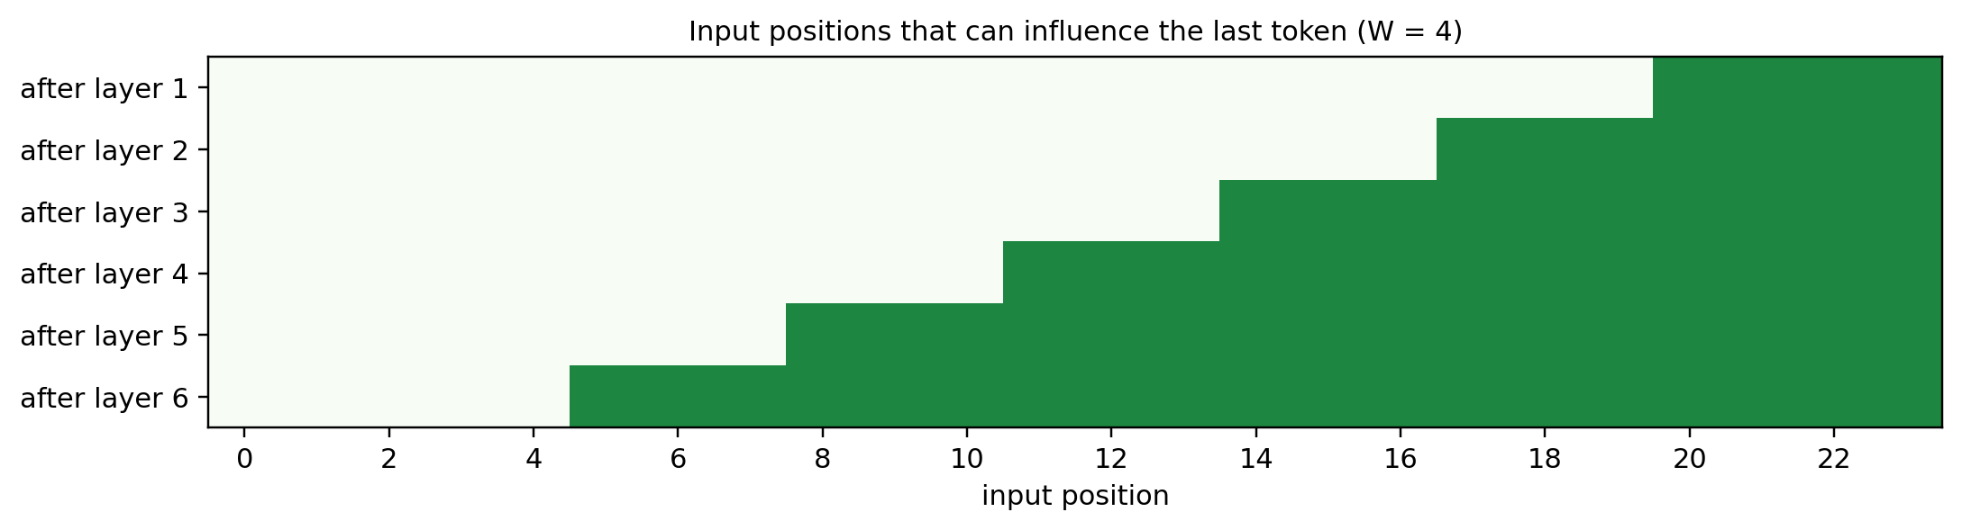
Optional: reach grows with depth
LIVE DEMO cell 32
Reach after L layers
L · (W − 1) + 1
W = 4: 4, 7, 10, … 19
≈ 131K tokens
The catch:
far-back information is passed along through intermediate positions and can be diluted. It is never read directly.
So models mix layer types:
local (sliding-window) layers plus global (full causal) layers that read far tokens directly. Gemma 2: 1 : 1, W = 4,096. Gemma 3: 5 : 1, W = 1,024.
theoretical reach of Mistral 7B (W = 4,096, 32 layers) with ≤ 4,096 cached entries per layer
Notes:
If a token sees only 4 positions, how can it use something said 100 tokens earlier? Indirectly. In layer 1 position 10 reads positions 7 to 10, but position 7's vector already holds information from 4 to 7, collected in the layer below. Each layer extends the reach by W minus 1, like the receptive field of stacked convolutions. Cell 32 computes it exactly by multiplying the window masks layer by layer. Mistral 7B: W = 4,096 and 32 layers, a theoretical reach of about 131K tokens with at most 4,096 cached entries per layer. The catch: distant information is passed along through intermediate positions and can be diluted; it is never read directly. That is why models mix layer types. Local layers use a sliding window; global layers use ordinary full attention, still causal, so they read any earlier token directly, and only their caches grow with the context. Gemma 2 alternates them one to one with a 4,096-token window; Gemma 3 uses five local layers for every global one, with a 1,024-token window (Gemma 3 Technical Report, 2025).

Slide 18
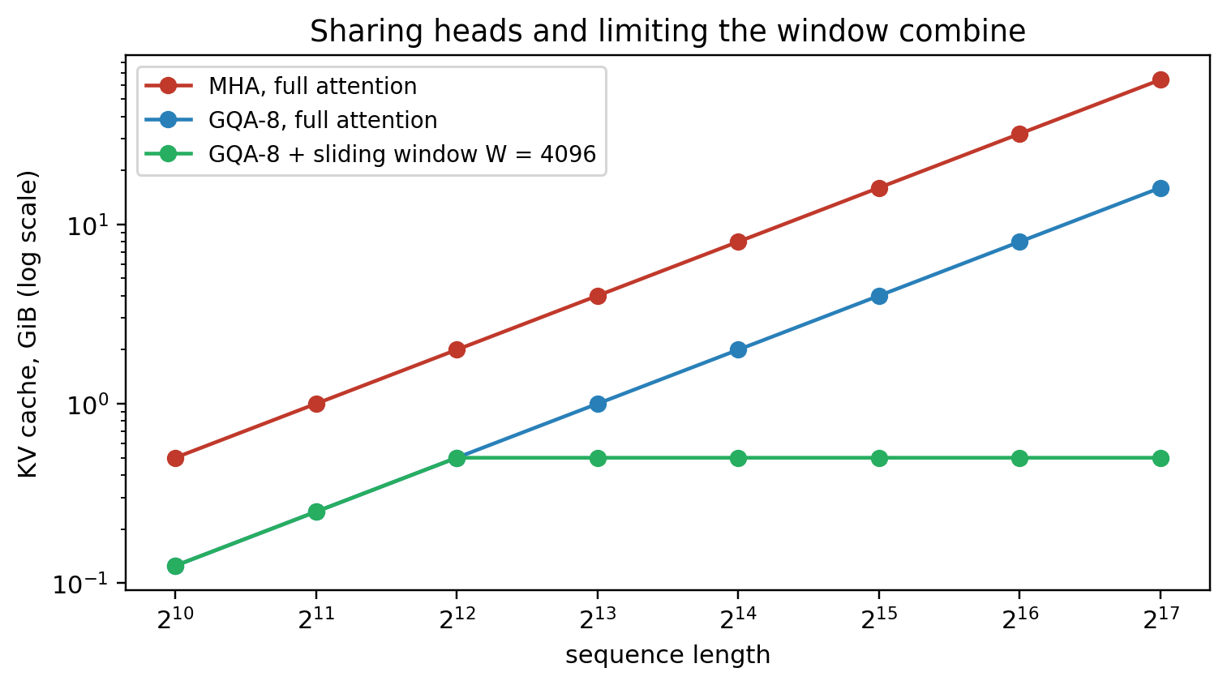
Optional: a rolling-buffer cache
LIVE DEMO cells 34–36
Rolling buffer, W = 4 with 2 sink tokens
new t7
t0
t1
t2
t3
t4
t5
t6
t7
new t8
t0
t1
t3
t4
t5
t6
t7
t8
new t9
t0
t1
t4
t5
t6
t7
t8
t9
Amber: sinks, always kept. Struck out: evicted. Teal: the newest token. The cache holds 2 + W = 6 keys.
64 GiB
16 GiB
0.50 GiB
Cell 34 check, 10 decoding steps
cached tokens per step: 4, 4, …, 4 (no sinks) and 6, 6, …, 6 (2 sinks)
matches a full pass with the band mask: True
MHA
GQA-8
GQA-8 + window
KV cache for one sequence at 128K tokens
Notes:
Cell 34 subclasses GroupedQueryAttention with two changes: prefill applies the band mask, and whenever a token is appended the cache is trimmed to the sink tokens plus the last W tokens. The trimmed cache then holds exactly the keys the new token may see, so decoding needs no mask. The printed check: cache length stays at 4 (no sinks) or 6 (2 sinks) for all ten steps, and the outputs match a full masked pass. One caveat for real models: with RoPE you must decide which position each cached token has; StreamingLLM uses positions within the cache. Cell 36: with Mistral-like sizes the two savings multiply. At 128K tokens: MHA 64 GiB, GQA-8 16 GiB, GQA-8 with a 4,096 window 0.5 GiB. The price is the indirect reach from the previous slide.

Slide 19
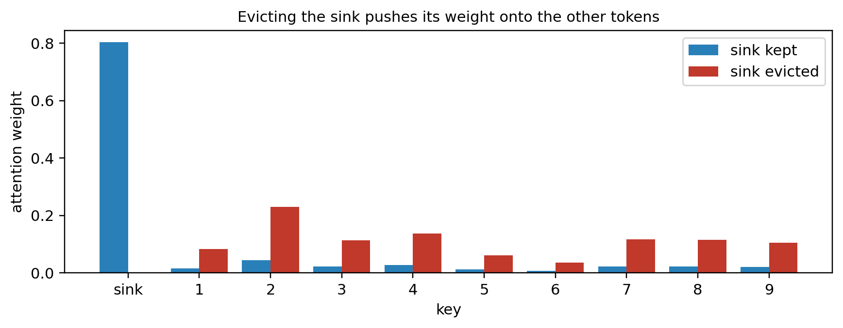
Optional: why plain windows break
LIVE DEMO cell 38
Why sinks form (a plausible explanation)
Softmax weights must sum to 1, even when a head has nothing useful to read.
The first token is visible to every later position, so models learn to park spare attention there. Its value adds little.
What breaks
A plain window evicts the first token; softmax spreads its weight over real tokens; hidden states drift from anything seen in training. StreamingLLM: perplexity explodes.
The fix
Always keep the first few tokens (n_sink). StreamingLLM: 4 sink tokens + a recent window, stable over millions of tokens, no retraining.
Made-up scores: key 0 (the sink) scores high and its value is nearly zero.
0.80
3.8×
of the weight on the sink, which contributes almost nothing
larger output after eviction (norm 0.26 → 1.00)
Notes:
In many trained LLMs a large share of attention goes to the very first tokens even when they mean nothing, such as <s> or 'The'. Xiao et al. (2023) call them attention sinks. A plausible explanation: softmax forces each head's weights to sum to 1 even when there is nothing useful to read, and the first token is visible to every later position, so models learn to park unneeded attention there; its value contributes little. Once a plain window evicts it, softmax spreads that weight over real tokens and hidden states drift away from anything seen in training. StreamingLLM reports perplexity exploding as soon as the initial tokens leave the window, and stable generation over millions of tokens with 4 sink tokens plus a recent window, without retraining. Cell 38 uses made-up scores that mimic the pattern; say so explicitly.

Slide 20
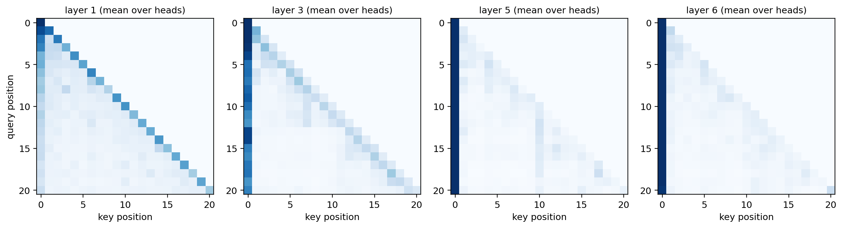
Optional: sinks in DistilGPT-2
LIVE DEMO cell 40
“The robot opened the door and walked into the quiet library, where an old man was reading a book.” Rows: query; columns: key; darker = more weight.
Average weight on the first token (“The”), per layer
0.17
0.35
0.44
0.76
0.70
0.69
layer 1
layer 2
layer 3
layer 4
layer 5
layer 6
Notes:
Cell 40 downloads distilgpt2 (about 350 MB on first run) and plots its attention averaged over heads for one sentence. Layer 1 mostly attends to the token itself and its neighbours: ordinary local patterns. From the middle layers on, the first column dominates: about 70 percent of all attention in layers 4 to 6 goes to the first token, which here is just 'The'. This is exactly the attention a plain sliding window would throw away. Scope: one sentence, one small model, averaged over heads; it illustrates the pattern rather than measuring it in general.

Slide 21
Summary
Method | What changes | Main benefit | Cost
Multi-head attention | baseline: separate Q, K, V per head | most expressive | largest KV cache
Grouped-query attention | K/V heads shared within groups | cache ÷ H/G, quality close to MHA | slightly less expressive
Multi-query attention | one K/V head for all query heads | smallest cache, fastest decoding | quality can drop
KV cache | stores past K, V during generation | no recomputation of past tokens | memory grows with batch × length
Sliding window (optional) | each token sees only the last W tokens | cache capped at W per layer | far context reachable only indirectly
Attention sinks (optional) | always keep the first few tokens | stable long generation with a window | a few extra cached tokens
Notes:
Read the table by the 'what changes' column: three rows change the heads, two change which positions are kept, and one is bookkeeping. Rows marked optional were covered only if time allowed. FlashAttention, which changes only how attention is computed, is in its own lecture.

Slide 22
Common misconceptions
Myth “MQA removes heads.”
Myth “MQA changes the attention formula.”
Fact It keeps H query heads and H attention patterns. Only the K/V heads are shared.
Fact Only the shapes and the sharing of K and V change; each head computes softmax(QKᵀ/√dₖ)V as before.
Myth “MQA mainly speeds up training.”
Myth “A smaller KV cache means smaller attention scores.”
Fact The main benefit is in decoding, where reading the cache is the bottleneck.
Fact Scores stay (B, H, Tq, Tk). The saving is in what is stored and read.
Notes:
Ask students to vote true or false on each claim before revealing. All four are false. They are the confusions most often seen on this topic.

Slide 23
Check your understanding
1
With H = 16, how many K/V heads are cached by MHA, by GQA with 4 groups, and by MQA?
2
Why can MQA heads produce different attention patterns when they share keys?
3
During decoding, why does reading fewer bytes help more than computing fewer FLOPs?
4
In GroupedQueryAttention, why is the cache stored before repeat_interleave?
5
Why might GQA be preferred over MQA?
6
Why does a plain sliding window break once the first tokens are evicted? How do sinks fix it? (optional)
Notes:
Six of the seven questions at the end of the notebook; 6 needs the optional sliding-window block. Good for think-pair-share. Answers: 1) MHA 16 K and 16 V heads; GQA-4 4 of each; MQA 1 of each. 2) each head has its own query projection, so its dot products with the shared keys, and its softmax weights, differ. 3) with Tq = 1 each cached byte is used for only about H/G FLOPs; the GPU waits on memory, so reading less is what speeds it up. 4) the repeated copies carry no new information; storing only the G original heads is the saving; repetition or broadcasting happens on the fly. 5) GQA keeps most of the cache saving while each group keeps its own keys and values, so quality stays closer to MHA. 6) models learn to park unneeded attention on the first tokens; after eviction softmax spreads that weight over real tokens and the hidden states drift from what the model saw in training; keeping a few sink tokens restores a place to park it.

Slide 24
Practice and further reading
Practice
Further reading
Notebook: module2/transformers/attention_mechanisms.ipynb
Shazeer (2019). Fast Transformer Decoding: One Write-Head is All You Need. arXiv:1911.02150 (MQA)
Ainslie et al. (2023). GQA: Training Generalized Multi-Query Transformer Models from Multi-Head Checkpoints. arXiv:2305.13245
Beltagy et al. (2020). Longformer: The Long-Document Transformer. arXiv:2004.05150
Xiao et al. (2023). Efficient Streaming Language Models with Attention Sinks. arXiv:2309.17453
answer the seven questions in Section 9
change n_kv_heads and predict the cached shapes
compute the KV cache for your own model sizes with kv_cache_bytes
change W and n_sink in window_mask and predict the plot
Related: Key–value cache · Positional encodings (RoPE positions in a rolling cache) · FlashAttention · GPT-2
Notes:
There is no separate lab for this unit. The notebook's Section 9 has seven questions with answers. FlashAttention has its own notebook and deck. Good small experiments: change n_kv_heads and check the shapes; change W and n_sink in window_mask and predict the plot before running it.

