Slide 1
GPT-2
A causal Transformer for next-token generation
Generative AI (ABAI3009L) · Module 2: Transformers & LLMs
Companion notebook: module2/transformers/GPT-2.ipynb
Notes:
Open the companion notebook in a second window and run it once top to bottom before class (under a minute on a CPU, no downloads), so every live demo already has output. Amber 'LIVE DEMO' tags mark where to switch to the notebook; the cell numbers are 0-based positions in the notebook. Suggested split for 60 minutes: slides 2-8 (about 15 min), notebook-led demos for slides 9-15 (about 35 min), slides 16-21 (about 10 min). The Supplement slides (GELU, parameter count) are for questions or later study.

Slide 2
What you will learn
The
robot
opened
the
?
How does a model pick a plausible next token without looking at text that does not exist yet?
1
2
3
4
5
Causal language modeling
The architecture
Causal self-attention
Training vs. generation
Decoding
The objective GPT-2 is trained on, and how it differs from BERT's masked language modeling
How token IDs become next-token probabilities, with the tensor shape at every step
Queries, keys, values, heads, and the mask that blocks the future
Why training scores all positions in parallel, while generation produces one token at a time
Greedy, temperature, and top-k: choices made at generation time that do not change the weights
Notes:
Start from the concrete question on the slide: how does a model pick a plausible next token without looking at text that does not exist yet? Everything in the lecture answers that question. Preview the five parts.

Slide 3
Causal language modeling: predict each token from its past
One factor per token of “The robot opened the door”
The chain rule
P(x₁, …, x_{T}) = ∏_{t} P( x_{t} | x₁, …, x_{t−1} )
<eot>
The
Each factor is a next-token distribution over the vocabulary, given the prefix.
<eot>
The
robot
The training loss
<eot>
The
robot
opened
L = − (1/T) Σ_{t} log P_{θ}( x_{t} | x_{<t} )
<eot>
The
robot
opened
the
Cross-entropy against the real next token, averaged over positions. Lower is better.
<eot>
The
robot
opened
the
door
Perplexity = e^{L}: “as uncertain as a uniform choice among this many tokens”.
<eot> stands for GPT-2's start token <|endoftext|>. Grey: visible prefix. Teal: the token to predict.
Autoregressive: at generation time each chosen token is appended and fed back in.
Rule: each token is predicted only from the tokens before it.
Notes:
The chain rule is exact, not an approximation: any probability over sequences factorizes this way. The only modeling choice is left-to-right order. Walk down the rows on the right: each row is one factor, the grey chips are what the model may see, the teal chip is what it must predict. The loss is the average negative log-probability of the teal chips. Perplexity is just e to the loss, read as 'as uncertain as a uniform choice among this many tokens'.

Slide 4
The GPT-2 family: one design, four sizes
Model | L (layers) | H (hidden size) | A (heads) | Parameters | fp32 weights
GPT-2 Small | 12 | 768 | 12 | 124M | ~0.5 GB
GPT-2 Medium | 24 | 1024 | 16 | 355M | ~1.4 GB
GPT-2 Large | 36 | 1280 | 20 | 774M | ~3.1 GB
GPT-2 XL | 48 | 1600 | 25 | 1.5B | ~6.2 GB
50,257
1,024
64
vocabulary size V (byte-level BPE tokens)
context length T in tokens
per-head width H / A in every size
Size = parameters × 4 bytes (fp32), in GB of 10⁹ bytes; weights only. The paper reports 117M, 345M, 762M and 1542M; the table counts the released checkpoints.
Notes:
All four checkpoints share the architecture and differ only in depth (L) and width (H). The parameter counts are what you get by counting the released checkpoints' weights; the paper itself reports 117M, 345M, 762M and 1542M. Sizes are fp32 weights only: training needs several times more memory (covered in the Module 3 fine-tuning lecture).

Slide 5
Causal LM vs. masked LM vs. the original Transformer
 | Original encoder–decoder | BERT (masked LM) | GPT-2 (causal LM)
Components | encoder + decoder with cross-attention | encoder stack | decoder stack, no cross-attention
Attention | encoder: full · decoder: causal + cross | full (both sides) | causal (left only)
Training target | target tokens, given the source | hidden [MASK] tokens (~15%) | the next token, at every position
Positions that give a loss | all target positions | masked positions only | all T positions
Generates text? | yes, conditioned on the source | not directly | yes: predict, append, repeat
Typical use | translation | classification, tagging, QA | generation, prompting
GPT-2 stacks decoder blocks without cross-attention: masked self-attention → feed-forward, repeated (12 blocks in GPT-2 small, vs. 6 + 6 in the original base Transformer). A prompt is conditioning context, not encoder output.
Notes:
Read the table by rows. The 'positions that give a loss' row is the one students most often miss: GPT-2 gets a training signal at every position, BERT only at the roughly 15 percent of positions it masked. GPT-2 keeps only the decoder stack and drops cross-attention, because there is no encoder. A prompt is conditioning context, not encoder output.

Slide 6
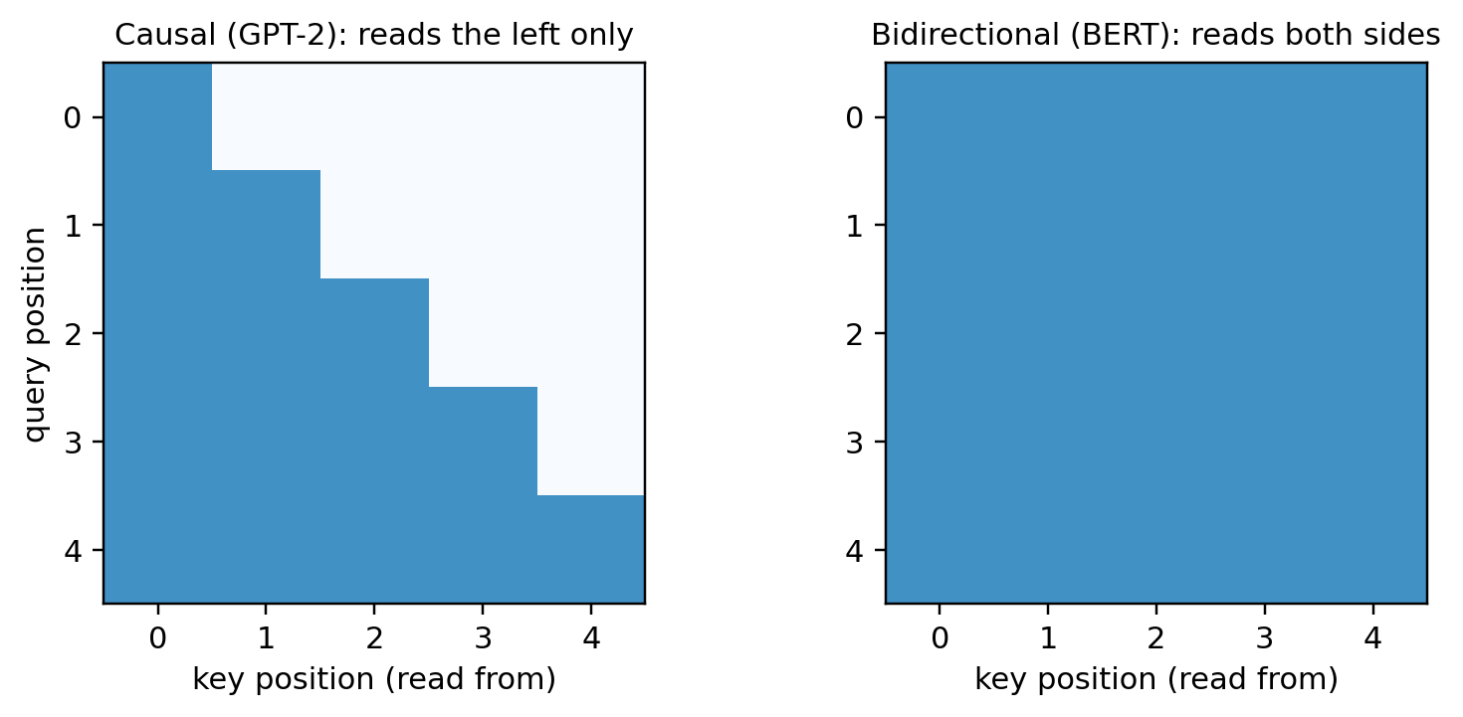
Why GPT-2 needs a mask
LIVE DEMO cell 4
[MASK] is not the attention mask
[MASK] is a token BERT puts into its input. GPT-2's attention mask is a rule about which positions may read which; it changes nothing in the input.
Neither objective is “better”
Causal matches the task of generating text. Masked uses context from both sides, which helps understanding tasks, but gets fewer training signals per sequence.
Dark squares: positions a query (row) may read from (column).
Causal: lower triangle. The answer token is in the input, so only the mask keeps the model from reading it.
Bidirectional: full square. Safe for BERT because the answer is replaced by [MASK] first.
Notes:
Show cell 4. During training the next token is already in the input, so without a mask position t could simply read token t+1. BERT can afford full attention because it replaces the answer with [MASK] before the model sees it. Spend a moment on the first confusion: [MASK] is an input token, the attention mask is a rule about which positions may read which.

Slide 7
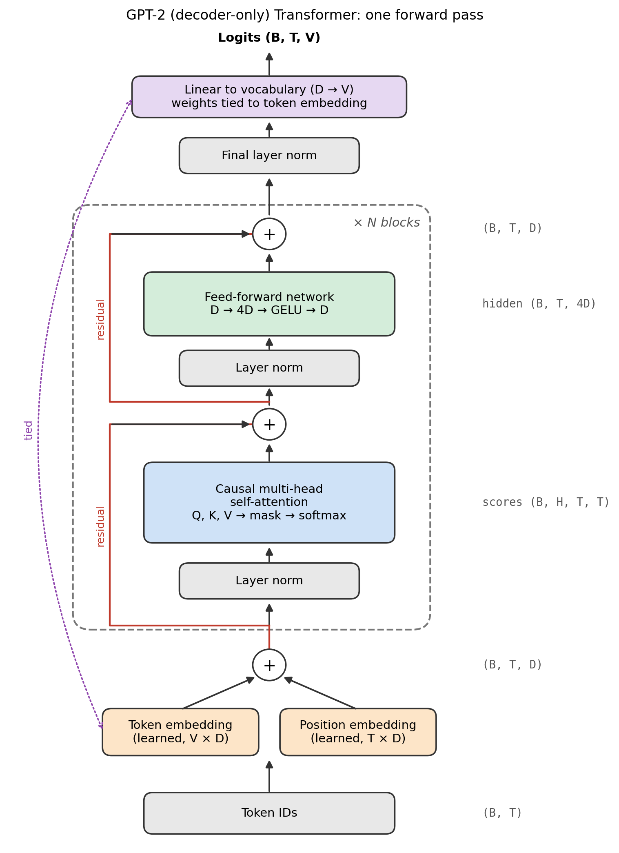
From token IDs to logits
Component | What it does | Mixes positions?
Token + position embedding | ID → D-dim vector that also encodes its position (both learned) | no
Layer norm (pre-norm) | Normalizes the input to each sublayer | no
Causal self-attention | Each position gathers information from itself and earlier positions | yes, and only here
Feed-forward network | D → 4D → GELU → D, each position separately | no
Residual add | Adds each sublayer's output back to its input | no
Final norm + vocabulary projection | D → V logits; weights tied to the token embedding | no
Key idea: attention is the only place positions exchange information, so one mask inside attention makes the whole model causal. Every block maps (B, T, D) → (B, T, D), so blocks stack.
Notes:
Trace one input through the figure, naming the shape at each step: IDs (B, T), embeddings (B, T, D), the same shape out of every block, logits (B, T, V). The key idea at the bottom is what makes the whole design work: attention is the only place positions exchange information, so a single mask inside attention makes the entire model causal. Position embeddings are learned, unlike the original Transformer's sinusoids; most modern LLMs use RoPE instead (positional encodings notebook).

Slide 8
Inside causal self-attention
Vector | Role | Filing-cabinet picture
Query qᵢ | what position i is looking for | a note describing your topic
Key kⱼ | what position j offers to be matched | the label on a folder
Value vⱼ | what j contributes if selected | the contents of the folder
For each position i
1
Score every allowed key: qᵢ · kⱼ / √d_{k}
2
Turn the scores into weights with softmax
3
Output the weighted sum of the values
Shape trace through one attention layer
Input x
Fused Q, K, V projection D → 3D
Split, then reshape into heads
q kᵀ / √dₖ → mask → softmax
Weighted values: weights @ v
Merge heads
Output projection D → D (heads mix)
(B, T, D)
(B, T, 3D)
q, k, v (B, H, T, dₖ)
(B, H, T, T)
(B, H, T, dₖ)
(B, T, D)
(B, T, D)
Heads: each works on a dₖ = D / H slice, so different heads can attend to different positions. GPT-2 small: D = 768, H = 12, dₖ = 64.
Notes:
Use the filing-cabinet picture: the query is your research topic, keys are folder labels, values are folder contents. Then trace the shapes along the bottom row, which is exactly what CausalSelfAttention.forward does in notebook cell 13: one fused D to 3D layer (c_attn) makes Q, K and V for all heads at once; view and transpose into (B, H, T, d_k); scores, mask, softmax; weighted values; merge heads; output projection (c_proj) lets the heads mix. For GPT-2 small, H = 12 and d_k = 64. The notebook's figure in cell 9 shows the same flow in more detail; dropout is omitted.

Slide 9
The causal mask on made-up scores
LIVE DEMO cell 10
A = softmax( QK^{T} / √d_{k} + M ), M_{ij} = 0 if j ≤ i, −∞ if j > i
Scores after masking
Attention weights
robot
must
obey
orders
robot
must
obey
orders
robot
2.0
−∞
−∞
−∞
robot
1.00
0.00
0.00
0.00
must
1.5
1.6
−∞
−∞
must
0.48
0.52
0.00
0.00
obey
0.5
1.2
1.4
−∞
softmax
per row
obey
0.18
0.37
0.45
0.00
orders
0.3
0.6
1.1
1.5
orders
0.13
0.17
0.28
0.42
rows: query · columns: key
rows: query · columns: key
Future positions get exactly zero weight, and each row still sums to 1: softmax normalizes over the allowed columns only.
The mask limits what each position reads; it does not make computation sequential. All rows come out of one matrix operation.
Notes:
Run cell 10. Point at row 0: it can see only itself, so its weight is exactly 1. Row 1 splits its weight between 'robot' and 'must'. Adding minus infinity before softmax gives the future exactly zero weight, and each row still sums to 1 because softmax normalizes over the allowed columns only. Emphasize the last bullet: the mask restricts what each position can read; it does not make computation sequential.

Slide 10
Is the model really causal? Three checks
LIVE DEMO cells 13–25
TinyGPT2: V = 16, D = 32, H = 4, N = 2 · 26,496 parameters · logits (1, 4, 16) · attention (1, 4, 4, 4)
1
Visual check
2
Leakage test
3
Prefix consistency
One head of the untrained model: every weight above the diagonal is 0.
Change only positions 2–3; do the logits at positions 0–1 move?
One pass over the whole sequence vs. separate passes over each prefix.
0
0.0 vs 3.6×10⁻²
6.0×10⁻⁸
future-position weights
change at 0–1: causal vs. causal=False
largest difference (float rounding)
cell 21
cell 23
cell 25
Why this matters: one parallel pass over T tokens computes exactly what T separate prefix runs would. That is why training can score every position at once, and why a key–value cache can reuse past work during generation.
Notes:
Show cell 13 only for the CausalSelfAttention class: fused c_attn, split, view and transpose into heads, mask, softmax, merge, c_proj. Then run the three checks in cells 21, 23 and 25. The unmasked model's leak is small (3.6e-2) only because untrained weights are small; the point is that it is not zero. The prefix-consistency gap of 6e-8 is floating-point rounding. Finish on the callout: this equivalence is why training scores every position in parallel and why a key-value cache gives the same answers during generation.

Slide 11
Training: shifted next-token prediction
Input
A
B
C
D
Sanity check before training
An untrained model spreads probability evenly, 1/V per token, so the first loss should be close to
Target
B
C
D
E
ln V
position t is scored against token t + 1
V = 16 → ln 16 = 2.77
loss_{t} = − log softmax(z_{t})_{y(t+1)}
Much above ln V: badly scaled initialization or a bug
Much below ln V: the model can probably see its labels (leakage)
Averaged over all B × T predictions (F.cross_entropy)
Padding: must be left out of the loss separately; the causal mask does not do it
Real GPT-2 was pretrained this way on WebText; that needs a large corpus and a lot of compute
Notes:
The targets are the inputs shifted left by one. Each position is scored against the token that follows it, and all B times T predictions are averaged by F.cross_entropy. Two warnings: the causal mask does not exclude padding from the loss (that needs ignored labels), and the first loss is a free bug detector. With V = 16 an untrained model should start near ln 16 = 2.77. Ask: what would a first loss of 9.0 suggest? (badly scaled initialization or a bug). And one of 0.5? (the model can see its labels).

Slide 12
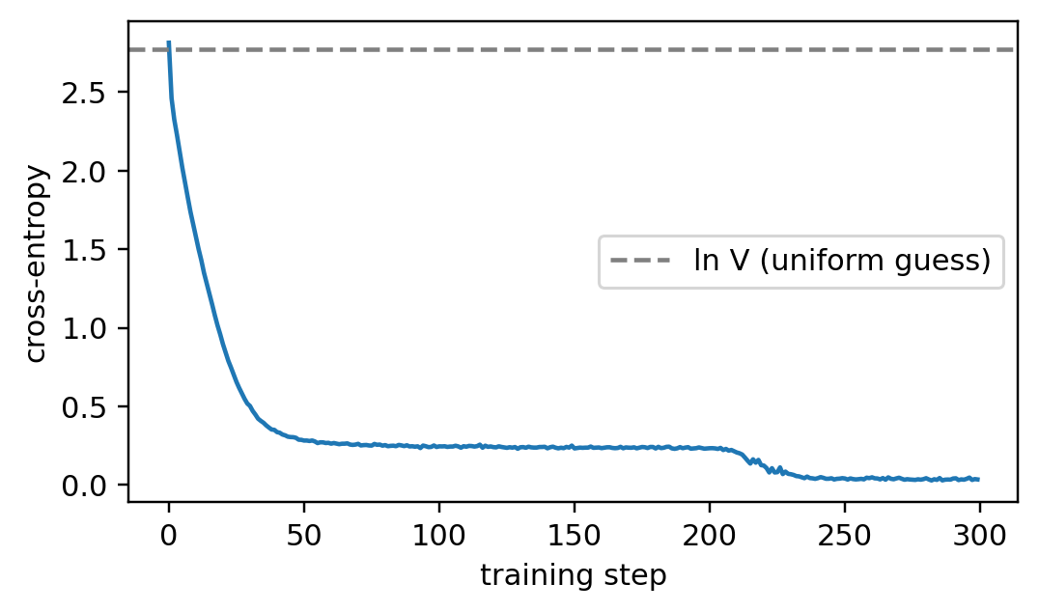
A toy run: learning the cycle 1 2 3 1 2 4
LIVE DEMO cell 28
The repeating pattern
1
2
3
1
2
4
1
2
?
After 1 2 comes 3 or 4, depending on what came before the 1. The current token alone is not enough: the model needs attention.
Batches: 32 windows of 17 tokens at random offsets; 16 inputs, 16 shifted targets
300 AdamW steps, learning rate 3×10⁻³, on a CPU
Scope: this shows that optimization works, not a language-modeling result
Cross-entropy per step; dashed line: ln V, the loss of a uniform guess. One CPU run, seed 42.
2.813
2.773
0.035
loss at step 1
ln 16
loss at step 300
Notes:
Run cell 28 (300 AdamW steps, a few seconds on a CPU). After '1 2' the next token is 3 or 4, depending on what came before the 1, so a model that looks only at the current token cannot reach zero loss: it needs attention. The curve starts at 2.81, next to ln 16 = 2.77, which passes the sanity check, and falls to 0.035. A plateau before a second drop is a plausible sign of first learning the easy, current-token predictions and later the 3-or-4 decision; where it falls depends on seed and hardware. Stress the scope: this shows that optimization works, not a language-modeling result. There is no held-out set because the pattern is the whole distribution.

Slide 13
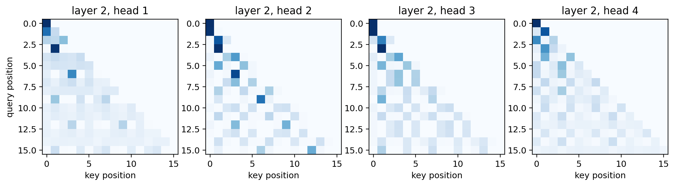
What the trained attention heads look at
LIVE DEMO cell 30
Layer 2, all four heads, one 16-token sequence. Rows: query position; columns: key position; darker = more weight.
Forced by the mask:
the empty upper triangle in every head.
Not an explanation:
attention maps are a diagnostic. The residual stream and feed-forward layers also carry information.
Notes:
Cell 30. All four heads are lower-triangular because of the mask; where each head puts its weight inside the triangle was learned. Some heads look back a fixed distance, which is what the cycle requires. Do not over-read the maps: attention weights are a diagnostic, not an explanation. The residual stream and the feed-forward layers also carry information.

Slide 14
Training is parallel; generation is one token at a time
Training
A
B
C
D
one pass
logits at all 4 positions → loss against
B
C
D
E
Generation
A
B
C
D
pass 1
logits at the last position → choose
E
→ append
A
B
C
D
E
pass 2
logits at the last position → choose
F
→ append
A
B
C
D
E
F
pass 3
logits at the last position → choose
G
→ …
Context window: only the last context_size tokens are visible; older tokens are dropped.
Key–value cache: store each block's past keys and values, so each step computes only the newest position. Same result, by prefix consistency.
Notes:
Training is parallel because every target is already known. Generation is sequential because each new token is unknown until it is chosen, and only the last position's logits are used. The context window drops tokens older than context_size. The notebook's loop reruns the whole window at every step; a key-value cache stores each block's past keys and values so each step computes only the newest position. The prefix-consistency test is why the cache gives identical results (key-value cache notebook).

Slide 15
Decoding: same logits, different choices
LIVE DEMO cell 33
Setting | What it does
Greedy | pick the most probable token (deterministic)
Sampling | draw a token from the softmax distribution
Temperature | divide logits by T before softmax: T < 1 sharpens, T > 1 flattens
Top-k | sample only from the k highest-scoring tokens
Prompt 1 2 3 1 2, then 10 generated tokens
pattern
1
2
3
1
2
4
1
2
3
1
2
4
1
2
3
greedy
1
2
3
1
2
4
1
2
3
1
2
4
1
2
3
sampled, T = 1
1
2
3
1
2
4
1
2
3
1
2
4
1
2
3
None of these change the weights.
Decoding is a choice made at generation time, applied to the same logits. Change it and the model is the same; only the text differs.
T = 3, top-3
1
2
3
1
2
4
1
2
3
1
1
2
4
1
2
Grey: prompt. Teal: generated. Coral: the first token that leaves the cycle. Seeded sampling on a CPU; other seeds give other samples.
Notes:
Run cell 33, then change the temperature and top_k live. Prompt 1 2 3 1 2: the cycle says the next token is 4, which requires looking back three tokens. Greedy reproduces the cycle. Sampling at T = 1 stays on the pattern because the trained distribution is sharp. At T = 3 with top-3 the flattened distribution lets a 1 slip in where the cycle has a 2. The point to land: none of these settings touch the weights or the training loss; they only change how a token is chosen from the same logits.

Slide 16
Any task, written as a prefix
Task | Prefix given to the model | Continuation we hope for
Summarization | <article text> TL;DR: | a short summary
Translation | a few english = french pairs, then The cat sleeps. = | Le chat dort.
Question answering | Q: Who wrote On the Origin of Species? A: | Charles Darwin
Sentiment | Review: The film was dull. Sentiment: | negative
Few-shot classification | a few labelled examples, then one unlabelled example | its label
Why it can work:
these cues occur in web text (TL;DR summaries, Q/A pages, translated sentences), so predicting what follows them well means picking up the pattern.
Nothing new mechanically:
the same causal forward pass and the same predict–append loop. Decoding choices are part of the method.
Notes:
GPT-2 has no summarize or translate mode. To use it for a task, write a prefix whose most likely continuation is the answer. Why can this work at all? These cues occur naturally in web text: TL;DR before a short summary, Q and A on FAQ pages, and the GPT-2 paper shows English sentences followed by French translations in WebText (Radford et al. 2019, Table 1). Nobody trained the model to summarize; it is a side effect of learning to continue text. Decoding is part of the method: for summarization the paper sampled 100 tokens with top-k, k = 2, and kept the first three sentences.

Slide 17
Zero-shot: possible, but weak and unreliable
Task (dataset, metric) | GPT-2 1.5B | Comparison reported in the paper
Summarization (CNN/Daily Mail, avg. ROUGE) | 21.40 | 20.98 random 3 sentences · 31.55 first 3 sentences · 15.03 without TL;DR:
Translation En → Fr (WMT-14, BLEU) | 5 | slightly worse than word-by-word dictionary substitution
Translation Fr → En (WMT-14, BLEU) | 11.5 | 33.5 for the best unsupervised system at the time
Open-domain QA (Natural Questions, exact match) | 4.1% | 30–50% for systems that combine retrieval with reading
Reading comprehension (CoQA, F1) | 55 | matches or beats 3 of 4 trained baselines; humans reach 89
The prompt selects the task
Removing TL;DR: costs 6.4 ROUGE points.
Can do ≠ does well
Summaries barely beat random sentences and confuse details.
Scale mattered
Every ability improved with size; the 124M model is much weaker.
Source: Radford et al. (2019), Language Models are Unsupervised Multitask Learners. Evaluate any prompted task with fixed prompts, decoding settings and a baseline.
Notes:
These are the GPT-2 paper's numbers for its largest, 1.5B model, about 12 times GPT-2 small. Zero-shot means no task-specific training; the prompt may still contain examples, but the weights never change. Read the summarization row first: removing TL;DR drops the average ROUGE by 6.4 points, so the wording of the input alone selects the task. But the summaries barely beat three random sentences and lose clearly to the first three sentences. On CoQA the document is in the prompt and the paper reports that GPT-2 often relies on heuristics, such as answering a 'who' question with a name from the document.

Slide 18
When prompting is not enough: three levers
Prompting
Fine-tuning
Retrieval (RAG)
Changes:
only the input text: instructions, format, examples
Changes:
the weights, by training on task examples
Changes:
the context: retrieved documents go in the prompt
Stays fixed:
the weights
Stays fixed:
the architecture and the loss
Stays fixed:
the weights
Example:
add TL;DR:, or show 3 labelled reviews first
Example:
train on article TL;DR: summary texts
Example:
put the relevant handbook paragraph before the question
Fine-tuning reuses the training loss (shifted targets, cross-entropy) on task examples. LoRA updates a few added parameters instead of all weights: Module 3.
Retrieval teaches the model nothing: remove the documents and the knowledge is gone. It suits facts that change often or are private.
Notes:
Each lever changes something different. Fine-tuning reuses exactly the loss from the training section, on task examples; a common choice is to score only the answer tokens. LoRA and other parameter-efficient methods update a small number of added parameters instead of all weights (Module 3). Retrieval teaches the model nothing: remove the documents and the knowledge is gone, which is why it suits facts that change often or are private. Prompting and retrieval both act on the input.

Slide 19
Likely is not the same as true
The loss rewards what came next in the training text. Nothing in it checks whether a statement is correct.
From the GPT-2 paper's question-answering examples
“What US state forms the western boundary of Montana?”
A model trained this way…
can repeat a false claim that is common in its training data
tends to accept a false premise in the prompt, because accepting it is often the likeliest continuation
produces fluent, confident text whether or not it has the answer: hallucination
GPT-2's answer
Montana
with 52.3% probability (Radford et al., 2019)
Retrieval can put real sources in context, but the model can still ignore or misread them. Check generated text against evidence.
Notes:
The loss rewards giving high probability to what came next in the training text; nothing in it checks correctness. The example is from the GPT-2 paper's question-answering results: asked which US state forms the western boundary of Montana, the model answered 'Montana' with 52.3 percent probability. Ask students what continuation the objective actually rewards here. Retrieval can help by putting real sources in the context, but the model can still ignore or misread them.

Slide 20
Check your understanding
1
In a four-token input, which columns may query row 1 attend to, and which does the mask block?
2
Why can training score every position in one pass, while generation needs one pass per new token? Which test shows the two agree?
3
If you remove the mask but keep the shifted targets, what leaks? Which test detects it?
4
Why does one mask inside attention make the whole model causal?
5
An untrained model with V = 16 starts at loss 9.0. What does ln 16 tell you, and what might be wrong?
6
Do temperature or top-k change the model's weights or its training loss?
Notes:
Six of the eleven questions at the end of the notebook. Good for think-pair-share in the last few minutes. Answers: 1) row 1 reads columns 0 and 1; the mask blocks 2 and 3. 2) all targets are known during training; prefix consistency shows the two agree. 3) every position could read its own target; the leakage test detects it. 4) attention is the only place positions mix. 7) ln 16 = 2.77 is the uniform-guess loss; 9.0 suggests badly scaled initialization or a bug. 9) neither: they only change how a token is chosen.

Slide 21
Practice and further reading
Practice
Further reading
GPT-2 lab: module2/labs/gpt2_causal_lm/
Radford et al. (2019). Language Models are Unsupervised Multitask Learners. OpenAI technical report.
Vaswani et al. (2017). Attention Is All You Need. arXiv:1706.03762
Hugging Face docs: GPT-2 model documentation and the openai-community/gpt2 model card
Jay Alammar. The Illustrated GPT-2 (blog post)
Huang et al. (2018). Music Transformer. arXiv:1809.04281 (next-token prediction beyond text)
write the causal mask
handle padding in the loss
build a leaking model and detect it
count parameters
implement top-k sampling
train and decode a small model
Next: Key–value cache · Fine-tuning GPT-2 (Module 3)
Notes:
Point students to the lab before the next practical session. The fine-tuning notebook in Module 3 picks up exactly where slide 18 leaves off.

Slide 22
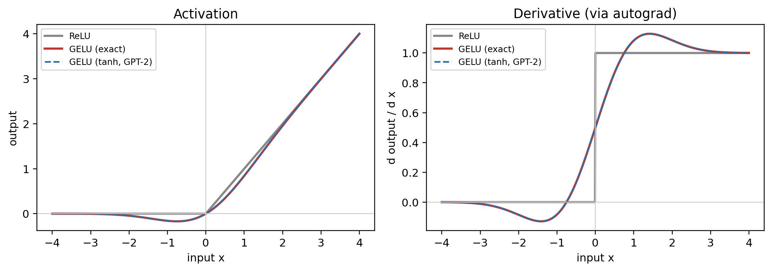
Supplement: GELU vs. ReLU
LIVE DEMO cell 16
ReLU(x) = x · 1[x > 0]
Hard gate. For x < 0 the output and the gradient are exactly 0.
GELU(x) = x · Φ(x)
Soft gate: Φ is the standard normal CDF. At x = −1, 16% passes; minimum −0.17 at x ≈ −0.75.
GPT-2: tanh approximation
Largest gap from exact GELU on [−4, 4]: 4.7×10⁻⁴. Newer LLMs often use SiLU or SwiGLU.
Notes:
Optional. Both activations are the input times a gate between 0 and 1. ReLU's gate is hard; GELU's gate is the standard normal CDF, so it is soft. Intuition: keep each input at random with probability Phi(x); GELU is the expected output. Read the derivative plot: ReLU's derivative is a step, GELU's is smooth, 0.5 at the origin, and still nonzero for moderately negative inputs, so a unit that is often negative still gets some gradient. GPT-2 uses the tanh approximation; the largest gap from the exact form on [-4, 4] is 4.7e-4. The case for GELU is mainly empirical; newer LLMs often use SiLU or SwiGLU.

Slide 23
Supplement: parameter count
LIVE DEMO cell 19
Component (per block) | Parameters
Layer norm 1 + layer norm 2 | 4D
Fused Q, K, V projection (D → 3D, with bias) | 3D² + 3D
Attention output projection (D → D) | D² + D
Feed-forward network (D → 4D → D) | 8D² + 5D
Block total | 12D² + 13D
124,439,808
GPT-2 small by formula (V = 50,257, T = 1,024, D = 768, N = 12)
⅔
of each block is the feed-forward network (8D² of 12D²)
params = VD + TD + N(12D² + 13D) + 2D
≈ 38.6M
token table + positions + blocks + final norm. The tied output head adds 0. In wide models the 12D² term dominates.
parameters saved by tying the output head to the token embedding
Notes:
Optional. Layer norm learns a scale and a shift per feature, 2D per norm. The fused projection is a D by 3D weight plus a 3D bias. Two-thirds of each block is the feed-forward network. Plugging in GPT-2 small's numbers gives 124,439,808, which matches the released checkpoint's 124M. Weight tying saves another V times D, about 38.6M parameters.

