Slide 1
BK MARKET DASHBOARD
Daily Brief · 27 March 2026 18:07
47-Instrument Universe · 10 Asset Classes · Returns, Risk & Signal
Market Tone: MIXED
Split signals: 12 RED · 16 AMBER · 19 GREEN.
12
16
19
RED
AMBER
GREEN
Signal: RED = Max DD < −15% AMBER = −15% to −7% GREEN = > −7% from 52-week high
Source: Yahoo Finance · Price return, local currency · CONFIDENTIAL

Slide 2










EQUITIES — RETURNS
27 March 2026 18:07
US Broad · US Sectors · Dev Mkts · EM · Defence · Trend / 1W / 1M / 3M / YTD / Vol / Signal
Asset | Ticker | Trend | 1D | 1W | 1M | 3M | YTD | Vol (vs 1M) | Signal
EQUITIES — US BROAD
Nasdaq 100 | QQQ |  | +0.0% | -1.4% | -4.3% | -7.9% | -6.6% | 19.2% ▲ | AMBER
Russell 2000 | IWM |  | +0.0% | +2.2% | -1.2% | -6.4% | +0.7% | 20.9% ▲ | AMBER
S&P 500 | SPY |  | +0.0% | -0.5% | -3.8% | -6.1% | -5.1% | 15.3% ▲ | GREEN
World (ACWI) | ACWI |  | +0.0% | -0.1% | -3.7% | -6.0% | -3.6% | 20.7% ▲ | AMBER
EQUITIES — US SECTORS
Energy | XLE |  | +0.0% | +3.7% | +8.8% | +25.1% | +37.6% | 15.5% ▲ | GREEN
Financials | XLF |  | +0.0% | -0.1% | -3.0% | -7.6% | -10.4% | 5.1% ▼ | AMBER
Real Estate (REITs) | VNQ |  | +0.0% | -1.2% | -6.2% | -3.1% | -0.9% | 13.0% ▲ | AMBER
Utilities | XLU |  | +0.0% | +1.5% | -3.0% | +6.5% | +6.2% | 4.1% ▼ | GREEN
EQUITIES — DEVELOPED MARKETS
Australia | EWA |  | +0.0% | -0.5% | -4.1% | -0.8% | +3.7% | 30.0% ▲ | AMBER
Europe Dev (EAFE) | EFA |  | +0.0% | +1.1% | -3.7% | -5.3% | -1.4% | 24.9% ▲ | AMBER
Page 1 of 3

Slide 3










EQUITIES — RETURNS
27 March 2026 18:07
US Broad · US Sectors · Dev Mkts · EM · Defence · Trend / 1W / 1M / 3M / YTD / Vol / Signal · 2/3
Asset | Ticker | Trend | 1D | 1W | 1M | 3M | YTD | Vol (vs 1M) | Signal
Eurozone | EZU |  | +0.0% | +1.3% | -3.7% | -8.2% | -4.9% | 26.5% ▲ | AMBER
Germany | EWG |  | +0.0% | +1.2% | -5.3% | -11.1% | -9.0% | 27.6% ▲ | AMBER
Japan | EWJ |  | +0.0% | +1.9% | -2.4% | -2.2% | +2.4% | 29.1% ▲ | AMBER
Singapore | EWS |  | +0.0% | +0.9% | +1.3% | -3.4% | +0.4% | 20.8% ▲ | GREEN
UK | EWU |  | +0.0% | +0.8% | -3.9% | -3.0% | +0.5% | 21.9% ▲ | AMBER
EQUITIES — EMERGING MARKETS
Brazil | EWZ |  | +0.0% | +5.0% | +1.4% | +0.6% | +15.8% | 39.9% ▲ | AMBER
China | FXI |  | +0.0% | -0.7% | -2.5% | -11.4% | -8.8% | 25.3% ▲ | RED
EM Broad | EEM |  | +0.0% | -0.3% | -3.2% | -6.1% | +1.4% | 35.5% ▲ | AMBER
India | INDA |  | +0.0% | +0.0% | -6.8% | -9.0% | -13.8% | 31.4% ▲ | RED
Korea | EWY |  | +0.0% | -4.6% | -5.3% | +1.7% | +23.4% | 67.2% ▲ | RED
Page 2 of 3

Slide 4





EQUITIES — RETURNS
27 March 2026 18:07
US Broad · US Sectors · Dev Mkts · EM · Defence · Trend / 1W / 1M / 3M / YTD / Vol / Signal · 3/3
Asset | Ticker | Trend | 1D | 1W | 1M | 3M | YTD | Vol (vs 1M) | Signal
South Africa | EZA |  | +0.0% | +2.2% | -9.3% | -16.2% | -7.0% | 40.0% ▲ | RED
Taiwan | EWT |  | +0.0% | +0.5% | +0.8% | +0.6% | +10.3% | 39.7% ▲ | AMBER
DEFENCE & GEOPOLITICAL
Defence Bull 3x | DFEN |  | +0.0% | -3.6% | -25.7% | -21.5% | +1.5% | 64.9% ▲ | RED
S&P Aerospace & Defence | XAR |  | +0.0% | -0.7% | -8.0% | -9.2% | +6.5% | 30.8% ▲ | AMBER
US Aerospace & Defence | ITA |  | +0.0% | -1.1% | -9.1% | -6.3% | +2.6% | 20.8% ▲ | AMBER
Page 3 of 3

Slide 5










FIXED INCOME, COMMODITIES & OTHER — RETURNS
27 March 2026 18:07
Fixed Income & Credit · Commodities · Crypto · FX · Volatility · Trend / 1W / 1M / 3M / YTD / Vol / Signal
Asset | Ticker | Trend | 1D | 1W | 1M | 3M | YTD | Vol (vs 1M) | Signal
FIXED INCOME & CREDIT
Cash (T-Bills) | BIL |  | +0.0% | +0.0% | +0.2% | +0.6% | +0.8% | 0.2% ▲ | GREEN
EM Local Currency | EMLC |  | +0.0% | +0.1% | -2.5% | -4.2% | -2.4% | 12.8% ▲ | GREEN
EM USD Sovereigns | EMB |  | +0.0% | +0.3% | -2.4% | -2.6% | -2.1% | 12.4% ▲ | GREEN
HY Credit | HYG |  | +0.0% | +0.0% | -1.0% | -1.8% | -1.2% | 7.3% ▲ | GREEN
IG Credit | LQD |  | +0.0% | +0.0% | -2.1% | -2.0% | -1.4% | 7.8% ▲ | GREEN
Senior Loans | BKLN |  | +0.0% | -0.0% | +0.6% | -1.4% | -1.5% | 2.1% ▼ | GREEN
Treasuries 1-3Y | SHY |  | +0.0% | -0.1% | -0.6% | -0.2% | -0.2% | 2.2% ▲ | GREEN
Treasuries 20Y+ | TLT |  | +0.0% | +0.3% | -2.7% | -1.4% | -0.5% | 10.6% ▲ | GREEN
Treasuries 7-10Y | IEF |  | +0.0% | -0.3% | -1.9% | -0.8% | -1.0% | 7.5% ▲ | GREEN
US Aggregate | AGG |  | +0.0% | -0.1% | -1.6% | -0.9% | -0.7% | 5.8% ▲ | GREEN
Page 1 of 3

Slide 6










FIXED INCOME, COMMODITIES & OTHER — RETURNS
27 March 2026 18:07
Fixed Income & Credit · Commodities · Crypto · FX · Volatility · Trend / 1W / 1M / 3M / YTD / Vol / Signal · 2/3
Asset | Ticker | Trend | 1D | 1W | 1M | 3M | YTD | Vol (vs 1M) | Signal
US TIPS | TIP |  | +0.0% | -0.4% | -1.5% | -0.4% | -0.1% | 3.9% ▲ | GREEN
COMMODITIES
Agriculture | DBA |  | +0.0% | +1.0% | +1.5% | +5.3% | +6.2% | 3.6% ▼ | GREEN
Broad Commodities | DBC |  | +0.0% | -1.7% | +3.4% | +17.6% | +27.2% | 32.2% ▲ | GREEN
Copper Miners | COPX |  | +0.0% | +2.6% | -11.3% | -17.6% | -1.3% | 68.6% ▲ | RED
Gold | GLD |  | +0.0% | -3.1% | -15.4% | -12.5% | +1.1% | 36.8% ▲ | RED
Natural Gas | UNG |  | +0.0% | -4.4% | -7.1% | -15.2% | -3.4% | 36.5% ▼ | RED
Silver | SLV |  | +0.0% | -1.2% | -20.0% | -34.6% | -5.7% | 55.9% ▼ | RED
WTI Oil | USO |  | +0.0% | -3.4% | +7.8% | +58.6% | +69.5% | 72.5% ▲ | GREEN
CRYPTO
Bitcoin | BTC-USD |  | -1.6% | -0.3% | -0.7% | -24.4% | -23.7% | 44.0% ▼ | RED
FX
US Dollar Index | UUP |  | +0.0% | +0.5% | +1.2% | +3.3% | +2.9% | 4.8% ▲ | GREEN
Page 2 of 3

Slide 7


FIXED INCOME, COMMODITIES & OTHER — RETURNS
27 March 2026 18:07
Fixed Income & Credit · Commodities · Crypto · FX · Volatility · Trend / 1W / 1M / 3M / YTD / Vol / Signal · 3/3
Asset | Ticker | Trend | 1D | 1W | 1M | 3M | YTD | Vol (vs 1M) | Signal
VOLATILITY
Ultra VIX Short-Term | UVXY |  | +0.0% | +1.8% | +1.8% | +55.5% | +53.2% | 98.2% ▲ | RED
VIX Short-Term Futures | VIXY |  | +0.0% | +1.5% | +3.0% | +38.2% | +38.4% | 64.2% ▲ | RED
Page 3 of 3

Slide 8
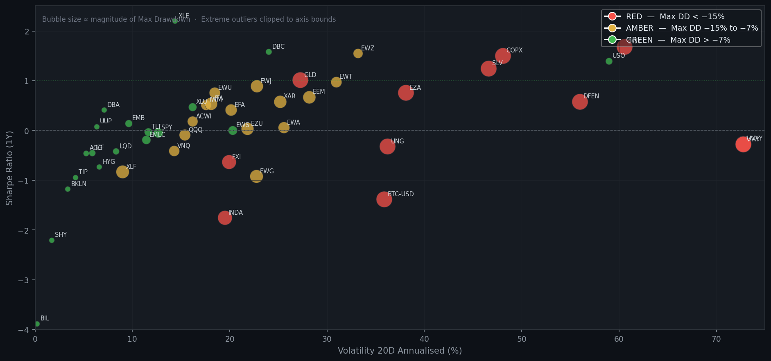
RISK SNAPSHOT — ALL INSTRUMENTS
27 March 2026 18:07
Volatility (20D ann.) vs Sharpe Ratio (1Y) · Bubble size = Max Drawdown magnitude · Colour = Signal

Slide 9
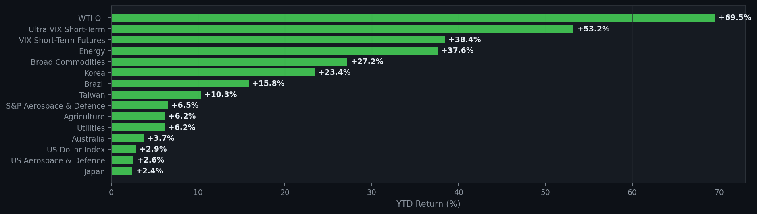
YTD PERFORMANCE — ALL INSTRUMENTS
27 March 2026 18:07
Year-to-Date Return · Sorted best to worst · 1/4

Slide 10
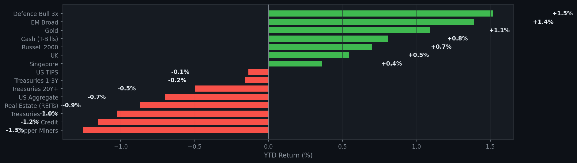
YTD PERFORMANCE — ALL INSTRUMENTS
27 March 2026 18:07
Year-to-Date Return · Sorted best to worst · 2/4

Slide 11
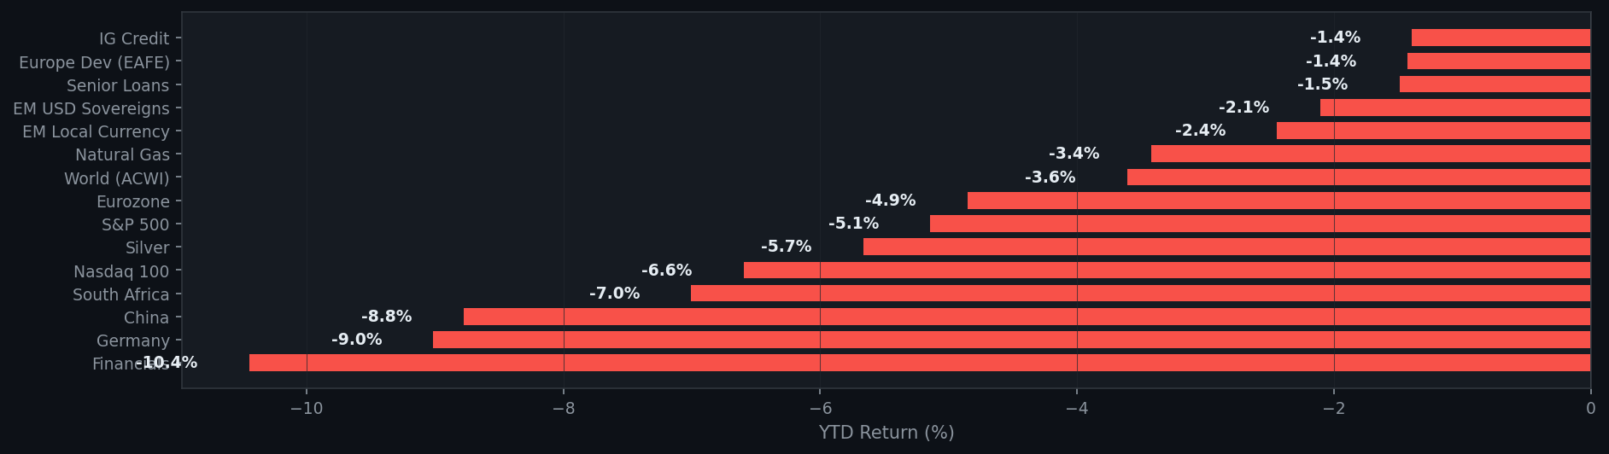
YTD PERFORMANCE — ALL INSTRUMENTS
27 March 2026 18:07
Year-to-Date Return · Sorted best to worst · 3/4

Slide 12
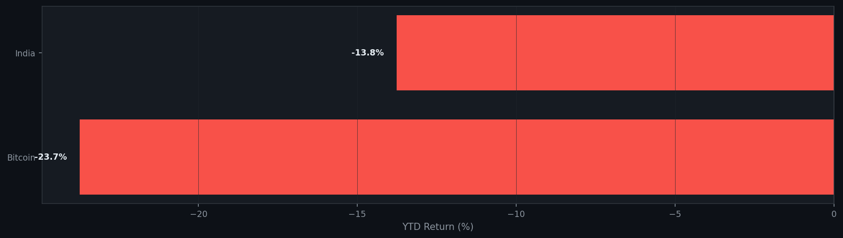
YTD PERFORMANCE — ALL INSTRUMENTS
27 March 2026 18:07
Year-to-Date Return · Sorted best to worst · 4/4

