Slide 1
BK MARKET DASHBOARD
Daily Brief · 30 March 2026 17:26
47-Instrument Universe · 10 Asset Classes · Returns, Risk & Signal
Market Tone: MIXED
Split signals: 12 RED · 17 AMBER · 18 GREEN.
12
17
18
RED
AMBER
GREEN
Signal: RED = Max DD < −15% AMBER = −15% to −7% GREEN = > −7% from 52-week high
Source: Yahoo Finance · Price return, local currency · CONFIDENTIAL

Slide 2










EQUITIES — RETURNS
30 March 2026 17:26
US Broad · US Sectors · Dev Mkts · EM · Defence · Trend / 1W / 1M / 3M / YTD / Vol / Signal
Asset | Ticker | Trend | 1D | 1W | 1M | 3M | YTD | Vol (vs 1M) | Signal
EQUITIES — US BROAD
Nasdaq 100 | QQQ |  | +0.0% | -4.3% | -7.4% | -10.1% | -8.4% | 19.7% ▲ | AMBER
Russell 2000 | IWM |  | +0.0% | -3.5% | -4.0% | -7.7% | -1.1% | 18.4% ▲ | AMBER
S&P 500 | SPY |  | +0.0% | -3.5% | -6.3% | -8.2% | -6.8% | 15.8% ▲ | AMBER
World (ACWI) | ACWI |  | +0.0% | -3.4% | -5.9% | -7.7% | -4.9% | 17.6% ▲ | AMBER
EQUITIES — US SECTORS
Energy | XLE |  | +0.0% | +3.3% | +11.1% | +27.1% | +39.9% | 14.5% ▲ | GREEN
Financials | XLF |  | +0.0% | -3.1% | -5.0% | -10.5% | -12.7% | 16.3% ▼ | RED
Real Estate (REITs) | VNQ |  | +0.0% | -1.0% | -7.2% | -3.8% | -1.7% | 5.1% ▼ | AMBER
Utilities | XLU |  | +0.0% | +0.8% | -2.7% | +6.3% | +6.8% | 3.8% ▼ | GREEN
EQUITIES — DEVELOPED MARKETS
Australia | EWA |  | +0.0% | -2.1% | -5.7% | -1.5% | +3.9% | 16.9% ▼ | AMBER
Europe Dev (EAFE) | EFA |  | +0.0% | -3.0% | -5.2% | -6.6% | -2.3% | 18.6% ▲ | AMBER
Page 1 of 3

Slide 3










EQUITIES — RETURNS
30 March 2026 17:26
US Broad · US Sectors · Dev Mkts · EM · Defence · Trend / 1W / 1M / 3M / YTD / Vol / Signal · 2/3
Asset | Ticker | Trend | 1D | 1W | 1M | 3M | YTD | Vol (vs 1M) | Signal
Eurozone | EZU |  | +0.0% | -3.3% | -5.7% | -10.0% | -6.0% | 18.2% ▼ | AMBER
Germany | EWG |  | +0.0% | -3.5% | -7.3% | -13.1% | -10.4% | 19.3% ▲ | AMBER
Japan | EWJ |  | +0.0% | -3.9% | -4.9% | -3.8% | +0.9% | 23.0% ▲ | AMBER
Singapore | EWS |  | +0.0% | -0.9% | -0.3% | -3.3% | +0.3% | 10.3% ▼ | GREEN
UK | EWU |  | +0.0% | -2.3% | -4.7% | -3.7% | +0.3% | 18.7% ▲ | AMBER
EQUITIES — EMERGING MARKETS
Brazil | EWZ |  | +0.0% | -2.4% | -1.3% | +0.1% | +15.3% | 22.1% ▼ | AMBER
China | FXI |  | +0.0% | -3.2% | -4.5% | -11.7% | -9.0% | 24.7% ▲ | RED
EM Broad | EEM |  | +0.0% | -3.9% | -5.6% | -6.7% | +0.9% | 26.0% ▲ | AMBER
India | INDA |  | +0.0% | -3.4% | -8.3% | -10.9% | -15.2% | 23.0% ▲ | RED
Korea | EWY |  | +0.0% | -5.3% | -9.6% | +3.1% | +24.4% | 40.2% ▼ | RED
Page 2 of 3

Slide 4





EQUITIES — RETURNS
30 March 2026 17:26
US Broad · US Sectors · Dev Mkts · EM · Defence · Trend / 1W / 1M / 3M / YTD / Vol / Signal · 3/3
Asset | Ticker | Trend | 1D | 1W | 1M | 3M | YTD | Vol (vs 1M) | Signal
South Africa | EZA |  | +0.0% | -2.9% | -10.8% | -17.0% | -6.6% | 35.4% ▼ | RED
Taiwan | EWT |  | +0.0% | -4.0% | -1.8% | -0.6% | +9.4% | 28.1% ▲ | AMBER
DEFENCE & GEOPOLITICAL
Defence Bull 3x | DFEN |  | +0.0% | -13.0% | -29.9% | -24.0% | -4.1% | 71.0% ▲ | RED
S&P Aerospace & Defence | XAR |  | +0.0% | -6.0% | -11.2% | -10.5% | +3.9% | 31.5% ▲ | AMBER
US Aerospace & Defence | ITA |  | +0.0% | -4.3% | -10.7% | -7.4% | +0.7% | 23.0% ▲ | AMBER
Page 3 of 3

Slide 5










FIXED INCOME, COMMODITIES & OTHER — RETURNS
30 March 2026 17:26
Fixed Income & Credit · Commodities · Crypto · FX · Volatility · Trend / 1W / 1M / 3M / YTD / Vol / Signal
Asset | Ticker | Trend | 1D | 1W | 1M | 3M | YTD | Vol (vs 1M) | Signal
FIXED INCOME & CREDIT
Cash (T-Bills) | BIL |  | +0.0% | +0.1% | +0.2% | +0.6% | +0.8% | 0.3% ▲ | GREEN
EM Local Currency | EMLC |  | +0.0% | -1.1% | -2.6% | -4.7% | -2.7% | 6.5% ▼ | GREEN
EM USD Sovereigns | EMB |  | +0.0% | -1.6% | -3.1% | -3.2% | -2.6% | 10.3% ▲ | GREEN
HY Credit | HYG |  | +0.0% | -0.9% | -1.8% | -2.1% | -1.4% | 5.1% ▲ | GREEN
IG Credit | LQD |  | +0.0% | -1.0% | -2.9% | -2.3% | -1.6% | 6.0% ▲ | GREEN
Senior Loans | BKLN |  | +0.0% | -0.8% | -0.9% | -2.0% | -2.2% | 5.3% ▼ | GREEN
Treasuries 1-3Y | SHY |  | +0.0% | -0.0% | -0.5% | -0.0% | +0.0% | 2.3% ▲ | GREEN
Treasuries 20Y+ | TLT |  | +0.0% | -1.4% | -4.0% | -2.4% | -1.0% | 9.8% ▲ | GREEN
Treasuries 7-10Y | IEF |  | +0.0% | -0.8% | -2.2% | -0.9% | -1.0% | 6.8% ▲ | GREEN
US Aggregate | AGG |  | +0.0% | -0.6% | -1.9% | -1.1% | -0.7% | 4.7% ▲ | GREEN
Page 1 of 3

Slide 6










FIXED INCOME, COMMODITIES & OTHER — RETURNS
30 March 2026 17:26
Fixed Income & Credit · Commodities · Crypto · FX · Volatility · Trend / 1W / 1M / 3M / YTD / Vol / Signal · 2/3
Asset | Ticker | Trend | 1D | 1W | 1M | 3M | YTD | Vol (vs 1M) | Signal
US TIPS | TIP |  | +0.0% | -0.4% | -1.7% | -0.6% | -0.2% | 3.4% ▲ | GREEN
COMMODITIES
Agriculture | DBA |  | +0.0% | +0.8% | +2.3% | +5.5% | +6.5% | 3.5% ▼ | GREEN
Broad Commodities | DBC |  | +0.0% | +3.3% | +7.2% | +19.8% | +30.1% | 15.6% ▼ | GREEN
Copper Miners | COPX |  | +0.0% | -5.3% | -12.9% | -18.7% | -0.3% | 51.7% ▲ | RED
Gold | GLD |  | +0.0% | -0.4% | -12.2% | -10.8% | +4.6% | 41.5% ▲ | RED
Natural Gas | UNG |  | +0.0% | +3.5% | -0.2% | -17.2% | +0.2% | 24.0% ▼ | RED
Silver | SLV |  | +0.0% | -2.7% | -18.9% | -35.5% | -1.5% | 62.8% ▲ | RED
WTI Oil | USO |  | +0.0% | +9.5% | +19.0% | +69.0% | +79.6% | 42.7% ▼ | GREEN
CRYPTO
Bitcoin | BTC-USD |  | +2.3% | -5.4% | -1.3% | -23.5% | -23.9% | 38.4% ▼ | RED
FX
US Dollar Index | UUP |  | +0.0% | +0.5% | +1.4% | +4.0% | +3.0% | 2.5% ▼ | GREEN
Page 2 of 3

Slide 7


FIXED INCOME, COMMODITIES & OTHER — RETURNS
30 March 2026 17:26
Fixed Income & Credit · Commodities · Crypto · FX · Volatility · Trend / 1W / 1M / 3M / YTD / Vol / Signal · 3/3
Asset | Ticker | Trend | 1D | 1W | 1M | 3M | YTD | Vol (vs 1M) | Signal
VOLATILITY
Ultra VIX Short-Term | UVXY |  | +0.0% | +23.7% | +34.0% | +74.5% | +71.6% | 101.2% ▼ | RED
VIX Short-Term Futures | VIXY |  | +0.0% | +15.1% | +22.6% | +49.2% | +49.1% | 64.8% ▼ | AMBER
Page 3 of 3

Slide 8
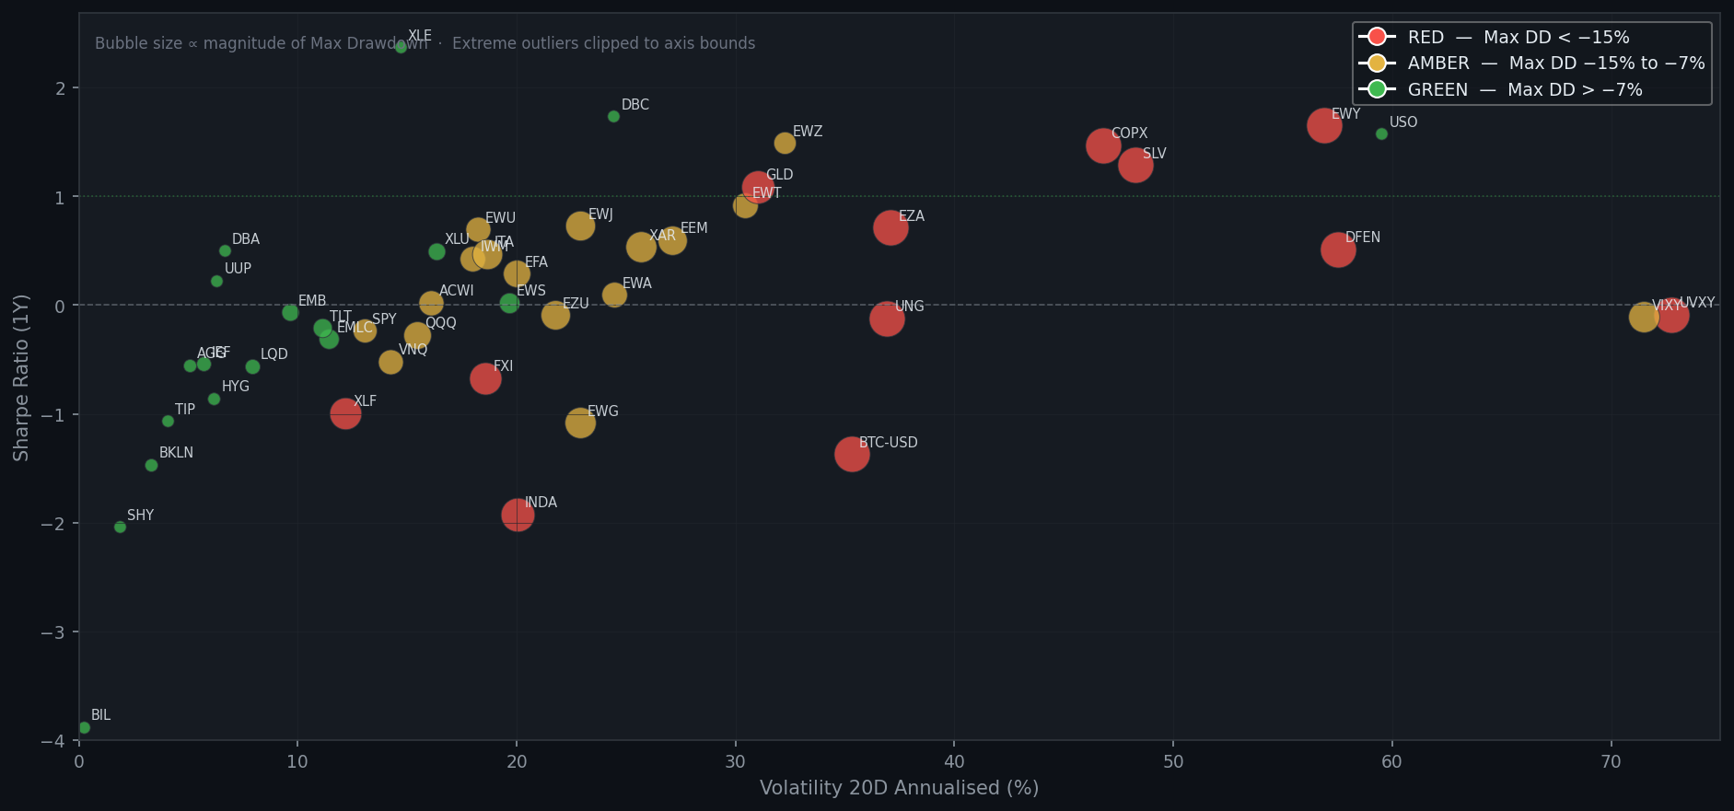
RISK SNAPSHOT — ALL INSTRUMENTS
30 March 2026 17:26
Volatility (20D ann.) vs Sharpe Ratio (1Y) · Bubble size = Max Drawdown magnitude · Colour = Signal

Slide 9
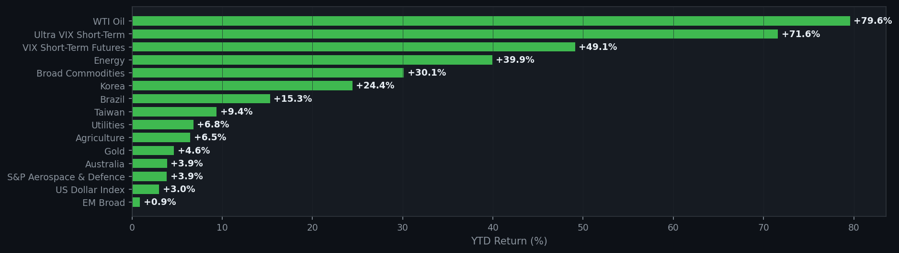
YTD PERFORMANCE — ALL INSTRUMENTS
30 March 2026 17:26
Year-to-Date Return · Sorted best to worst · 1/4

Slide 10
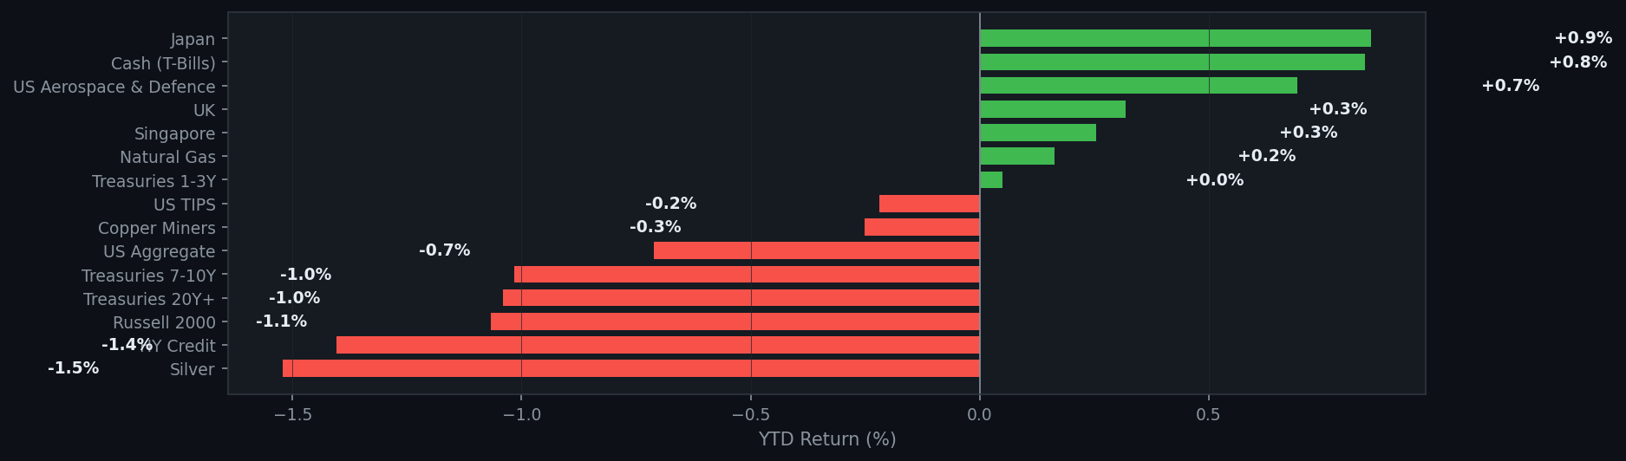
YTD PERFORMANCE — ALL INSTRUMENTS
30 March 2026 17:26
Year-to-Date Return · Sorted best to worst · 2/4

Slide 11
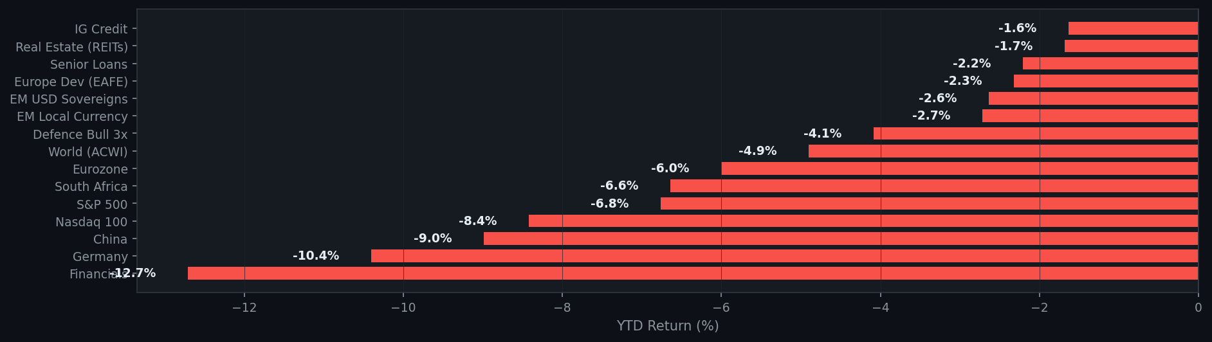
YTD PERFORMANCE — ALL INSTRUMENTS
30 March 2026 17:26
Year-to-Date Return · Sorted best to worst · 3/4

Slide 12
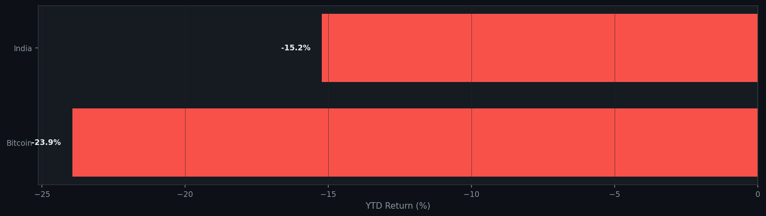
YTD PERFORMANCE — ALL INSTRUMENTS
30 March 2026 17:26
Year-to-Date Return · Sorted best to worst · 4/4

