Slide 1


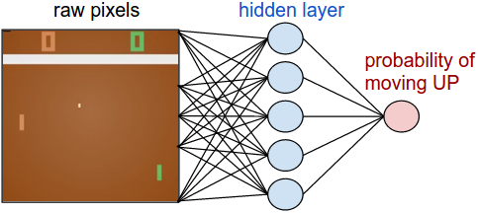
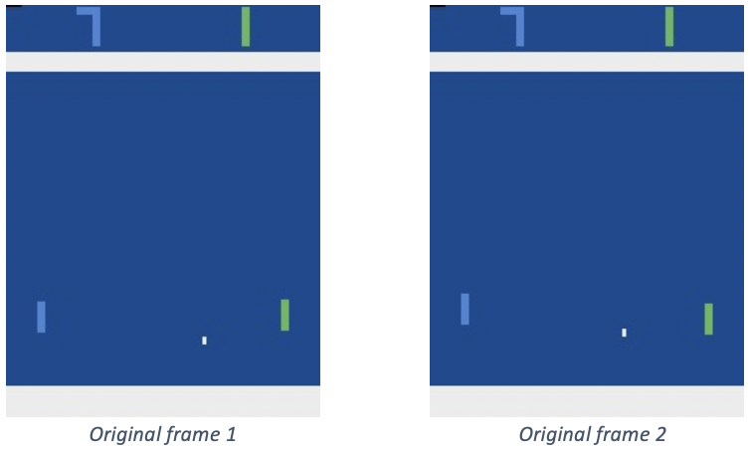
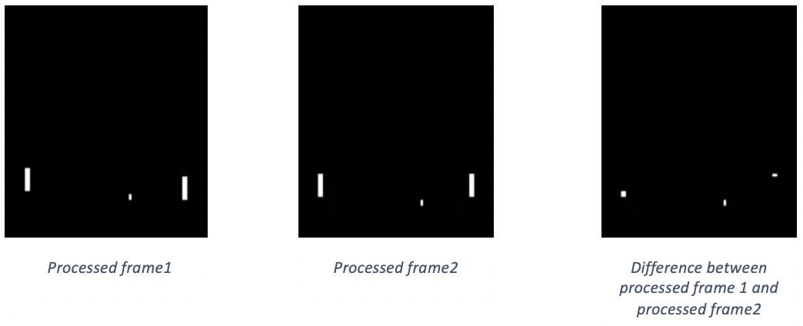
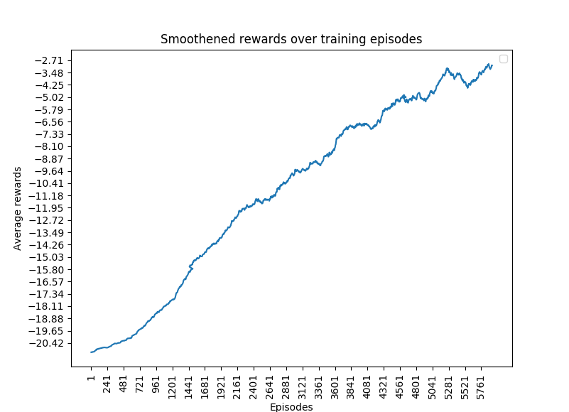
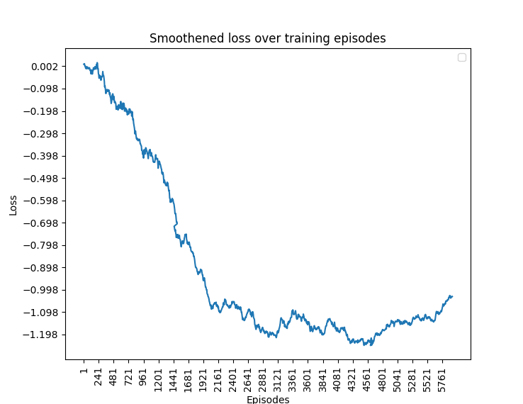
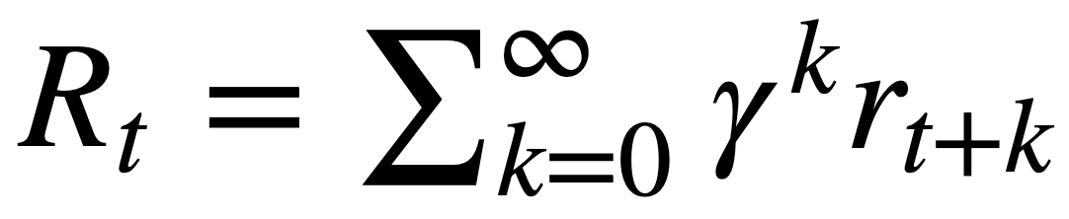
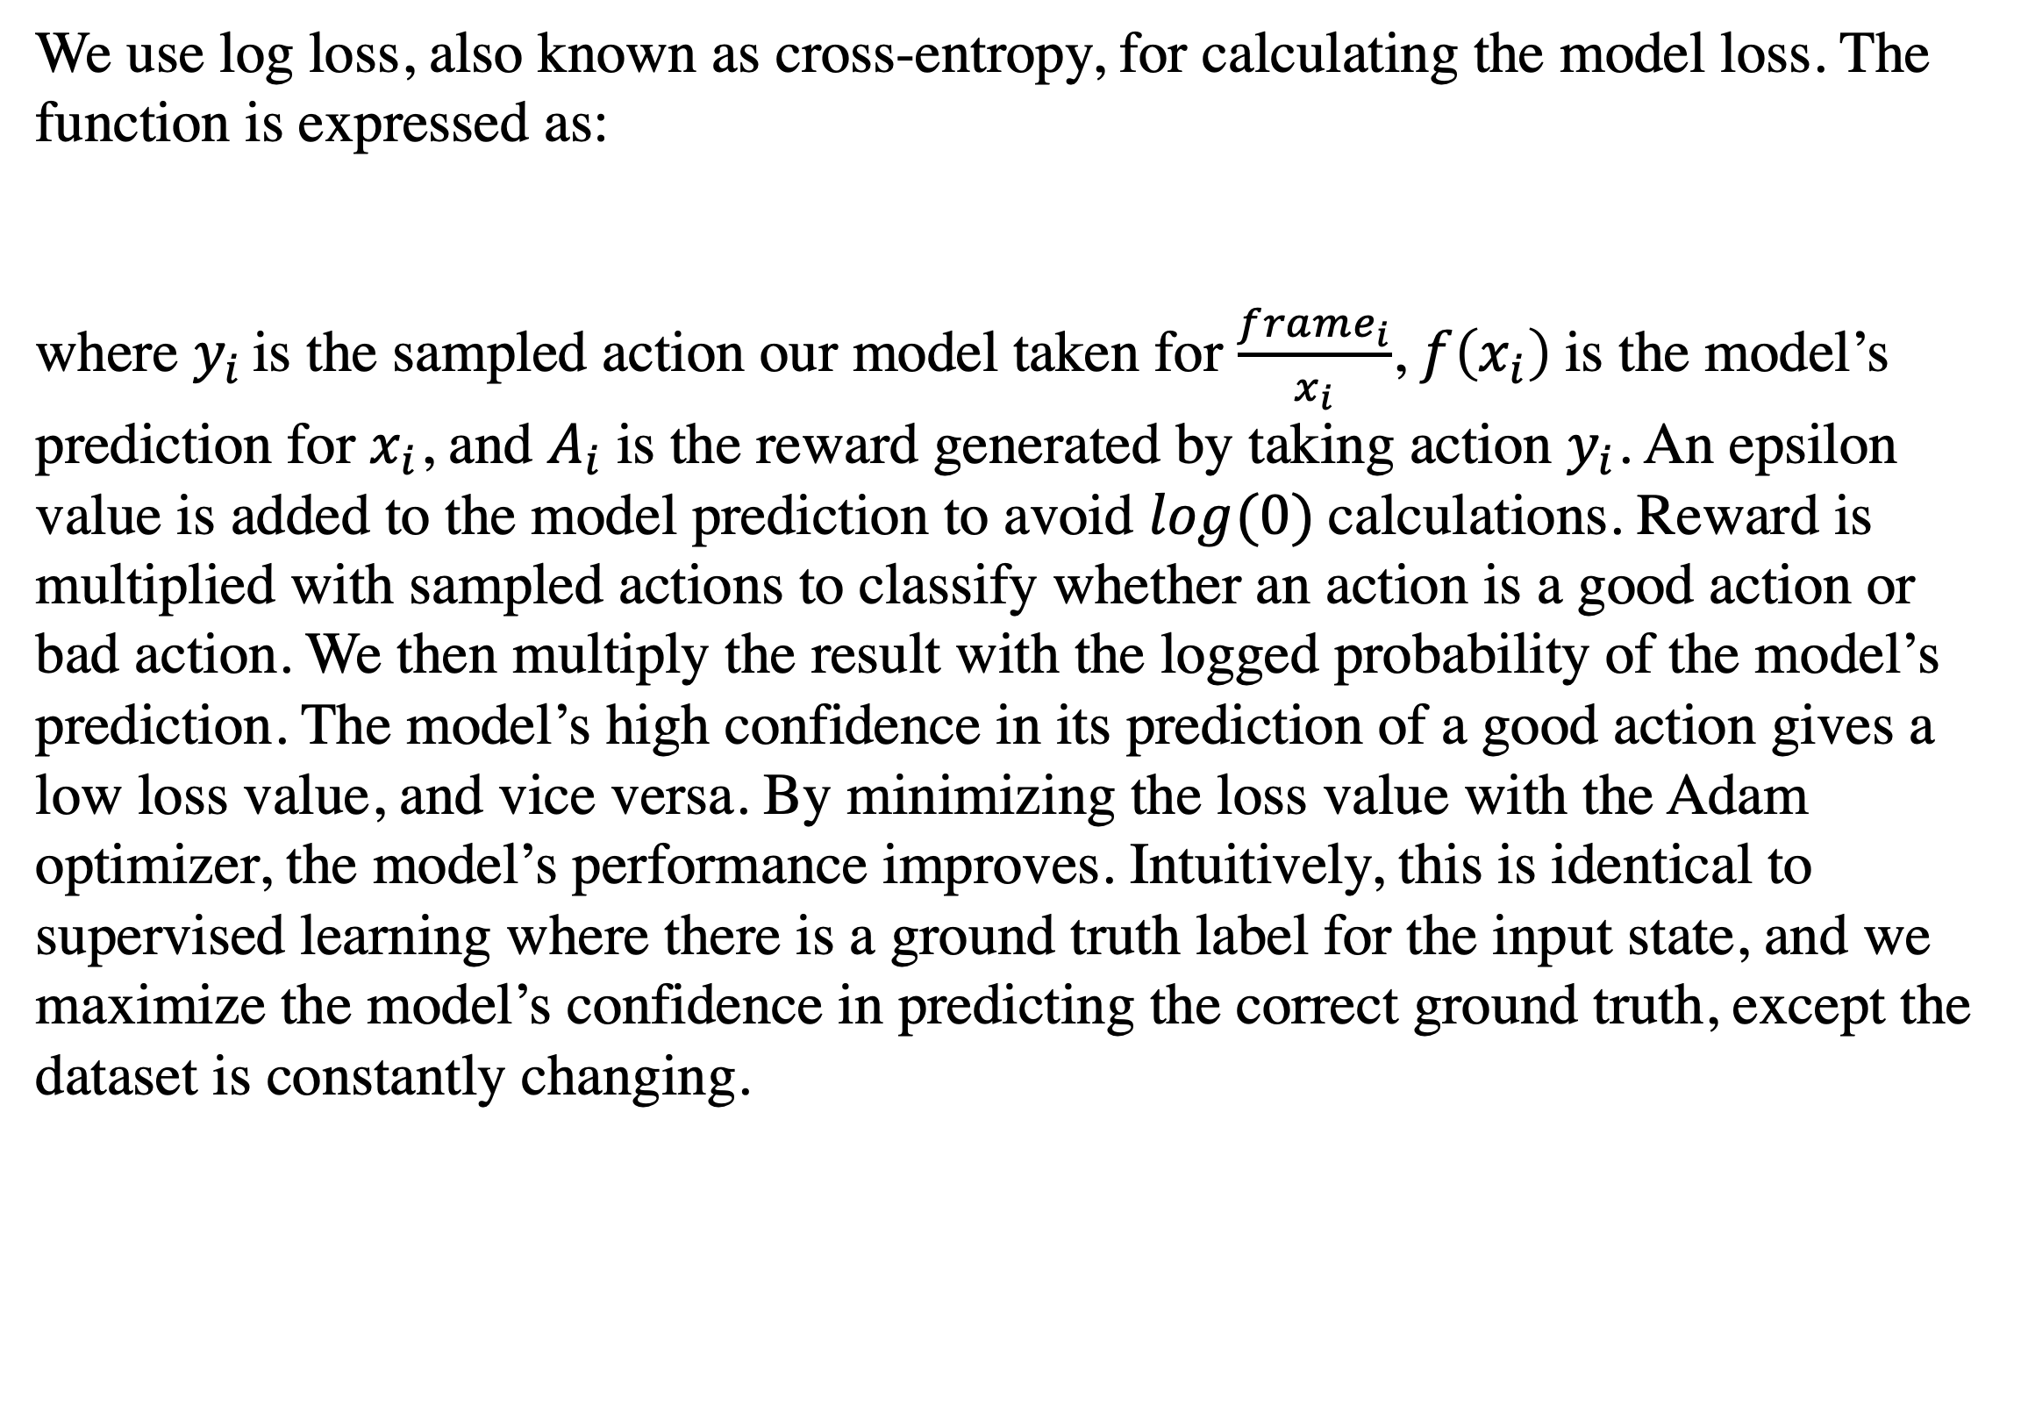
Reinforcement Learning with Pong
John Liu, Jacky Lee
Pong from Pixels
CALLOUT TITLE / FULL WIDTH SECTION TITLE
Policy network
The game of Pong is an excellent example of a RL task. The agent receives an image frame (a 210x160x3 byte array) and decides whether to move the paddle up or down. After every single choice, the game simulator executes the action and gives us a reward: either a +1 reward if the ball goes past the opponent, a -1 reward if we miss the ball, or 0 otherwise. Our goal is to move the paddle and maximize the rewards.
Some text and visuals here …
First, we define a policy network that implements our player. This network will take the state of our game and decide what we should do. The game has eight action in the action space, [‘NOOP’, ‘FIRE’, ‘RIGHT’, ‘LEFT’, ‘RIGHTFIRE’, ‘LEFTFIRE’]. However, only ‘RIGHT’ and ‘LEFT’ are effective actions. They move the paddle UP and DOWN. As a result, our model has only one output, which predicts the probability of going up, activated using the sigmoid function.
To construct the model, we selected a simple architecture with a dense layer containing 200 neurons. This architecture has previously been proven to be competent for our task.
Preprocessing
We apply two preprocessing techniques to the input frame to accelerate the convergence of our model.
We use a help function written by Andrej Karpathy, which down samples the frame and crops out unnecessary parts (score boards and background) of the frame. This helps reduce noise in the input, so the model does not have to learn unnecessary features. This results in a 80 by 80 array that preserves all the necessary information of the game.
The difference between two frames are taken as the input to the model. This technique helps detect the motion of the ball and paddles, which helps the model converge earlier.
Training
Each episode of training consists of 20 games, and a gradient update is performed every episode. At each frame, corresponding action and discounted reward are used into calculating loss and optimization. The smoothened reward and loss plots have shown a direct correlation between the two. As loss decreases, the in-game reward increases. Unlike in supervised learning, the dataset is constantly changing, so there are no measurements of overfitting prevention taken here.
Optimization
We use log loss, also known as cross-entropy, for calculating the model loss. The function is expressed as:
where $y_{i}$ is the sampled action our model taken for $\frac{frame_{i}}{x_{i}}$, $f\left(x_{i}\right)$is the model’s prediction for $x_{i}$, and $A_{i}$is the reward generated by taking action $y_{i}$. An epsilon value is added to the model prediction to avoid $log(0)$calculations. Reward is multiplied with sampled actions to classify whether an action is a good action or bad action. We then multiply the result with the logged probability of the model’s prediction. The model’s high confidence in its prediction of a good action gives a low loss value, and vice versa. By minimizing the loss value with the Adam optimizer, the model’s performance improves. Intuitively, this is identical to supervised learning where there is a ground truth label for the input state, and we maximize the model’s confidence in predicting the correct ground truth, except the dataset is constantly changing.
The credit assignment problem
Suppose the agent performs a series of expertise level actions initially, but fails to defend the ball in the last 20 frame. Then the network will mark that series of action as “bad actions” and discourage gradients of this behavior, even if some of the moves were “good actions”. Since the task for this project is simple enough, this problem can be overcome with thousands of episodes of training. However, this problem might lead to training divergence when the task is complicated enough, where a series of random actions never generate positive rewards.
Dense reward setting: by generating small rewards for achieving intermediate goals. For example, we can give a +0.1 reward every time the paddle hits the ball. The trade-off of this approach is that it may lead to the model learning the local minima (where the agent focuses on hitting the ball with the paddle) and not the global minima (where the agent focuses on scoring more points).
Imitation learning: by collecting data from expertise plays, the model will learn the collected data in a supervised learning setting. Once the model achieves expertise level, it moves on to an unsupervised environment and continues the training process. The trade-off of this approach is that data collection from an expertise is required. In some scenarios, manual data labelling is also required.
Discounted reward
Discounted rewards are only calculated at the terminating frame, producing a -1 or +1 reward. Other frames are given zero reward. Applying discounted rewards would avoid multiplying log loss with zero, which results in a loss value of zero.
Since each game is independent of each other, the discounted rewards are calculated independently of each game. We use the following formula:
where R_{t} is the discounted reward at frame t, and gamma is the discount factor (0.99 in our training config). Ultimately, each frame will have some reward of its consequence reward in range of (0, 1). The discount factor also acts as a long-short term reward factor. In this case, a large gamma implies that long term rewards are preferred.
Long training times
As the model performance improves over time, the length of frames for each episode increases significantly. As a result, the training time is much longer. This causes two issues:
Gradient updates become much less frequent. This can be alleviated by collecting data from multiple agents’ game plays and then combining them to perform a larger gradient update. It is important to note that the other agents are only playing the game and not being trained.
Memory issues begin to occur. Buffer size for storing collected data grows as the game length increases. This can potentially lead to buffer overload. Batch size reduction or gradient update during an episode can help avoid these issues. If not, then adding more memory to the machine should do the job.
[Footer: links, additional logos, QR codes etc., remove box if not needed]

