Slide 1
Cloud Cost Savings Plan (FinOps)
Reducing our $60 Million yearly cloud bill to $49.5 Million.
Created by: Bittu (Data Analyst)

Slide 2
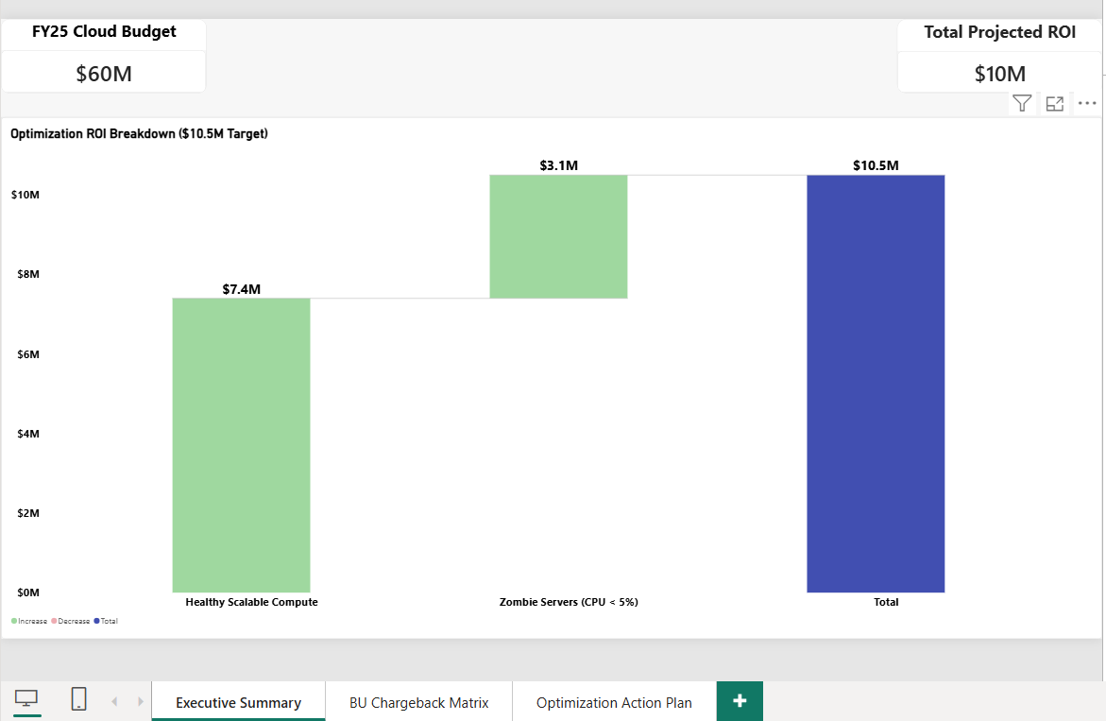
The Big Picture (Executive Summary)
Current Problem: Our total cloud budget for FY2025 is $60 Million. But 20% of this ($12 Million) is not assigned to any department (Untagged).
Our Solution: We found a safe way to save $10.5 Million across Amazon Web Services (AWS), Microsoft Azure, and Google Cloud.
What We Need: Approval to stop unused servers and buy long-term server contracts.

Slide 3
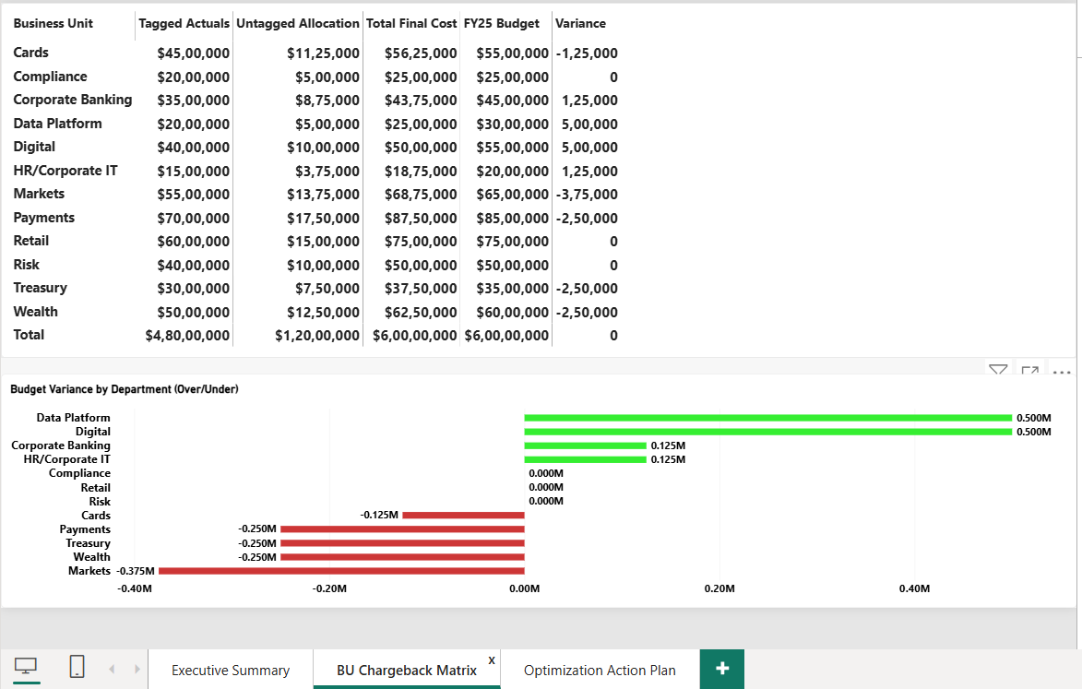
Fixing the Unassigned Costs ($12 Million)
The Issue: We had $12 Million in bills with no department tags.
How We Fixed It: We used a Fair Share Distribution (Pro-Rata) method. We divided the $12 Million based on how much each department normally uses.
Result: We found that the Digital and Data Platform departments are spending $500,000 more than their given budget.

Slide 4
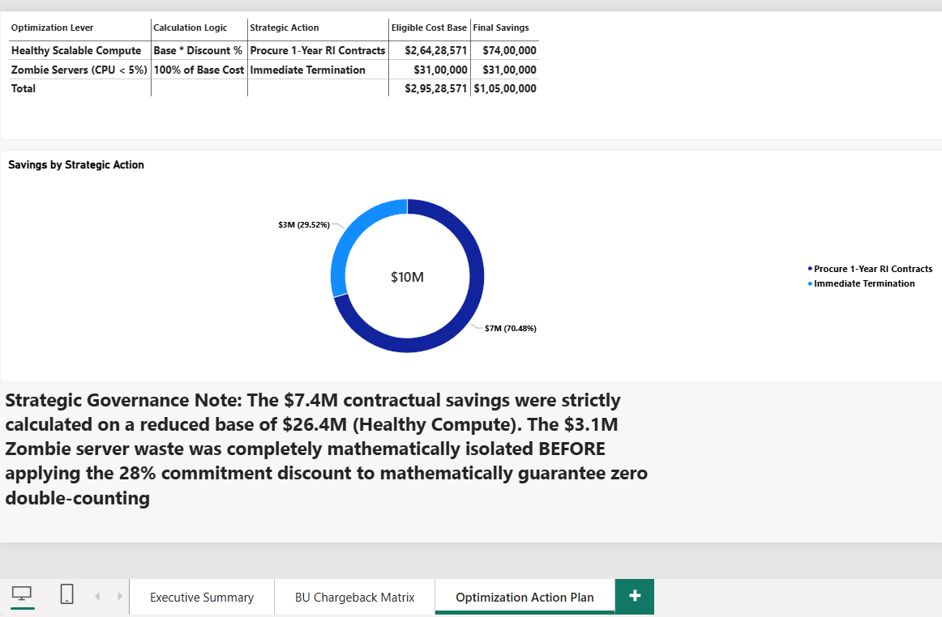
How We Save $10.5 Million (Return on Investment / ROI)
Action 1 (Save $3.1 Million): Turn off 'Zombie Servers' (Servers using less than 5% of their Central Processing Unit / CPU).
Action 2 (Save $7.4 Million): Buy 1-Year Reserved Instances (RI) - which means long-term contracts at a 28% discount for the healthy servers.
Safety Check: We removed the dead servers from our math BEFORE calculating the discount, so we do not count the savings twice.

Slide 5
Next Steps for the Team
Week 1 (IT Team): Turn off the unused Zombie Servers.
Week 2 (Finance Team): Approve and sign the 1-Year long-term contracts (Reserved Instances).
Month 1 (Cloud Team): Set a strict rule - no new server can be started without a proper department tag.

