Slide 1
Domain-aware Self-supervised Pre-training for Label-Efficient Meme Analysis
Brijendra Asthana: bka2022
Rishabh Singh: rbs7261

Slide 2
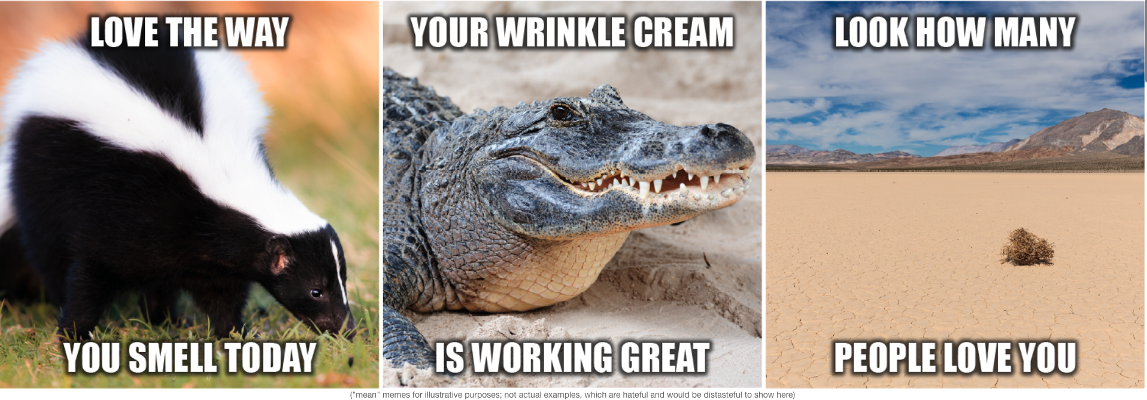
Introduction: Hateful Meme Challenge

Slide 3
Introduction
Based on arXiv:2209.14667 (Domain-aware Self-supervised Pre-training for Label-Efficient Meme Analysis). We are specifically working on self supervised pre-training method MM-SimCLR introduced in above paper.
This paper presents the design and evaluation of efficient multimodal frameworks that do not rely upon large scale dataset curation and annotation and can be pretrained using the datasets from the wild.
Our goal is to profile and benchmark the model using different hyperparameters to gain a better understanding of the implementation's training efficiency.

Slide 4
Challenges
GPU Resources: Our ability to estimate trends for training over multiple GPUs was limited due to our inability to reserve more than 2 GPUs.
Data: We had intended to train our self-supervised model using more meme datasets in order to analyze performance improvements during fine-tuning. However, we faced difficulty in acquiring meme-related datasets as they are scarce.
Algorithmic: Despite mostly utilizing a pre-existing codebase, we faced challenges in getting the model to run due to the unavailability of a Readme or documentation. We had to put in significant effort, including multiple code fixes, to successfully run the model.

Slide 5
Technical Contributions
The significance of efficient training in self-supervised models to handle large-scale datasets and reduce reliance on labeled data.
Explored the hardware setups (GPUs) and optimization techniques (parallelization, distributed training) utilized to enhance training efficiency.
Evaluated the relationship between dataset size, training time, and model performance, and found the optimal balance for efficient self-supervised learning.
Quantified training efficiency through metrics like training time, convergence speed, memory usage, and computational costs.

Slide 6
Implementation details
Dataset
Pre-training: MMHS150K + Hateful Memes dataset
Fine tuning and Evaluation: Hateful Memes dataset
MMHS150K:
150K multimodal tweets
Hateful Memes dataset:
8500 Training Examples, 2000 Testing Examples
Training split: 80% train/ 20% val
Platform: We are using NYU HPC cluster
Hardware: NVIDIA A100-SXM

Slide 7
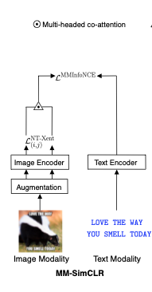
MM-SimCLR
The MM-SimCLR approach is a novel method that leverages discriminative modeling capacity through the use of contrastive learning in the latent space for images and a dedicated formulation for a multi-modal setup.

Slide 8

MM-SimCLR(contd.)
The objective function of MM-SimCLR comprises two terms that aim to maximize the association between image and text representations.
Loss function:
Notes:
1. Explain the loss function during presentation

Slide 9
Experiments
To assess the quality of the pre-trained representations, we use the linear evaluation method, which trains a simple classifier using fixed base network parameters. This is a widely used approach to evaluate the representations in a fair and minimalistic way.
The performance on the test set implies the quality of the representations learned.

Slide 10
Experimental setup and Hyperparameters
We train all our experiments using Pytorch on a NVIDIA A100-SXM with 80GB dedicated memory.
We have trained on 1 and 2GPUS using DataParallel
We have trained on. Multiple batch sizes, 32,64 and 128.
Name | Batch Size | Epochs | Learning Rate | Image Encoder | Text encoder
MM-SimCLR | 32 | 100 | 0.0001 | ResNet-18 | Distilbert-base-uncased
MM-SimCLR | 64 | 100 | 0.0001 | ResNet-18 | Distilbert-base-uncased
MM-SimCLR | 128 | 100 | 0.0001 | ResNet-18 | Distilbert-base-uncased

Slide 11

High Performance Analysis

Slide 12
Training time and Loss with Batch Sizes
1 GPU
Batch Size | Epochs | Loss | Total Data IO time (sec) | Total training time (sec) | Total time (sec) | Data IO time per epoch(sec) | Training time per epoch (sec) | Time per epoch (sec)
32 | 32 | 2.96E-06 | 514.01 | 4271.62 | 4786.66 | 16.06 | 133.49 | 149.58
64 | 36 | 2.56E-06 | 580.4049 | 4379.7 | 4961.19 | 16.12 | 121.66 | 137.81
128 | 65 | 6.68E-05 | 1090.43 | 7432.56 | 8524.37 | 16.78 | 114.35 | 131.14
2 GPU
Batch Size | Epochs | Loss | Total Data IO time (sec) | Total training time (sec) | Total time (sec) | Data IO time per epoch(sec) | Training time per epoch (sec) | Time per epoch (sec)
32 | 72 | 0.0 | 2181.7728 | 6922.4112 | 9105.4152 | 30.30 | 96.14 | 126.46
64 | 62 | 4.20E-06 | 495.156 | 5418.3175 | 5914.4083 | 7.99 | 87.39 | 95.39
128 | 67 | 1.24E-04 | 418.7502 | 5437.8161 | 5856.8055 | 6.25 | 81.16 | 87.42

Slide 13
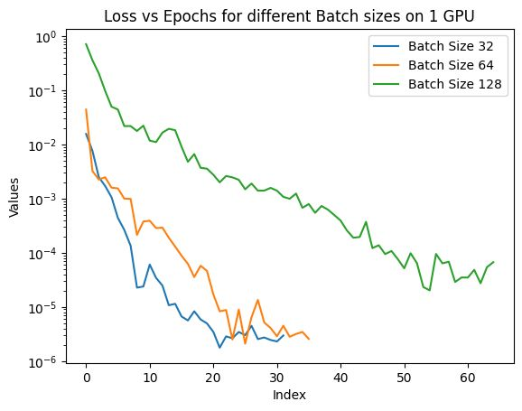
Loss vs Epoch for Batch sizes

Slide 14
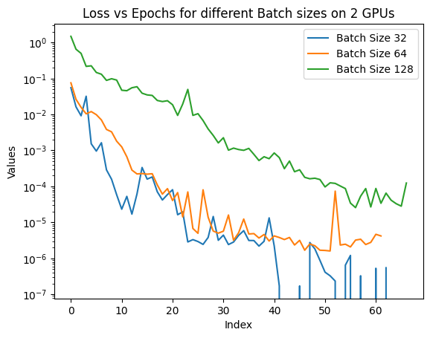
Loss vs Epoch for Batch sizes

Slide 15
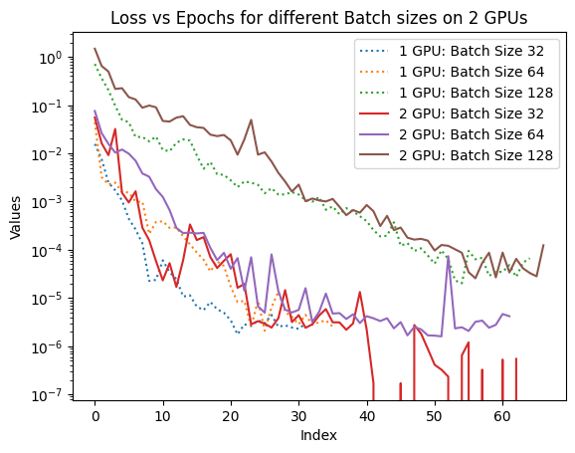
Loss vs Epoch for Batch sizes

Slide 16
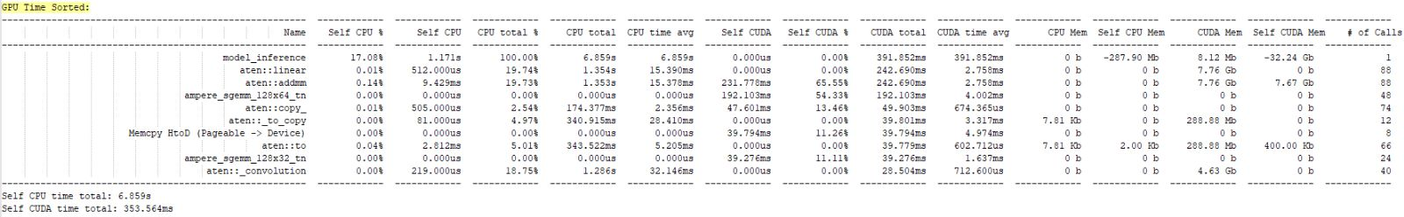
PyTorch Profiler

Slide 17
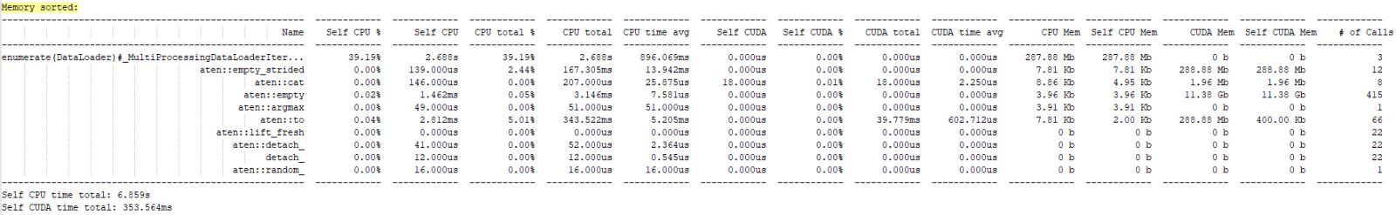
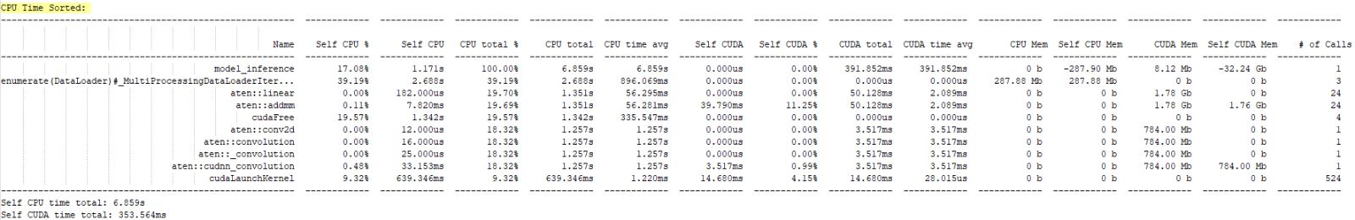

Slide 18
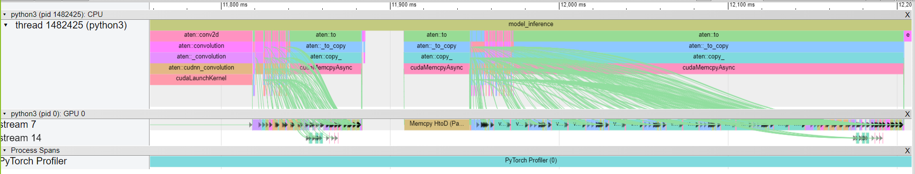
Inference Trace

Slide 19
GitHub Link
https://github.com/ris0801/HPMLProject-HatefulMemesChallenge

