Slide 1
Day 01
BKACAD’s Security Coding Training

Slide 2
Web Application Fundamental & Secure Software Concept
BKACAD’s Security Coding Training

Slide 3
Table of Content
HTTP
Modern vs Legacy Web Applications
JavaScript
Security Basics
System Tenets

Slide 4
Table of Content
HTTP
Modern vs Legacy Web Applications
JavaScript
Security Basics
System Tenets

Slide 5
HTTP
Intro
An application-layer protocol for transmitting hypermedia documents, such as HTML.
Designed for communication between web browsers and web servers.
HTTP is a stateless protocol, meaning that the server does not keep any data (state) between two requests.

Slide 6
HTTP
HTTP Requests
A request message from a client to a server includes, within the first line of that message, the method to be applied to the resource, the identifier of the resource, and the protocol version in use.

Slide 7
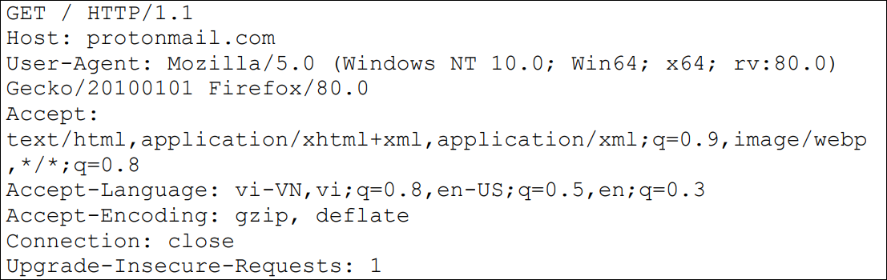
HTTP
HTTP Requests

Slide 8
HTTP
HTTP Responses
After receiving and interpreting a request message, a server responds with an HTTP response message.

Slide 9
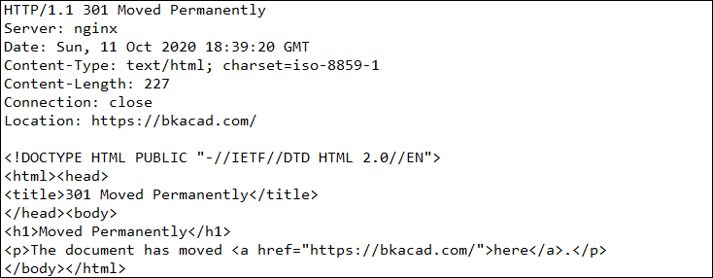
HTTP
HTTP Responses

Slide 10
Table of Content
HTTP
Modern vs Legacy Web Applications
JavaScript
Security Basics
System Tenets

Slide 11
Modern vs Legacy
Decade ago
Most web applications were built using server-side frameworks that rendered an HTML/JS/CSS page that would then be sent to the client.

Slide 12
Modern vs Legacy
Now
Web applications began making use of HTTP more frequently with the rise of Ajax (asynchronous JavaScript and XML), allowing network requests to be made from within a page session via JavaScript.

Slide 13
Modern vs Legacy
Now
• REST API
• JSON or XML
• JavaScript
• SPA framework (React, Vue, EmberJS, AngularJS)
• An authentication and authorization system
• One or more web servers (typically on a Linux server)
• One or more web server software packages (ExpressJS, Apache, NginX)
• One or more databases (MySQL, MongoDB, etc.)

Slide 14
Table of Content
HTTP
Modern vs Legacy Web Applications
JavaScript
Security Basics
System Tenets

Slide 15
JavaScript
Hello, world!
Invented at Netscape
Provides interactivity with the user
Client side Scripting language
Runs within browser sandbox
Server side JS: Node.js

Slide 16
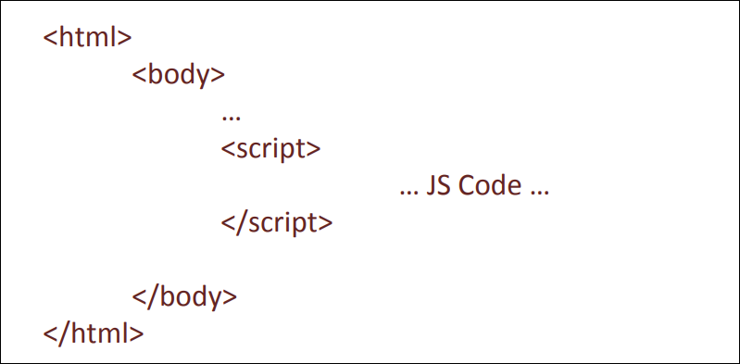
JavaScript
Hello, world!

Slide 17
JavaScript
Basics
https://www.w3schools.com/js
Variables
Operators
Conditional
Loop
Function
DOM Document

Slide 18
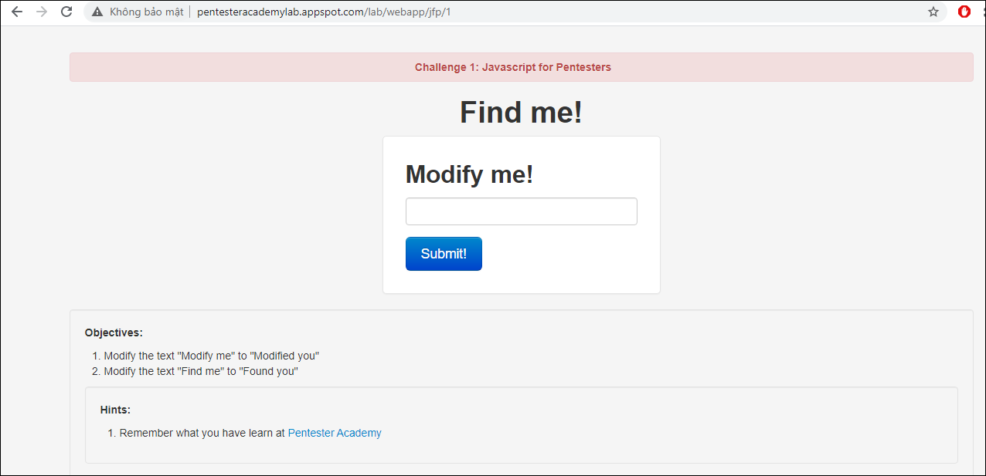
JavaScript
Lab 1, 2, 4, 5

Slide 19
Table of Content
HTTP
Modern vs Legacy Web Applications
JavaScript
Security Basics
System Tenets

Slide 20
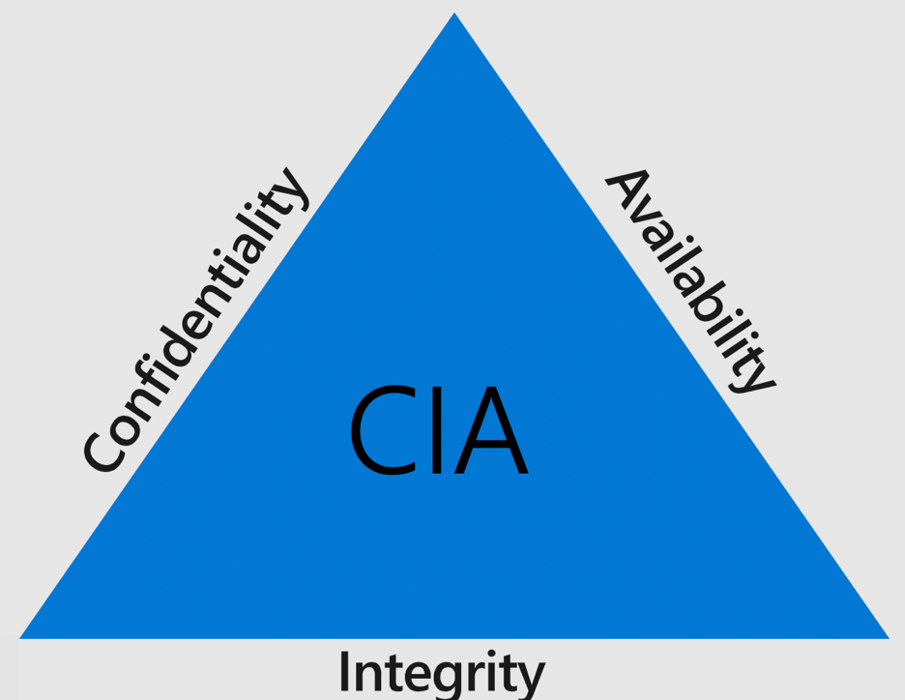
Security Basics
CIA Triad

Slide 21
Security Basics
AAA
Authentication – Who is allowed to access?
Authorization – What resources are allowed to access?
Accounting – What is being accessed?

Slide 22
Table of Content
HTTP
Modern vs Legacy Web Applications
JavaScript
Security Basics
System Tenets

Slide 23
System Tenets
Cores
a
kali@kali:~$ man nc

Slide 24
System Tenets
Cores
a
kali@kali:~$ man nc

