Slide 1
Movie Lens Analysis
“ The length of the Film is directly related to endurance of a human bladder.”
Case Study 2
Bir Kafle
Mohammed Ayub
Suman Lama

Slide 2
Topics
Why Movie Analysis is Important ???
Analysis, Plots and Results
Propositions to the “Cash Guy”
Future Work
Questions

Slide 3

Why Analysis is Important ?
Hollywood Industry has a revenue of Billion Dollar per year.
Forecasting the financial success based on the ratings, cast, timings etc.
Calculating if Cinema attendance has an effect on DVD sales.
Tailoring the movies to a particular audience.

Slide 4
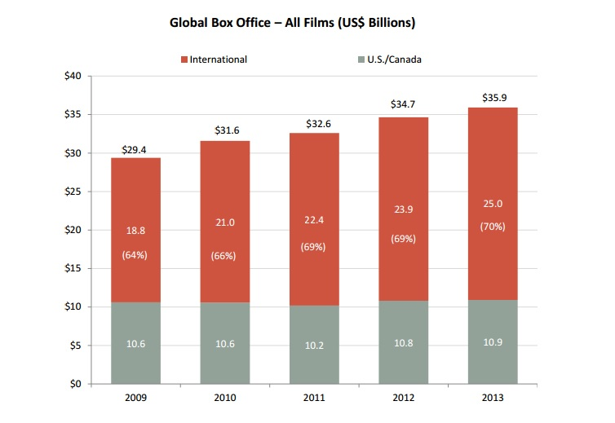
Theoretical Market Statistics 2013
http://www.mpaa.org/wp-content/uploads/2014/03/MPAA-Theatrical-Market-Statistics-2013_032514-v2.pdf

Slide 5
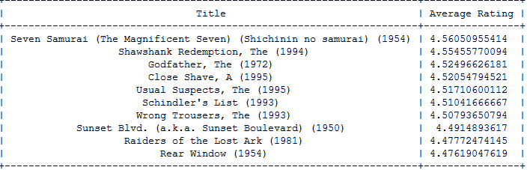
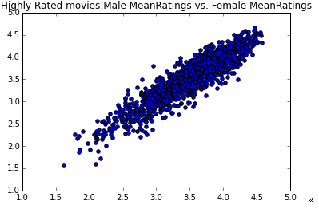
Experiments & Analysis
Most Popular Movies in the Data Set
Gender Analysis

Slide 6
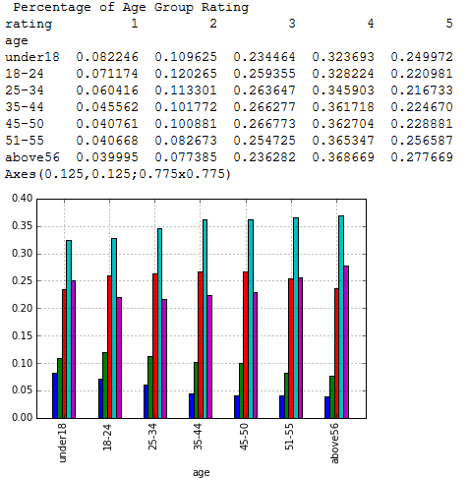
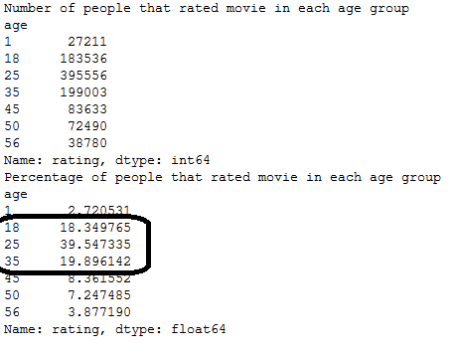
% Ratings by different Age groups
Count of ratings by different Age groups

Slide 7

Business Question
Who is my target audience & what kind of movies should I make next ???
Choose your demography..!
Age(yrs) | Population(%)
Under 18 | 24
18-44 | 36.5
45-64 | 26.4
Above 64 | 13.1
https://www.census.gov/newsroom/releases/archives/2010_census/cb11-cn147.html

Slide 8
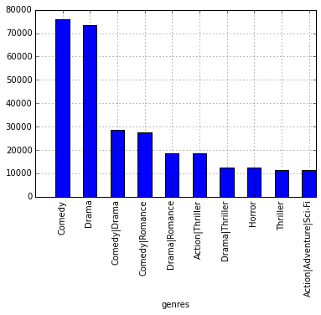
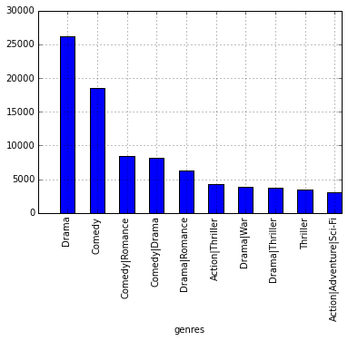
Proposition to the Investors
Genre Preference for Ages from 18-44
Genre Preference for Ages <18 and >45

Slide 9

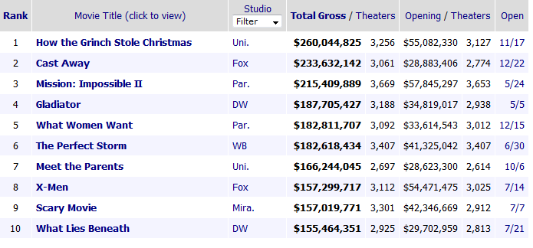

Validation for our results
Some Box Office Hit Releases in the Year 2000
http://www.boxofficemojo.com/yearly/chart/?yr=2000&p=.htm

Slide 10


Lessons learned
Don’t torture the data !!!
Selection of Computing tool
Importance of Mathematical Concepts
Necessity of rational assumptions
RAW Data is full of information
Working in team is very valuable
http://www.darpa.mil/NewsEvents/Releases/2012/03/29.aspx

Slide 11
Future Work
Is MPAA the right form of Rating for Movies ??
Sentiment Analysis, Text Categorization and much more….!!!!
http://www.cs.cornell.edu/people/pabo/movie-review-data/otherexperiments.html

Slide 12
Thank you & Questions

