Slide 1
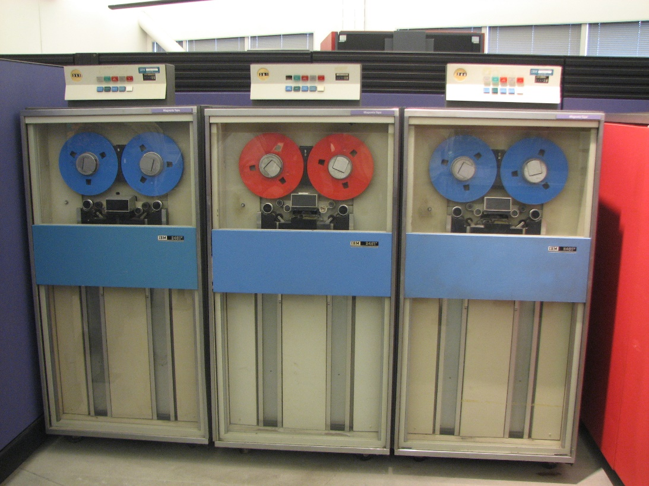
SeqAn I/O Support
Getting that pesky data from disk to memory or vice versa.

Slide 2
Contents
I/O in the SeqAn Library
Bioinformatics File Formats
Sequences (FASTA, FASTQ, Compression, FAI)
Genome Annotations (BED, GFF, GTF)
Variants (VCF)
Writing Parsers

Slide 3

I/O In SeqAn
A Bird’s Eye View

Slide 4
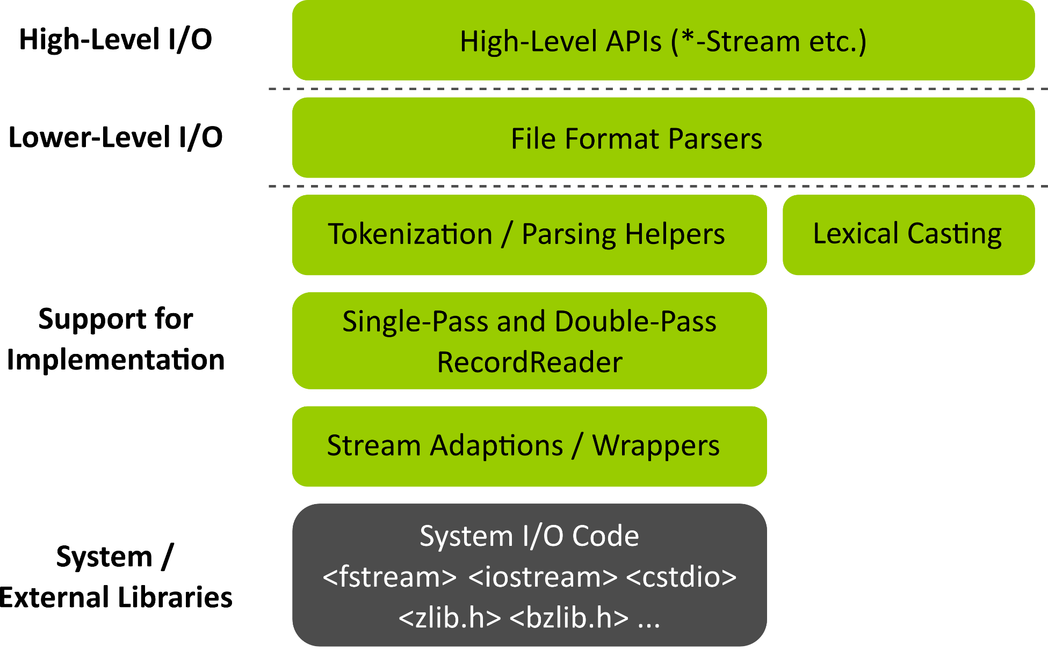
I/O Layers in SeqAn

Slide 5
Implementation Support
Making writing Bioinformatics file format parsing easier.
Lexical Casting
Parsing
Stream Abstractions
more on all of this later…
int i = 0;
const char * buf = “42”;
if (!lexicalCast2(i, buf))
throw std::runtime_error(“Something went wrong”);
FILE * f; /* or */ std::istringstream f; /* or… */
std::fstream f;
seqan::RecordReader<std::fstream, seqan::SinglePass<>> reader(f);
seqan::CharString buffer;
if (readUntilWhitespace(buffer, reader) != 0) { /* error */ } // QNAME
if (skipChar(reader, ‘\t’) != 0) { /* error */ } // “\t”
if (readDigits(buffer, reader) != 0) { /* error */ } // FLAG

Slide 6


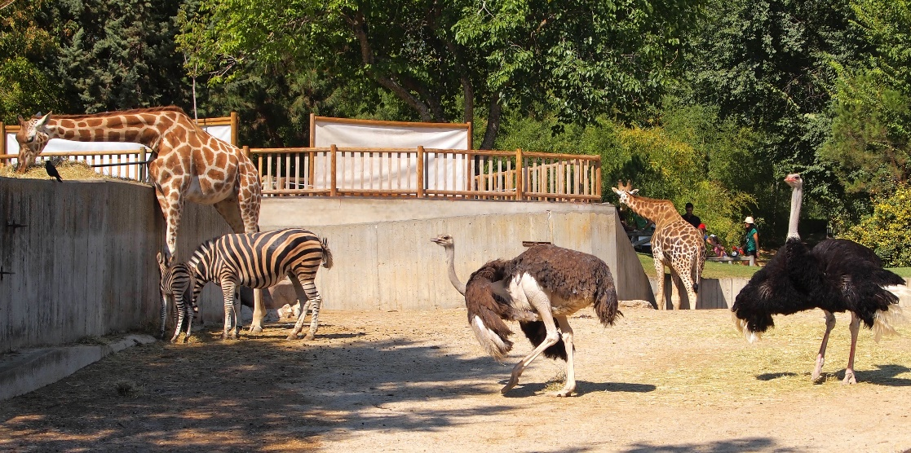

Bioinformatics file formats

Slide 7
SeqAn File Format Support
Low-Level Functions
Data Structures
std::fstream f;
seqan::RecordReader<std::fstream, seqan::SinglePass<>> reader(f);
seqan::CharString id, seq;
while (!atEnd(reader))
if (readRecord(id, seq, reader, seqan::Fasta()) != 0)
throw std::runtime_error(“Problem while reading.”);
#include <seqan/bam_io.h>
seqan::BamHeader bamHeader;
seqan::BamAlignmentRecord bamRecord;
#include <seqan/gff_io.h>
seqan::GffRecord gffRecord; // also good for GTF
#include <seqan/vcf_io.h>
seqan::VcfHeader vcfHeader;
seqan::VcfRecord vcfRecord;
#include <seqan/bed_io.h>
seqan::BedRecord<> bedRecord;

Slide 8
SeqAn’s *Stream Classes
Using RecordReader is cumbersome.
Better use the *Stream Classes!
std::fstream f(“input.fa”, std::ios::binary | std::ios::in);
if (!f.good())
throw std::runtime_error(“Problem opening file.”);
seqan::RecordReader<std::fstream, seqan::SinglePass<>> reader(f);
seqan::CharString id, seq;
while (!atEnd(reader))
if (readRecord(id, seq, reader, seqan::Fasta()) != 0)
throw std::runtime_error(“Problem while reading.”);
automatic file type detection.
“input.fa.gz”
“input.fq”
seqan::SequenceStream in(“input.fa”, seqan::SequenceStream::READ);
if (!isGood(in))
throw std::runtime_error(“Problem opening file.”);
seqan::CharString id, seq;
while (!in))
if (readRecord(id, seq, in) != 0)
throw std::runtime_error(“Problem while reading.”);

Slide 9
Reading Sequences
Reading record by record
Reading batches of records
Reading everything
seqan::SequenceStream in(“input.fa”);
if (!isGood(in))
throw std::runtime_error(“Problem opening file.”);
seqan::CharString id, seq;
while (!in))
if (readRecord(id, seq, in) != 0)
throw std::runtime_error(“Problem while reading.”);
seqan::StringSet<seqan::CharString> ids, seqs;
while (!atEnd(in)))
if (readBatch(ids, seqs, in, 1000))
throw std::runtime_error(“Problem while reading.”);
seqan::StringSet<seqan::CharString> ids, seqs;
while (!atEnd(in)))
if (readAll(ids, seqs, in))
throw std::runtime_error(“Problem while reading.”);

Slide 10
Writing Sequences
Writing record by record
Writing everything
seqan::SequenceStream out(“output.fa”, seqan::SequenceStream::WRITE);
if (!isGood(out))
throw std::runtime_error(“Problem opening file.”);
seqan::CharString id = “name”, seq = “CGATGATAGATAGAT”;
if (writeRecord(out, id, seq) != 0)
throw std::runtime_error(“Problem while writing.”);
seqan::StringSet<seqan::CharString> ids, seqs;
// fill ids and seqs
if (writeAll(out, ids, seqs))
throw std::runtime_error(“Problem while reading.”);

Slide 11
GFF and GTF I/O I
#include <seqan/basic.h>
#include <seqan/gff_io.h>
int main()
{
// Open input stream.
seqan::GffStream gffIn("example.gff");
// Open output stream, filename "-" means stdout.
seqan::GffStream gffOut("-", seqan::GffStream::WRITE);
// Read the file record by record.
seqan::GffRecord record;
while (!atEnd(gffIn))
{
readRecord(record, gffIn);
if (record.rID >= (int)length(gffOut.sequenceNames))
addSequenceName(gffOut, record.ref); // make reference known to output stream
writeRecord(gffOut, record);
}
return 0;
}

Slide 12
GFF and GTF I/O II
struct GffRecord
{
static int const INVALID_POS = 2147483647;
static intconst INVALID_IDX = -1;
CharString ref;
int rID;
CharString source;
CharString type;
StringSet<CharString> tagName;
StringSet<CharString> tagValue;
int beginPos;
int endPos;
float score;
char strand; // ‘+’, ‘-’, ‘.’
char phase; // ‘0’, ‘1’, ‘2’
}

Slide 13
BED I/O
#include <seqan/basic.h>
#include <seqan/bed_io.h>
int main()
{
// Open input stream.
seqan::BedStream bedIn("example.bed");
// Open output stream, filename "-" means stdout.
seqan::BedStream bedOut("-", seqan::BedStream::WRITE);
// Read the file record by record.
seqan::BedRecord<seqan::Bed3> record;
while (!atEnd(bedIn))
{
readRecord(record, bedIn);
// If record is on a sequence that is not known to bedOut yet then we
// have to make it known there.
if (record.rID >= (int)length(bedOut.sequenceNames))
addSequenceName(bedOut, record.ref);
writeRecord(bedOut, record);
}
return 0;
}

Slide 14
BED I/O II
template <>
class BedRecord<Bed12>
{
public:
CharString ref; // reference name
int rID; // index in sequenceNames of BedStream
int beginPos; // begin position of the interval
int endPos; // end position of the interval
CharString name; // name of the interval
CharString score; // score of the interval
char strand; // strand of the interval
int thickBegin; // begin position for drawing thickly
int thickEnd; // end position for drawing thickly
BedRgb itemRgb; // color for the item
int blockCount; // number of blocks/exons
String<int> blockSizes; // block sizes
String<int> blockBegins; // block begin positions
CharString data; // any data not fitting into other members
// Constants for marking reference id and position as invalid.
static const int INVALID_REFID = -1;
static const int INVALID_POS = -1;
};

Slide 15
VCF I/O I
class VcfRecord
{
public:
int rID; // CHROM
int beginPos; // POS
CharString id; // ID
CharString ref; // REF
CharString alt; // ALT
float qual; // QUAL
CharString filter; // FILTER
CharString info; // INFO
CharString format; // FORMAT
StringSet<CharString> genotypeInfos; // <individual1> <individual2> ..
// Constants for marking reference id and position as invalid.
static const int INVALID_REFID = -1;
static const int INVALID_POS = -1;
// This function returns the float value for "invalid quality".
static float MISSING_QUAL();
};

Slide 16
VCF I/O II
#include <seqan/basic.h>
#include <seqan/vcf_io.h>
int main()
{
seqan::VcfStream vcfIn("example.vcf");
if (!isGood(vcfIn))
return 1;
seqan::VcfStream vcfOut("-", seqan::VcfStream::WRITE);
vcfOut.header = vcfIn.header;
seqan::VcfRecord record;
while (!atEnd(vcfIn))
{
if (readRecord(record, vcfIn) != 0)
return 1;
if (writeRecord(vcfOut, record) != 0)
return 1;
}
return 0;
}

Slide 17
BAM I/O I
class BamAlignmentRecord
{
public:
CharString qName; // QNAME
unsigned short flag; // FLAG
int rID; // REF
int beginPos; // POS
unsigned char mapQ; // MAPQ mapping quality, 255 for */invalid
unsigned short bin; // bin for indexing
String<CigarElement<> > cigar; // CIGAR string
int rNextId; // RNEXT (0-based)
int pNext; // PNEXT (0-based)
int tLen; // TLEN
CharString seq; // SEQ, as in SAM/BAM file.
CharString qual; // Quality string as in SAM (Phred).
CharString tags; // Tags, raw as in BAM.
// Constants for marking pos, reference id and length members invalid (== *).
static int const INVALID_POS = MaxValue<int>::VALUE;
static int const INVALID_REFID = -1;
static int const INVALID_LEN = MaxValue<int>::VALUE;
};

Slide 18
BAM I/O II
#include <iostream>
#include <seqan/bam_io.h>
int main()
{
// Open input stream, BamStream can read SAM and BAM files.
seqan::BamStream bamStreamIn("example.sam");
// Open output stream, "-" means stdin on if reading, else stdout.
seqan::BamStream bamStreamOut("-", seqan::BamStream::WRITE);
// Copy header. The header is automatically written out before the first record.
bamStreamOut.header = bamStreamIn.header;
seqan::BamAlignmentRecord record;
while (!atEnd(bamStreamIn))
{
readRecord(record, bamStreamIn);
writeRecord(bamStreamOut, record);
}
return 0;
}

Slide 19
BAM I/O III – BAM Indices
#include <iostream>
#include <seqan/bam_io.h>
int main()
{
seqan::BamStream bamStreamIn("example.bam");
seqan::BamStream bamStreamOut("-", seqan::BamStream::WRITE);
bamStreamOut.header = bamStreamIn.header;
seqan::BamIndex<seqan::Bai> baiIndex;
if (read(baiIndex, “example.bam.bai”) != 0)
return 1;
bool hasAlignments = false; int rID = 0, posBegin = 1000, posEnd = 2000;
jumpToRegion(bamStreamIn, hasAlignments, rID, posBegin, posEnd, baiIndex);
seqan::BamAlignmentRecord record;
while (hasAlignments && !atEnd(bamStreamIn))
{
readRecord(record, bamStreamIn);
writeRecord(bamStreamOut, record);
}
return 0;
}

Slide 20
Index FASTA I/O
#include <seqan/seq_io.h>
int main(int argc, char const * argv)
{
seqan::FaiIndex faiIndex;
int res = read(faiIndex, "file.fasta"); // file.fasta.fai must exist
if (res != 0)
return 1;
unsigned idx = 0;
if (!getIdByName(faiIndex, "chr1", idx))
return 1; // chr1 not known in FAI file
unsigned seqLength = sequenceLength(faiIndex, idx);
// Load first 1000 characters of chr1.
seqan::CharString seqChr1Prefix;
if (readRegion(seqChr1Prefix, faiIndex, idx, 0, 1000) != 0)
return 1;
// Load all of chr1.
seqan::CharString seqChr1;
if (readSequence(seqChr1, faiIndex, idx) != 0)
return 1;
return 0;
}

Slide 21

Writing Parsers
It’s not rocket surgery!

Slide 22
Writing a BED 3 Parser
The BED format (TSV)
BED fields
chr7 127471196 127472363 Pos1 0 + 127471196 127472363 255,0,0
chr7 127472363 127473530 Pos2 0 + 127472363 127473530 255,0,0
chr7 127473530 127474697 Pos3 0 + 127473530 127474697 255,0,0
chr7 127474697 127475864 Pos4 0 + 127474697 127475864 255,0,0
chr7 127475864 127477031 Neg1 0 - 127475864 127477031 0,0,255
chr7 127477031 127478198 Neg2 0 - 127477031 127478198 0,0,255
chr7 127478198 127479365 Neg3 0 - 127478198 127479365 0,0,255
chr7 127479365 127480532 Pos5 0 + 127479365 127480532 255,0,0
chr7 127480532 127481699 Neg4 0 - 127480532 127481699 0,0,255
BED 3
ref (1)
beginPos (2)
endPos (3)
name (4)
score (5)
strand (6)
thickBegin (7)
thickEnd (8)
itemRgb (9)
blockCount (10)
blockStarts (11)
blockSizes (12)

Slide 23
BED3 Data Structures, Interfaces
// Record data structure.
class Bed3Record
{
public:
CharString ref; // reference name
int beginPos; // begin position of the interval
int endPos; // end position of the interval
};
void clear(Bed3Record & record) { clear(record.ref); record.beginPos = record.endPos = -1; }
// Tags.
struct Bed3_;
typedef seqan::Tag<Bed3_> Bed3;
// Reading.
template <typename TStream>
int readRecord(Bed3Record & record, seqan::RecordReader<TStream, SinglePass<> > & reader,
Bed3 const & /*tag*/);
// Writing.
template <typename TStream>
int writeRecord(TStream & out, Bed3Record & record, Bed3 const & /*tag*/);

Slide 24
Write Support
// Writing.
template <typename TStream>
int writeRecord(TStream & out, Bed3Record & record, Bed3 const & /*tag*/);
{
streamPut(out, record.ref);
streamPut(out, '\t');
streamPut(out, record.beginPos);
streamPut(out, '\t');
streamPut(out, record.endPos);
streamPut(out, '\n');
return !streamError(out);
}

Slide 25
Writing the Parser
template <typename TStream>
int readRecord(Bed3Record & record, seqan::RecordReader<TStream, SinglePass<> > & reader,
Bed3 const & /*tag*/)
{
clear(record); seqan::CharString buffer;
if (readUntilTabOrLineBreak(record.ref, reader) != 0)
return 1;
if (skipChar(reader, '\t') != 0)
return 1; // error or char was not TAB
if (readUntilTabOrLineBreak(buffer, reader) != 0)
return 1;
if (skipChar(reader, '\t') != 0)
return 1; // error or char was not TAB
if (!lexicalCast2(reader.beginPos, buffer))
return 1;
clear(buffer); // IMPORTANT, read*() functions append to buffer
if (readUntilTabOrLineBreak(buffer, reader) != 0)
return 1;
if (!lexicalCast2(reader.endPos, buffer))
return 1;
return !!skipLine(reader);
}

Slide 26

The End
Thank you for your Interest.
Questions?

