Slide 1


SeqAn – BioStore Conference 2014
Journaled String Tree
René Rahn
Algorithmische Bioinformatik
FU Berlin, Germany

Slide 2
What we have!
Sequential algorithm:
start
start
initialize
initialize
at end?
yes
stop
stop
State
State
Context
no
counter
position
bit mask
…
counter
position
bit mask
…
process
context
read
update
process
context
s⁰:
at pos 350
success?
yes
report
report
no
move forward
move forward
Notes:
CDFGDC
CDEFGAHGC

Slide 3
What we want!
Process multiple sequences
s⁰:
s¹:
s²:
s³:
…
Notes:
CDFGDC
CDEFGAHGC

Slide 4
What we want!
Process multiple similar sequences
s⁰:
0: 531
1: 545
2: 531
3: 545
s¹:
1: 245
3: 245
s²:
s³:
Notes:
CDFGDC
CDEFGAHGC

Slide 5
Referential Compression
src:
TAGCGTAGCAGCTATGAGGAGG-ACCGAGTT
|||||||||||| |||||| ||||||||
tar:
tar^{Δ}:
TAGCGTAGCAGC---GAGGAGCGACCGAGTT
TAGCGTAGCAGC---GAGGAGCGACCGAGTT
TAGCGTAGCAGC---GAGGAGCGACCGAGTT
Journaled String
ref: *
(19,1,1,1)
G
Virtual Position
ib: CG
Physical Position
3
Journal Entry
1
(12,15,6,0)
GAGGAG
4
(20,22,8,0)
ACCGAGTT
Length
Source
0
(0,0,12,0)
TAGCGTAGCAGC
2
(18,0,1,1)
C
Notes:
ViewToSourcePosition of Row1
toSourcePosition(row,pos)
SourceToViewPosition of Row1
toViewPosition(row,pos)

Slide 6
Journaled String Interface
template <typename TValue, typename THostSpec, typename TJournalSpec,
typename TBuffSpec>
class String<TValue, Journaled<THostSpec, TJournalSpec, TBuffSpec>>
{
… };
typedef String<Dna, Journaled<>> TJournalString;
typedef typename Iterator<TJournalString, Standard>::Type TIter;
TJournalString jString(”ACGTACGT”);
insert(jString, 5, ”CCC”);
erase(jString, 2, 4);
jString[8] = ’A’;
for(TIter it = begin(jString); it != end(jString); ++it)
std::cout << *it << std::flush;
std::cout << std::endl; // ACACCCCGA
std::cout << host(jString); // ACGTACGT
Can be used as any other String<> in SeqAn

Slide 7
Journaled String Tree
0 1 2
0123456789012345678901-23456789
ref: TAGCGTAGCAGCTATGAGGAGG-ACCGAGTT
0 1 2
012345678901234567890123456789
ref: TAGCGTAGCAGCTATGAGGAGGACCGAGTT
s¹: TAGCGTAGCAGC---GAGGAGCGACCGAGTT
s²: TAGCGTGGCAGC---GAGGAGC-ACCGAGTT
s³: TAGCGTGGCAGCTATGAGGAGC-ACCGAGTT
Delta Map
r-pos Delta a
6 ⬅ R-( ‘G’,{2,3})
12 ⬅ D-(‘TAT’,{1,2})
21 ⬅ R-( ‘C’,{1,2,3})
22 ⬅ I-( ‘G’,{1})
Journaled String Set
j¹: TAGCGTAGCAGC---GAGGAGCGACCGAGTT
j²: TAGCGTGGCAGC---GAGGAGC-ACCGAGTT
j³: TAGCGTGGCAGCTATGAGGAGC-ACCGAGTT
Notes:
- Can be used like strings
- Modifieres can be nested, e.g reverse complement

Slide 8
Journaled String Tree Traversal
Traversal
start
Sequential Algorithm
initialize
setState()
state : getState()
at end?
yes
stop
State
State Stack
int : execute()
no
counter
position
bit mask
…
process
context
read
update
it : getContext()
success?
yes
report
Journaled String Tree
no
vec : getPositions()
move forward

Slide 9
Journaled String Tree Traversal
Delta-Map
Horspool:
r-pos Delta a
6 ⬅ R-( ‘G’,{2,3})
12 ⬅ D-(‘TAT’,{1,2})
21 ⬅ R-( ‘C’,{1,2,3})
22 ⬅ I-( ‘G’,{1})
Pattern: AGCG
A: 3 C: 1 G: 2 T: 4
Context size: 4
{2*,3}
A G C A C C
{2*,3}
{1*,2}
{1*,2,3}
A G C G A G
A G C
G A C
{1*}
C G T G G C A
{1*}
G A C C G
T A G C G T A G C A G C T A T G A G G A G G A C C G A G T T
0 1 2 3 4 5 6 7 8 9 0 1 2 3 4 5 6 7 8 9 0 1 2 3 4 5 6 7 8 9
0 1 2
s¹ : 1
s² : 1
s³ : 1
s¹ : 9
s² : 9
s¹ : 16

Slide 10
Scale Memory Footprint
Process in blocks
Block 1
Block 2
Block 3
Block 4
--- GA
G C
G GA
-
A C
C T
-- T
-- G
G T
CA T
A

Slide 11
Results

Slide 12

Questions?
Thank you for your attention!

Slide 13





Background
Notes:
- Can be used like strings
- Modifieres can be nested, e.g reverse complement

Slide 14
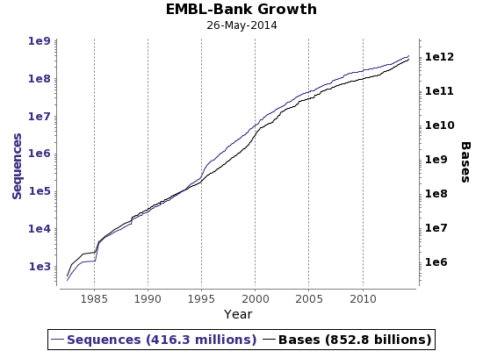
Background
http://www.ebi.ac.uk/ena/about/statistics; Accessed 01.06.2014

Slide 15
Journaled String Tree
Traversal
getPositions
start
initialize
Sequential Algorithm
process
reference segment
shift size
no
next
segment?
yes
stop
success?
yes
yes
no
process
context
no
report
at end?
push state
compute shift
yes
stack
empty?
yes
no
no
at end?
getState
State
split?
yes
no
counter
position
bit mask
…
read
update
pop state
process
branch
segment
push state
shift size
setState

Slide 16
Core Parallelization
T1
Concurrent
Queue
T2
T3
Master

