Slide 1




AG Algorithmic Bioinformatics
Biostore Project
Björn Kahlert
Institut für Informatik
Freie Universität Berlin
12.09.2011
Notes:
I want to spend some words
on my work in the framework
of the Biostore respectively SeqAn project.

Slide 2
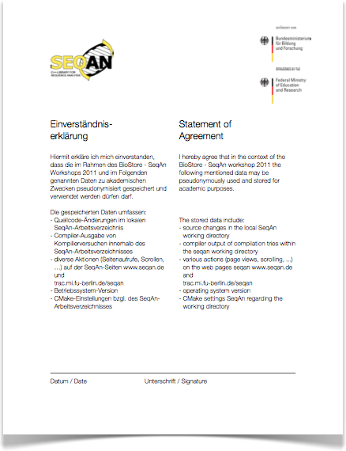

Goal
Usability improvement
  requirements
  less time
  satisfactory results
Observation needed
Experiment within this workshop
Björn Kahlert, Usability Improvement of the SeqAn Library, AG Algorithmic Bioinformatics, Freie Universität Berlin
Notes:
better meets your requirements

Slide 3



Data Collection
#1 Random ID
#2 Progress Data
core data
  os version
  development environment
diff files
online documentation usage
$ CMake
Björn Kahlert, Usability Improvement of the SeqAn Library, AG Algorithmic Bioinformatics, Freie Universität Berlin
Notes:
What you can do voluntarily is

Slide 4
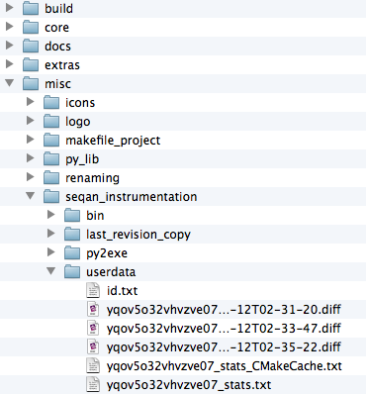

Transmitted Data
"machine": { "machine": "x86_64", "processor": "i386", "architecture": "64bit" }, "devenv": { "CMAKE_CXX_COMPILER":
"/usr/bin/g++", "CMAKE_GENERATOR":
"Xcode",
"CMAKE_BUILD_TYPE":
"Debug", }, "os": { "system": "Darwin", "platform": "Darwin-11.1.0-64bit", "release": "11.1.0" }
--- alignment.cpp 2011-09-12
02:26:03
+++ alignment.cpp 2011-09-12
02:35:17@@ -1,4 +1,4 @@-///A tutorial about alignments.+///A tutorial about global alignments. #include <iostream> #include <seqan/align.h> #include <seqan/graph_align.h>
yqov5o32vhvzve07
Björn Kahlert, Usability Improvement of the SeqAn Library, AG Algorithmic Bioinformatics, Freie Universität Berlin
Notes:
I want to give you an understanding of the
nature of data transmitted to our SeqAn server.
checked out
you see this tree of directories

Slide 5
Privacy
only pseudonymized data
  no link to real person
only SeqAn sites
  www.seqan.de
  trac.mi.fu-berlin.de/seqan
activated manually
Björn Kahlert, Usability Improvement of the SeqAn Library, AG Algorithmic Bioinformatics, Freie Universität Berlin

Slide 6

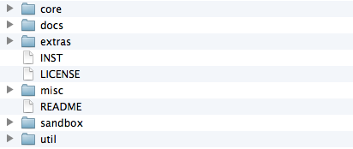

activated manually
home$ cd seqan-trunk
  seqan-trunk$ echo "" > INST
Björn Kahlert, Usability Improvement of the SeqAn Library, AG Algorithmic Bioinformatics, Freie Universität Berlin

Slide 7
Summary
diff and doc usage logged
privacy
create file INST in seqan-trunk
  seqan-trunk$ echo "" > INST
run cmake
open seqan.de/?id=[YOUR ID HERE]
please only use the online documentation
Have fun using SeqAn!
Thank you for taking part in the experiment!
Björn Kahlert, Usability Improvement of the SeqAn Library, AG Algorithmic Bioinformatics, Freie Universität Berlin

