Slide 1
App Session 2 New Argument Parser
SeqAn – BioStore Workshop 2013

Slide 2
Motivation
Replacement of Command Line Parser (cmd_parser)
Bad design
Not designed for substantial extensions
Need for CTD support
Allows for easy KNIME node creation

Slide 3
Argument Parser Features
Robust parsing of command line arguments
Definition of restrictions
data type
ranges
allowed values
file extensions
Broad parameter support
Flag options (--opt, -o)
Value options (–opt 5, -o 5)
Positional arguments
Lists -o 1 –o 2 –o 9
Very nice help screens, html page and man page output
CTD output (allows KNIME node generation)
$ ./my_tool –x –y arg1 arg2

Slide 4
Example
seqan::ArgumentParser parser("Argument Parser Demo");
addOption(parser, seqan::ArgParseOption("i", ”times”, ”Number of repetitions.”, seqan::ArgParseArgument::INTEGER, "INT"));
demo$ ./demo --help
Argument Parser Demo ====================
SYNOPSIS
DESCRIPTION
-h, --help
Displays this help message.
--version
Display version information
-i, --times INT
Number of repetitions.
VERSION
Argument Parser Demo version:
Last update
Notes:
addOption(ArgumentParser, ArgParseOption)
ArgParseOption(short name, long name, description, datatype, label)
SYNOPSIS
Version
Last update missing

Slide 5
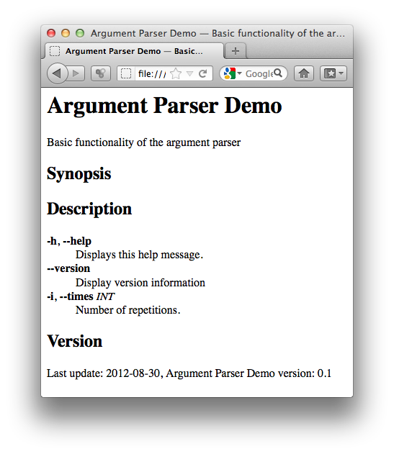
HTML output
demo$ ./demo --export-help html > demo.html

Slide 6
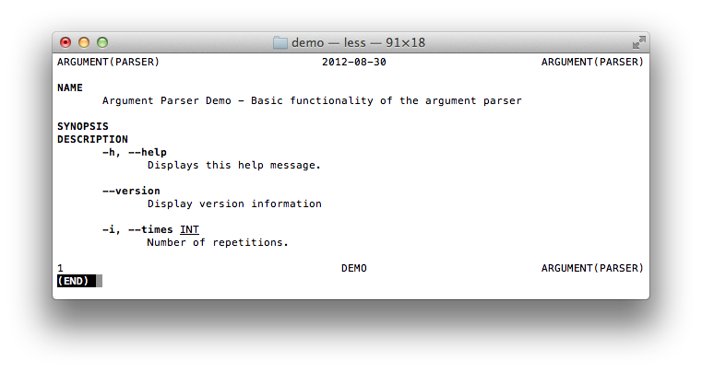
Manpage output
demo$ ./demo --export-help manpage > demo.man

Slide 7
Example
seqan::ArgumentParser parser("Argument Parser Demo");
addOption(parser, seqan::ArgParseOption("i", ”times”, ”Number of repetitions”, seqan::ArgParseArgument::INTEGER, "INT"));
addArgument(parser, seqan::ArgParseArgument(
seqan::ArgParseArgument::STRING, "TEXT"));
Option
demo$ ./demo –i 5 –text “Text”
demo$ ./demo –i 5 “Text”
int main(int argc, char const ** argv)
Argument
seqan::ArgumentParser::ParseResult res = seqan::parse(parser, argc, argv);
if (res != seqan::ArgumentParser::PARSE_OK)
return res == seqan::ArgumentParser::PARSE_ERROR;
All options and arguments
are valid at this place :)
unsigned times = 0;
getOptionValue(times, parser, “times”);
seqan::CharString text;
getArgumentValue(text, parser, 0);

Slide 8
Example
No Arguments
demo$ ./demo
Argument Parser Demo ====================
Try 'Argument Parser Demo --help' for more information.
VERSION
Argument Parser Demo version:
Last update
Valid arguments
demo$ ./demo -i 5 Test
times 5
text Test
Invalid Arguments
demo$ ./demo -i no_int
Argument Parser Demo: the given value 'no_int' cannot be casted to integer

Slide 9
Restrictions
Data type checking (of integer, double, string, input file, output file)
Undefined options and arguments
Min and max values
setMinValue(parser, "times", "1");
setMaxValue(parser, "times", "100");
List of valid values
setValidValues(parser, "text", "value1 value2");
demo$ ./demo -i no_int
Argument Parser Demo: the given value 'no_int' cannot be casted to integer
demo$ ./demo -i 5 "Test" -x
Argument Parser Demo: illegal option -- x

Slide 10
Input and Output Files
addOption(parser, seqan::ArgParseOption( "I", "input-file", "Path to the input file”, seqan::ArgParseArgument::INPUTFILE, "IN"));
addOption(parser, seqan::ArgParseOption( "O", "output-file", "Path to the output file", seqan::ArgParseArgument::OUTPUTFILE, "OUT"));
setValidValues(parser, "output-file", "txt");
getOptionValue(outputFileName, parser, "output-file");

Slide 11
Default Values
seqan::ArgumentParser parser("Argument Parser Demo");
addOption(parser, seqan::ArgParseOption("i", ”times”, ”Number of repetitions.”, seqan::ArgParseArgument::INTEGER, "INT"));
setDefaultValue(parser, "times", 1);
demo$ ./demo -i 5 "Test"
times 5
text Test
demo$ ./demo "Test”
times 1
text Test
Notes:
addOption(ArgumentParser, ArgParseOption)
ArgParseOption(short name, long name, description, datatype, label)
SYNOPSIS
Version
Last update missing

Slide 12
Rich Documentation
seqan::ArgumentParser parser;
setShortDescription(parser, "Basic functionality of the argument parser");
setVersion(parser, "0.1");
setDate(parser, "2013-09-18");
addUsageLine(parser,
”[OPTIONS] \”TEXT\"");
addDescription(parser,
"This program allows simple string repetition by i times.");
Notes:
addOption(ArgumentParser, ArgParseOption)
ArgParseOption(short name, long name, description, datatype, label)
SYNOPSIS
Version
Last update missing

Slide 13
Rich Documentation
Argument Parser Demo - Basic functionality of the argument parser
=================================================================
SYNOPSIS
demo [OPTIONS] "TEXT"
DESCRIPTION
This program allows simple string repetition by i times.
-h, --help
Displays this help message.
--version
Display version information
-i, --times INT
Number of repetitions. In range [1..100]. Default: 1.
-O, --output-file OUT
Path to the output file Valid filetype is: txt.
VERSION
Argument Parser Demo version: 0.1
Last update 2012-08-30
Notes:
addOption(ArgumentParser, ArgParseOption)
ArgParseOption(short name, long name, description, datatype, label)
SYNOPSIS
Version
Last update missing

Slide 14
Rich Documentation
Separate default parameters from yours
addSection(parser, "Demo Options");
Add examples
addTextSection(parser, "Examples");
addListItem(parser,
"modify_string -i 5 \"text\"",
"Print \"text\" 5 times");
Notes:
addOption(ArgumentParser, ArgParseOption)
ArgParseOption(short name, long name, description, datatype, label)
SYNOPSIS
Version
Last update missing

Slide 15
Argument Parser Demo - Basic functionality of the argument parser
=================================================================
SYNOPSIS
demo [OPTIONS] "TEXT"
DESCRIPTION
This program allows simple string repetition by i times.
-h, --help
Displays this help message.
--version
Display version information
Demo Options:
-i, --times INT
Number of repetitions. In range [1..100]. Default: 1.
-O, --output-file OUT
Path to the output file Valid filetype is: txt.
EXAMPLES
modify_string -i 5 "text"
Print "text" 5 times
modify_string "text" --output-file out.txt
Print "text" once in file out.txt
VERSION
Argument Parser Demo version: 0.1
Last update 2012-08-30
Notes:
addOption(ArgumentParser, ArgParseOption)
ArgParseOption(short name, long name, description, datatype, label)
SYNOPSIS
Version
Last update missing

Slide 16
Best Practice
Encapsulate Options
struct DemoOptions
{
unsigned times;
CharString text;
DemoOptions() :
times(1)
{}
};
Encapsulate Parsing ArgumentParser::ParseResult
parseCommandLine(DemoOptions & options, int argc, char const ** argv)
{
ArgumentParser parser("Argument Parser Demo");
addArgument(parser, seqan::ArgParseArgument(...));
addOption(parser, seqan::ArgParseOption(...));
ArgumentParser::ParseResult res = parse(...);
if (res != seqan::ArgumentParser::PARSE_OK) return res;
getOptionValue(options.times, parser, "times");
getArgumentValue(options.text, parser, 0);
return seqan::ArgumentParser::PARSE_OK;
}
Notes:
addOption(ArgumentParser, ArgParseOption)
ArgParseOption(short name, long name, description, datatype, label)
SYNOPSIS
Version
Last update missing

Slide 17
Best Practice
int main(int argc, char const ** argv)
{
DemoOptions options;
ArgumentParser::ParseResult res = parseCommandLine(options, argc, argv);
if (res != seqan::ArgumentParser::PARSE_OK)
return res == seqan::ArgumentParser::PARSE_ERROR;
std::cout << "times\t" << options.times << '\n';
std::cout << "text\t" << options.text << '\n';
return 0;
}
Notes:
addOption(ArgumentParser, ArgParseOption)
ArgParseOption(short name, long name, description, datatype, label)
SYNOPSIS
Version
Last update missing

Slide 18
How To Get Started
Option A
Create a new SeqAn app
seqan-trunk$ ./util/bin/skel.py app my_app sandbox/my_sandbox
Option B
Work through the Argument Parser tutorial
trac.seqan.de/wiki/Tutorial/ParsingCommandLineArguments

Slide 19
Thank you
=========
SYNOPSIS
pose_question –q "TEXT"
DESCRIPTION
-q, --question TEXT
Question you want to pose.

