Slide 1
A FACE RECOGNITION SYSTEM USING LOCAL BINARY PATTERN
BASED ON
ONE SAMPLE PER PERSON PROBLEM
A
Project Work
Will be presented by-
Bipul Kalita
M.Sc. 4th semester
Roll No: 137/16
Reg No: 034386 of 2013-14
UNDER THE GUIDANCE
OF
Dr. Pranamika Kakati
Assistant Professor
(contractual)
Department of Computer Science
Gauhati University
2018

Slide 2
Aim of this project: To identify an unknown face image.
Objective: 1. Build a face recognition system.
2. Using Local Binary Pattern(LBP) for features.
3. Using less number of existing face images per person.
1

Slide 3
ONE SAMPLE PER PERSON PROBLEM IN FACE RECOGNITION
The problem is to recognize a face image based on the database of known face images where each person has only one face image
2

Slide 4
STEPS DONE IN THIS PROJECT
1. Preparation of Face Database.
2. Normalization of Face Images.
3. Extraction of LBP features.
4. Calculation of Histogram Data.
5. Calculation of Euclidean Distances.
6. Accuracy measure of recognition.
7. Identification of unknown faces.
3

Slide 5
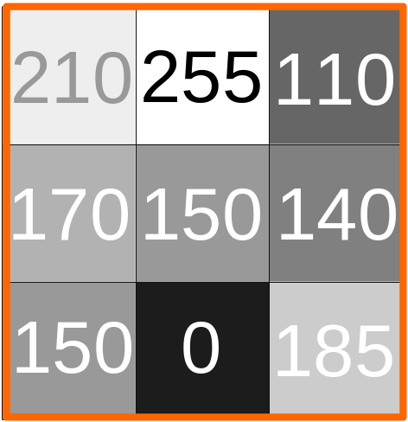
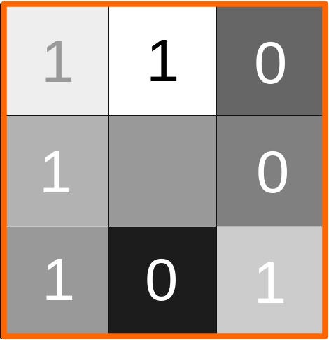
3. EXTRACTION OF LBP FEATURES
Central pixel
Step 1
Step 2
11001011
Step 3
8x8 grayscale pixels
203
Figures : Calculation of LBP for One Pixel.
4

Slide 6

3. EXTRACTION OF LBP FEATURES
Pixel
LBP feature
Total LBP features = 8x8
= 64
10x10 pixels
Diagram : Number of LBP feature in 10x10 pixels
5

Slide 7


3. EXTRACTION OF LBP FEATURES
Image to gray scale image
100x100 color pixels
100x100 gray scale pixels
STEP 1: Calculating LBP for an 100x100 color pixels image
6

Slide 8
3. EXTRACTION OF LBP FEATURES
Partition into 10x10 block
100x100 gray scale pixels
10x10 blocks of 100x100 grayscale pixels image
STEP 2: Calculating LBP for an 100x100 color pixels image
7

Slide 9
3. EXTRACTION OF LBP FEATURES
Calculate
LBP
For Each Block
10x10 blocks of 100x100 grayscale pixels image
64x10x10 = 6400 features
STEP 3: Calculating LBP for an 100x100 color pixels image
8

Slide 10
4. CALCULATION OF HISTOGRAM
2 | 9 | 0
14 | 3 | 10
11 | 13 | 8
FIG 4.1: 3x3 LBP features
Histogram Diagram of data in FIG 4.1
Calculation of Histogram Data from 3x3 LBP features taking interval value of 5 in per Bar in X-axis
9

Slide 11
4. CALCULATION OF HISTOGRAM
Calculate histogram data for each block
10x10x52=5,200 Histogram features
64x10x10 = 6400 features
histogram data from 10x10 blocks in 6400 LBP features, taking value of 5 as interval per bar in x-axis
10

Slide 12
4. CALCULATION OF EUCLIDEAN DISTANCE
FACE 1
Histogram Data of FACE 1
5,200 values
Calculate Euclidean
distance
FACE 2
Histogram Data of FACE 2
5,200 values
Euclidean distance
Block Diagram: Calculation of euclidean distance between two Faces
11

Slide 13
5. IDENTIFICATION OF UNKNOWN FACES
FACE 1
FACE 2
FACE 1
FACE 2
eu₁₁
eu₁₂
eu₂₁
eu₂₂
PERSON
1
PERSON
2
eu₁=eu₁₁+eu₁₂
eu₂=eu₂₁+eu₂₂
UNKNOWN
FACE
Identified person = minimum(eu₁,eu₂)
Block Diagram: Recognition of an unknown face based on 2 persons faces
12

Slide 14
6. ACCURACY MEASURE OF RECOGNITION
Accuracy in % =
13

Slide 15
CONCLUSION
Database | Individuals | Image per person | Number of test images | Miss | Match | Accuracy %
ORL | 40 | 1 | 40 | 18 | 22 | 55
 |  | 2 | 40 | 14 | 26 | 65
 |  | 3 | 40 | 13 | 27 | 67.5
 |  | 4 | 40 | 14 | 26 | 65
 |  | 5 | 40 | 12 | 28 | 70
 |  | 6 | 40 | 12 | 28 | 70
 |  | 7 | 40 | 11 | 29 | 72.5
 |  | 8 | 40 | 10 | 30 | 75
 |  | 9 | 40 | 8 | 32 | 80
faces94 | 151 | 19 | 151 | 1 | 150 | 99.337
 |  | 10 | 151 | 3 | 148 | 98.0132
 |  | 4 | 151 | 2 | 149 | 98.6755
Friends | 7 | 4 | 12 | 3 | 9 | 75

Slide 16
REFERENCES
1. One Sample Per Person Facial Recognition With Local Binary Patterns and Image Sub-Grids,
Gordon Stein, Yuan Li, Dr. Yin Wang Department of Math and Computer Science
Lawrence
Technological University
Southfield, Michigan, USA
2016 Annual Conference on Information Science and Systems (CISS)
2. Face Recognition with Single Sample per Person using Haar Cascade and LBPH
IJISET - International Journal of Innovative Science, Engineering & Technology, Vol. 4 Issue 9,
September 2017
3. T. Ojala, M. Pietikäinen, and D. Harwood (1994), "Performance evaluation of
texture measures with classification based on Kullback discrimination of distributions"
Proceedings of the 12th IAPR International Conference on Pattern Recognition (ICPR
1994), vol. 1, pp. 582 – 585.
4. “Face Recognition from a Single Image per Person: A Survey”
Xiaoyang Tan, Songcan Chen ,Zhi-Hua Zhou,Fuyan Zhang
Department of Computer Science and Engineering
Nanjing University of Aeronautics & Astronautics, Nanjing 210016, China
National Laboratory for Novel Software Technology
Nanjing University, Nanjing 210093, China
State Key Laboratory of Pattern Recognition
Institution of Automation, Chinese Academy of Sciences, Beijing 100080, China
15

Slide 17
THANK YOU

