Slide 1
Stock Traders Application
Alyssa Younger
John Ryan
Kamalnivas Balasubramanian
Patricia Rajamanickam

Slide 2
Topics
Background
Analysis
Predictions
Challenges
Expansion Ideas
Questions

Slide 3
Background
Apply the learnings from the course to build a dashboard for investors & traders to make informed financial decisions.

Slide 4
Background
Apply the learnings from the course to build a dashboard for investors & traders to make informed financial decisions.

Slide 5
Analysis
Returns
Volume

Slide 6
Screener
Goal: Screen stocks to identify new stocks from a pool based on a set of criteria.
Limit the pool of stocks to NASDAQ100.
The criteria used to screen the pool are the market cap & sector info.
This idea can be very easily extended to a much larger pool of stocks & more customized criterias.

Slide 7
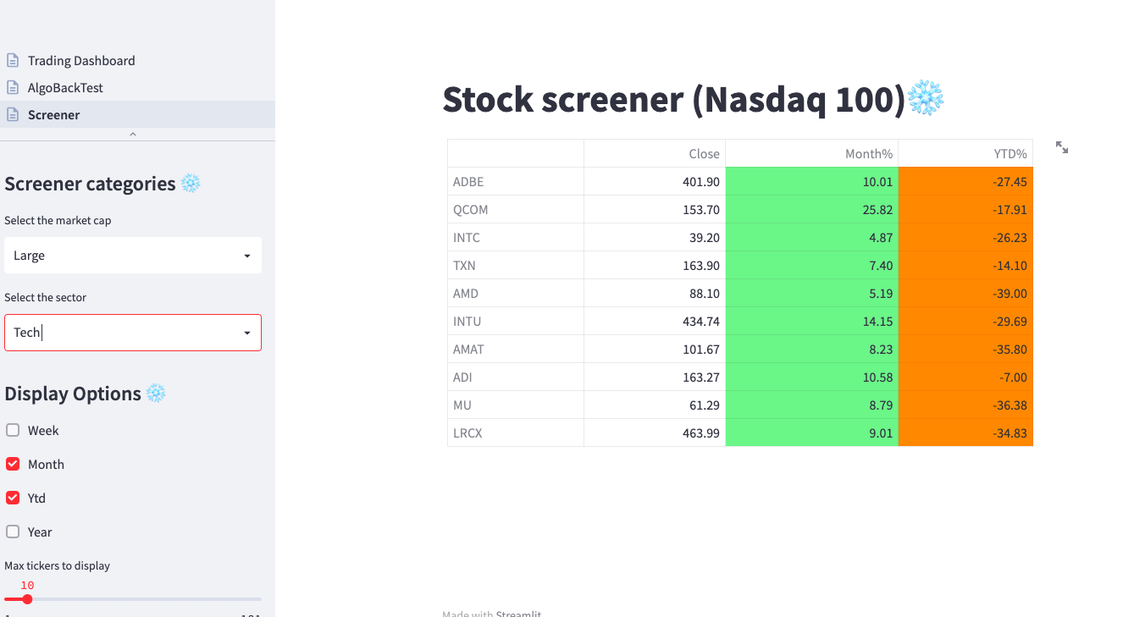
Screener

Slide 8
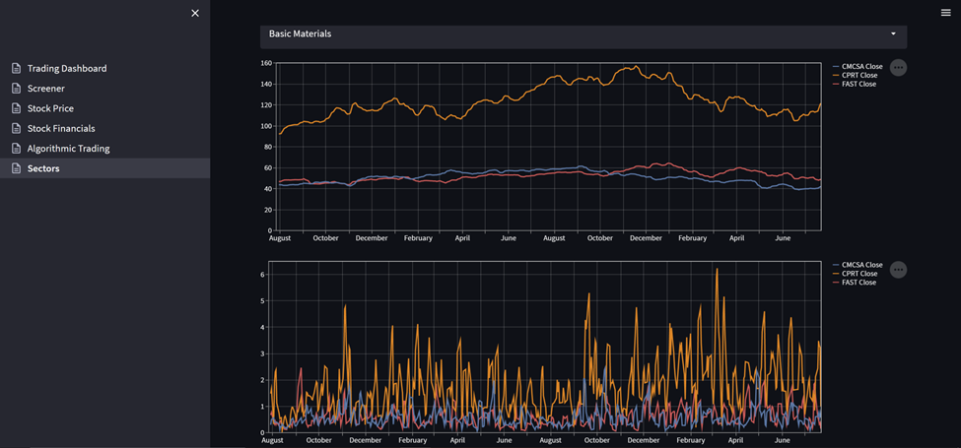
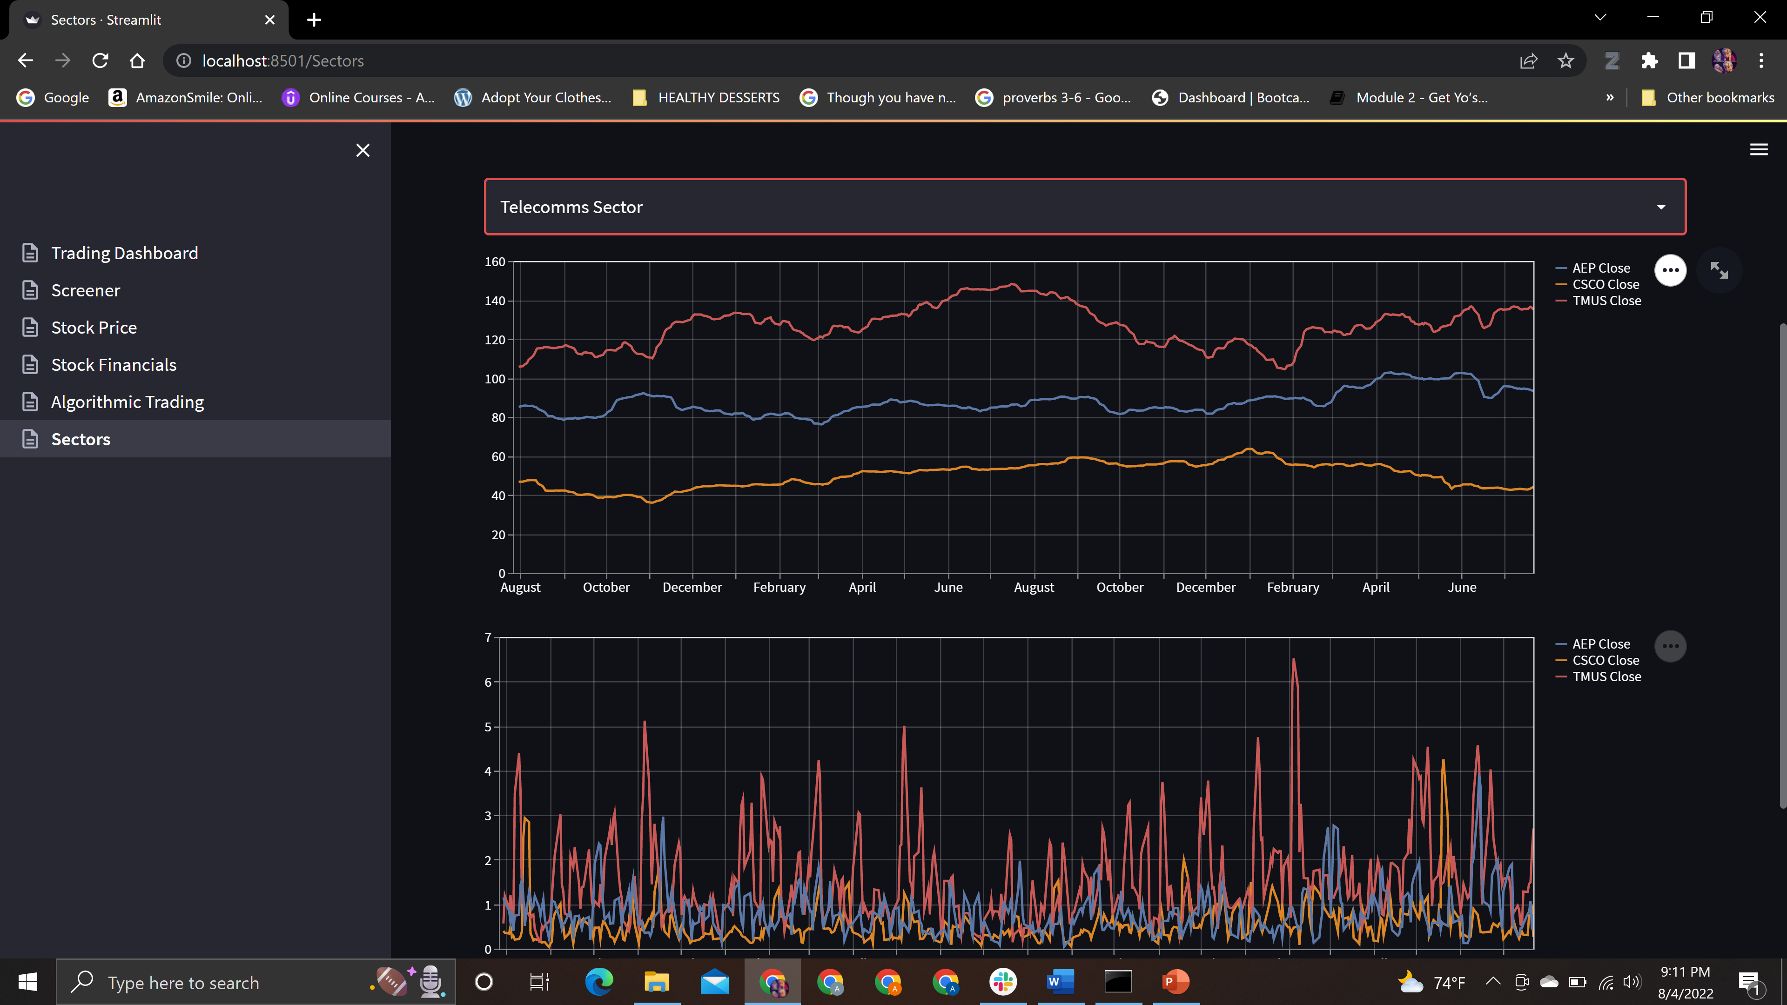
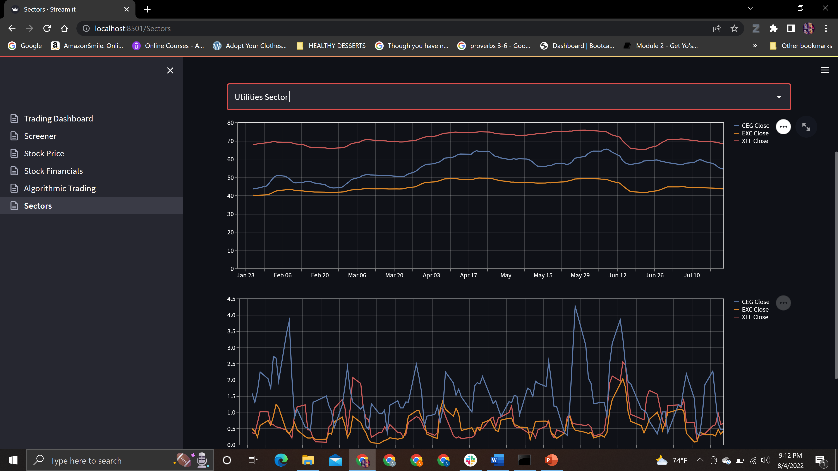
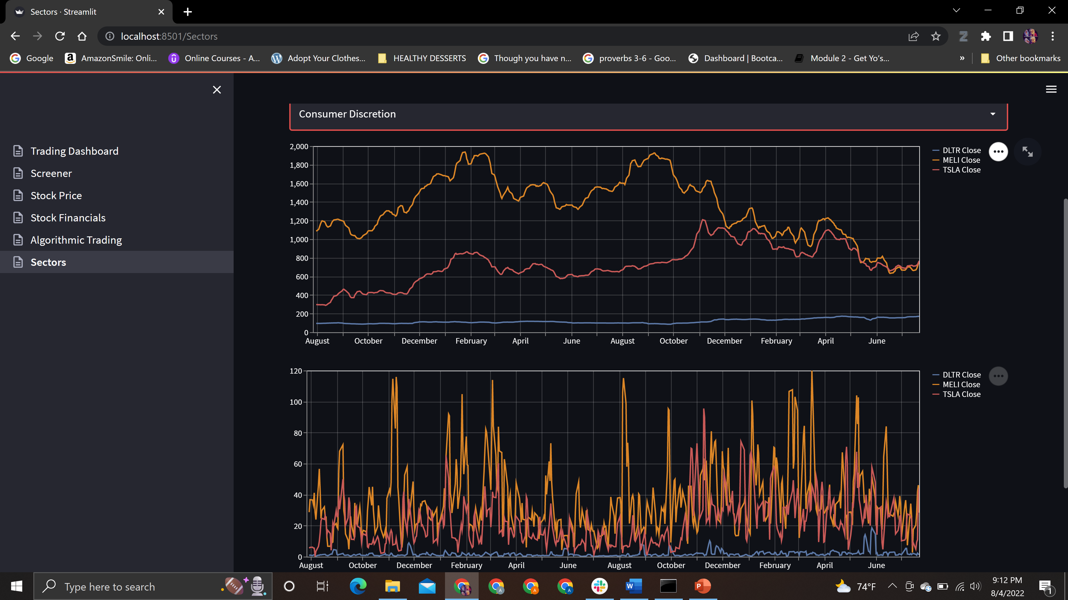
Rolling Averages and Volatility Set as of July 25th

Slide 9
Predictions

Slide 10
Challenges

Slide 11
Expansion ideas
The screener can be extended to wider pool of stocks, ETFs & other securities.
If integrated with a user based database, we could even push notifications based on the screening criteria.
The algo trading can provide a lot more commonly used algorithm & let the user back test the algorithm before deploying it in realtime.

Slide 12
Questions?

