Slide 1
Exploratory data analysis
DigiCAP UCC
US Police Shootings
Group 3

Slide 2
HYPOTHESIS
The police shooting were all acts of racism

Slide 3
QUESTIONS
Whether or not the policeman had body camera
What type of ammunition was mostly used
Whether or not victims showed signs of mental illness
What race was prevalently killed/shot
What gender was prevalently shot/killed

Slide 4
VISUALISATIONs

Slide 5
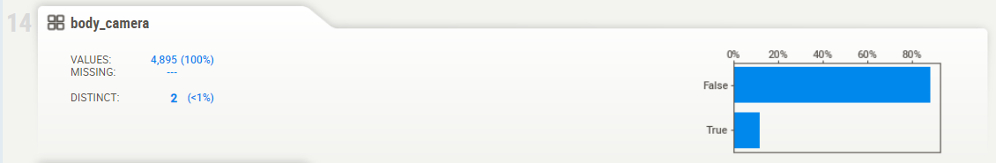
Whether or not the policeman had body camera

Slide 6
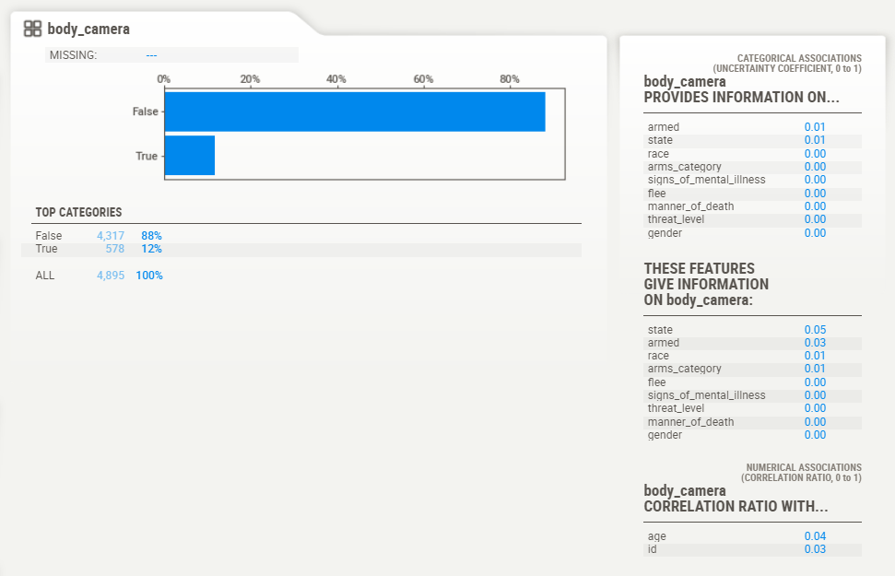

Slide 7
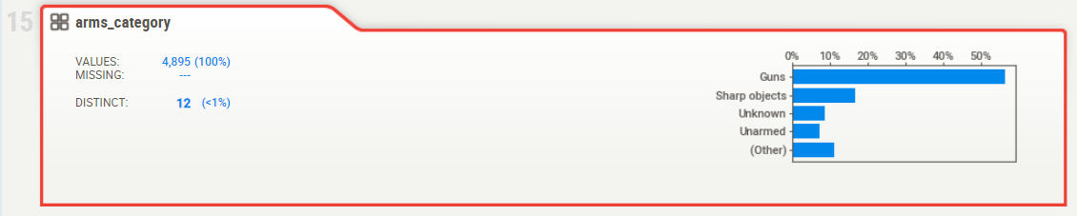
What type of ammunition was mostly used

Slide 8
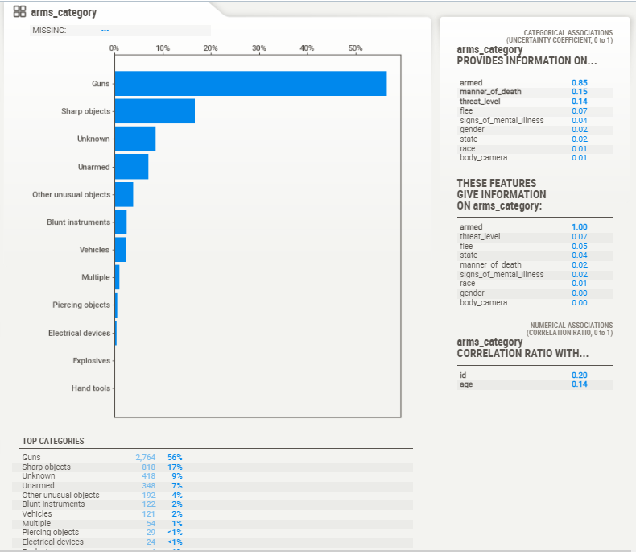

Slide 9
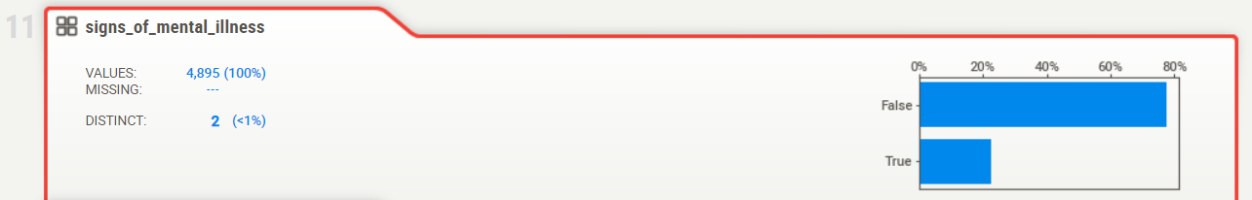
Whether or not victims showed signs of mental illness

Slide 10
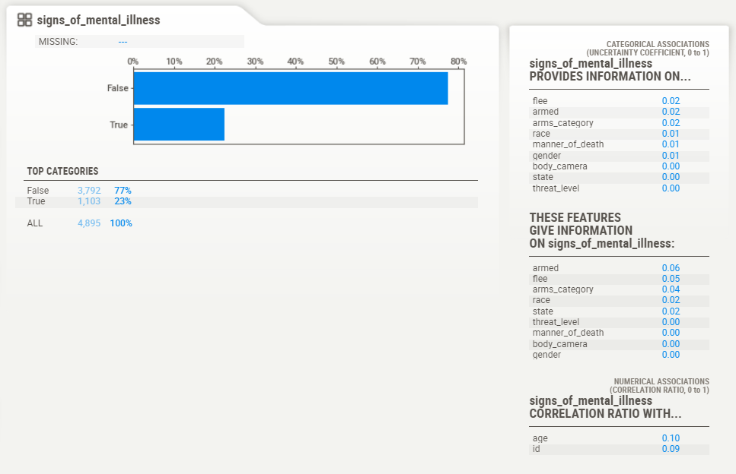

Slide 11
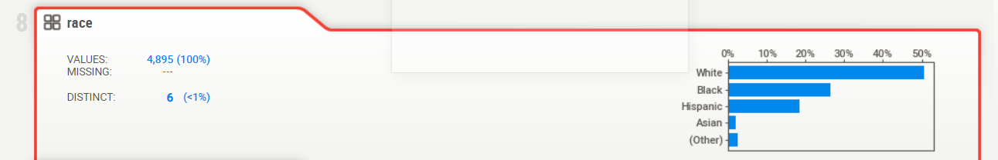
What race was prevalently killed/shot

Slide 12
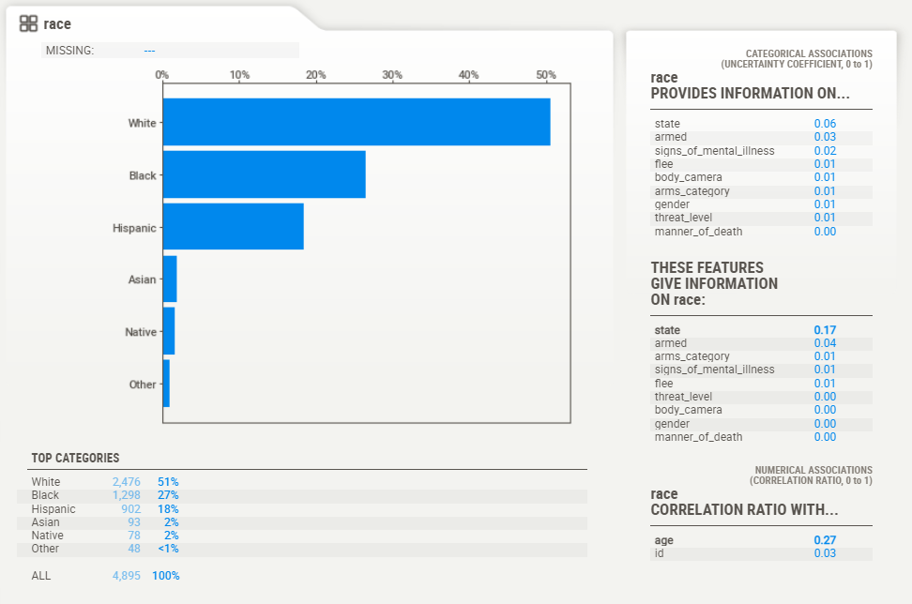

Slide 13
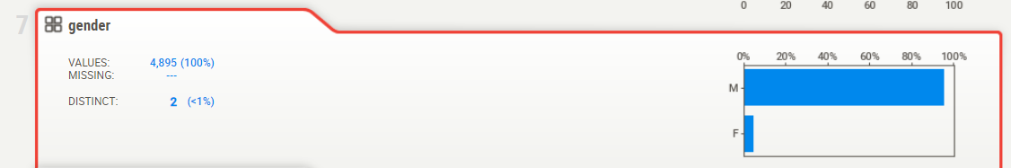
What gender was prevalently shot/killed

Slide 14
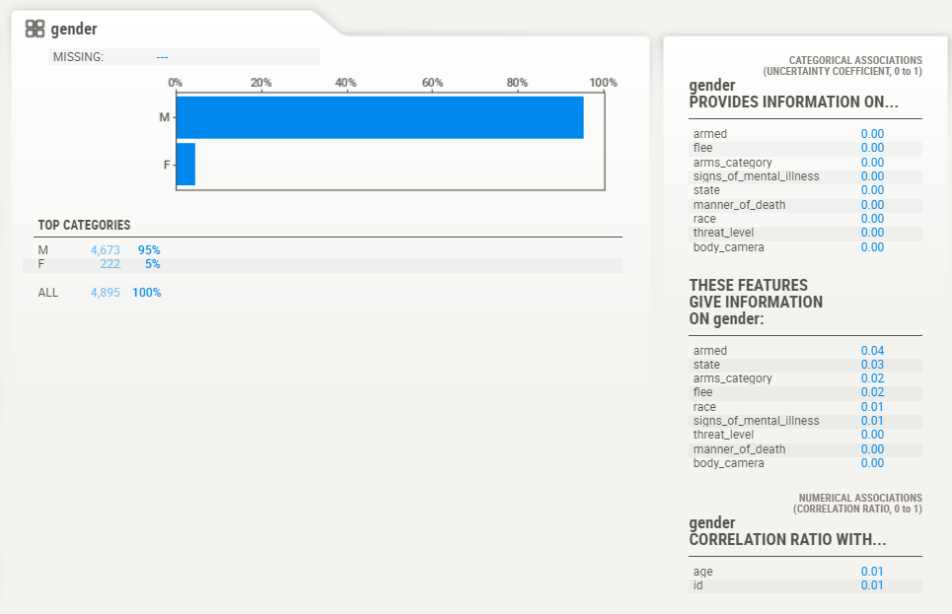

Slide 15
INSIGHTS

Slide 16
Most of the policemen had no body camera on in 88% of the cases. This raises a lot of questions as to their intentions.
Was it intentional to hide the incident?
Were the said policemen off duty?
Were their body cameras working hours, days prior to the incident?

Slide 17
56% of the killings were executed with guns.
Does this suggest an execution of the act from a safe distance that would not have the perpetrator hurt or compromised in any regard?
17% of the killings were done using sharp objects
Does this suggest a struggle between the victims and the police?
What could have caused this struggle?
Which party initiated it? Was it the police or the victim’s doing?

Slide 18
Only 23% of the victims showed signs of mental illness.
This implies 77% of them had knowledge and a clear enough mind on how to hold a reasonable interaction with an officer on duty
What went south?

Slide 19
51% and 27% of the killings involved victims of the white and black race respectively.
Does this point to the long existing strife between the latter and the former?

Slide 20
95% of the killings involved males rather than females
Does this suggest that the male gender is more susceptible to physical violence?

Slide 21
CONCLUSION
Based on the dataset given and the visualisations we drew out of it, we saw for a fact that the shootings or killings were not acts of racism. This is because most of the victims were Whites.

