Slide 1
ERHS 535 Jacob Fontenot, Burton Karger, Eric Wendt, Caroline Wendt

Slide 2
Overview

Slide 3
Research question
What are the most important and most difficult school subjects according to Jeopardy?

Slide 4
Introduction
Initial data investigation showed subject bias
Prompted us to consider traditional school subjects
Decided to compare “Jeopardy-based” education to public school education

Slide 5
Methods: Joining Quizlet and Jeopardy data
Created a dataframe of school subjects and related terms (from Quizlet)
Converted all Jeopardy data and school subject data to lowercase and removed all special characters
Randomly sampled 155 vocab terms from school subject data
Used inner_join from the dplyr pacakage to match a the “question” to a specific vocab term
Grouped the “questions” by subject

Slide 6
Methods: Determining subject importance and difficulty using joined dataframe
Discovered answer value changes after November 26, 2006 and decided to separate data into two categories
Calculated number of occurances of each school subject (most important subject)
Calculated average value of all “answers” for each school subject (most difficult subject)
Graphed results using interactive heat map faceted by round and date

Slide 7
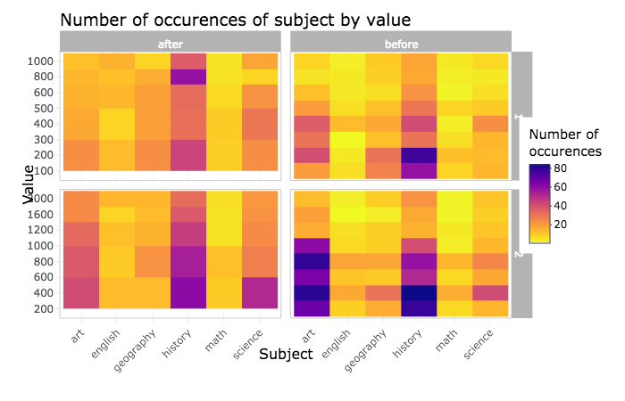
Results: Heat map for round 1 and 2
“Heat Map 3”

Slide 8
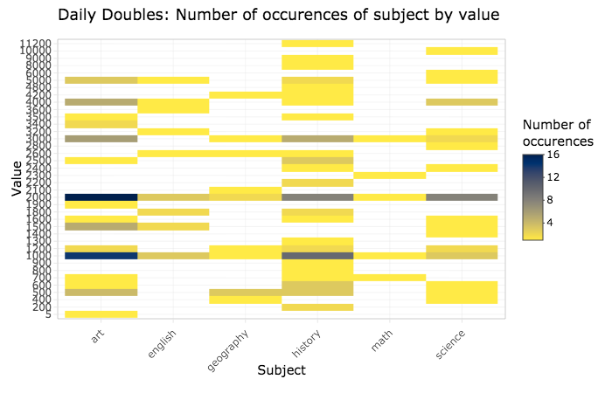
Results: Merging round 1 and 2 heat maps
“Heat Map 4”

Slide 9
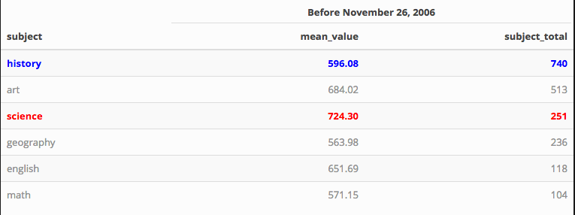
Results: Summary Statistics before 11/26/2006
“before”

Slide 10
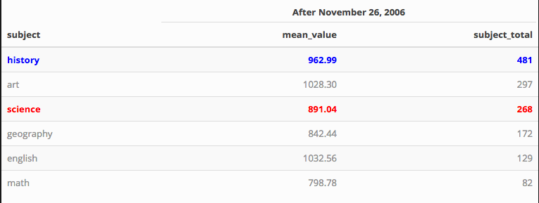
Results: Summary statistics after 11/26/2006
“after”

Slide 11
Conclusion
AP test scores: Geo, English, History, Science, Math, Art
Before 11/26/2006: Art, Science, History, English, Math, Geo
After 11/26/2006: Art, English, History, Science, Geo, Math

Slide 12
Tutorial

Slide 13
Overview: Approach in R
The data for the subjects which, we would use to filter down the Jeopardy!, questions needed to be created and cleaned
Initial Jeopardy! and subject data cleaning steps were taken to make the data more uniform (lowercase columns and values) removing special characters and numbers to facilitate our joining.
The Jeopardy! and subject terms data were then joined, using inner_join, by the “question” column to only keep the rows which are in are in Jeopardy! and subjects terms data frames, and inner_join returns all columns.

Slide 14
Overview: Approach in R
For the creation of the subject data we had to utilize the sample_n() function from dplyr since we had more words for some subjects than others, and we chose to randomly select 155 words from each subject.
Following our join of the two data frames we had to create one more column to depict the change in value of the question/answers that occurred after November 26, 2006.

Slide 15
Packages
packages for data filtering
library(readr)
library(dplyr)
library(stringr)
package for tables
library(kableExtra)
packages for plots
library(ggplot2)
library(viridis)
library(forcats)
library(plotly)
library(ggthemes)
library(RColorBrewer)

Slide 16
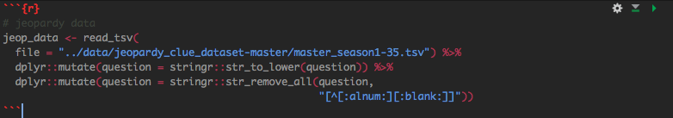
Our Code

Slide 17
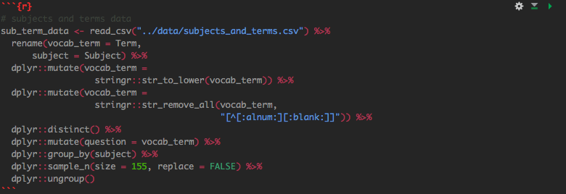
Our Code

Slide 18

Our Code

Slide 19
Lessons learned
.Rmd can be a curse and a blessing
Getting exactly what you think your .pdf should look like knitted isn’t always the easist thing.
GitHub is a wonderful tool for collaborative work
Be very sure to inform others when you have pushed large amounts of changes…

Slide 20
References
Quizlet Inc. (2019). Quizlet. Retrieved from https://quizlet.com/
R Programming for Research Retrieved from https://geanders.github.io/RProgrammingForResearch/
Stack Exchange Retrieved from https://stackexchange.com/

