Slide 1
Barcode and QR Code
Classification System
Image processing, computer vision, and deep learning for reliable code-type identification.
CLASSIFY FIRST · DECODE SMARTER

Slide 2
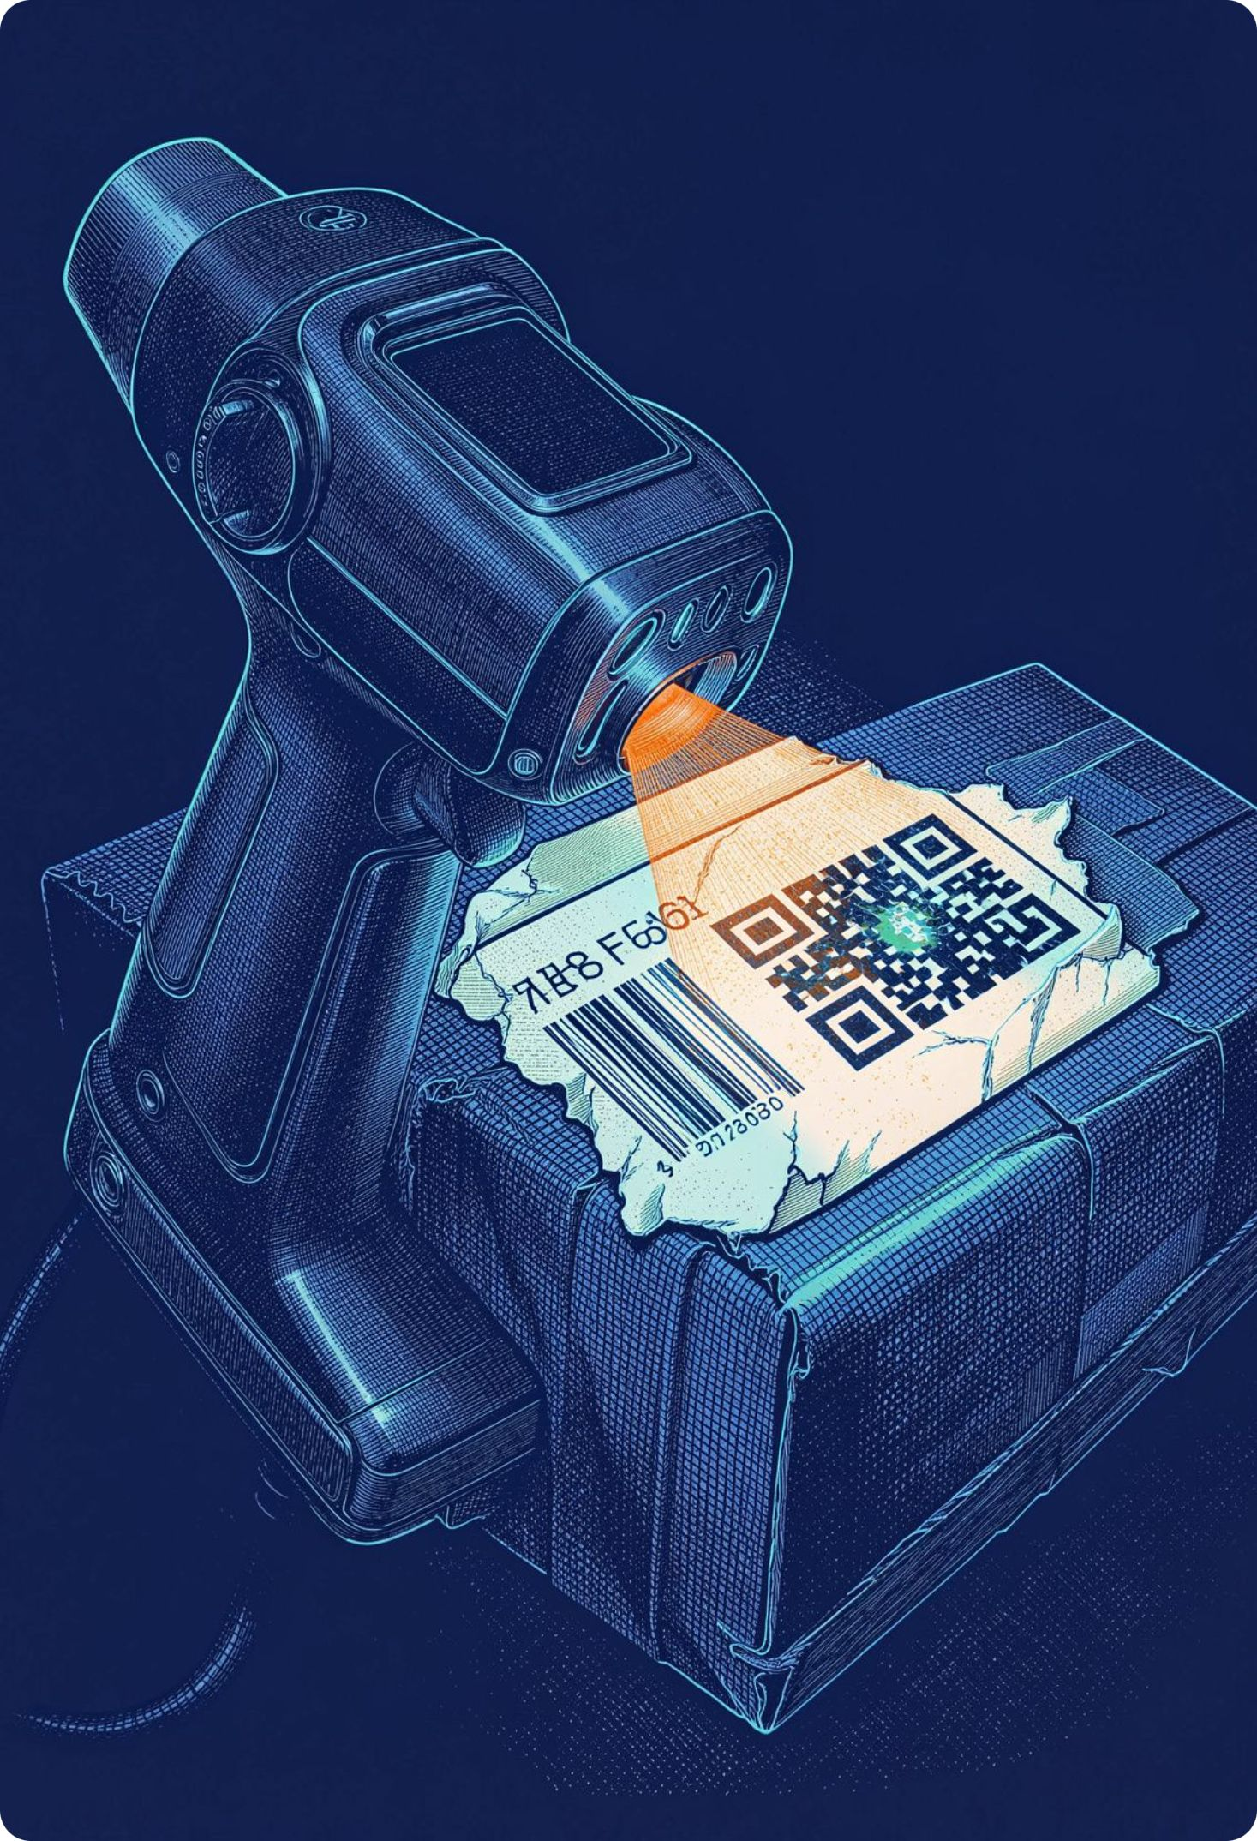
THE PROBLEM
Identification starts before decoding
Classify the code before decoding.
Recognition is fragile
Codes are everywhere
Blur, poor lighting, rotation, low quality, and damage make recognition harder.
Identification and tracking span retail, logistics, healthcare, warehouses, and inventory systems.

Slide 3
OBJECTIVES
Objectives turn visual patterns into a decision
Identify
Enhance
Extract
Decide
Automatically classify barcode and QR code images.
Improve image quality through preprocessing.
Capture visual and geometric features.
Generate a class and confidence score.
METHOD
VALUE
Computer vision plus deep learning supports varied capture conditions.
Less manual identification effort before decoding.

Slide 4
SYSTEM PIPELINE
From camera input to classification report
1
2
3
Input
Preprocessing
Feature extraction
Image upload or camera input
Resize, denoise, enhance
Features and region detection
4
5
6
Classifier
Classification
Report
Computer vision or CNN
Barcode / QR code
Confidence score and report
Optional after classification: decoder → extracted information.

Slide 5
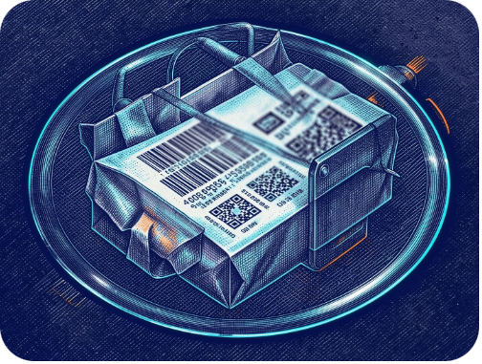
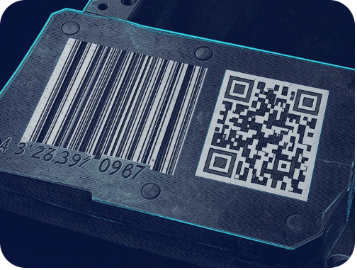
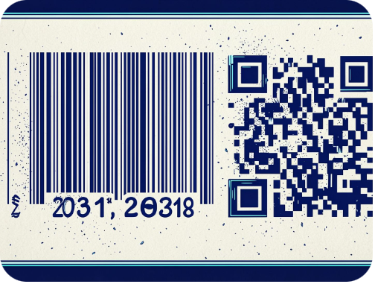
IMAGE PROCESSING
Preprocessing makes code structure visible
01
02
03
Contrast enhancement and thresholding
Edge detection and rotation correction
ORIGINAL
GRAYSCALE
DENOISE
Normalized processed image
Preprocessing supports more reliable classification by making code structure consistent across capture conditions.

Slide 6
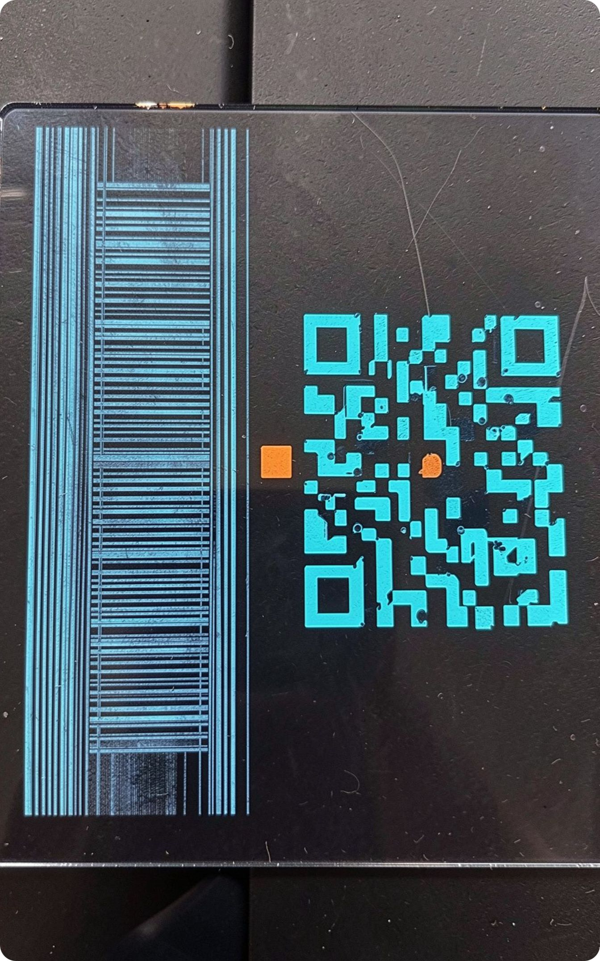
VISUAL SIGNATURES
1D lines and 2D geometry leave different signatures
BARCODE · 1D
QR CODE · 2D
Parallel lines
Square geometry
Widths, spacing, orientation; primarily one-dimensional information.
Square grid; two-dimensional information; position-detection squares.
Shared features: orientation, edge density, geometry, shape, texture, and spatial distribution.

Slide 7
MODEL LOGIC
The classifier learns what the eye notices
Input image
Preprocessing
Region detection
Feature extraction
CNN / computer-vision classifier
Predicted class: barcode or QR code
Confidence score and result
CNN STRIP
Image → Convolution → ReLU → Pooling → Flatten → Fully connected → Classification

Slide 8
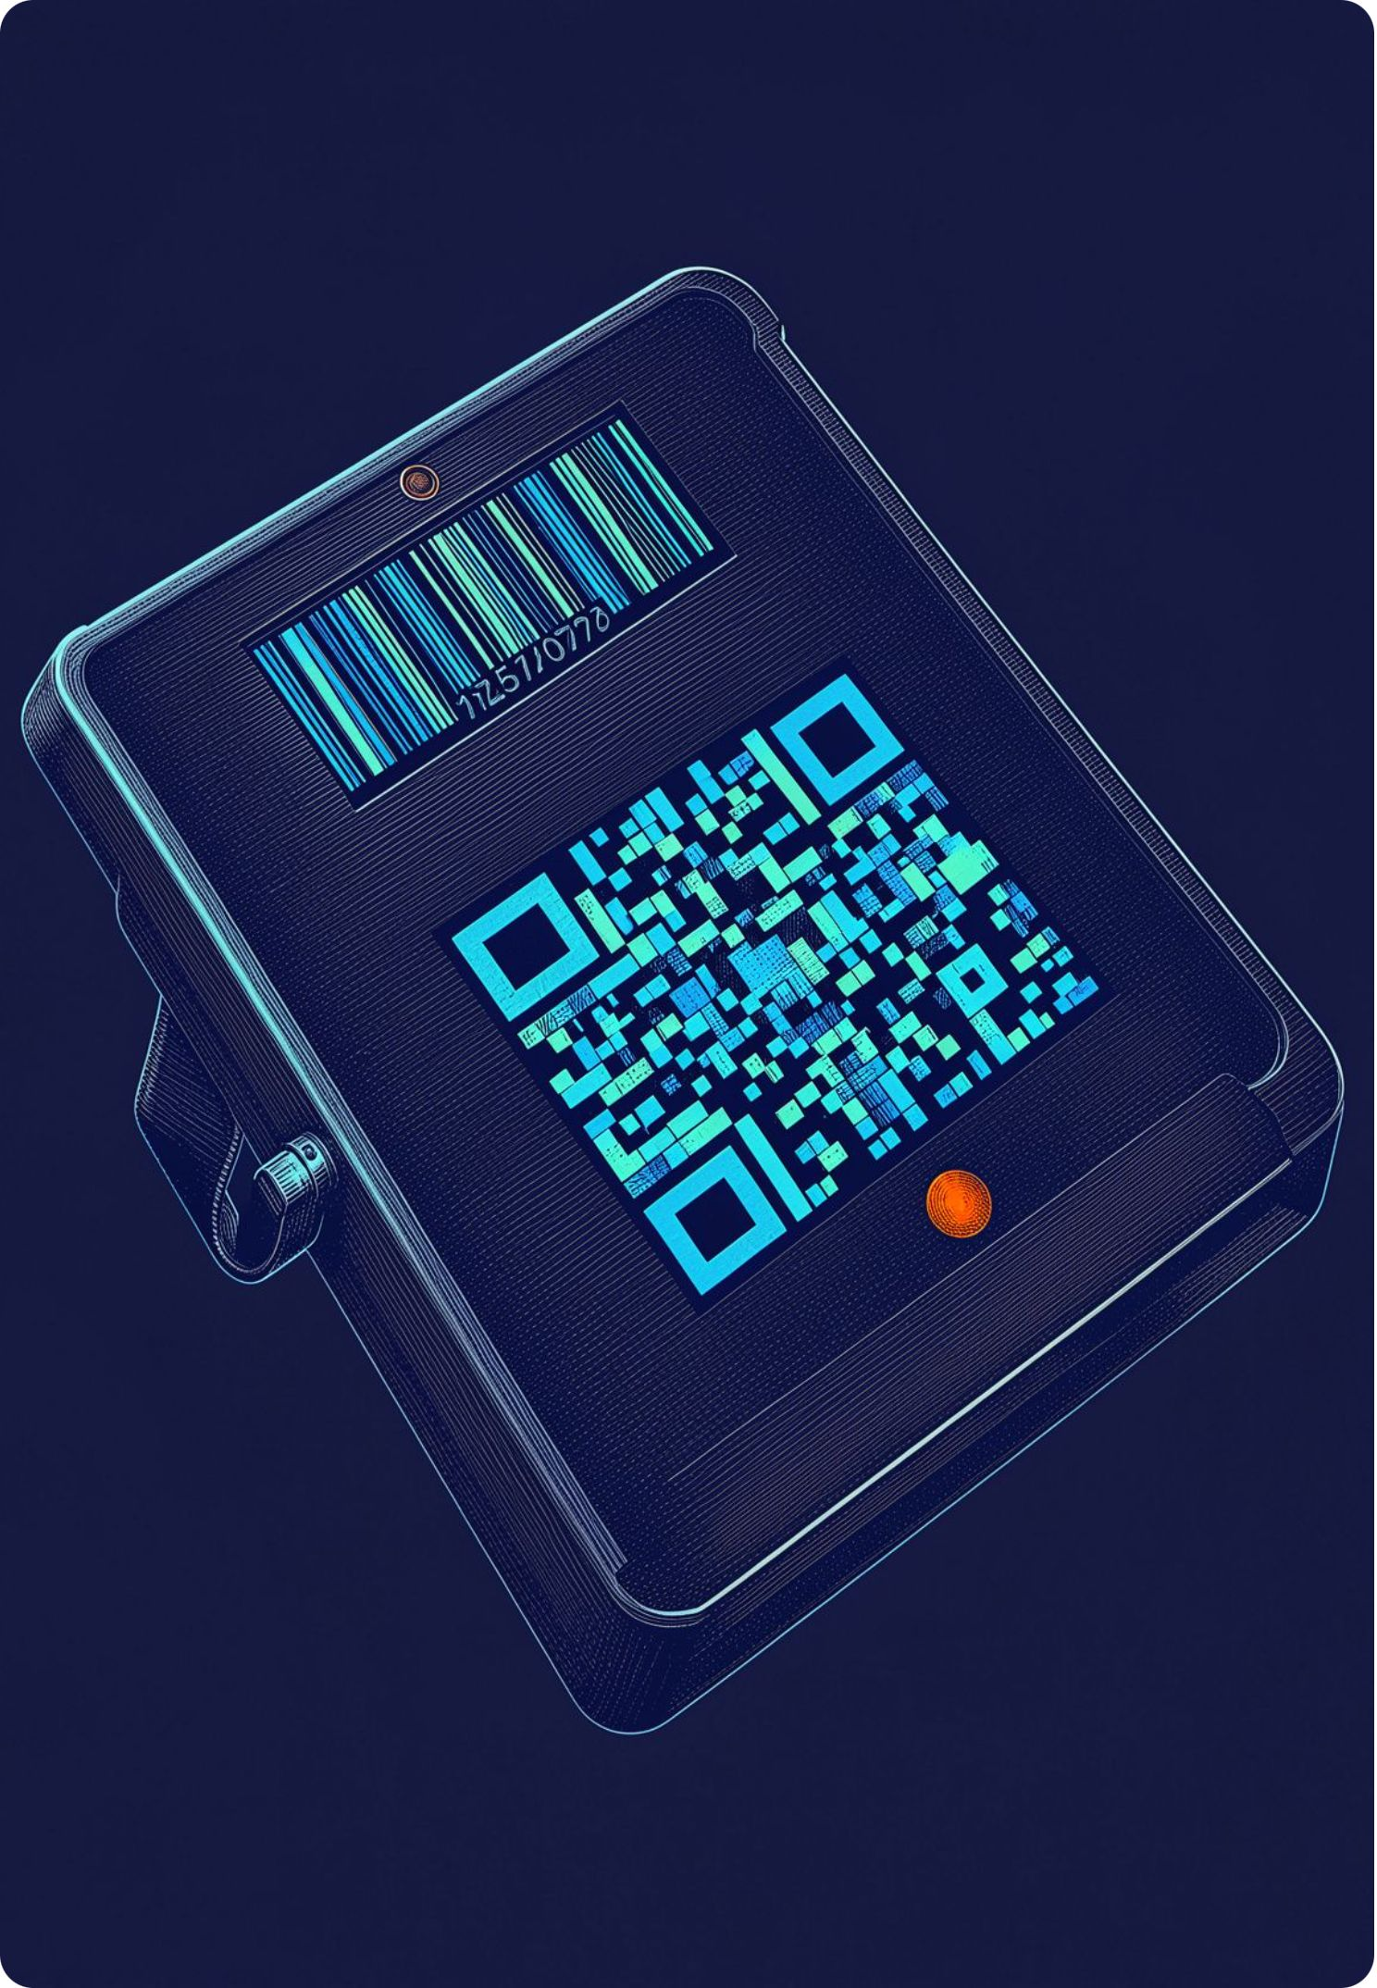
USER INTERFACE
Dashboard turns the model into a usable tool
INPUT
RESULT
Uploaded image preview
File name · processing status
Predicted Class: QR Code
Confidence: Demo value — replace with measured result.
ANALYSIS
METRICS
Original image · processed image · detected code region
Accuracy · precision · recall · F1-score · confusion matrix

Slide 9





PRACTICAL VALUE
Built for retail, logistics, and intelligent tracking
ADVANTAGES
APPLICATIONS
Automatic classification; faster image-based identification; varied-condition support; confidence scores; reduced manual effort.
Retail
Warehouses
Logistics
Healthcare
Industrial automation
Inventory and product tracking.
FUTURE SCOPE
Real-time camera detection · decoding · multiple-code detection · mobile and cloud deployment · damaged-code recognition · IoT integration

Slide 10
FINAL TAKEAWAY
Classify first.
Decode smarter.
By combining preprocessing, visual features, and deep-learning classification, the system distinguishes one-dimensional barcodes from two-dimensional QR codes for efficient tracking and inventory workflows.
THANK YOU · QUESTIONS?

