Slide 1
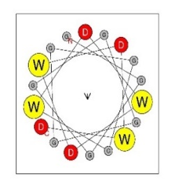
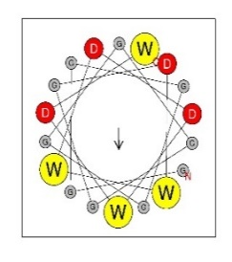
Fig. 1
A
Experimental setup
B
C
D
E
F
G
............WDWDWDWD -1.13
3 → 4 →
............DWWDDWDW 1.11
Figure 1. A single W and a single D are sufficient for the functionality of AD. A – experimental setup: oligo pool synthesis, followed by cloning in bacteria, then isolation of plasmid library and transformation in yeast, followed by screening for growth phenotype determined by expression of the reporter gene regulated by activator with a specific AD, then isolation of DNA pool, NGS sequencing, and data analysis (for more details see Methods section). B – Growth of sequences with different numbers of WD repeats. X axis: individual sequences indicated in the inset table, where black dots represent glycine, yellow dots represent tryptophan, and red dots represent aspartic acid residues. Y axis: Log2 growth slope. Axes are same in C, D, E, F. C – Sequences with different numbers of WD repeats, either surrounded or interrupted by repeated glycines. D – Sequences with non-alternating clusters of Ws and Ds. E – Sequences with non-alternating clusters of Ws and Ds, separated by varying numbers of Gs. F – Sequences with a single W and D, separated by varying numbers of Gs. Error bars show growth slope +/- root-mean-square-deviation (RMSD) of the fit of the growth slope. G – Log2 growth slopes and images of the α-helix frontal view for two different sequences with four W’s and four D’s, showing that despite identical composition, only one is functional.

Slide 2
Fig. 2
Note on figure C – mixing calculation:
Sequences were “simplified”
VVGGDFIVRENNYVYSWPSLGSEVEFDDYM
=
DFEYYWEEFDDY
(removed all but aro and acidic then calculated mixing)
A
B
W = 6 D = 6
D
● - [DE]
● - [WYF]
●●●●
●●●●
●●●●
●●●●
●●●●
C
●●●●
●●●●
Motif
●●●●
WYF = 6 DE = 6
●●●●
●●●●
●●●●
●●●●
●●●●
●●●●
●●●●
●●●●
E
F
Functional tAD %
G
Functional tAD %
ML Features | AUROC
aa composition | 0.61
aa x position | 0.72
tetrapep | 0.78
tetrapep x position | 0.82
tetrapep x position (trained on Gcn4) | 0.67
tetrapep x position + balance | 0.87
Shallow NNet | 0.90
● - [DE]
● - [WYF]
●●●●
●●●●
●●●●
●●●●
●●●●
●●●●
●●●●
●●●●
●●●●
●●●●
●●●●
●●●●
●●●●
●●●●
●●●●
●●●●
Figure 2. The balance and intermixing of acidic and aromatic residues is beneficial for AD function. A – X axis: balance score, calculated as Balance=n(W)-n(D); Y axis: % of functional sequences in the sub-library of sequences containing all combinations of W and D for 12 positions (WD12 library, 3968 sequences quantified). B – X axis: mixing score, calculated as Mixing=n(WD)+n(DW); Y axis: % of functional sequences in the set of sequences containing all combinations of 6 W and 6 D (906 sequences quantified). C – X axis: mixing score, calculated as Mixing=n([WYF][DE]) + n([DE][WYF]) for the previously published AD dataset screened within the Gcn4 context 6; Y axis: % of functional sequences in the set of sequences from the Gcn4 random peptide library with 6 [WYF] and 6 [DE] (3018 sequences total). D – X axis: % functionality of sequences that contain the specified tetrapeptide motif; Y axis: tetrapeptide motifs. Regression lines are provided to demonstrate concordance between the three libraries, and motifs were ordered based on average % functionality between the three libraries, with the most functional on top. E – X axis: Starting amino acid position of tetrapeptide in tAD module for the WD12 library; Y axis: 16 sequence combinations for tetrapeptides containing D and W, Tile fill: % functionality of sequences that contain the specified tetrapeptide motif at the indicated position. Motifs were ordered by overall % functionality. F – X axis: Starting amino acid position of the tetrapeptide in the tAD module for the Gcn4 library 6; Y axis: 16 sequence combinations for tetrapeptides containing [DE] and [WYF], Tile fill: % functionality of sequences that contain the specified tetrapeptide motif at the indicated position. Motifs order is the same as in panel E. G – ML accuracy on the reserved testing set (20% of WD12 library) and trained on 80% of WD12 library unless noted otherwise, measured as area under the receiver operating characteristic (AUROC).

Slide 3
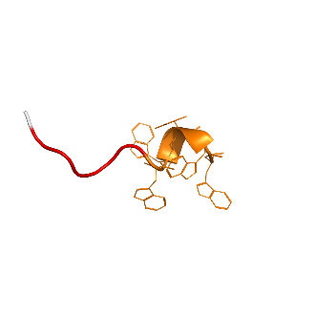
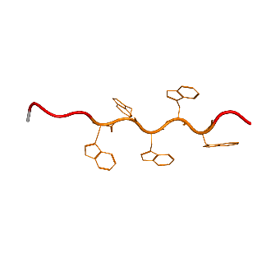
Fig. 3
A
B
C
Gal4 C-terminus
Gcn4 C-terminus
End caps
Notes for E:
Avg between all 5 alphafold structures was:
8.9 and 11.2 angstroms, I used more extreme cases to make the point of collapsed vs spread.
*
End caps
**
**
........................ϕϕϕ●●●
*
........xxxxxxx●●●●●
D
E
Sequence Constructs
Non-functional tAD
***
***
..........●●●●●●●●●●
7.8 Angstrom
Functional tAD
****
..........●●●●●●●●●●
13.1 Angstrom
****
Figure 3. Ds are generally beneficial internally, while Ws – terminally; however, with increased amount of Ws in the sequence, flanking them with Ds rescues the functionality. A – X axis: position of D (red) or W (yellow) within the sequence; Y axis: % functionality of sequences in the sub-library of sequences containing all combinations of W and D for 12 positions (3968 sequences quantified). B –X axis: size of W cluster preceding indicated end cap for sequences representing each line; Y axis: same as in A. (*) sequence construct shows tAD constructs of indicated sequence where “.” = G, “x” = [DW], ● = W, and ● = D. C – same as in B, calculated for the Gcn4 library 6 using [WYF] instead of just W and [DE] instead of just D for end caps. (**) sequence construct shows tAD constructs of indicated sequence where “.” = any AA, ϕ = [AVILMWYF], and ● = [WYF]. D – Growth slopes of sequences with different numbers of Ds flanking a stretch of 5 Ws. ● = W, and ● = D. E – sequence constructs of (***) and (****) sequences from panel D, “.” = G, ● = W, and ● = D. AlphaFold2 predicted structures shown for tAD region. Distance between alpha-carbons of first and last tryptophan were measured from predicted structure.

Slide 4
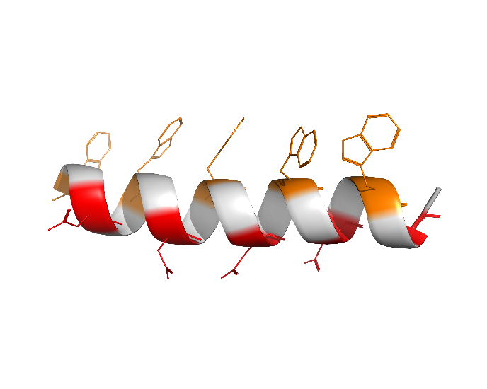
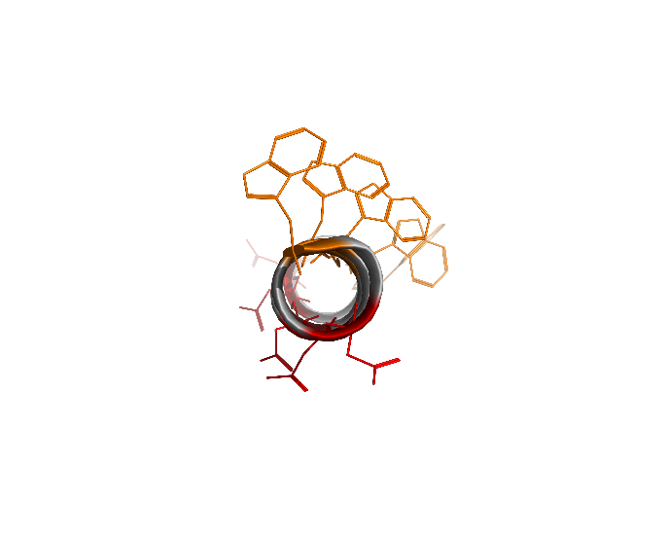
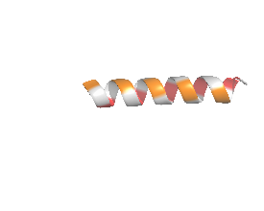
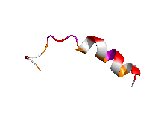
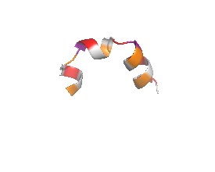
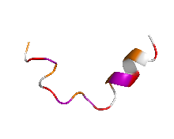
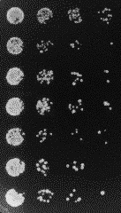
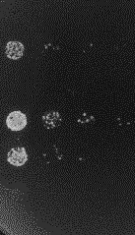
Fig. 4
A
B
Amphipathic Backbone Library
[W.D.W.D.W.D.W.D.W.D.]
Side view
Top view
C
D
WLDFWLDTWVDTWLDFWLDI
-1.74
WGDLWPDPWYDWWPDLWRDL 1.60
0-P
3-P
WFDLWPDLWTDPWIDCWLDV
1.51
*
2-P
WEDPWADPWPDGWPDLWADV
1.14
4-P
E
No Aur
+Aur
Stop codon
GGGGDFDLDMLGDFDLDMLG
DDDDDDDDDDWWWWWWWWWW
DWDWDWDWDWDWDWDWDWDW
*
WEDPWADPWPDGWPDLWADV
WNDYWTDSWADYWYDFWYDV
WFDSWDDFWCDCWCDCWSDF
Figure 4. Formation of the amphipathic α-helix is generally detrimental for AD functionality, and insertion of proline is beneficial. A – graphical representation of sequences for the WD5 library (107975 sequences quantified): each member of which has five Ws, five Ds, and ten random amino acids represented by black dots/circles between Ws and Ds. B – X axis: % α-helix predicted by the SPOT-1D algorithm for each set of sequences from the WD5 library; Y axis: % functionality of the set of corresponding sequences in the WD5 library. C – X axis: count of corresponding amino acid residues between set Ws and Ds of WD5 library; Y axis: % functionality of the set of corresponding sequences. D – Growth slopes and 3D structures of sequences with varying numbers of proline residues predicted by AlphaFold2. E – Growth phenotype on media with and without aureobasidin for cells expressing the indicated representative sequences. Spots are conglomerates of yeast colonies representing threefold serial dilutions of corresponding cell cultures .

