Slide 1

Beamforming Application Using RFSoc 4x2 Board

Slide 2
Introduction
Working Principle
Setup
Achieved Results
Summary
Questions

Slide 3
Working Principle
Transmitting and Receiving 433MHz Signals
Transmitting Side
Receiver Side
RFSOC
2 Dipole Antennas
1 Dipole Antenna
Bandpass Filter
RFSOC
1. Transmitting 433Mhz signals through 2 antenna phase array.
2. Detecting the amplitude of signals based on the radiation pattern of the phased array

Slide 4
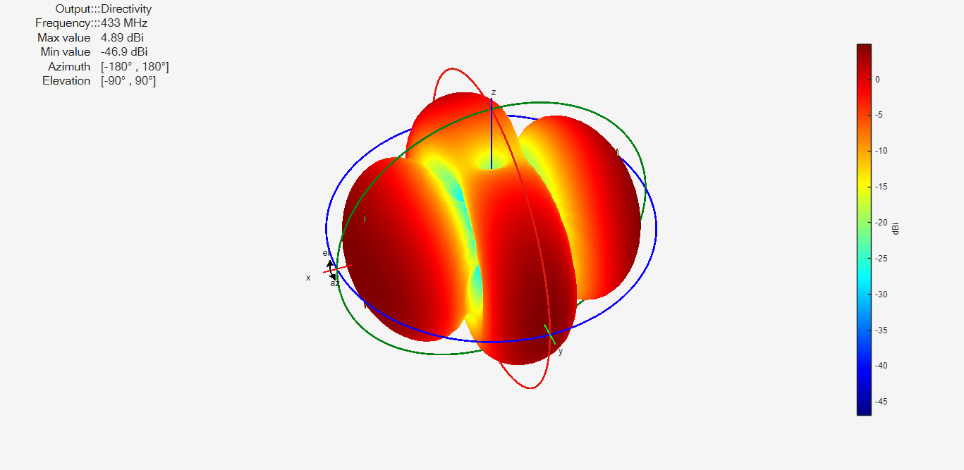
Radiation Pattern
The Radiation Pattern of the Phased Array With Full Wavelength Space Between Them (0.692cm)
Matlab Simulation

Slide 5
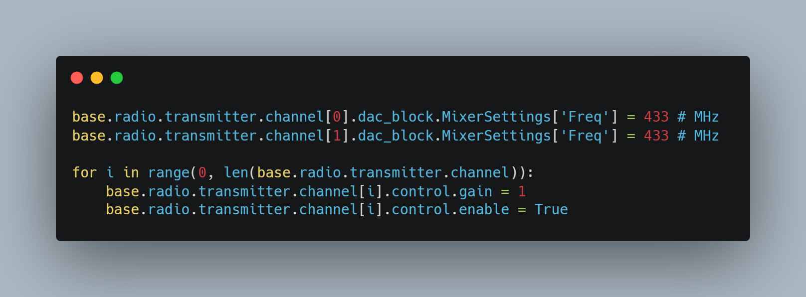
Transmitting
Selecting the individual DAC Ports
Iterating through available DAC Ports and transmitting signals

Slide 6
To do here
Show example code and pictures of received signal
Show the signal that antenna picks up also the 1.3ghz noise
Show that we solved it with bandpass filter

Slide 7
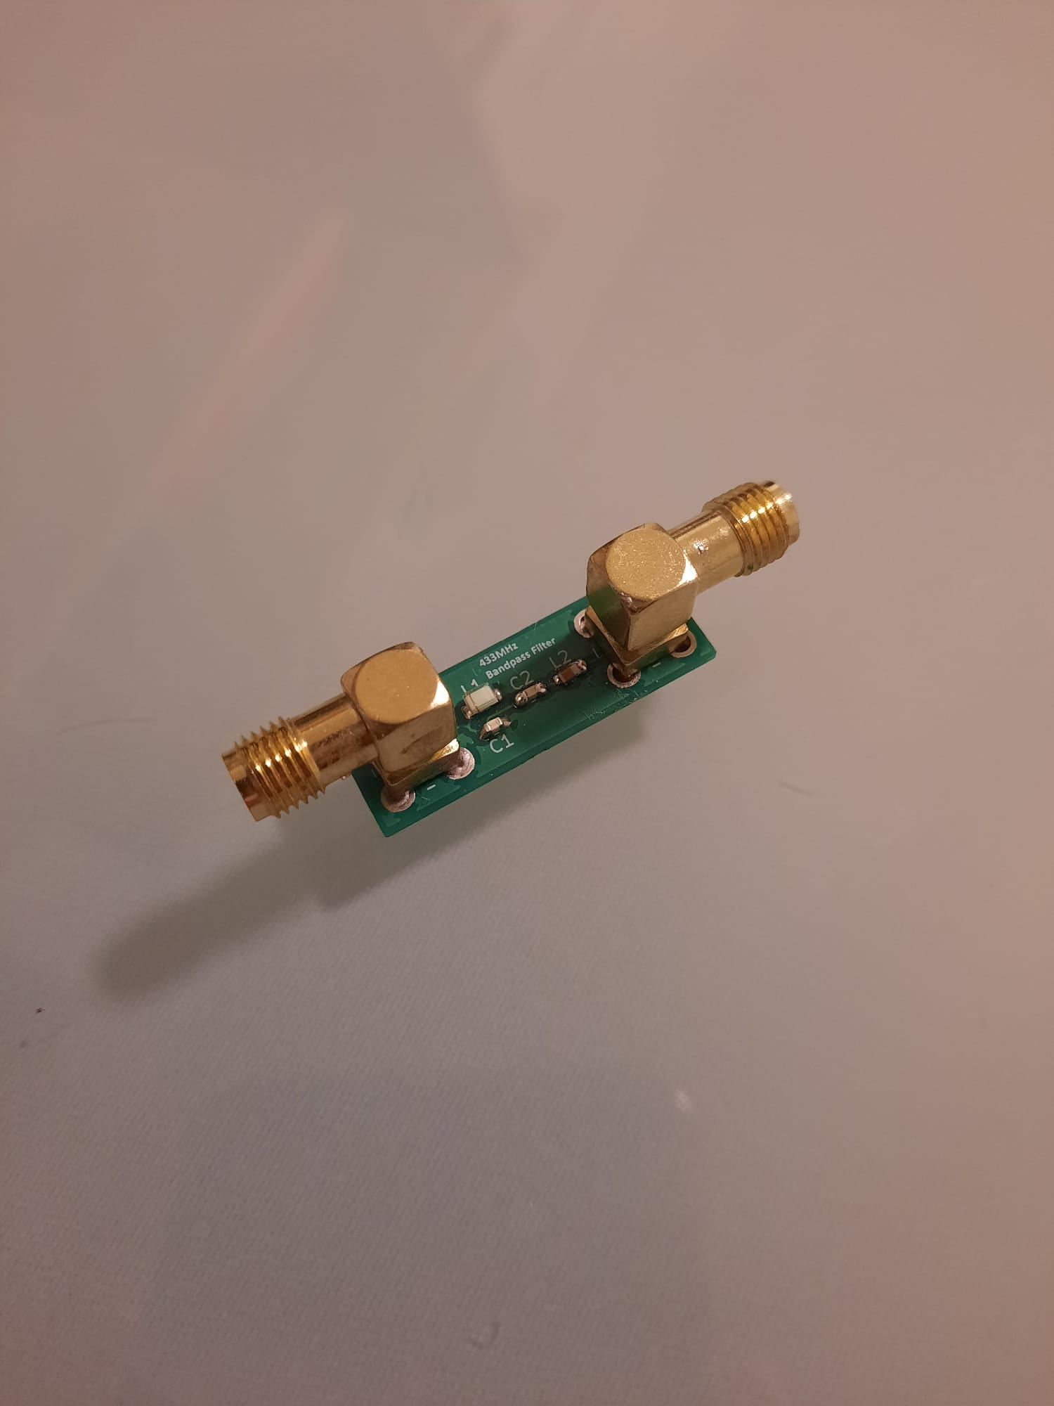
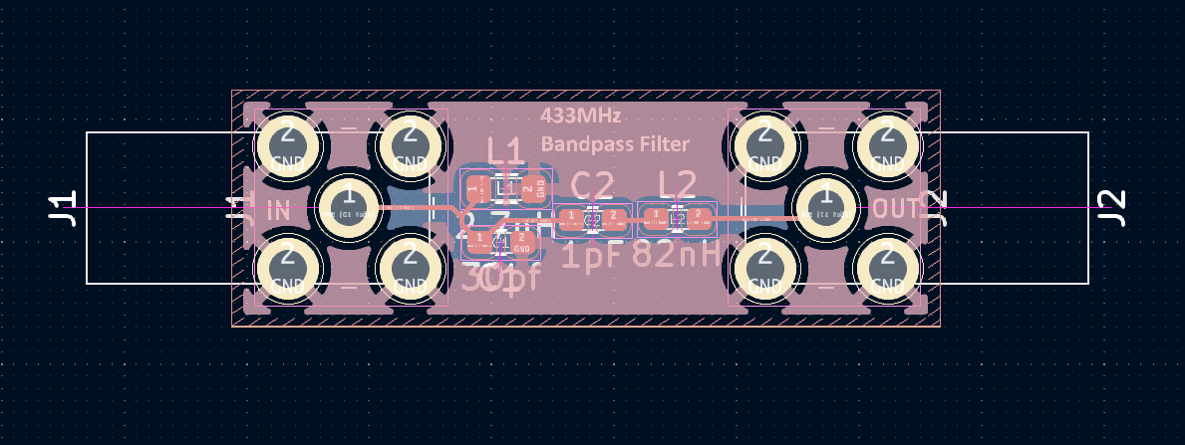
Bandpass Filter
Bandpass Filter Designed in KiCad

Slide 8
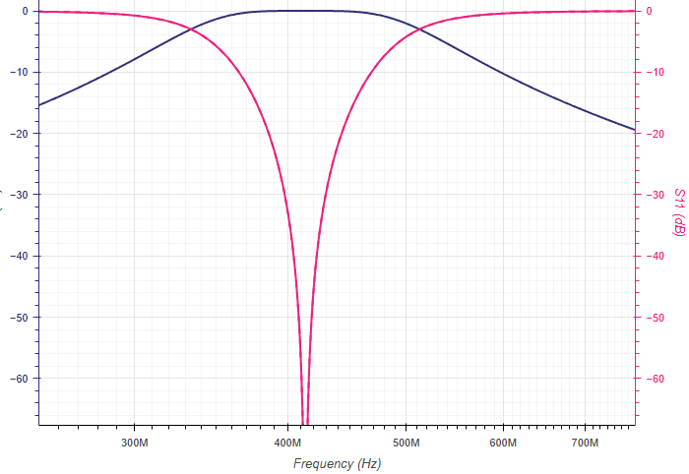
S11 and S21 Parameter of The Bandpass Filter

Slide 9
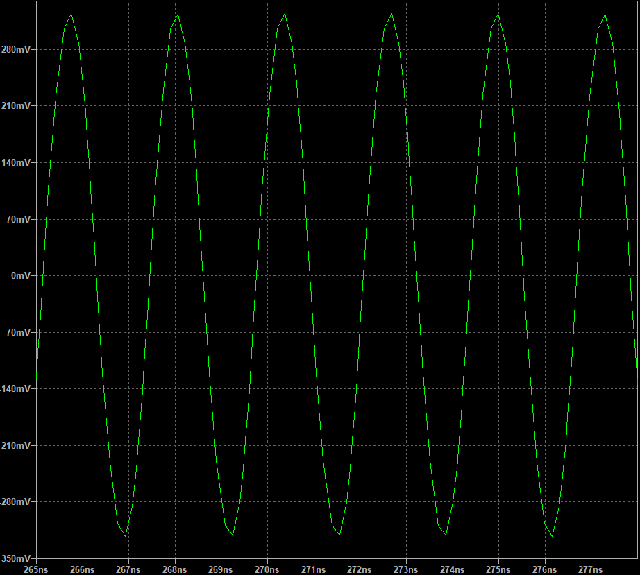
Testing The Bandpass Filter
Detected peak amplitude when fed with 1V 433MHz Signal is around 300mV

Slide 10
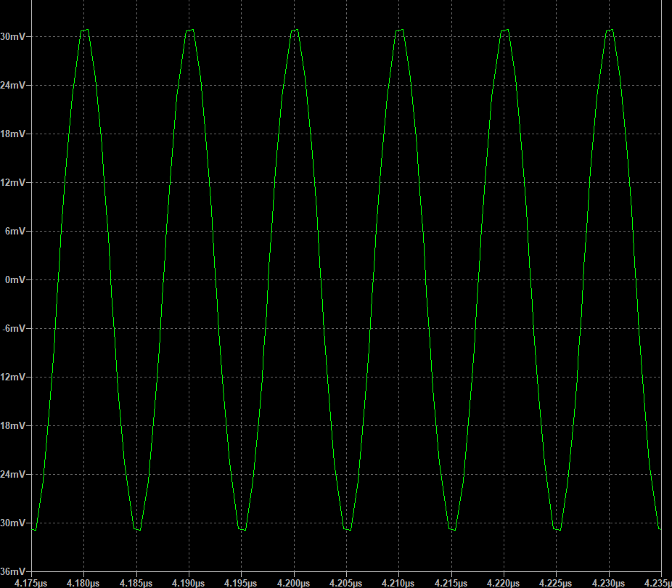
Testing The Bandpass Filter
Detected peak amplitude when fed with 1V 1.3GHz Signal is around 30mV (Filter is working as intended)

Slide 11
To do here
Results after bandpass filter
Summary
End

