Slide 1
Hotel Management
Member: Nguyễn Trọng Hải 19119028
Nguyễn Đình Hồng Quân 19119045
Trần Phan Bảo Khang 19119059

Slide 2
01
Project Description
02
Theoretical Basis
CONTENTS
03
Design
04
Test Cases
05
Conclusion

Slide 3
01
Project Description
Preface
With the topic "Building a hotel management program", our main goal is to build a program to support effective hotel management and can be applied in practice, managing booking problems. room, edit information, check-out, room type, invoice.
The program has a simple interface, effective management, easy to use.

Slide 4
02
Theoretical Basis
Linked list
A linked list is a data structure used to store a set of discrete elements that can be dynamically expanded.
The size of the linked list does not need to be defined in advance, it automatically changes when the number of elements in the list changes.
Unlimited number of elements
Easy to perform operations: add, delete, edit
Sequential data retrieval

Slide 5

02
Theoretical Basis
Linked list
In a linked list, each Node usually has at least 2 parameters, a value and a link to another node.

Slide 6
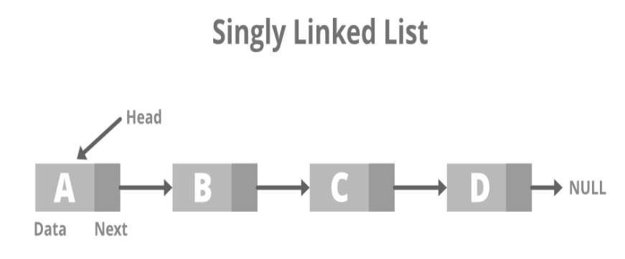
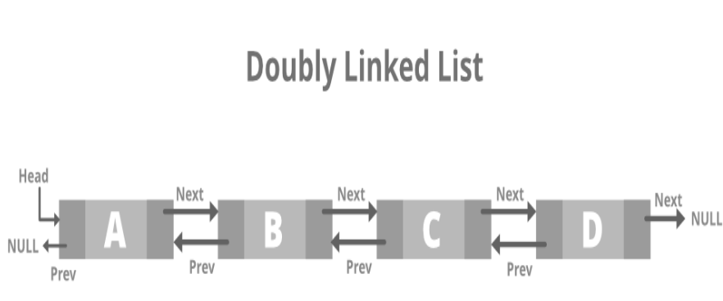
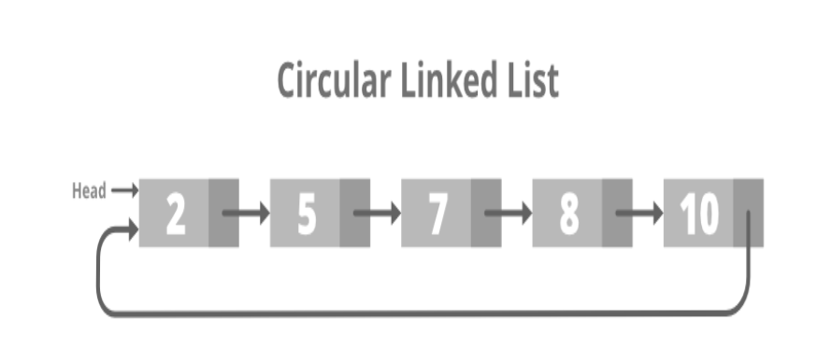
02
Theoretical Basis
Types of linked lists
Single linked lists
Double linked lists
Circular linked lists

Slide 7


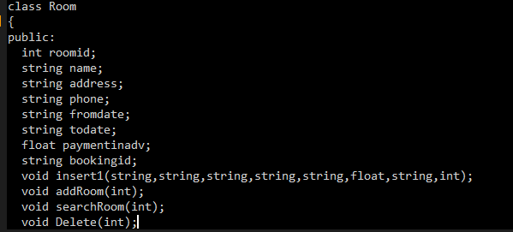
03
Design
Step1: Create a new Project in Dev C++
Step2: we will include all header file which will use in project
Step3 : Add the following line below header file:
ROOM
Step4: we will create a class(room) that can take the details of the room through a public

Slide 8

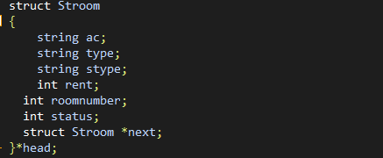
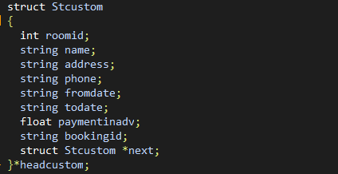
03
Design
Step5: we will create a public which can take the details of the menu hotel.
Step6: we will create a struct which can take the details of the room
Step7: we will create a struct which can take the details of the customer

Slide 9
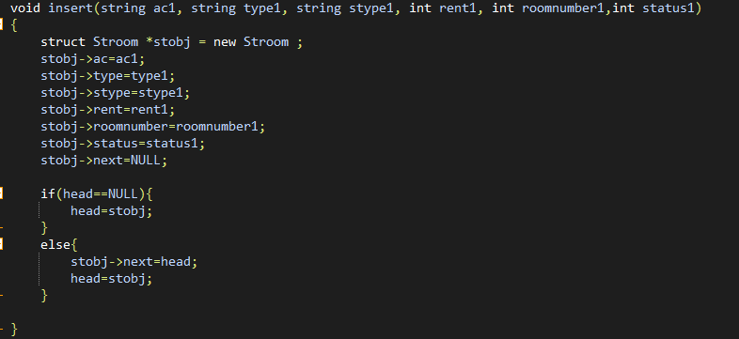
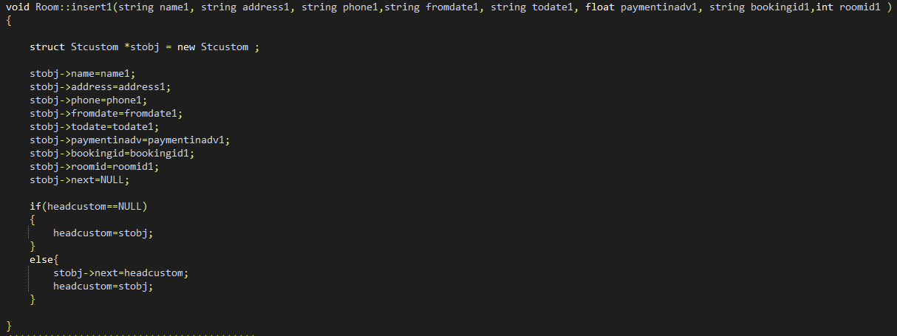
Step8: The insert function is to insert a node into the single list of Room
03
Design
Step8: The insert function is to insert a node into the single list of Room
Step9: The insert 1 function is to insert a node into the customer's single list

Slide 10
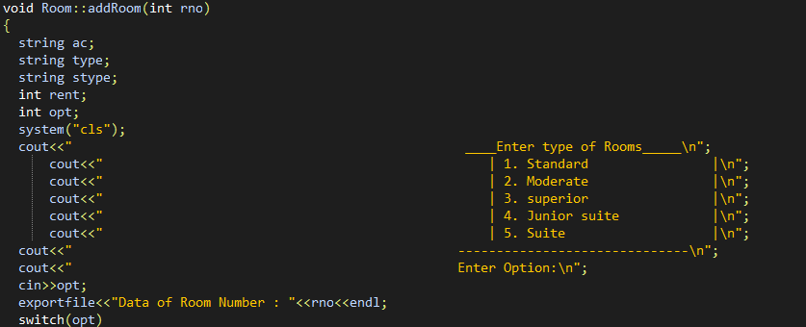
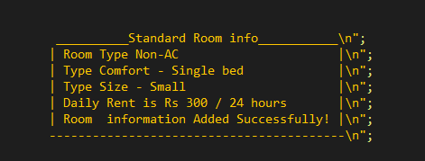
03
Design
Step 10: Now we will create a function to add, search, delete
Add Room
In function add room we have Room type, Comfort type, Type Size, Room Rent

Slide 11
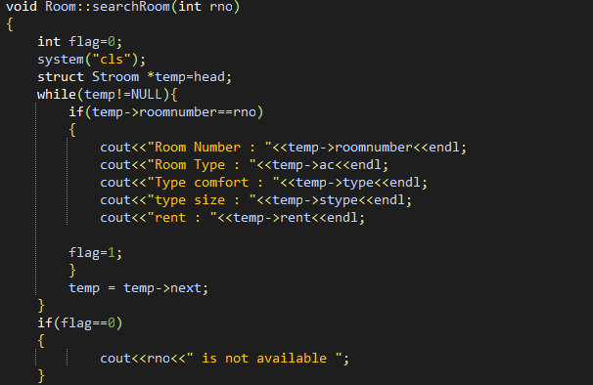
03
Design
Search Room

Slide 12
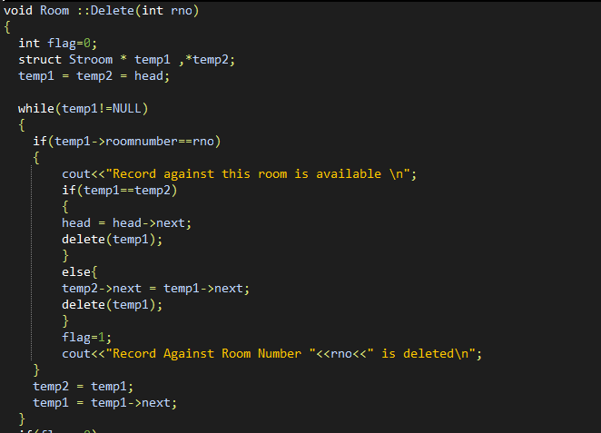
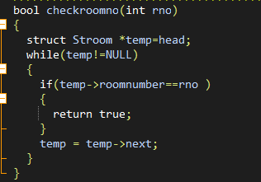
Delete Room
03
Design
Delete Room
Checkroom is to go through the single list to check if the room number is created in the single list. If yes, return true.

Slide 13
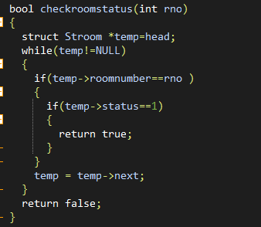
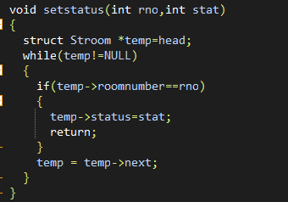
03
Design
Check Room Status is to check if the room number has been booked
Setstatus is to update the room number that is already booked

Slide 14
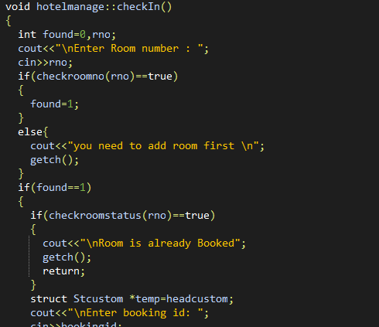
03
Design
In hotel management we have function: a check-in, check out, get available, search for customer and guest summary, manage room.
Check-in

Slide 15
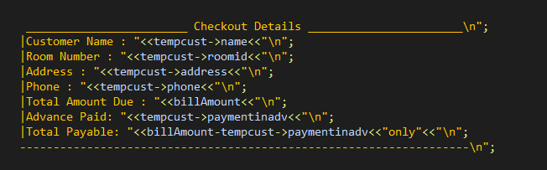
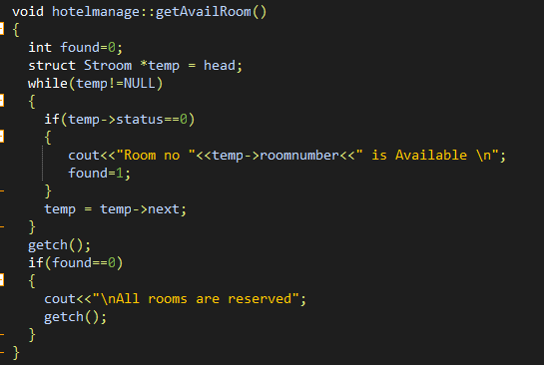
03
Design
Check-out
Get available

Slide 16
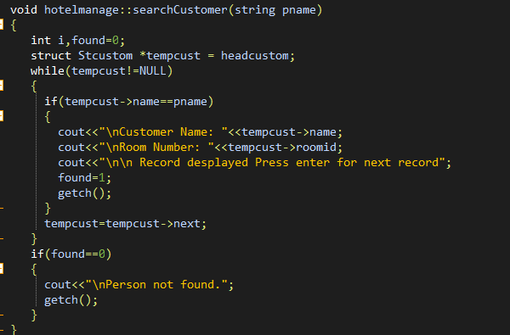
03
Design
Search customer

Slide 17
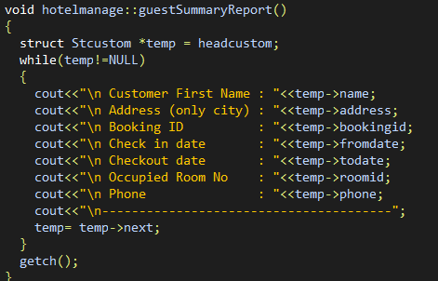
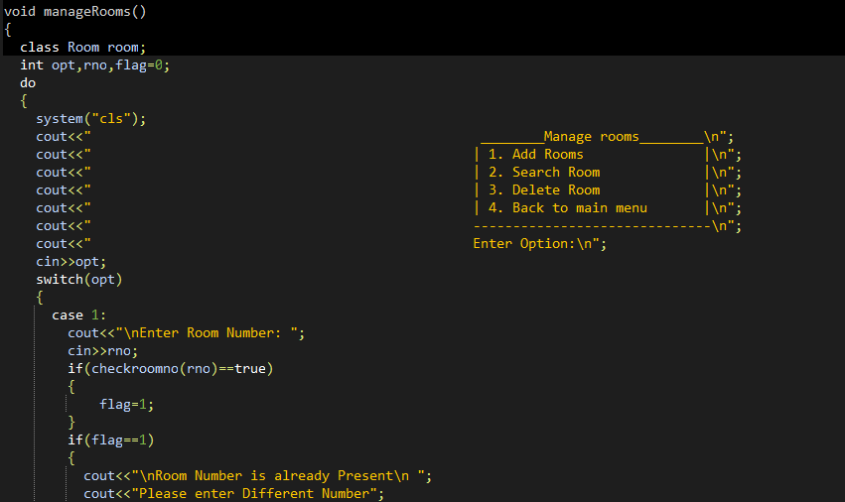
03
Design
Guest summary
Manage room

Slide 18
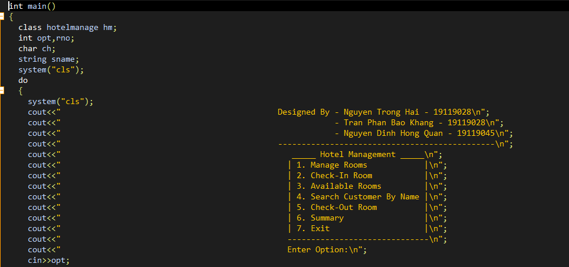
03
Design
Final step is Menu

Slide 19
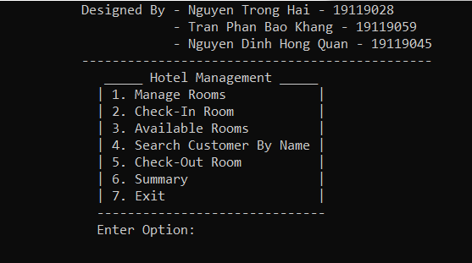
04
Test Case
Menu

Slide 20
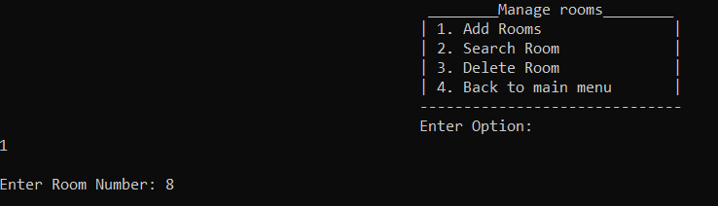
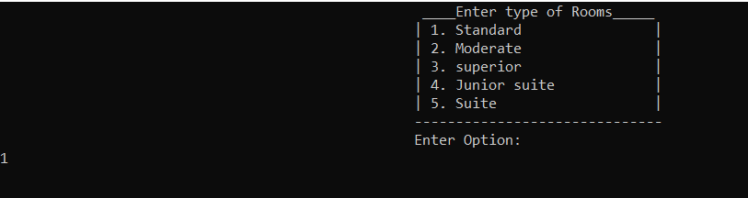
04
Test Case
Case 1

Slide 21
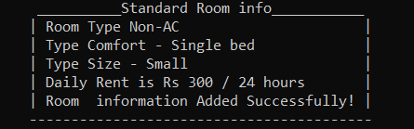
04
Test Case
After create room , it will show infomation of type of room

Slide 22
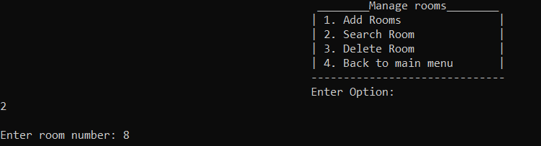
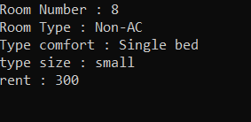
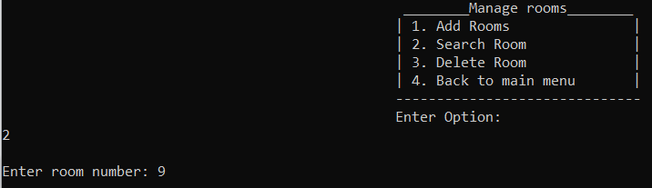

04
Test Case
Test Search Room
If input room wrong it will show

Slide 23
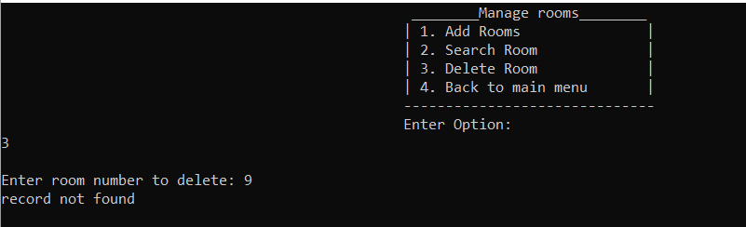
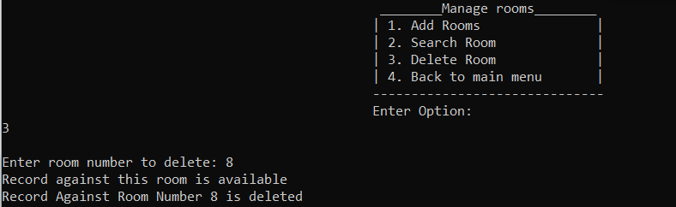
04
Test Case
Test Delete Room
Delete Room is not available it will show text in figure below
If input correct, it will delete

Slide 24
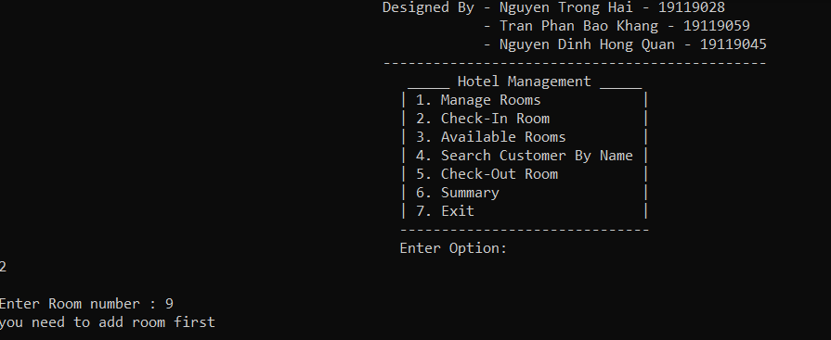
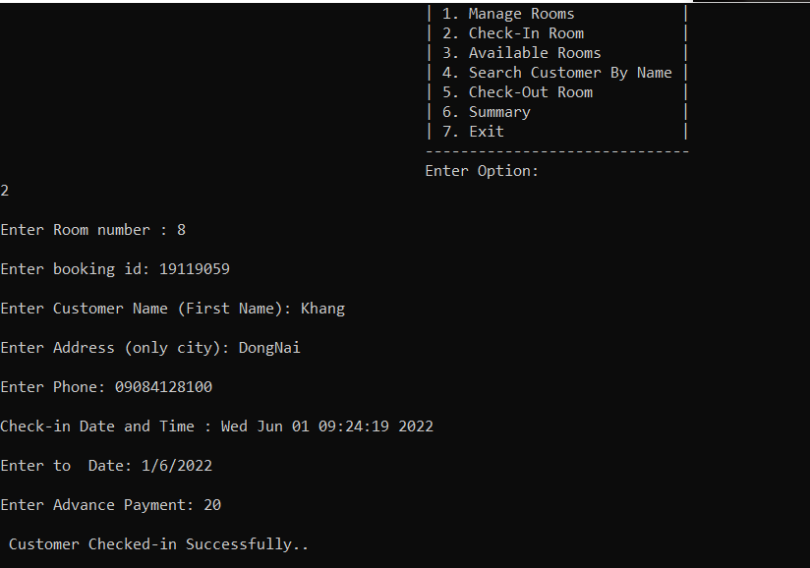
04
Test Case
Case 2 : Check - In Room
Wrong Input , it will warning
Right Input , we will fill information

Slide 25
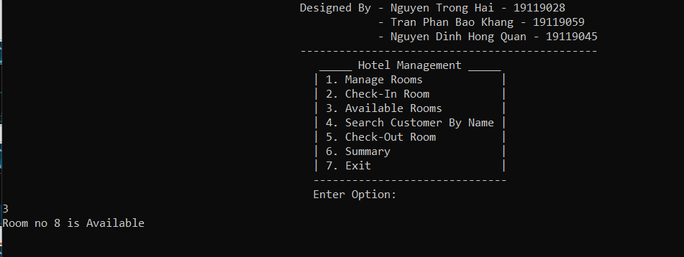
04
Test Case
Case 3 : Available Rooms

Slide 26
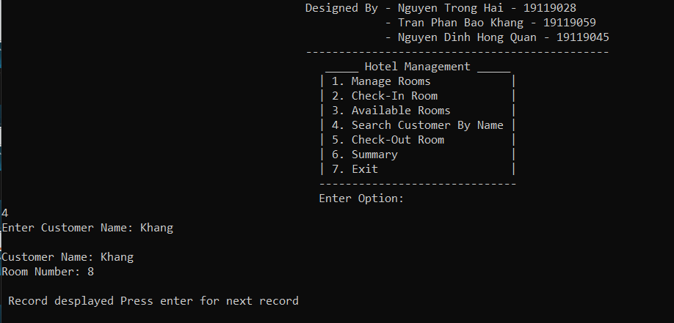
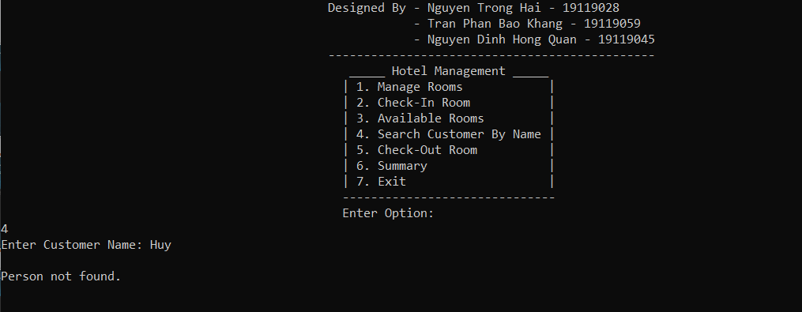
04
Test Case
Case 4 : Search Customer By Name
Name record is wrong
Name record is valid

Slide 27
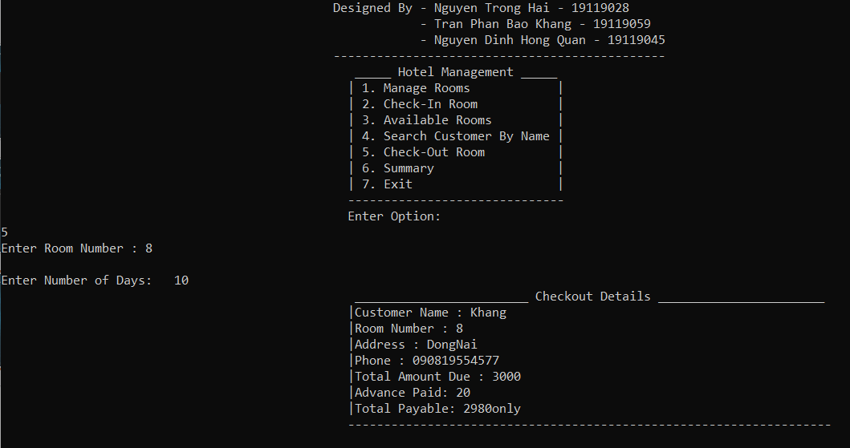
04
Test Case
Case 5 : Check- out Rooms

Slide 28
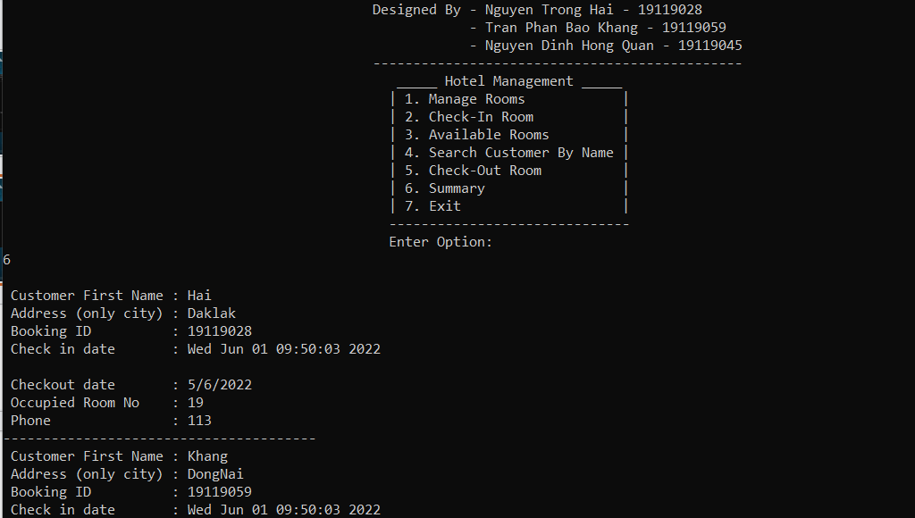
04
Test Case
Case 6 : Summary

Slide 29
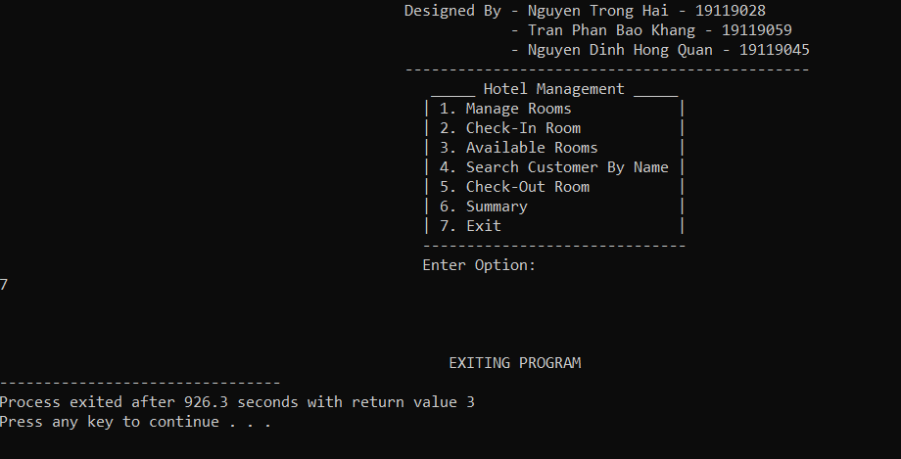
04
Test Case
Case 7 : Exit

Slide 30
05
Conclusion
Result
Successfully implemented the construction of a hotel management system in C++ language, displaying information through the screen, selecting and implementing, implementing,….
Difficulties and limitations
Customer satisfaction has not been assessed yet
Development of ideas
Will do more management work such as assessing guest satisfaction, allowing to assess whether the service level of the hotel is good or not.

Slide 31
THANK YOU
Link video nhóm https://drive.google.com/drive/folders/1n1j8rhp9mpEiiDg262sOZ5zsMd02JBGX?usp =sharing

