Slide 1
Dataset Analysis: Wisconsin Breast Cancer
Brendan Kearney, Statistics in Bioinformatics 6200

Slide 2
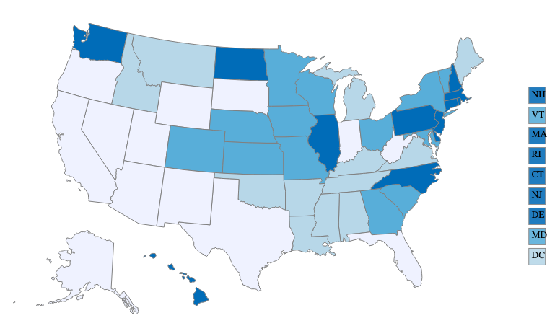
Background
Breast cancer affected 130.3 out of 100,000 women in 2016 (CDC)
Second leading type of death from cancer
Dataset samples collected in 1995
Figure 1. Breast cancer rates per 100,000 women, CDC

Slide 3

Dataset Background
Title: Wisconsin Diagnostic Breast Cancer (WDBC)
Features are computed from a digitized image of a fine needle aspirate (FNA) of a breast mass.
Describe characteristics of the cell nuclei present in the image.
Figure 2. Biopsy Procedure - Fine-Needle Aspiration.

Slide 4
Dataset Description
Number of instances: 569
Number of attributes: 32 (ID, diagnosis, 30 real-valued input features)
1) ID number
2) Diagnosis (M = malignant, B = benign)
3-32)
Ten real-valued features are computed for each cell nucleus:
a) radius (mean of distances from center to points on the perimeter)
b) texture (standard deviation of gray-scale values)
c) perimeter
d) area
e) smoothness (local variation in radius lengths)
f) compactness (perimeter^2 / area - 1.0)
g) concavity (severity of concave portions of the contour)
h) concave points (number of concave portions of the contour)
i) symmetry
j) fractal dimension ("coastline approximation" - 1)

Slide 5
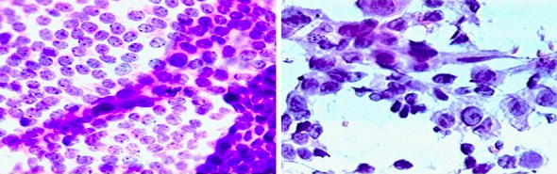
Main Question
Do the features of the nuclei measurements statistically differ between malignant (M) and benign (B) breast cancer cells?
Choose one continuous feature for all three tests - mean_radius
Figure 3. Smears with benign (left) and malignant (right) diagnoses

Slide 6


Test 0: Normality
Conclusion: Radius of malignant p-value is less than 0.05, so cannot assume normality. Benign sample is normal.
However, the central limit theorem allows for parametric tests if n is large enough (n > 30)

Slide 7
Test 1: Two-sample z-test
Compare the population means of two samples
Assumptions:
The samples must be independent from one another
The samples must be normally distributed or n > 30
95% significance, two-tailed test
H₀: u_{M} - u_{B} = 0, there is no different between malignant and benign means
H_{a}: u_{M} - u_{B} ≠ 0, there is a difference
Mean (x-bar) of radius-malignant: 17.46, n = 212
Mean (x-bar) of radius-benign: 12.15, n = 357

Slide 8
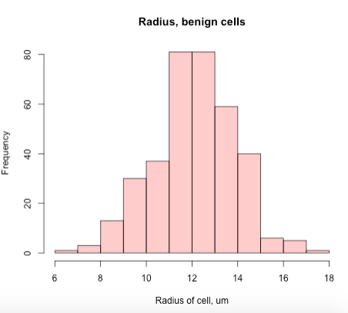
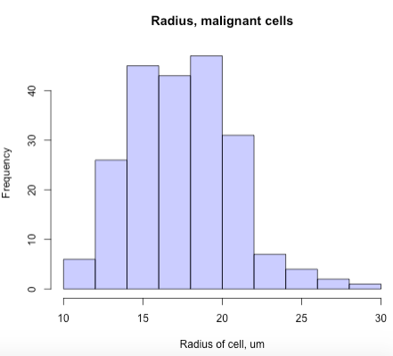
Two-sample z-test

Slide 9
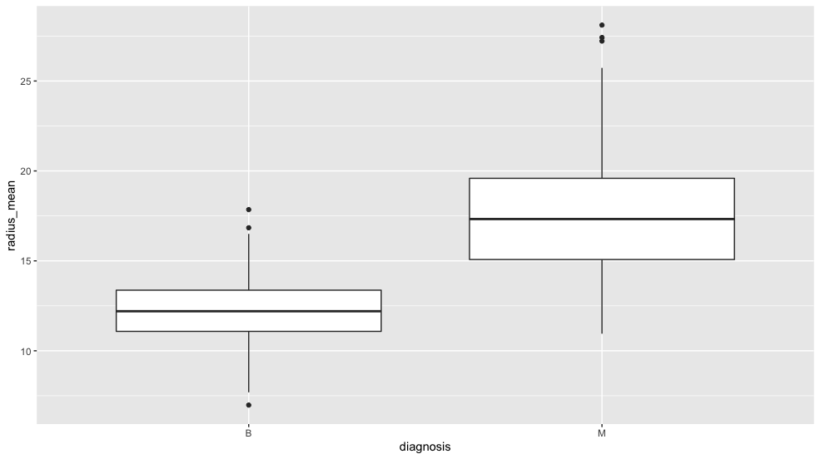

Slide 10
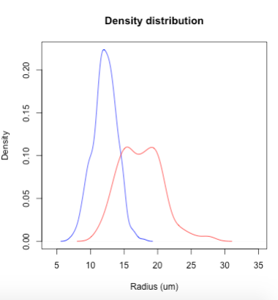
Two-sample z-test, results
Z test statistic = 22.21
Z_{crit} (α = 0.05) = 1.96
P-value = less than 0.0001
Conclusion: Reject the null hypothesis that u_{M} = u_{B}
The mean of malignant radius samples is greater than the mean of benign radius samples
Benign - blue, Malignant - red

Slide 11
Test 2: F test and Bartlett test
Scientific question: do the malignant and benign cancer samples have equal population variances?
H₀: σ_{M}² = σ_{B}²
H_{a}: σ_{M}² ≠ σ_{B}²
Malignant sample: mean = 17.463, σ² = 10.26543
Benign sample: mean = 12.147, o² = 3.170

Slide 12
Population Variance Test Results
F = σ_{M}² / σ_{B}² = 3.238
F-crit_{α=0.95/2, df1=211, df2=356} = 1.268
P-value = less than 0.0001
Conclusion: reject the null hypothesis that the ratio of population variances is equal to one
F-test is extremely sensitive to non-normality

Slide 13

Bartlett Test Results
Reject the null hypothesis. Because the p-value is not greater than 0.05, the variances are significantly difference from each other.

Slide 14
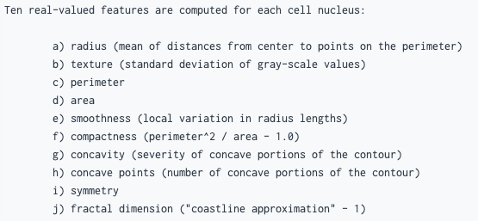
Test 3: Linear Regression
Scientific question: is there a linear relationship between the compactness of a nucleus and its concavity?
Linear regression can be used on other features

Slide 15
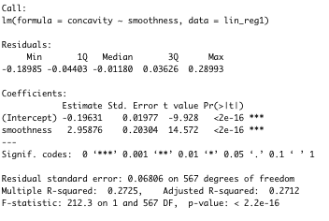
Linear Regression
H₀: β₁ = 0
H_{a}: β₁ ≠ 0
y_{i} = β₀ + β₁x_{i}
y_{i} = -0.196 + 2.959*x_{i}
The test statistic (F = 212.3) is significantly greater than the critical value (F = 3.857) at α = 0.05, so we reject the null hypothesis that β₁ = 0.
Conclusion: there is some linear relationship between x (smoothness) and y (concavity).

Slide 16
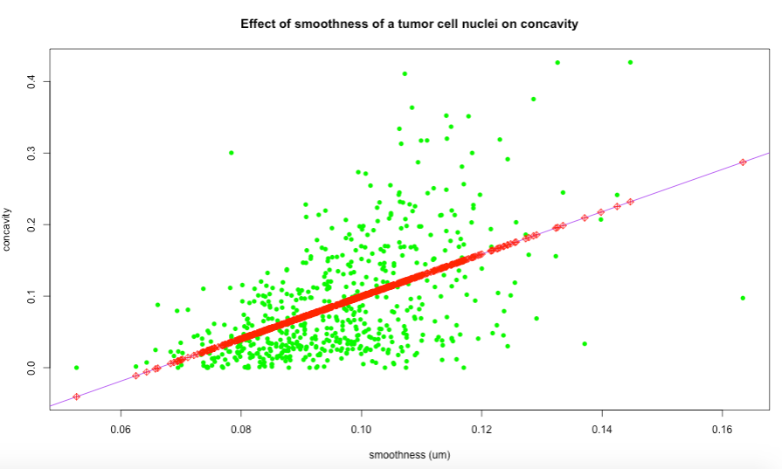
Linear Regression: smoothness vs concavity

Slide 17
Conclusions
Test 1 (two sample z-test): are the population means of the cancer cell nuclei radiuses different in benign and malignant samples?
Conclusion: Reject the null hypothesis that u_{M} = u_{B}
Test 2 (variance tests): do the variances of the populations differ, using the same samples?
Conclusion: Reject the null hypothesis that the variances are significantly difference from each other.
Test 3 (linear regression): does one feature (smoothness) correlate with another (concavity)?
Conclusion: Reject the null hypothesis that β₁ = 0. There is some linear relationship between x (smoothness) and y (concavity).

Slide 18
Credits
Data set retrieved from https://data.world/health/breast-cancer-wisconsin.
Dr. William H. Wolberg, General Surgery Dept., University of
Wisconsin, Clinical Sciences Center, Madison, WI 53792
wolberg@eagle.surgery.wisc.edu
W. Nick Street, Computer Sciences Dept., University of
Wisconsin, 1210 West Dayton St., Madison, WI 53706
street@cs.wisc.edu 608-262-6619
Olvi L. Mangasarian, Computer Sciences Dept., University of
Wisconsin, 1210 West Dayton St., Madison, WI 53706
olvi@cs.wisc.edu
Image Credits
Figure 1: https://gis.cdc.gov/Cancer/USCS/DataViz.html
Figure 2: https://www.cathealth.com/cat-care/testing/2504-fine-needle-aspiration-fna-in-cats
Figure 3: https://towardsdatascience.com/knn-3-coding-our-breast-cancer-classifier-503b804988f8

