Slide 1
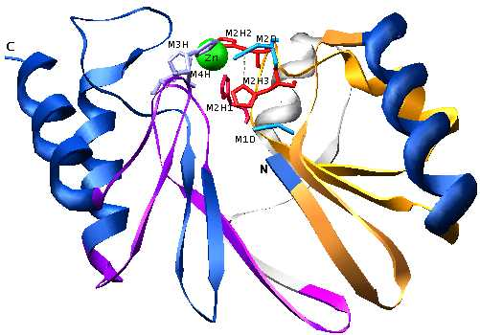
Phosphate Promotes the Recovery of Mycobacterium tuberculosis β-Lactamase from Clavulanic Acid Inhibition
Wouter Elings†, Raffaella Tassoni†, Steven A. van der Schoot, Wendy Luu, Josef P. Kynast, Lin Dai, Anneloes J. Blok, Monika Timmer, Bogdan I. Florea, Navraj S. Pannu, and Marcellus Ubbink*
Leiden Institute of Chemistry, Leiden University, Einsteinweg 55, Leiden, The Netherlands
Biochemistry, 2017, 56 (47), pp 6257–6267
DOI: 10.1021/acs.biochem.7b00556
Publication Date (Web): October 31, 2017
Copyright © 2017 American Chemical Society
Brendan Kearney
February 23, 2018
ß-lactamase
Image source:
http://www.bioinfo.de/isb/1998/01/0008/

Slide 2
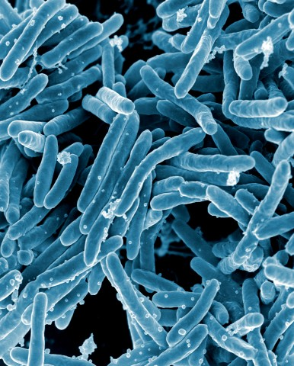
Tuberculosis (TB)
One of the deadliest infectious diseases in the world
Caused by bacterium Mycobacterium tuberculosis (Mtb)
Mycobacterium tuberculosis
Image source: http://blogs.nature.com/freeassociation/2017/04/mutation-rates-of-mycobacterium-tuberculosis-from-the-archives-2013.html

Slide 3
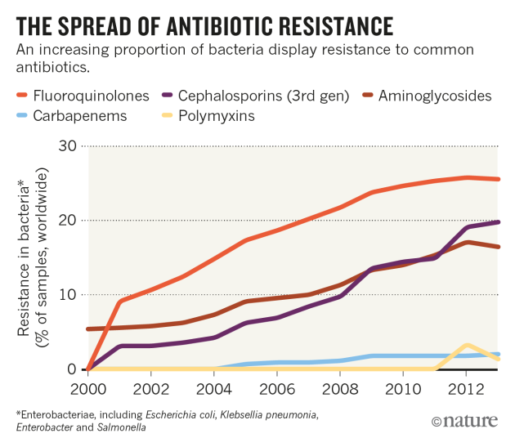
Antimicrobial resistance
Caused by poor patient adherence and long incubation period
Mtb strains can be multidrug resistant or totally drug resistant
Image source:
https://www.nature.com/news/spread-of-antibiotic-resistance-gene-does-not-spell-bacterial-apocalypse-yet-1.19037

Slide 4
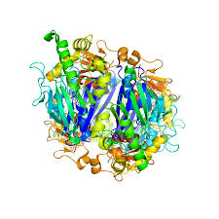
β-lactamases
Class of enzymes produced by bacteria that resist β-lactam antibiotics
Present in wide variety of disease-causing bacteria
E. coli
Salmonella
K. pneumoniae
Beta-lactamase
Image source:
www.csgid.org/deposits/view/3R2U

Slide 5
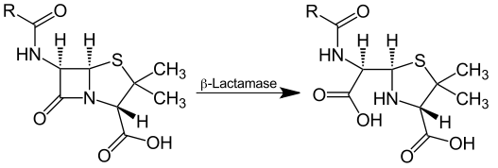

β-lactamase mechanism
Beta-lactamase OH
β-lactam drug Inactive metabolite
Image source:
http://www.antimicrobe.org/hisphoto/history/NDM-1_Mietzner_Dec2013.asp

Slide 6
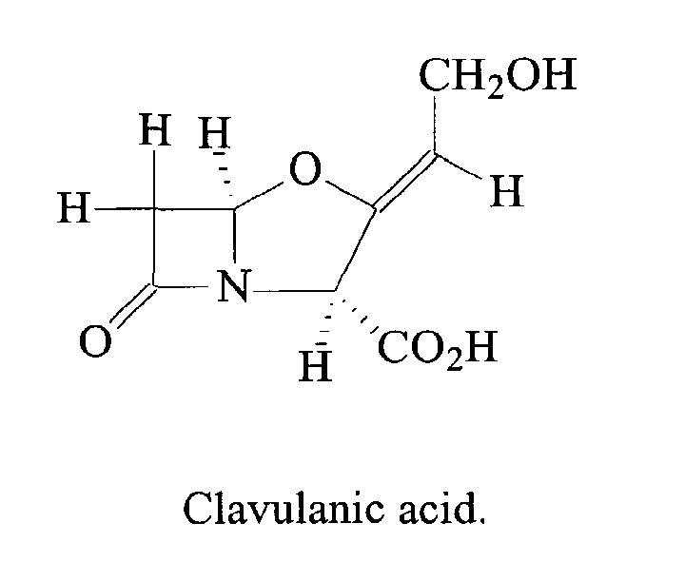
β-lactamase BlaC
Hydrolyzes β-lactam antibiotics
Resistance by BlaC can be circumvented by suicide inhibition
Clavulanic acid
Image source:
http://www.geopolmonitor.com/clavulanic-acid-market-sales-consumption-market-analysis-sales-volume-sales-price-sales-revenue-analysis-consumption-volume-analysis-2022/

Slide 7
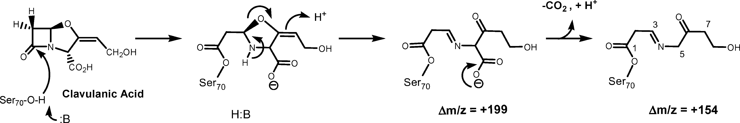
Suicide Inhibition of β-lactamase
Image Source:
Tremblay LW, Hugonnet J-E, Blanchard JS. Structure of the Covalent Adduct Formed between Mycobacterium tuberculosis β-Lactamase and Clavulanate†‡. Biochemistry. 2008;47(19):5312–5316.

Slide 8
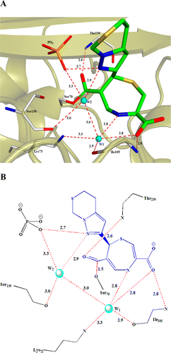
Phosphate ions
Several papers mention presence of phosphate ion in carboxylate binding site
Do these ions have an effect on β-lactamase binding and clavulanic acid inhibition?
Image source:
Hazra S, Kurz SG, Wolff K, Nguyen L, Bonomo RA, Blanchard JS. Kinetic and Structural Characterization of the Interaction of 6-Methylidene Penem 2 with the β-Lactamase from Mycobacterium tuberculosis. Biochemistry. 2015;54(36):5657–5664.

Slide 9
Objectives
Kinetics of BlaC inhibition by clavulanic acid
BlaC-phosphate structural characterization

Slide 10
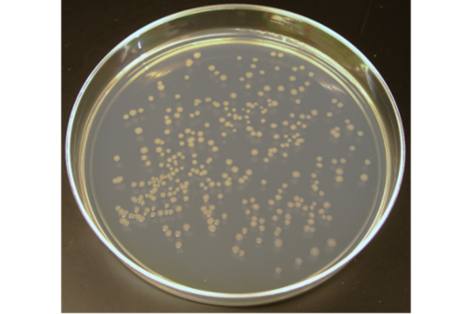
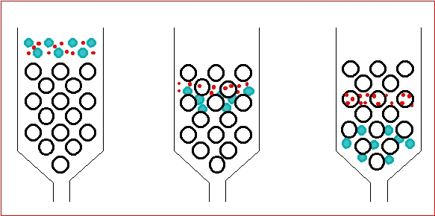
Methods
Production
Expression of blaC induced on E. coli cell culture
Purification
His-tagged protein purification nickel column
Size exclusion chromatography column
Image:
http://technologyinscience.blogspot.com/2011/09/gel-filtration-chromatography-gf-size.html
Image:
http://legacy.sciencelearn.org.nz/News-Events/Latest-News/News-Archive/2010-News-archive/2010-News-images/E.coli

Slide 11
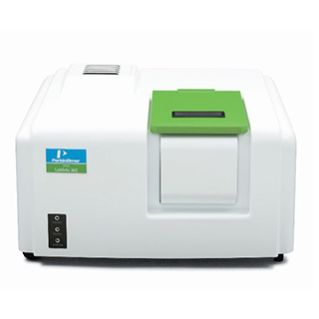
Methods: Kinetics
Hydrolysis of a chromogenic reporter with UV/vis (486 nm)
Nitrocefin
Michaelis-Menten kinetics
UV/vis spectrophotometer
Image:
http://www.perkinelmer.com/product/lambda-365-spectrophotometer-uv-express-n4100020

Slide 12
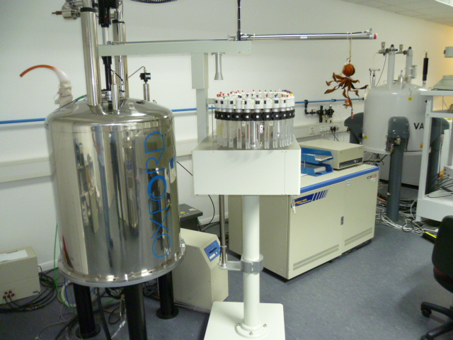
Methods: Structural Determination
Mass Spectrometry
X-ray crystallography
Nuclear Magnetic Resonance
²H, ¹⁵N, ¹³C
HSQC
NMR Spectrometer
Image:
http://equipment.data.ac.uk/item/4dc653f3b774e76162cda1de98943778.html

Slide 13
Results
Kinetics of BlaC inhibition by clavulanic acid
BlaC-phosphate structural characterization

Slide 14
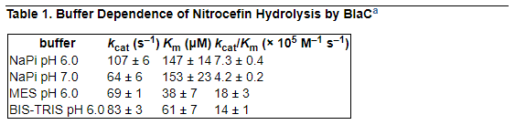
Nitrocefin Hydrolysis by BlaC
Kinetics in different buffers
Phosphate buffer has the highest K_{M} and lowest K_{cat}/K_{M}

Slide 15
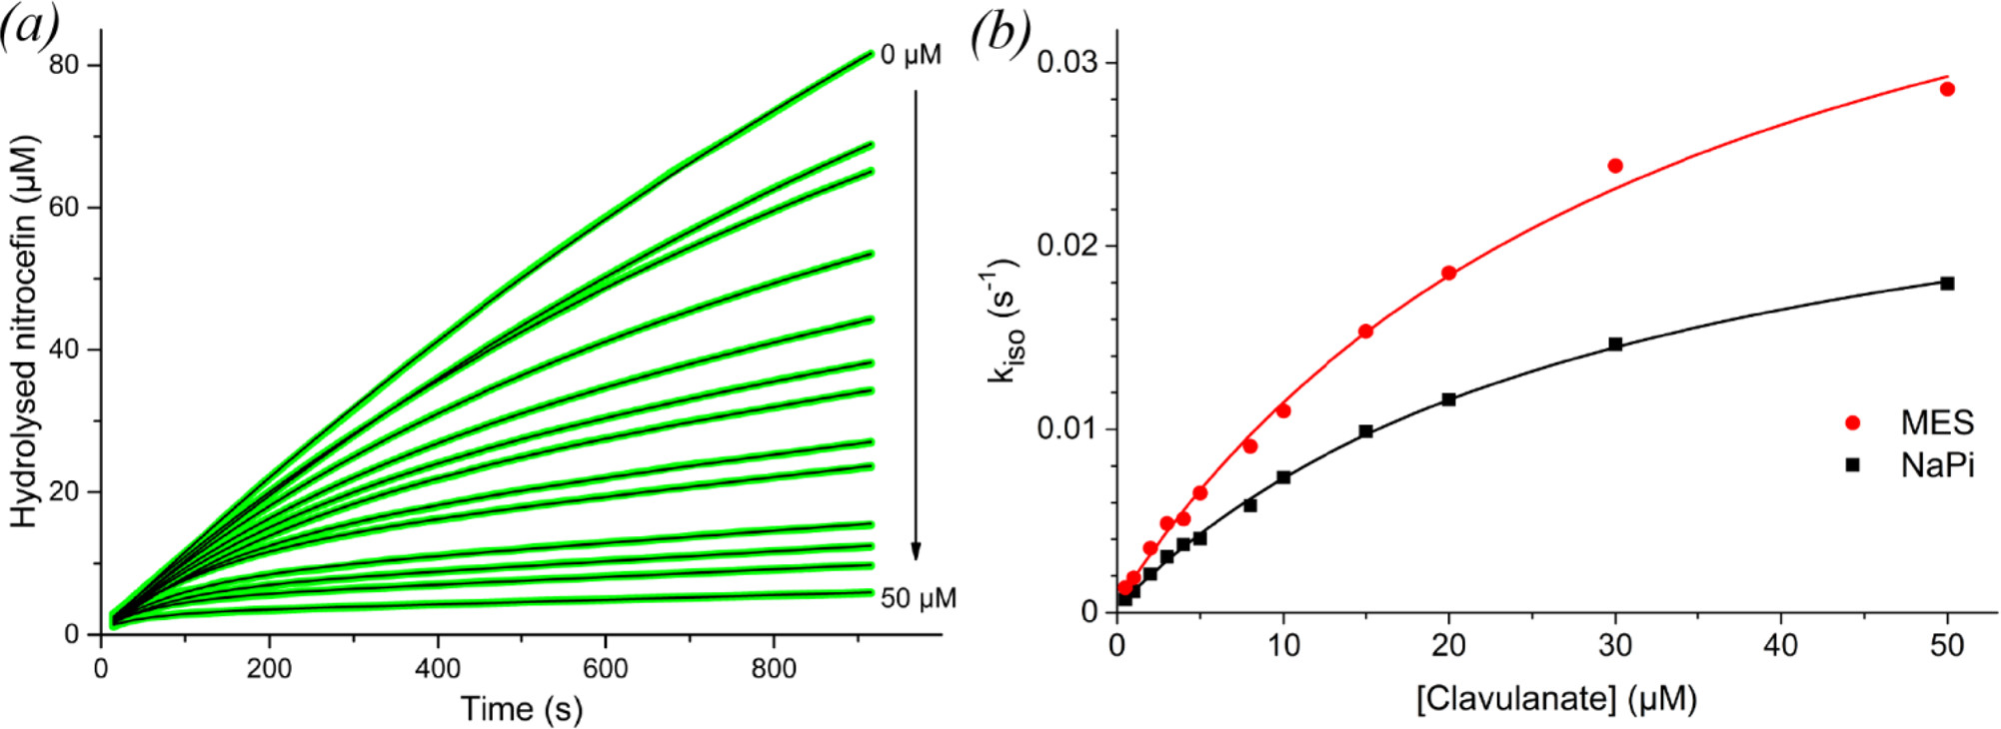
BlaC inhibition by clavulanic acid
Increasing concentrations of clavulanic acid in 100 mM NaPi

Slide 16
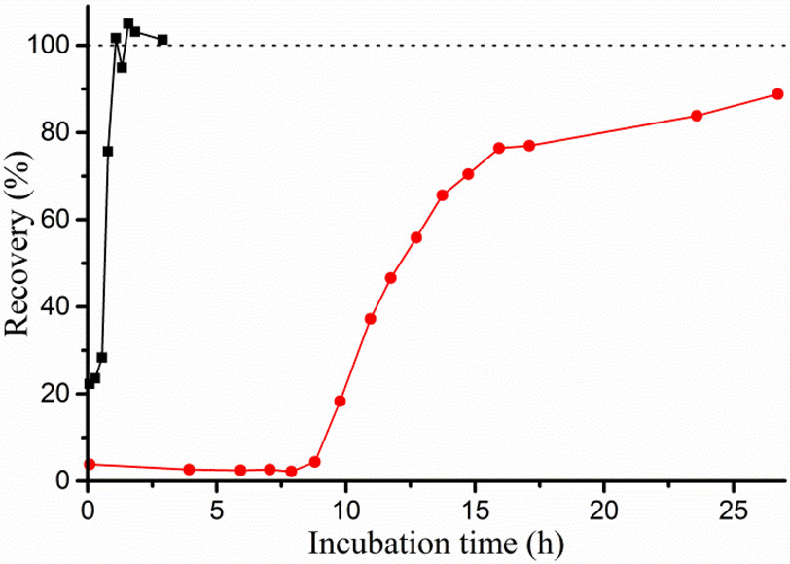
BlaC recovery from clavulanic acid inhibition
Legend
100 mM NaPi
MES

Slide 17
Discussion: Kinetics
Clavulanic acid is hydrolyzed under prolonged incubation
Hydrolysis is much faster in phosphate buffer
Phosphate competes with substrate at the carboxylate binding site

Slide 18
Results
Kinetics of BlaC inhibition by clavulanic acid
BlaC-phosphate structural characterization

Slide 19
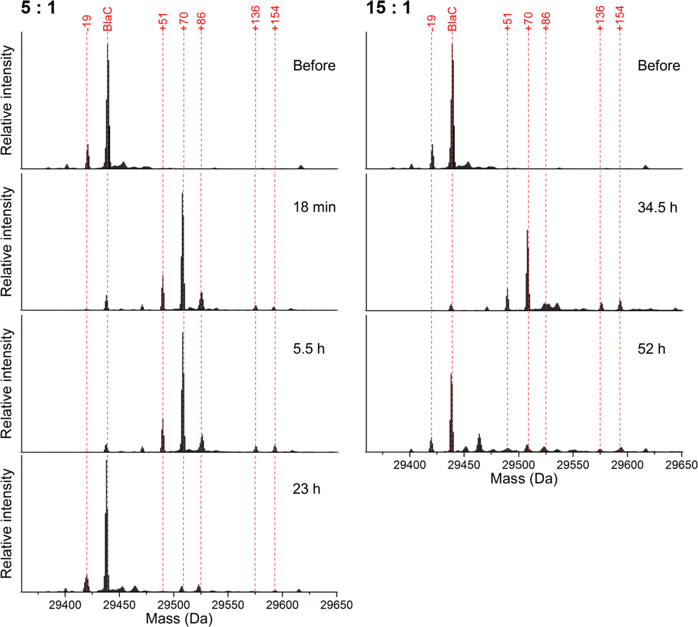
Mass spectra of BlaC during incubation with clavulanic acid
500 μM clavulanic acid 1500 μM clavulanic acid

Slide 20
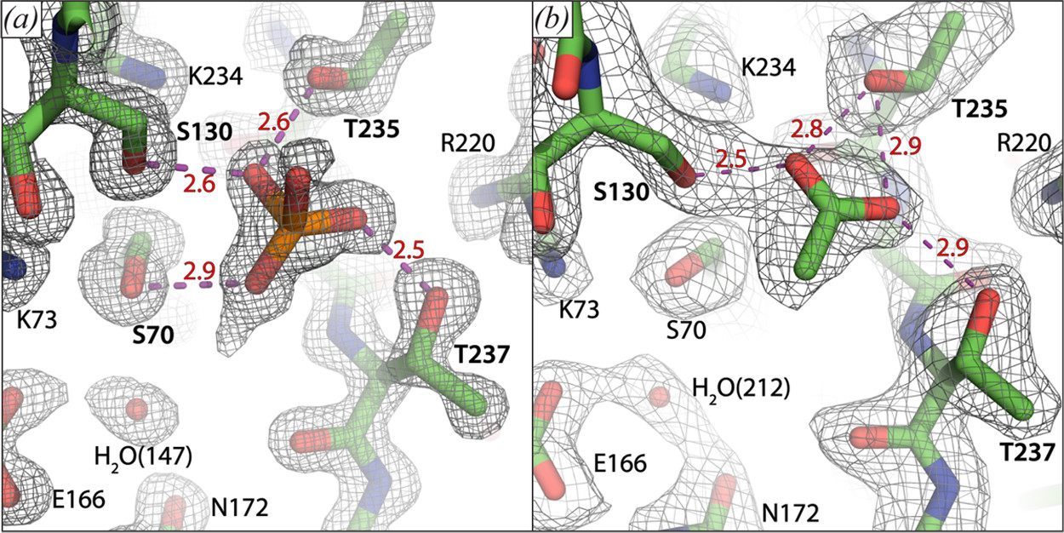
Carboxylate binding sites of BlaC crystal structures
BlaC crystal structures

Slide 21
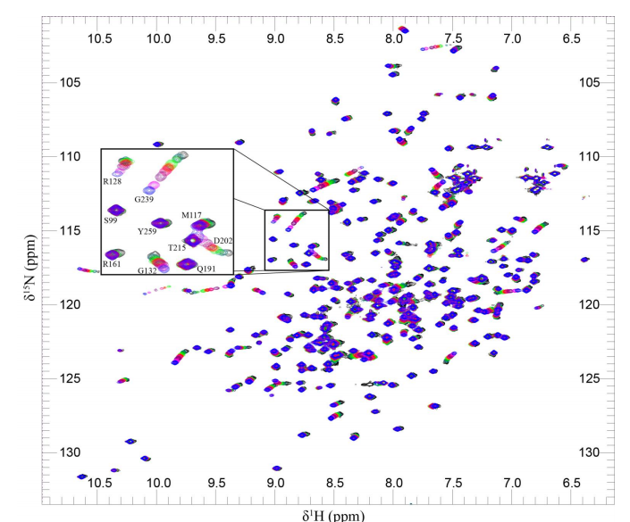
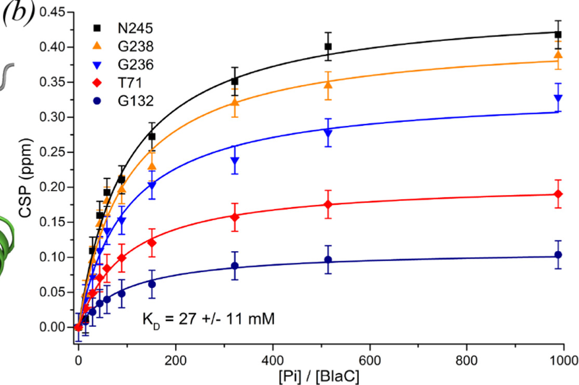
BlaC-phosphate interaction
¹H-¹⁵N HSQC spectra of BlaC with phosphate
^{Binding Curves}

Slide 22
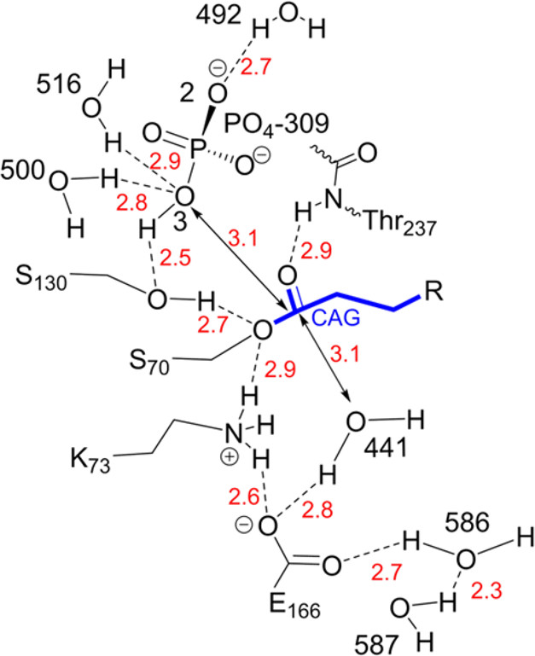
Conclusion: Characterization
Phosphate promotes BlaC recovery
Phosphate forms a hydrogen bridge at the active site
Acts as alternative nucleophile for hydrolysis

Slide 23
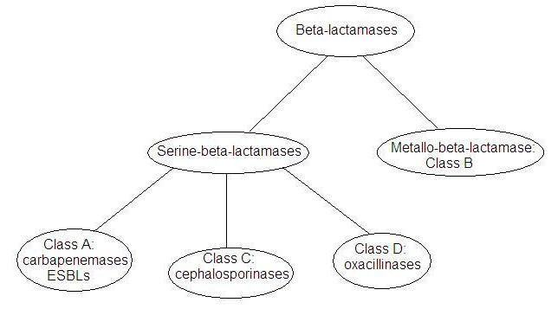
Perspective
Is this mechanism specific for BlaC?
Is the effect of phosphates relevant under physiological conditions?
M. tuberculosis

Slide 24
Credits
Elings W, Tassoni R, Schoot SAVD, Luu W, Kynast JP, Dai L, Blok AJ, Timmer M, Florea BI, Pannu NS, et al. Phosphate Promotes the Recovery of Mycobacterium tuberculosis β-Lactamase from Clavulanic Acid Inhibition. Biochemistry. 2017;56(47):6257–6267.
Hazra S, Kurz SG, Wolff K, Nguyen L, Bonomo RA, Blanchard JS. Kinetic and Structural Characterization of the Interaction of 6-Methylidene Penem 2 with the β-Lactamase from Mycobacterium tuberculosis. Biochemistry. 2015;54(36):5657–5664.
Tremblay LW, Hugonnet J-E, Blanchard JS. Structure of the Covalent Adduct Formed between Mycobacterium tuberculosis β-Lactamase and Clavulanate†‡. Biochemistry. 2008;47(19):5312–5316.
https://www.nature.com/news/spread-of-antibiotic-resistance-gene-does-not-spell-bacterial-apocalypse-yet-1.19037
http://www.bioinfo.de/isb/1998/01/0008/
http://blogs.nature.com/freeassociation/2017/04/mutation-rates-of-mycobacterium-tuberculosis-from-the-archives-2013.html
www.csgid.org/deposits/view/3R2U
http://www.antimicrobe.org/hisphoto/history/NDM-1_Mietzner_Dec2013.asp
http://www.geopolmonitor.com/clavulanic-acid-market-sales-consumption-market-analysis-sales-volume-sales-price-sales-revenue-analysis-consumption-volume-analysis-2022/
http://legacy.sciencelearn.org.nz/News-Events/Latest-News/News-Archive/2010-News-archive/2010-News-images/E.coli
http://technologyinscience.blogspot.com/2011/09/gel-filtration-chromatography-gf-size.html
http://www.perkinelmer.com/product/lambda-365-spectrophotometer-uv-express-n4100020
http://equipment.data.ac.uk/item/4dc653f3b774e76162cda1de98943778.html

