Slide 1
Developing New Modes of Reactivity by Bond Polarization
Brendan Kearney
Mentor: Dr. Jen Dabrowski

Slide 2
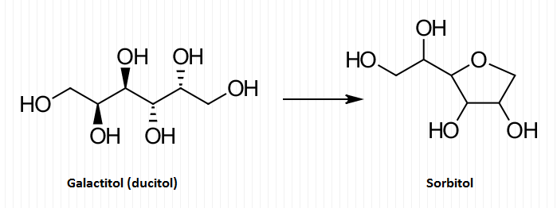
Purpose
Synthesis of sorbitan from sugar alcohols such as galactitol and sorbitol
Desired pathway - allylic transfer reaction

Slide 3
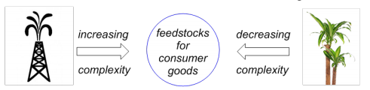
Background
Sorbitan - organic compound
Emulsifier - has applications in pharmaceuticals and food preparation
Current method of synthesis - crude oils
Requires high energy, not selective, environmentally unfriendly

Slide 4
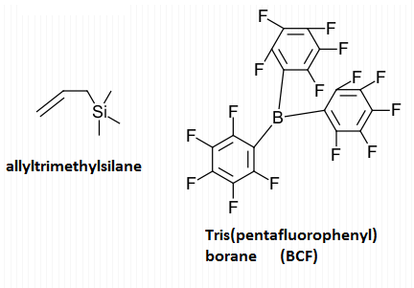
Mechanism
Olefin of allyltrimethylsilane activated by BCF
Pi orbitals of olefin and boron coordinate
Silicon - carbon bond is polarized

Slide 5
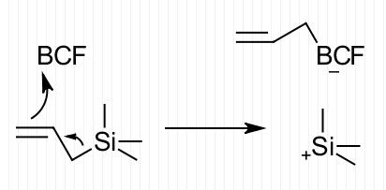
Mechanism (cont)

Slide 6
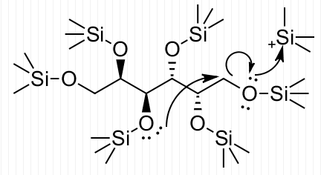
Mechanism (cont)
Alcohol of starting sugar substrate acts as nucleophile
Intramolecular cyclization occurs as O(SiMe₃)₂ group leaves
5 membered ring more likely to activate primary oxygens (less strain)

Slide 7
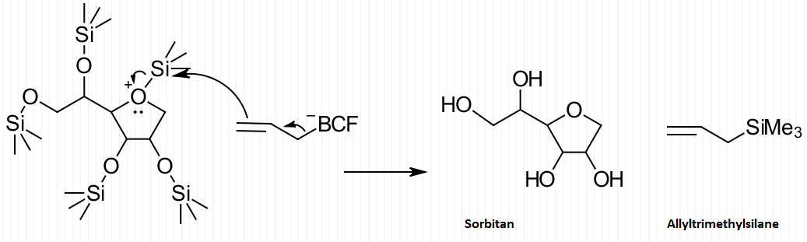
Regeneration of catalyst

Slide 8
Methods
Primary analysis - NMR (1H, 13C, 19F, HSQC, COSY)
NMR comparison tool
Mestrenova Research

Slide 9
Preliminary Results
Control reactions
Allyl+substrate, BCF+substrate, allyl+BCF
Full reaction
Under air
With molecular sieves
Under N₂
Allyl+BCF
Solvents

Slide 10
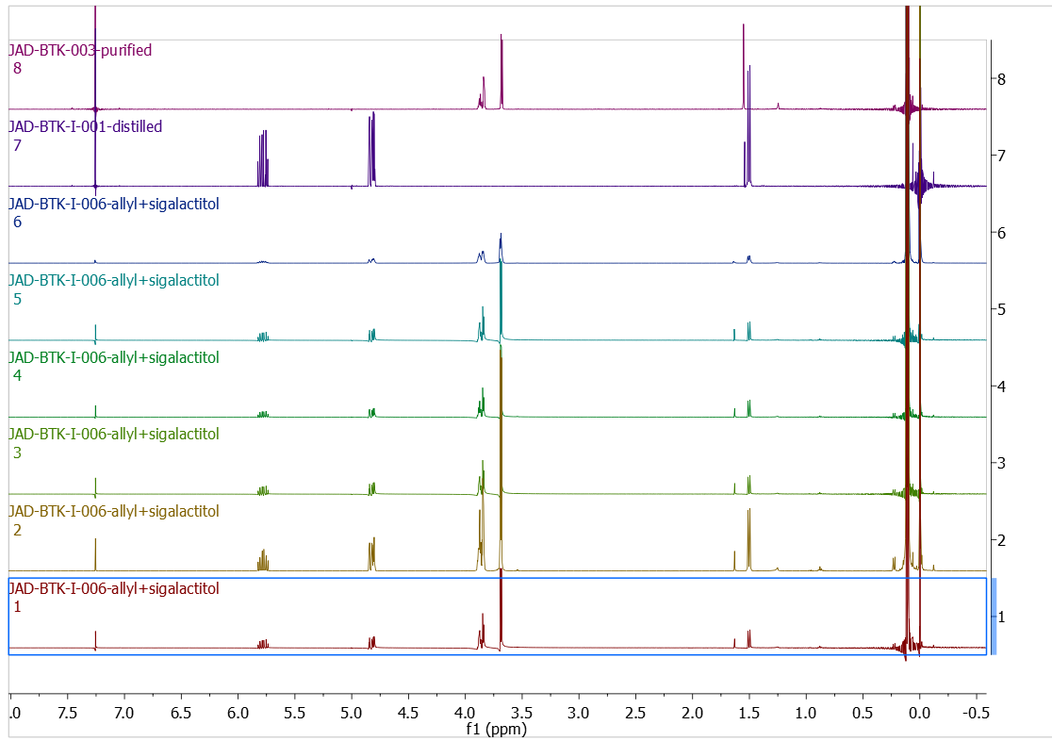
Allyl + Silated-
Galactitol
8 - substrate
7 - allyl
6 - allyl+substrate
5 - “
4 - “
3 - “
2 - “
1 - “

Slide 11
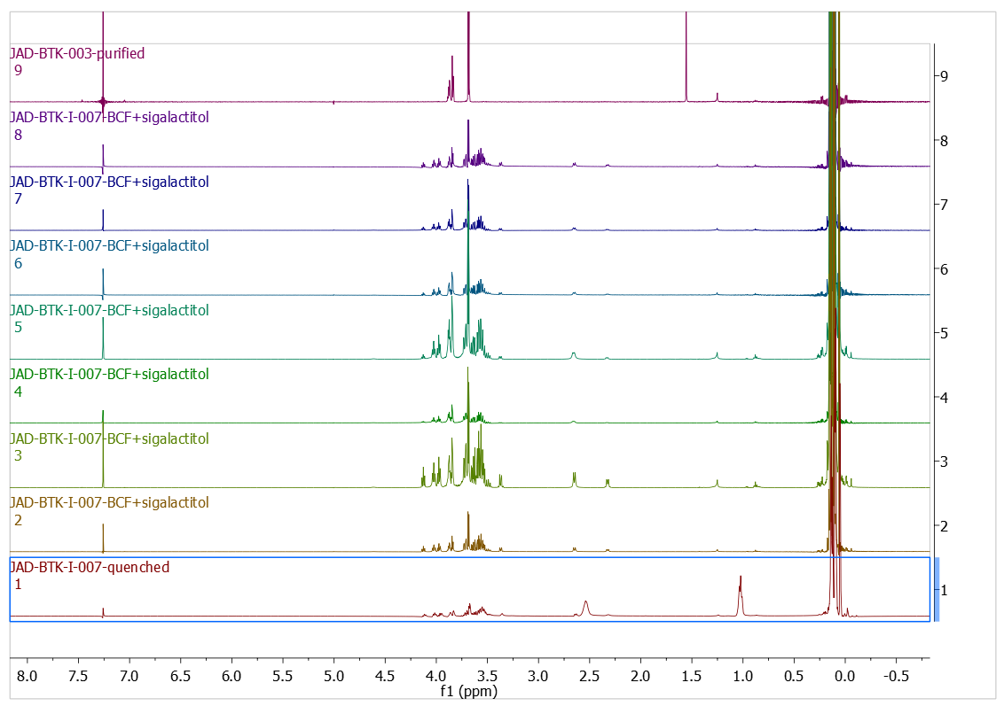
BCF + Silated-
Galactitol
9 - Silated-galactitol
8 - BCF + substrate
7 - “
6 - “
5 - “
4 - “
3 - “
2 - “
1 - Quenched rxn

Slide 12
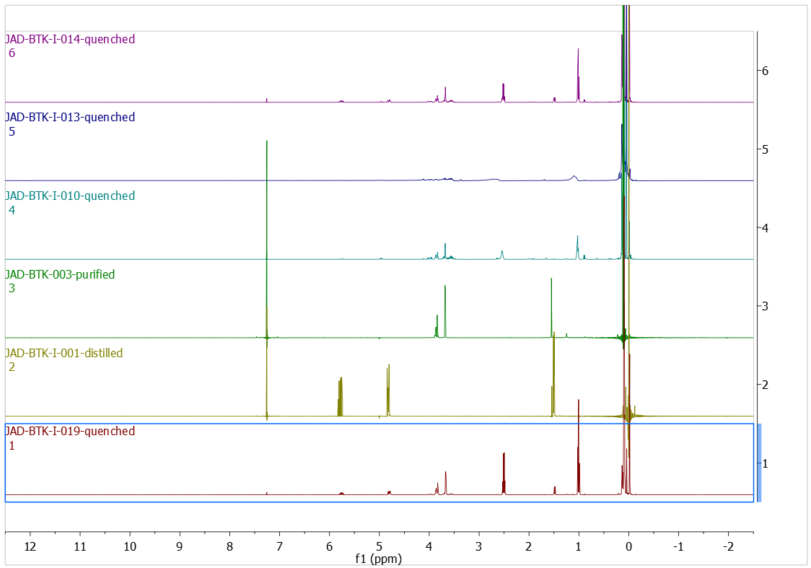
All 3 Reagents
6 - allyl,BCF,substrate
with mol. sieves
5 - BCF, substrate
with mol. sieves
4 - allyl, BCF,
substrate
3 - substrate
2 - allyl
1 - allyl,BCF,substrate
under N₂

Slide 13
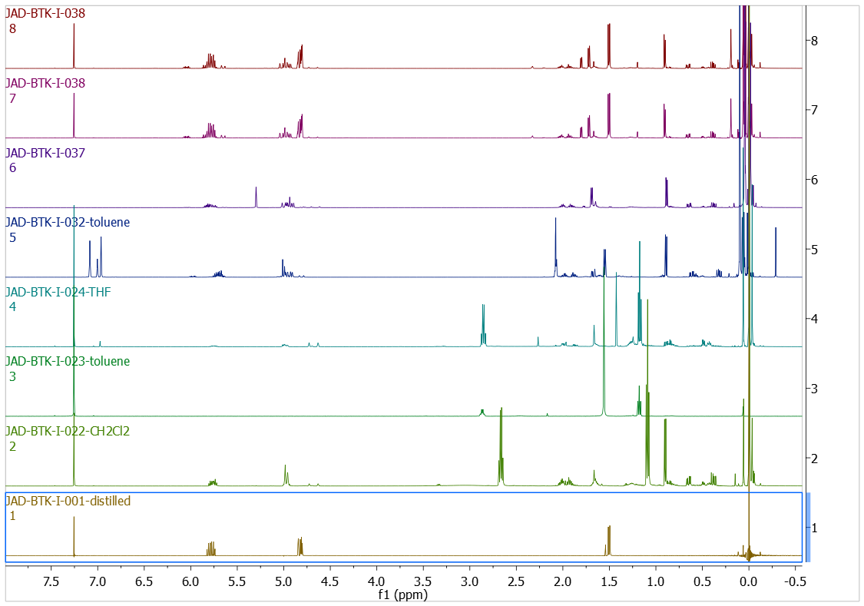
5mol% BCF+allyl,
different solvents
8 - CDCl₃
7 - “
6 - CD₂Cl₂
5 - toluene - D8
4 - THF
3 - toluene
2 - CH₂Cl₂
1 - allyl

Slide 14
Questions

