Slide 1


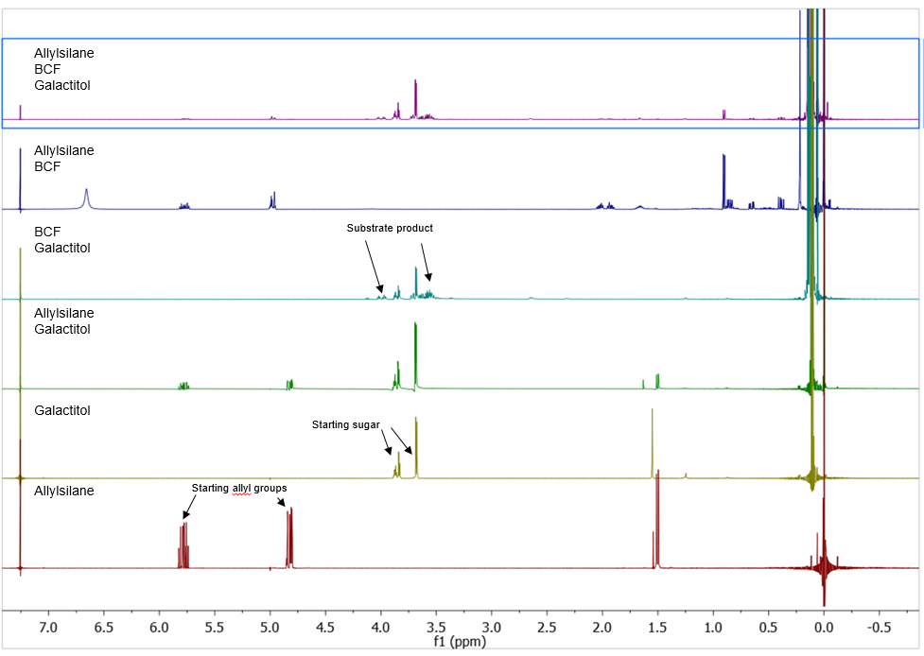
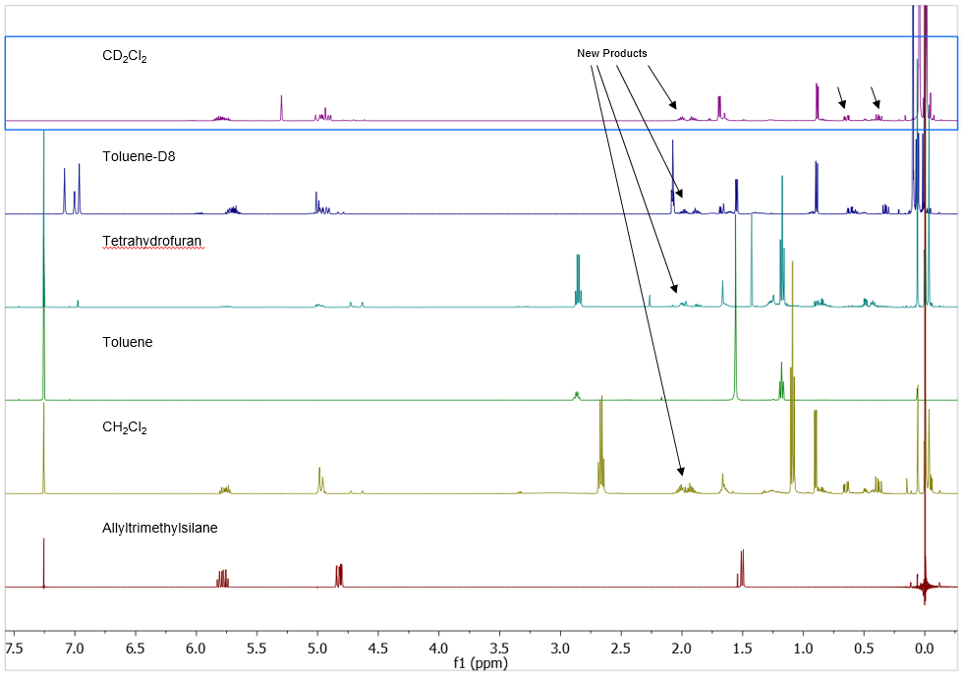
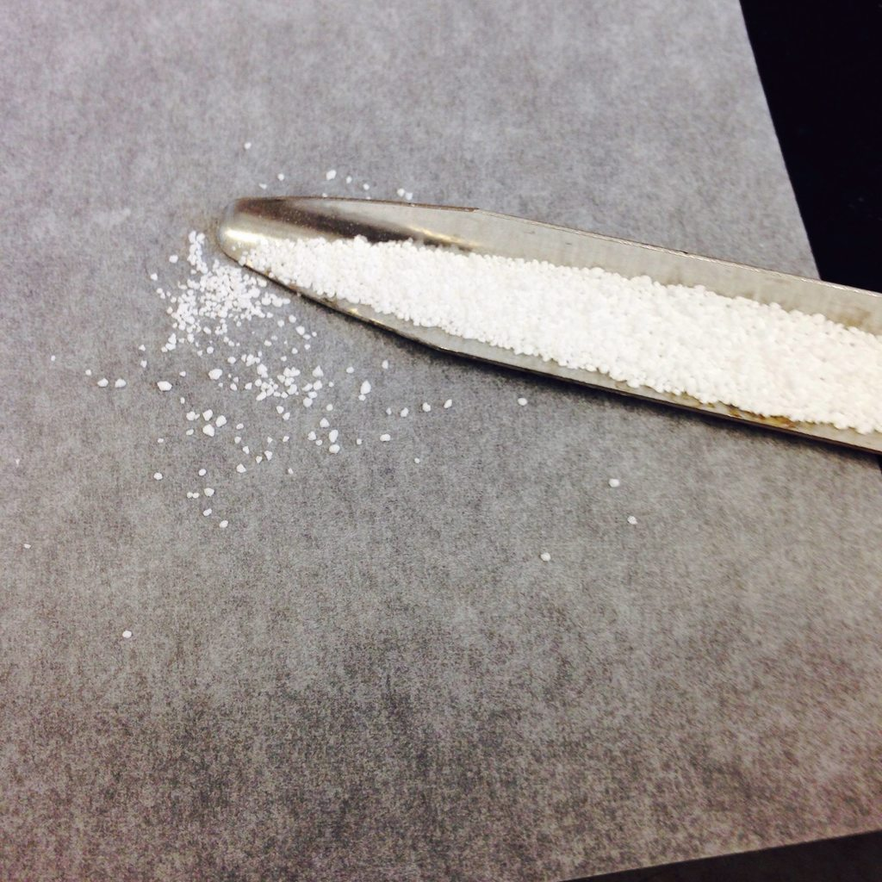
Development of an Efficient Route of Sorbitan Synthesis from Simple Sugars using BCF Activation of Allyltrimethylsilane
Brendan Kearney (Dr. Jen Dabrowski)
Department of Chemistry
Abstract
Activation of Allylsilane for Sorbitan Production
Preliminary Results
Sorbitan is an organic compound which is commonly used in areas such as food preservation and pharmaceutical production. Initial studies investigated the cyclization of galactitol, a simple sugar, to sorbitan promoted by allyltrimethylsilane and tris(pentafluorophenyl)borane (BCF). The reactivity and selectivity of the cyclization were analyzed using nuclear magnetic resonance spectroscopy (NMR). Preliminary results have shown that the combination of allyltrimethylsilane and BCF catalyze the reaction of simple sugars galactitol and sorbitol. Without BCF, no conversion of the starting galactitol occurred and with only BCF the reaction is less selective. An unexpected reaction between allyltrimethylsilane and BCF in the absence of galactitol yielded several distinct products. Future research will focus on identifying and analyzing the products and optimizing the selective formation of sorbitan.
The first reactions that were run were control reactions, which established set parameters and provided insight into the chemical interactions between any two of the three major reagents (galactitol, allyltrimethylsilane, BCF). Based on the results shown in Fig. 1, the focus of the research split into two different directions:
Conversion of Sugars to Sorbitan
Reaction conditions were probed to optimize both the conversion and selectivity.
Reaction Conditions:
Atmosphere of reaction – air (oxygen present) or under nitrogen (no oxygen)
Presence of molecular sieves (absorb water from reagents)
Catalytic or stoichiometric amounts – change in amount of starting reagents
Background
Sorbitan is an organic compound which is a common emulsifier. Currently, this compound is synthesized from crude oils, an unselective and inefficient process which requires high amounts of energy. One of the broad goals this research is developing practical alternatives to the usage of crude oils in the synthesis of useful feedstock (such as sorbitan) for consumer goods.
Figure 1. ¹H NMR (CDCl₃, 500 MHz) Analysis with Mestrenova© of Control Reactions after 2 hours under air.
In the proposed mechanism, sorbitan is synthesized from a sugar such as galactitol, with the addition of allyltrimethylsilane and tris(pentafluorophenyl)borane (BCF). In previously reported experiments,¹ it was found that the polarization of a silicon-hydride bond (Complex I) leads to facile reduction of alcohols on sugars like galactitol or sorbitol.²
Toluene
Scheme 1. Conversion of sorbitol and galactitol to sorbitan utilizing B(C₆F₅)₃-allylisilane catalysis.
BCF Activation of Allylsilane
With the unexpected formation of products in the control reaction of allylsilane and BCF, we first examined whether the product arises from reaction of the activated allylsilane with the solvent (CHCl₃), a variety of solvents were investigated, including: tetrahydrofuran, methylene chloride, chloroform-d, methanol-d₄, and toluene-d₈ (Fig. 2).
Simple sugar alcohol galactitol, which can be readily found in corn syrup and fruits
(Image credit: B. Kearney)
Figure 2. ¹H NMR (CDCl₃, 500 MHz) Analysis with Mestrenova© of Allylsilane+BCF reactions after quenching under air
BCF Activation of Allylsilane
Conclusions
Methods
Conversion of Sugars to Sorbitan
B(C₆F₅)₃ must be present for products to form (Fig. 1)
Allylsilane increases selectivity of reaction, little effect on reaction rate
Water, found in starting material, is detrimental to the reaction, molecular sieves absorb water leading to improved selectivity but decreased reactivity
Initial results for reactions performed under N₂ are inconclusive
BCF Activation of Allylsilane
New product formation occurs; characterization ongoing
Solvents effect selectivity and reactivity, but form the same product (Fig. 2)
Our experiments focused on investigating a different type of bond polarization, using the pi interaction of the allyl group on the allyltrimethylsilane (Complex II) instead of the silicon-hydride interaction (Complex I).
Procedures:
Silyl protection of sorbitol and galactitol (12.0 equiv. trimethylsilyl chloride, pyridine, 22 °C, 12 h)
Catalytic reactions (5 mol % BCF, 1.0 equiv. allylisilane, 0.6 mL solvent, 22°C, 24 h, NMR tube)
N₂ atmosphere reactions (22 °C, flame-dried vials, septa seal)
Separation of products with deactivated alumina column
Deprotection of cyclization products with Dowex® resin (22°C, methanol, 2 h)
Analytical Techniques:
NMR spectroscopy – ¹H, ¹³C, ¹⁹F • 2D NMR – COSY, HSQC
References
1) Adduci, L.; Bender, T.; Dabrowski, J.; Gagné, M. Nature Chem. 2015, 7, 576–581.
2) Parks, D.; Blackwell, J.; Piers, W. J. Org. Chem. 2000, 65, 3090-3098).; Sakata, K.; Fujimoto, H. J. Org. Chem. 2013, 78, 12505 -12512.
This project was conducted as part of Elon University’s Summer Undergraduate Research Experience, 2016

