Slide 1
Recap
Need for security
Security Principles
CIA Triad
People, Policy, and Technology

Slide 2
Outline
Types of Attack
Components of a cryptosystem
Security Models
- McCumber model
Intro to the web

Slide 3
Types of Attack
Passive
Active

Slide 4
Eavesdropping (Snooping)
An attacker intercepts communication between two parties to steal confidential information like passwords, credit card numbers, or proprietary business data.
This typically happens on unsecured, unencrypted networks (like public Wi-Fi).

Slide 5
Footprinting / Reconnaissance
A hacker gathers open-source information, scans open ports, or observes network activity to map out an organization’s system architecture before launching an active exploitation phase.

Slide 6
Case 1:
An office worker at a local bank receives an email that looks like a routine automated security alert from Microsoft 365, stating that their account password has expired. The email includes a button labeled "Update Password Now." When clicked, it opens a webpage that looks identical to the official company login screen. The employee enters their current username and password. However, after clicking "Submit," the page simply errors out, and the employee notices the web browser's URL bar reads micros0ft-secure-update.com instead of a legitimate login domain.
Name of the attack:
Type of Attack:
Attack On:
Prevent:

Slide 7
Case 2:
A university’s IT department notices a massive, sudden spike in incoming traffic directed at their primary student enrollment website right as course registration opens. Within minutes, the web servers become completely overwhelmed by millions of junk connection requests coming from thousands of different, unrelated IP addresses spread all across the globe. Real students trying to log in are met with "Server Timed Out" errors, and the entire registration system crashes.
Name of the attack:
Type of Attack:
Attack On:
Prevent:

Slide 8
Case 3:
An administrator logs into the main corporate database server on a Monday morning and finds that they cannot open any system files. Every document, spreadsheet, and backup file has had its file extension changed to .locked. When they try to open a file, a text document pops up on the screen reading: "Your network has been encrypted. To receive the decryption key, you must send 2 Bitcoin to the following wallet address within 48 hours, or your files will be permanently deleted."
Name of the attack:
Type of Attack:
Attack On:
Prevent:

Slide 9
Case 4:
A security team is conducting an audit and realizes that a malicious actor spent three weeks inside their network infrastructure without triggering any alerts. The attacker did not change any passwords, delete any accounts, or modify any files. Instead, network logs show they deployed a tool that quietly copied and observed data packets flowing across the local network segment, allowing them to map out the company's internal server topology and read unencrypted HR communications.
Name of the attack:
Type of Attack:
Attack On:
Prevent:

Slide 10
Case 5:
A delivery driver arrives at a secure corporate facility holding a large, heavy box that blocks their view. As an employee swipes their electronic badge and opens the security door, the delivery driver moves quickly behind them, politely calling out, "Can you hold the door for me? My hands are full!" The employee, wanting to be helpful, holds the door open, allowing the driver to walk directly into the private corporate offices without scanning a badge or signing in at the front desk.
Name of the attack:
Type of Attack:
Attack On:
Prevent:

Slide 11
Case 6:
While sitting in a crowded local coffee shop, a customer opens their laptop to log into their personal online banking portal. A person sitting at the table directly behind them pretends to look at their phone but positions themselves to clearly watch the customer's hands. By carefully tracking the customer's finger movements across the keyboard, the observer records the exact 12-character alphanumeric password and PIN as it is being typed.
Name of the attack:
Type of Attack:
Attack On:
Prevent:

Slide 12
Case 7:
An e-commerce website has a search bar that allows customers to look up products. A malicious actor types a specialized string of characters into the search bar: ' OR 1=1; --. Instead of searching for a product, this input tricks the backend database into bypassing the authentication logic. As a result, the website accidentally displays a hidden table containing the names, email addresses, and home addresses of every registered user on the platform.
Name of the attack:
Type of Attack:
Attack On:
Prevent:

Slide 13
On 21 October 2026, SBI reported a data incident involving 3,897 customer records containing personal information found on the dark web. Reported fields included names, mobile numbers, dates of birth, addresses, and loan-related information. SBI appointed an independent cybersecurity agency to investigate and said it expected no material impact on core business operations. The entry method remained under investigation,

Slide 14
Case 8:
An attack on SITA, Air India’s passenger service system provider, exposed passenger information. Air India reported that approximately 45 lakh people were affected. The information included names, contact details, passport information, and ticket information.
SITA stands for Société Internationale de Télécommunications Aéronautiques. It is an international company that provides information technology and communication services to the air transport industry.
Airlines and airports use SITA’s systems for services such as passenger processing, reservations, check-in, and baggage management.
Data Breach
Attack on: confidentiality
Preventive measure: Data encryption

Slide 15
Case 9:
A user logs into their online healthcare portal to view their medical test results. Once logged in, they notice that the web browser's URL address bar displays https://healthportal.com. Out of curiosity, the user changes the number at the very end of the URL from 88432 to 88431 and presses Enter. Without asking for any additional password or verification, the website immediately loads and displays the full medical history, full name, and private health records of a completely different patient.
IDOR / Insecure Direct Object Reference

Slide 16
Case 10:
Roger Duronio was a senior systems administrator for the financial firm UBS PaineWebber. He had high-level administrative access to the company's entire network.
Duronio was unhappy with a $32,000 bonus he received. Seeking revenge and financial gain, he devised a plan to short the company's stock. He spent over $21,000 buying "put options"—financial bets that the value of UBS stock would drop drastically.
Setup: He planted a hidden piece of malicious code across the corporate network. The code was designed to lie completely dormant until a specific trigger condition was met: 9:30 AM on March 4, 2002. He resigned from the company shortly before the trigger date.

Slide 17
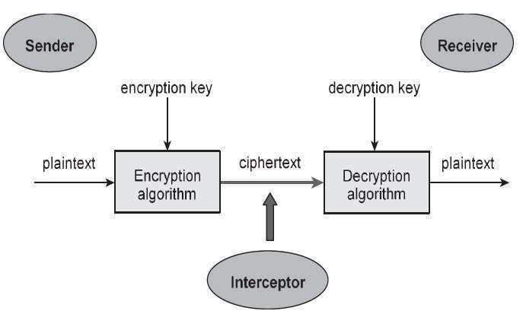
Components of a cryptosystem

Slide 18
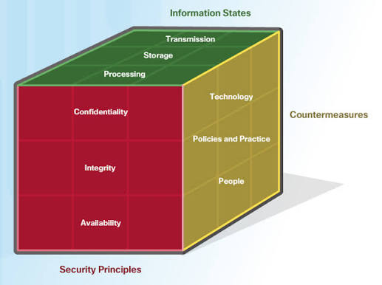
Mccumber Cube Model

Slide 19
Policy
In 2006–2007, media investigations found sensitive customer and employee information in publicly accessible rubbish containers used by CVS pharmacies. Discarded materials included prescription labels, medical information, employment applications, and financial information. People could read the information because the materials had not been securely destroyed.
What went wrong with policy?
The FTC alleged that CVS lacked adequate secure disposal procedures, employee training, and checks to ensure staff followed disposal requirements. In 2009, CVS agreed to corrective measures and a separate US$2.25 million settlement with HHS. Federal Trade Commission
“A pharmacy protects patient information while using it, but throws prescription records into an ordinary rubbish bin. Someone retrieves the papers and reads private details. Information security must continue until the records are securely destroyed.”

