Slide 2
Shared Memory is the fastest inter-process communication (IPC) method.
The operating system maps a memory segment in the address space of several processes so that those processes can read and write in that memory segment.The overview is as shown below:
Two functions
shmget() and shmat() are used for IPC using shared memory.
shmget() function is used to create the shared memory segment
shmat() function is used to attach the shared segment with the address space of the process.

Slide 3
Commands
ipcs
ipcrm

Slide 4

IPC System Calls
Functionality | Message Queue | Shared
Allocate IPC | msgget | shmget
Access IPC | msgsnd msgrcv | shmat shmdt
IPC Control | msgctl | shmctl

Slide 5
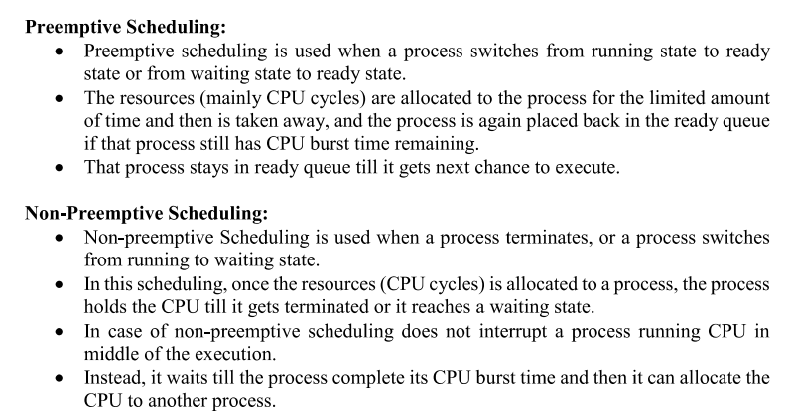

Slide 6
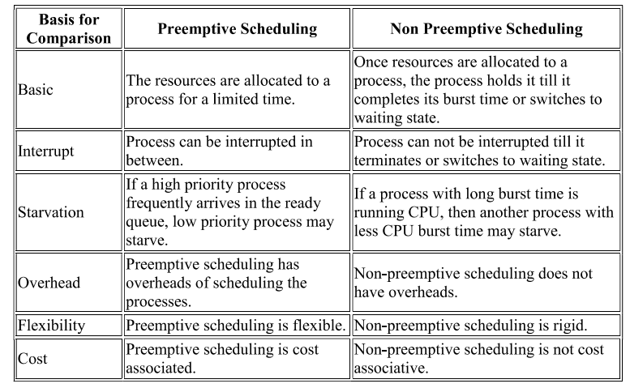

Slide 7
BOOTING OF A COMPUTER SYSTEM

Slide 8
WHY IS BOOTING REQUIRED ?
Hardware doesn’t know where the operating
system resides and how to load it.
Need a special program to do this job – Bootstrap
loader.
E.g. BIOS – Boot Input Output System.
Bootstrap loader locates the kernel, loads it into
main memory and starts its execution.
In some systems, a simple bootstrap loader fetches
a more complex boot program from disk, which in
turn loads the kernel.

Slide 9
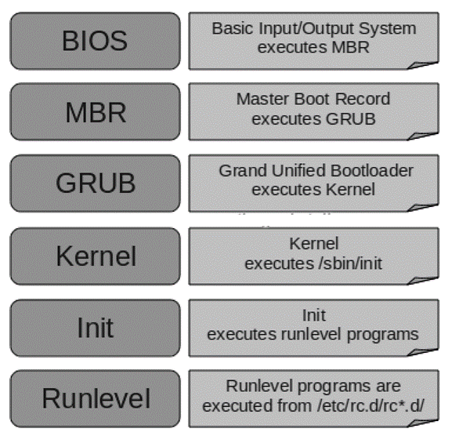
Linux booting process
There are six stages of Linux Boot Process (i.e. Startup Sequence)
Press the power button on your system, and after few moments you see the Linux login prompt.
Have you ever wondered what happens behind the scenes from the time you press the power button until the Linux login prompt appears?
The six high level stages of a typical Linux boot process.
Notes:
HOW BOOT PROCESS OCCURS ?  Reset event on CPU (power up, reboot) causes instruction register to be loaded with a predefined memory location. It contains a jump instruction that transfers execution to the location of Bootstrap program.  This program is form of ROM, since RAM is in unknown state at system startup. ROM is convenient as it needs no initialization and can’t be affected by virus.

Slide 10
(Continued) Linux booting process
BIOS
BIOS stands for Basic Input / Output System.
Performs some system integrity checks.
Searches, loads, and executes the boot loader program.
It looks for boot loader in floppy, cd-rom, or hard drive. You can press a key (typically F12 of F2, but it depends on your system) during the BIOS startup to change the boot sequence.
Once the boot loader program is detected and loaded into the memory, BIOS gives the control to it.
So, in simple terms BIOS loads and executes the MBR boot loader.
Notes:
 Run diagnostics to determine the state of machine. If diagnostics pass, booting continues.  Runs a Power-On Self Test (POST) to check the devices that the computer will rely on, are functioning.  BIOS goes through a preconfigured list of devices until it finds one that is bootable. If it finds no such device, an error is given and the boot process stops.  Initializes CPU registers, device controllers and contents of the main memory. After this, it loads the OS.

Slide 11
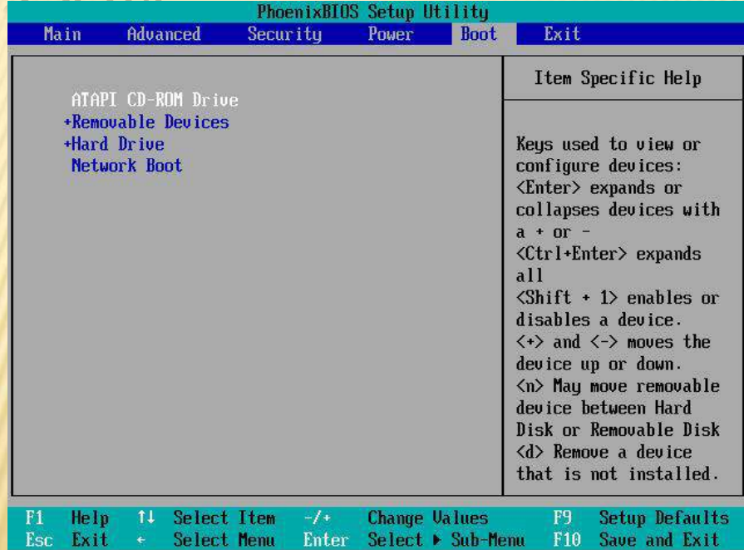

Slide 12
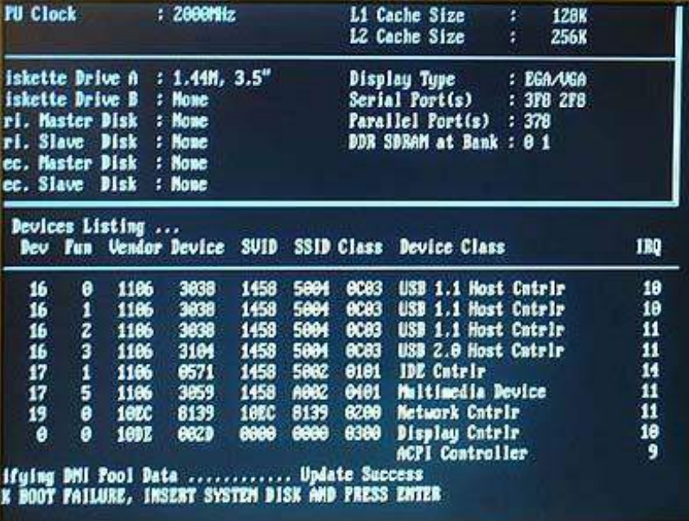

Slide 13
(Continued) Linux booting process
MBR
MBR stands for Master Boot Record.
It is located in the 1st sector of the bootable disk. Typically /dev/hda, or /dev/sda
MBR is less than 512 bytes in size. This has three components 1) primary boot loader info in 1st 446 bytes 2) partition table info in next 64 bytes 3) mbr validation check in last 2 bytes.
It contains information about GRUB (or LILO in old systems).
So, in simple terms MBR loads and executes the GRUB boot loader.
Notes:
On finding a bootable device, the BIOS loads and executes its boot sector.
In the case of a hard drive, this is referred to as the master boot record (MBR) and is often not OS specific.
The MBR code checks the partition table for an active partition. If one is found, the MBR code loads that partition's boot sector and executes it.
The boot sector is often operating system specific, however in most operating systems its main function is to load and execute a kernel, which continues startup.
If there is no active partition or the active partition's boot sector is invalid, the MBR may load a secondary boot loader and pass control to it and this secondary boot loader will select a partition (often via user input) and load its boot sector.  Examples of secondary boot loaders  GRUB – GRand Unified Bootloader  LILO – LInux LOader  NTLDR – NT Loader

Slide 14
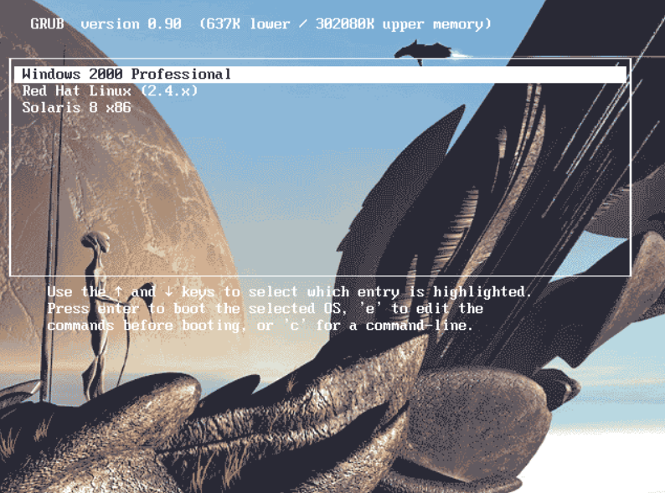

Slide 15
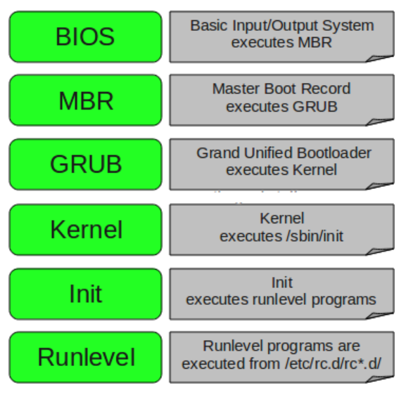
(Continued) Linux booting process
GRUB
GRUB stands for Grand Unified Bootloader.
If you have multiple kernel images installed on your system, you can choose which one to be executed.
GRUB displays a splash screen, waits for few seconds, if you do not enter anything, it loads the default kernel image as specified in the grub configuration file.
GRUB has the knowledge of the filesystem (the older Linux loader LILO didn’t understand filesystem).
Grub configuration file is /boot/grub/grub.conf (/etc/grub.conf is a link to this). The following is a sample grub.conf of CentOS.
Notes:
The following is sample grub.conf of CentOS.
#boot=/dev/sda
default=0
timeout=5
splashimage=(hd0,0)/boot/grub/splash.xpm.gz
hiddenmenu
title CentOS (2.6.18-194.el5PAE)
root (hd0,0)
kernel /boot/vmlinuz-2.6.18-194.el5PAE ro root=LABEL=/
initrd /boot/initrd-2.6.18-194.el5PAE.img
As you notice from the above info, it contains kernel and initrd image.
So, in simple terms GRUB just loads and executes Kernel and initrd images.

Slide 16
(Continued) Linux booting process
Kernel
Mounts the root file system as specified in the “root=” in grub.conf
Kernel executes the /sbin/init program.
Since init was the 1st program to be executed by Linux Kernel, it has the process id (PID) of 1. Do a ‘ps -ef | grep init’ and check the pid.
initrd stands for Initial RAM Disk.
initrd is used by kernel as temporary root file system until kernel is booted and the real root file system is mounted. It also contains necessary drivers compiled inside, which helps it to access the hard drive partitions, and other hardware.

Slide 17
(Continued) Linux booting process
Init
Looks at the /etc/inittab file to decide the Linux run level.
Following are the available run levels
0 – halt
1 – Single user mode
2 – Multiuser, without NFS
3 – Full multiuser mode
4 – unused
5 – X11
6 – reboot
Init identifies the default initlevel from /etc/inittab and uses that to load all appropriate program.
Execute ‘grep initdefault /etc/inittab’ on your system to identify the default run level
If you want to get into trouble, you can set the default run level to 0 or 6. Since you know what 0 and 6 means, probably you might not do that.
Typically you would set the default run level to either 3 or 5.

Slide 18
(Continued) Linux booting process
Runlevel programs
When the Linux system is booting up, you might see various services getting started.
For example, it might say “starting sendmail …. OK”. Those are the runlevel programs, executed from the run level directory as defined by your run level.
Depending on your default init level setting, the system will execute the programs from one of the following directories.
Run level 0 – /etc/rc.d/rc0.d/
Run level 1 – /etc/rc.d/rc1.d/
Run level 2 – /etc/rc.d/rc2.d/
Run level 3 – /etc/rc.d/rc3.d/
Run level 4 – /etc/rc.d/rc4.d/
Run level 5 – /etc/rc.d/rc5.d/
Run level 6 – /etc/rc.d/rc6.d/

Slide 19
(Continued) Linux booting process
(Continued) Runlevel programs
Please note that there are also symbolic links available for these directory under /etc directly. So, /etc/rc0.d is linked to /etc/rc.d/rc0.d.
Under the /etc/rc.d/rc*.d/ directories, you would see programs that start with S and K.
Programs starts with S are used during startup. S for startup.
Programs starts with K are used during shutdown. K for kill.
There are numbers right next to S and K in the program names. Those are the sequence number in which the programs should be started or killed.

Slide 20
There are a few possible attacks that can occur during the booting process in Linux, including:
Malicious bootloader
An attacker could replace the device's bootloader with a vulnerable version that has malware.
Modifying startup files
An attacker could insert malicious code into startup files, such as the hidden .bashrc file in a user's home directory.
Cold boot attack
An attacker could forcefully reboot the machine and boot a pre-installed operating system from a USB drive, CD-ROM, or over the network.

Slide 21
ಊಟಕ್ಕೆ ಉಪ್ಪು ಬೆಲೆ, ಮನುಷ್ಯಕ್ಕೆ ಬುದ್ಧಿ ಬೆಲೆ.
Salt gives value to food, Knowledge gives value to a person.

