Slide 1


Data Backup And Restore

Slide 2
Agenda
What is a Backup?
What is a Restore?
4 Greatest Causes of Data Loss
Backup Utilities and Supporting Tools
How to backup?
Backup Scheduling

Slide 3

Question: What is a Backup?

Slide 4
Copy of Computer Data taken and stored elsewhere
The purpose of backup is protect data from loss.

Slide 5
Question: What is a Restore?

Slide 6
The purpose of restore is recovering data that is temporarily unavailable due to some unexpected event.

Slide 7
4 Greatest Causes of Data Loss

Slide 8

Deleting files accidentally
Updating files or deleting them are very common activities and we do them almost every day. No wonder if we accidentally delete wrong files.

Slide 9

Viruses and damaging malware
There are numerous new viruses which attack computers every day. Being connected to worldwide network has many advantages; however, it opens computers to many serious risks.

Slide 10
Mechanical damages of hard drive
Hard drives of computers are the most sensitive parts of computers. So, they break down easily.
There are a few ways to recover data from faulty hard drives but this service might cost you more than $1,000.

Slide 11

Power failures
This is a Simple Example but imagine you are writing a long article and you have not saved it yet, then in case of power going out you lose your data.

Slide 12
Theft of computer
It is a real tragedy to lose both computer and data at the same time. But Losing computer may be less painful, if you use proper data backup strategy and keep data in safe storage.

Slide 13
Backup Utilities and Supporting Tools
CDs, DVDs
Usb Drives, Memory Sticks, Removable Media
External Hard Drives
Backup Tapes
Backup Software (Microsoft Azure, Veeam,…)
Notes:
B

Slide 14
How to backup?

Slide 15
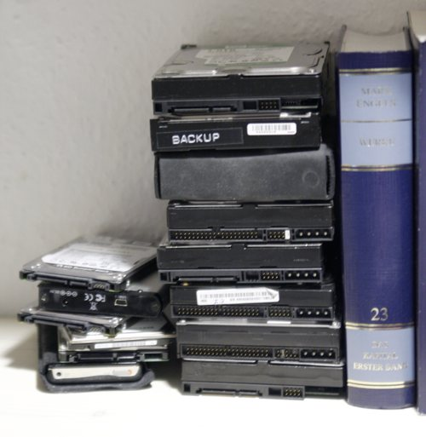
Manual Backup
What kind of Data
When to Backup
Which Device
Very slow and annoying

Slide 16
Semi-automated Backup
Use Backup Tools and Software
Require Somebody to launch
Disadvantages:
Human Error

Slide 17
Automated Backup
Use Backup Software
Set and Forget
Generally Run at Night

Slide 18

Backup Scheduling

Slide 19
Full Backup
A complete copy of a partition
Pros
Provides a complete copy of data
Easy to manage:
  Done less frequently than other types of backups due to cost and resource requirements:
  Monthly, semi-annually, annually.

Slide 20
Full Backup
Cons
Usually requires more media space than either differential or incremental.
Takes a long time to recover the full backup to a new disk

Slide 21
Differential Backup
An archive of only the files that have changed since the last full backup.
Pros
restore faster than incremental Backup
Usually takes up less time and space than a full backup.
If the differential backup grows to the size of the last full backup, then schedule a new full backup.

Slide 22
Differential Backup
Cons
Redundancy – potentially many unneeded copies of the same data.
Subsequent differentials take longer and use more media space.

Slide 23
Incremental Backup
An archive of only the file that have changed since the last backup (not necessarily full backup
Pros
Fastest backup type
Uses the least amount of media to complete a single backup

Slide 24
Incremental Backup
Cons
Much more difficult to manage:
Frequency of incremental backups depends
on the client needs.
  Weekly, daily, hourly, continuously

Slide 25
Schedule Example
Full backup twice per year
Differential each first Saturday morning of each month that is not scheduled for a full backup
Incremental each Saturday morning that is not scheduled for a Full or Differential

Slide 26

Questions

